Slide 1
Educational Website
Int x = 5 ;

Slide 2
Introduction
Good Morning everyone. Today, we’ll present our educational website project and Our project focuses on developing an educational website designed to make learning accessible, interactive, and personalized for users. The platform will offer a wide range of courses, interactive features, and tools to help learners acquire new skills effectively, whether they are students or professionals.
The goal is to provide a user-friendly and scalable solution that bridges the gap between learners and quality education, similar to platforms like Udemy and Coursera, but with innovative features tailored to user engagement and success.

Slide 3
01
02
03
04
05
06
In this presentation, we will explore the technical and business aspects of our project using diagrams
Usecase
Sequence
Activity
State
Archticture
Class

Slide 4
Diagrams
Use Case Diagram | Showing how users interact with the system.
Sequence Diagram | Explaining the flow of operations.
Activity Diagram | Highlighting the system’s workflows.
State Diagram | Showing how the system changes over time..
Architecture Diagram | Providing an overview of the system’s structure.
Business Model Canvas (BMC) | Explaining the business side of the project.

Slide 5
Problem Statement
Challenges of Traditional Education in Egypt
1. Overcrowded Classrooms: High student density limits focus and teacher-student interaction.
2. Lack of Freedom and Flexibility: Students follow rigid curricula with little room for personalized learning.
3. Unfocused Learning Environment: Issues such as poor student behavior disrupt the learning process, with no effective measures in place to this address.
4. Unqualified Teachers: Low teacher standards, unattractive salaries, and lack of incentives fail to attract talented educators.
5. Student Confusion: Students struggle due to a lack of prerequisites or understanding of subject requirements

Slide 6
Solution
Our Edu Online System addresses these challenges by providing:
1. Flexible Learning Options : freedom of date , place , subjects , Road-map , knowledge feilds Students choose courses aligned with their interests and goals to improve their skillset.
2. Create diverse, respectful environments: to counter negative student behaviors.
3. Higher Teaching Standards: Set clear qualifications for instructors, verify their credentials, and make them publicly accessible.
4. proper guidance: Ensure students meet course prerequisites through simple,
pre-course assessments.

Slide 7
Competitors
Some of the existing competitors in the online education space include:
1. Coursera : Offers university-level courses and certifications.
2. Udemy : Provides a vast library of affordable courses created by professionals.
3. Khan Academy : Focuses on free educational content for students of all levels.
4. edX : Partners with universities to provide professional courses and degrees.
5. Skillshare : Focuses on creative and professional skills
While these platforms are popular, they often lack certain features like personalization or affordability for specific audiences. Our system aims to address these gaps

Slide 8
Features
1. User-Friendly Interface :
Intuitive Navigation : Easy access to materials, lessons, and courses.
Search Functionality : Quick search for topics, courses, or resources.
Mobile Responsiveness : Works seamlessly on phones, tablets, and desktops.
2. Content Management System :
Multimedia Support: Include videos, images, text, and interactive elements.
Dynamic Content Updates: Easily update materials like courses, quizzes, or news.
Library/Repository: Store documents, research papers, and e-books.
3. Learning Tools :
Interactive Quizzes: Engage users with assessments and instant feedback.
Discussion Forums: Facilitate student-teacher and peer-to-peer communication.
Gamification Elements: Incorporate badges, points, or leaderboards to encourage participation.
Live Classes/Webinars: Host real-time lessons or Q&A sessions.

Slide 9
4. Personalization
User Profiles: Allow customization for students, teachers, and parents.
Progress Tracking: Visual dashboards showing course completion, grades, or milestones.
5. Administrative Features
Role Management: Separate logins for students, teachers, and administrators.
Attendance and Records: Track student participation and performance history.
6. Communication
Announcements/Notifications: Send updates about new courses, deadlines, or events.
Chat Support: Offer real-time support for users.
7. Accessibility
Multi-language Support: Cater to a global audience with content in multiple languages.
ADA Compliance: Ensure accessibility for users with disabilities (screen readers).
4. Personalization
User Profiles: Allow customization for students, teachers, and parents.
Progress Tracking: Visual dashboards showing course completion, grades, or milestones.
Recommendation System: Suggest courses, articles, or videos based on user preferences.
5. Administrative Features
Role Management: Separate logins for students, teachers, and administrators.
Attendance and Records: Track student participation and performance history.
6. Communication
Announcements/Notifications: Send updates about new courses, deadlines, or events.
Chat Support: Offer real-time support for users.
Email Integration: Notify users via email about their activities and progress.
7. Accessibility
Multi-language Support: Cater to a global audience with content in multiple languages.
ADA Compliance: Ensure accessibility for users with disabilities (screen readers).

Slide 10
8. Security
Data Encryption: Protect user information and transactions.
Parental Controls: Monitor and manage children’s access and progress.
Secure Logins: Use two-factor authentication
9. Integration
Third-Party Tools: Integrate with tools like Google Classroom, Zoom, or Microsoft Teams.
Payment Gateways: Support for subscriptions or course purchases.
API Access: Enable integration with external apps and systems.

Slide 11
01
Usecase

Slide 12
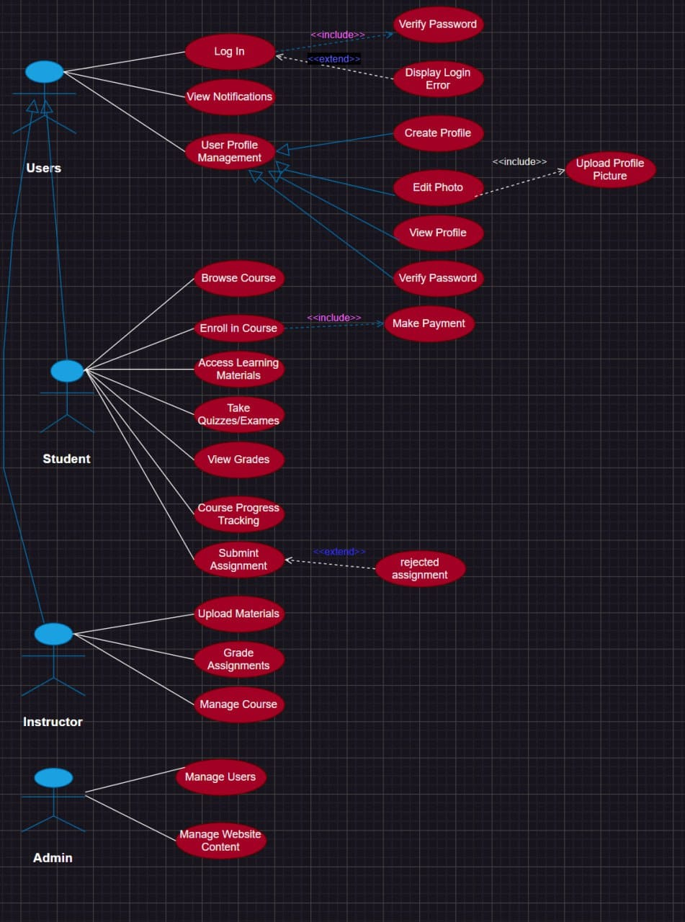
Educational Website Usecase

Slide 13
02
Sequence

Slide 14
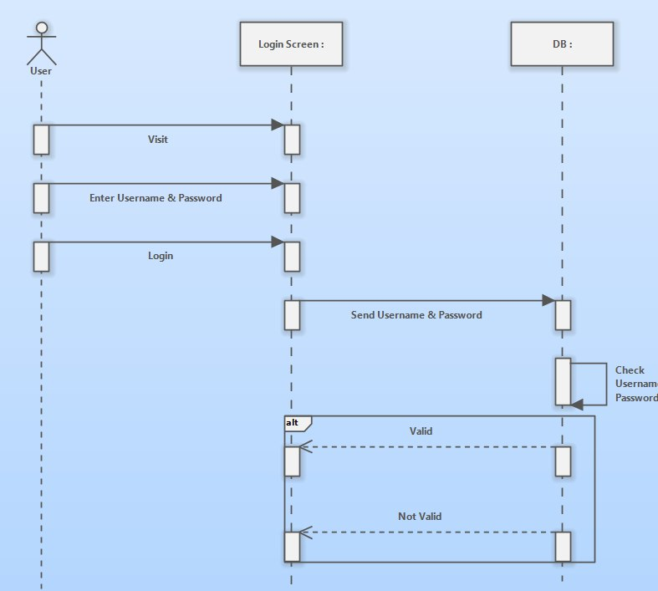
Login Sequence

Slide 15
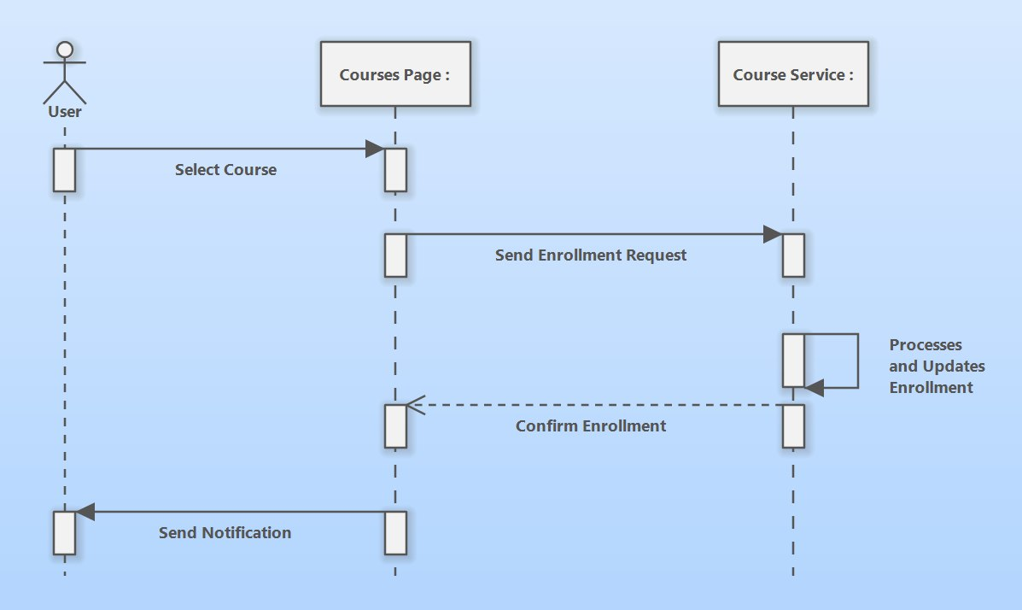
Course Enroll Sequence

Slide 16
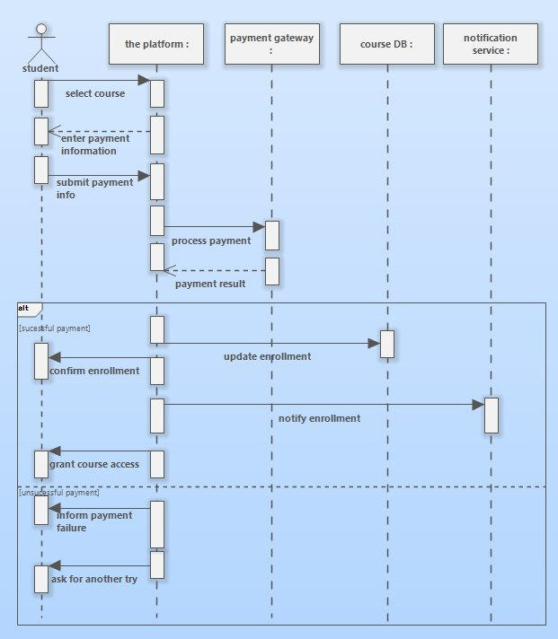
Payment Sequence

Slide 17
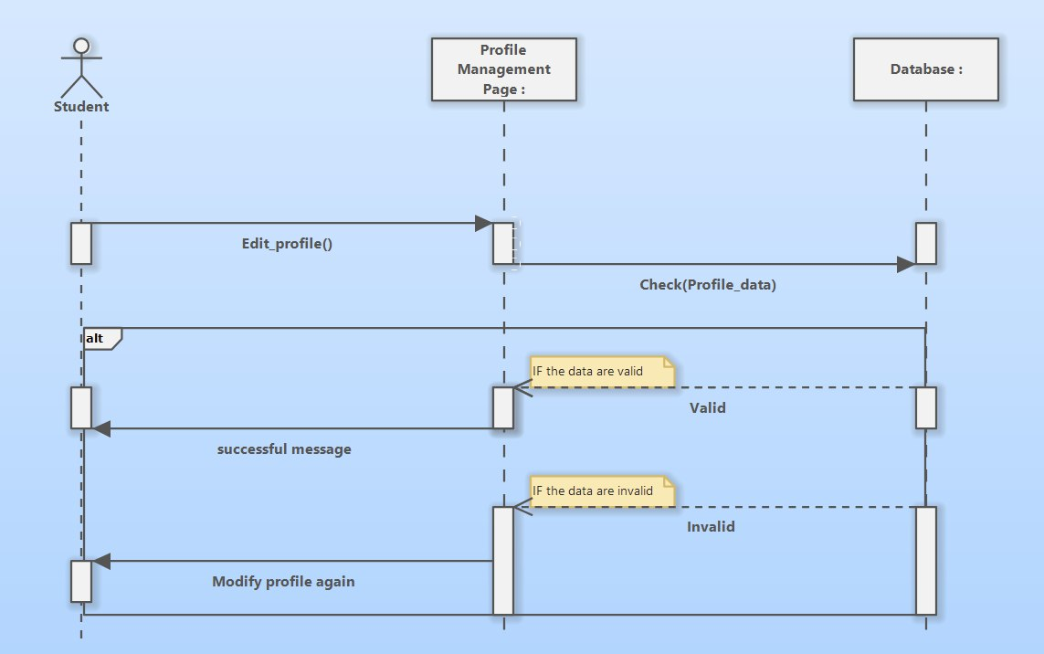
Profile Mng Sequence

Slide 18
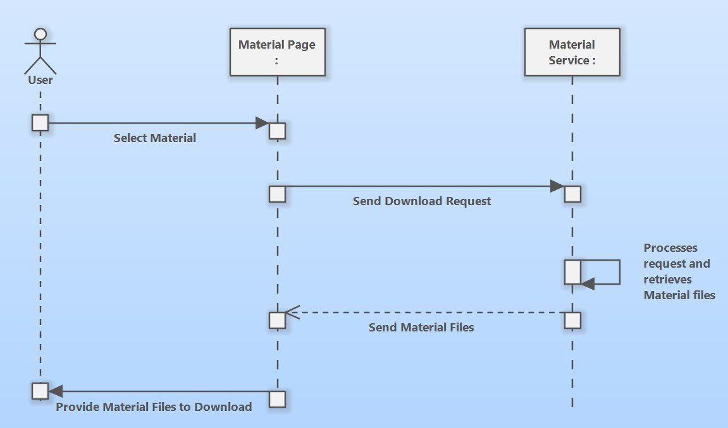
Dwn Material Sequence

Slide 19
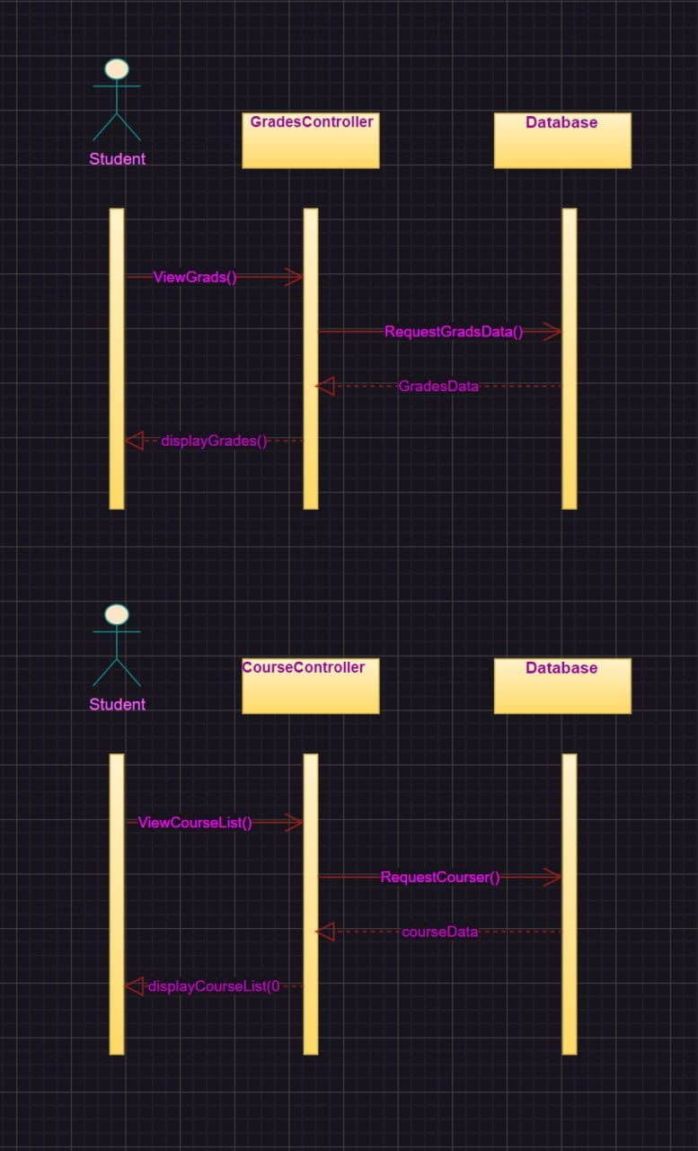
View Grade & Couse List Sequence

Slide 20
03
Activity

Slide 21
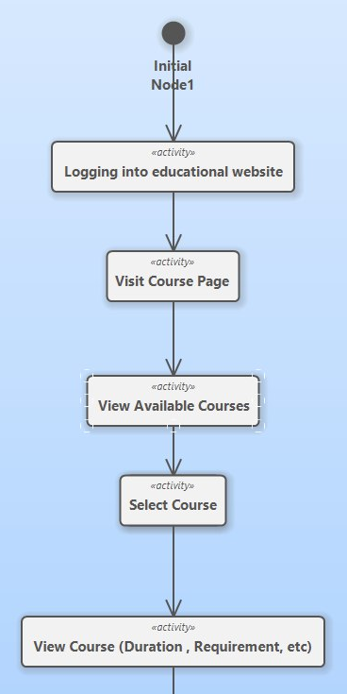
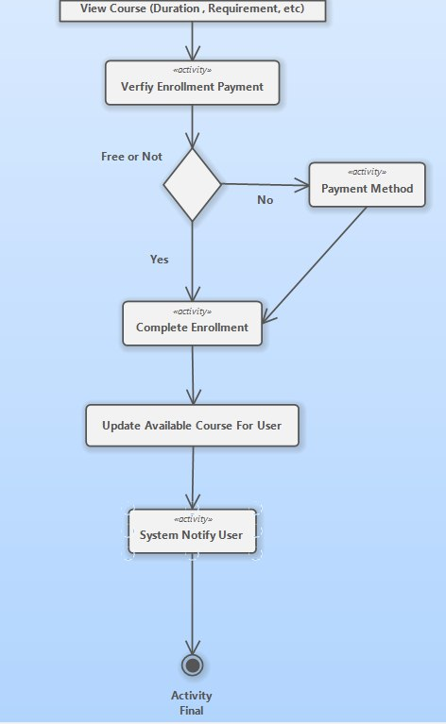
Course Enroll Activity

Slide 22
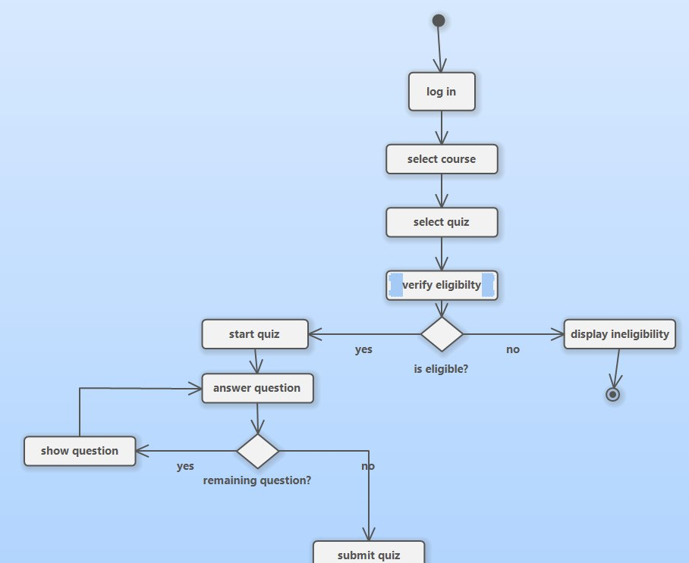
Take Quiz Activity

Slide 23
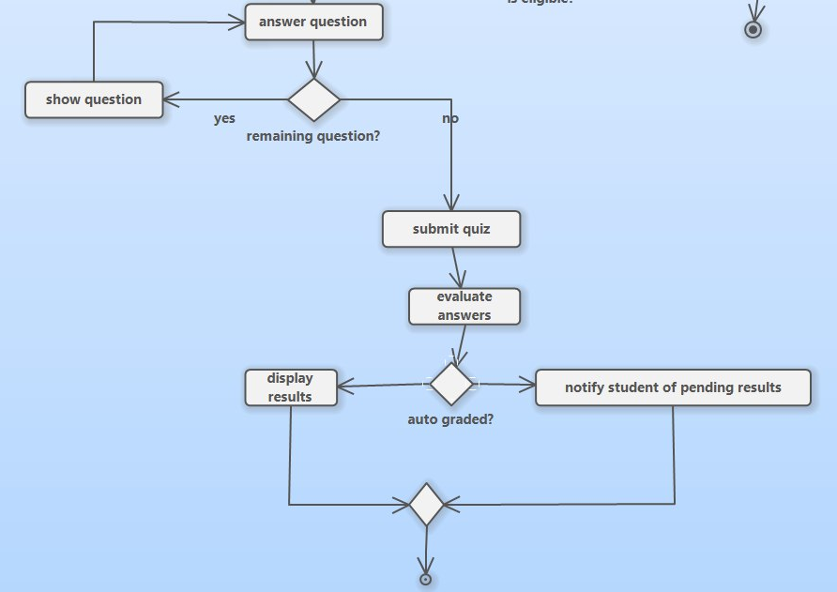
Take Quiz Activity

Slide 24
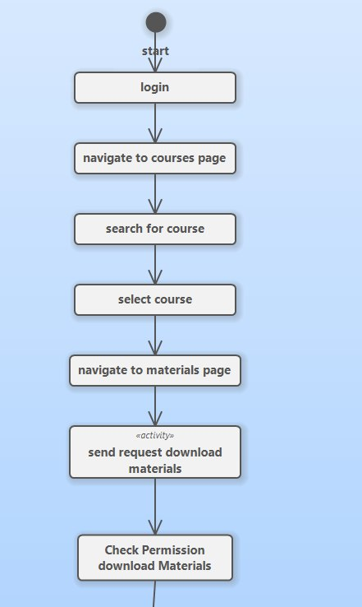
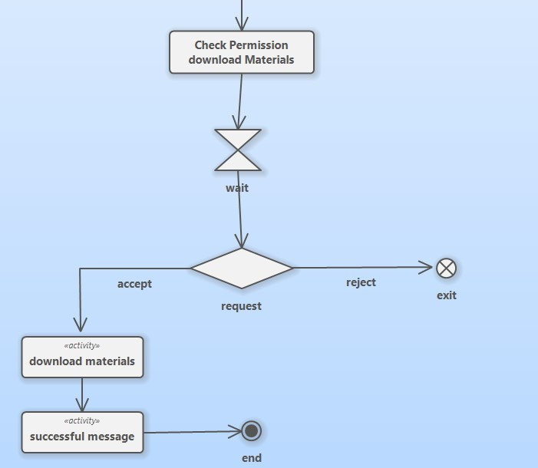
Material Activity

Slide 25
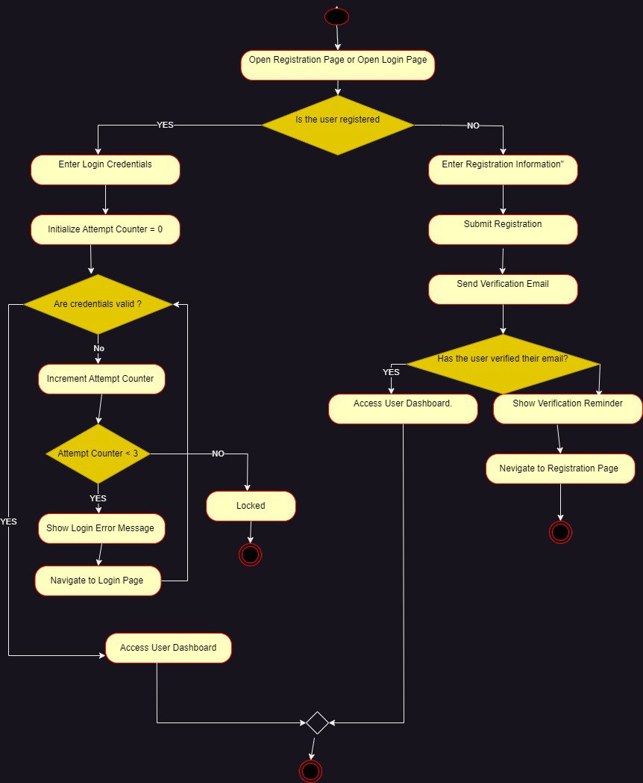
Registration Activity

Slide 26
04
State

Slide 27
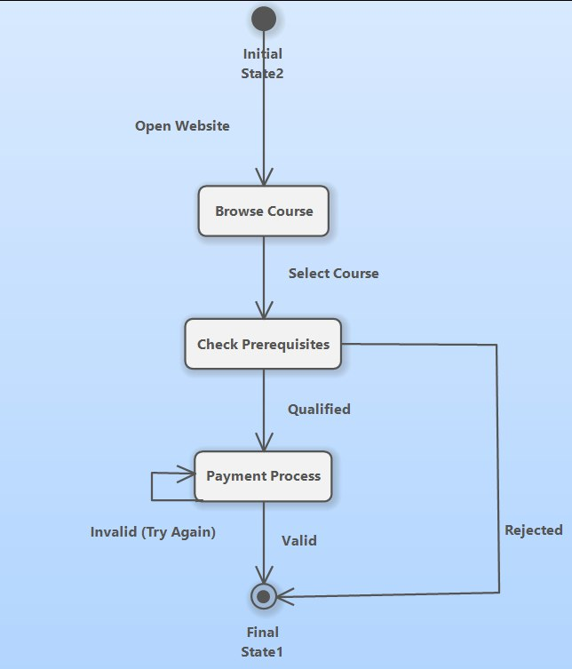
State Diagram

Slide 28
05
Architecture

Slide 29
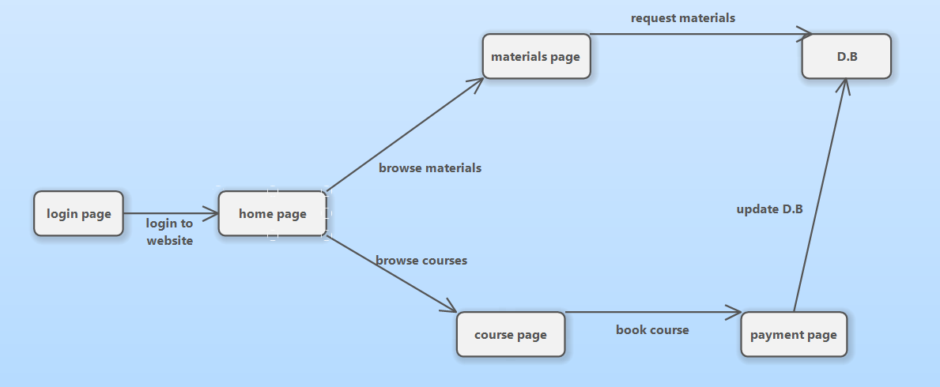
Arch Diagram

Slide 30
06
Class

Slide 31
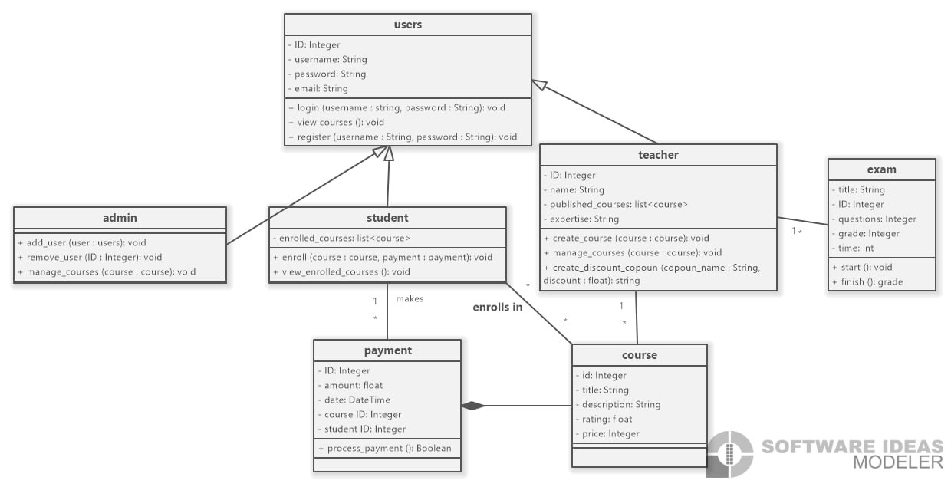
Class Diagram

Slide 32

Business Model Canvas
BMC

Slide 33
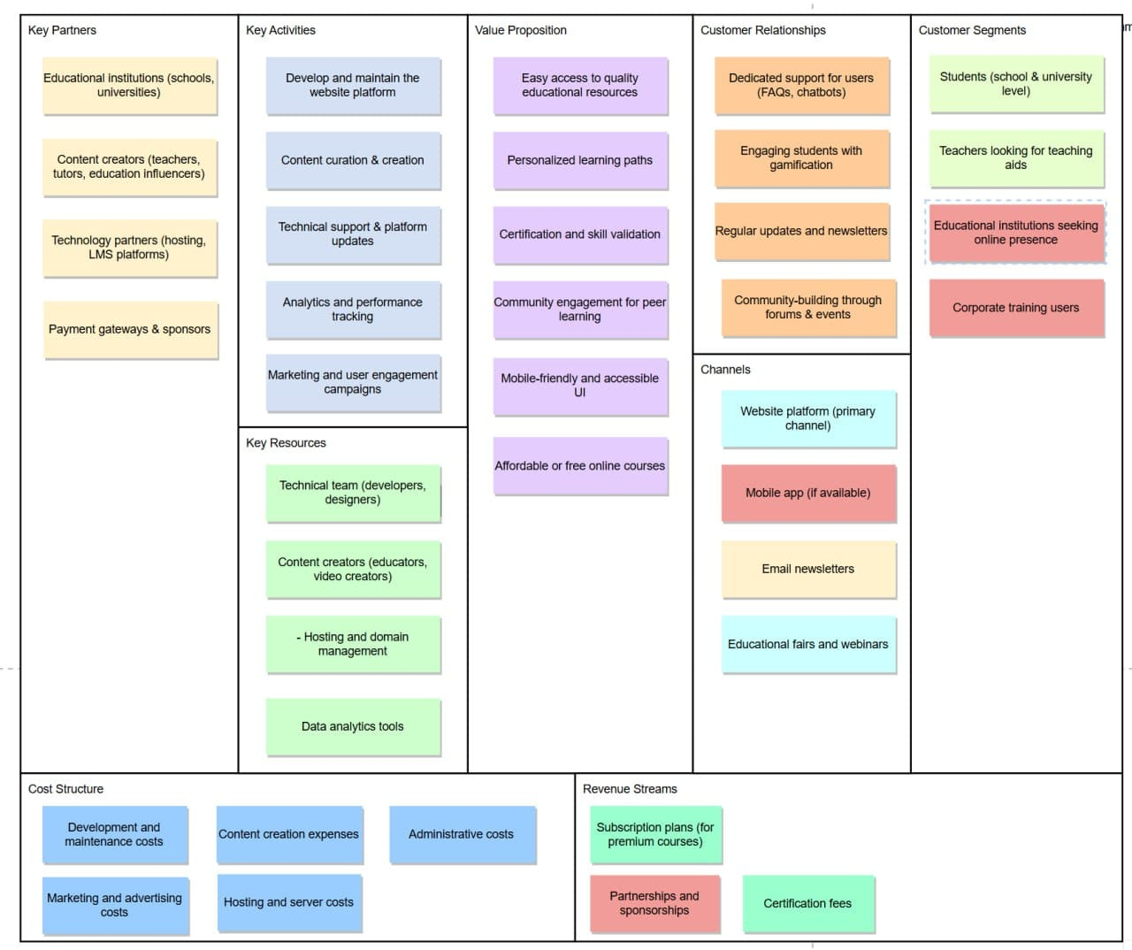
BMC

Slide 34
Thank You <3
01010100 01101000 01100001 01101110 01101011 00100000 01111001 01101111 01110101

