Slide 1
KOSS SELECTION TASK
AMRITA GHOSH
ROLL NO: 21AE30004
Email id: kgpamrita@gmail.com
Presentation on new git concepts

Slide 2
ACKNOWLEDGEMENT
I have taken help from these sites :
https://www.atlassian.com/git/tutorials
https://www.javatpoint.com/
https://www.git-tower.com/windows?utm_source=learn-website&utm_medium=navigation
https://www.youtube.com/watch?v=8JJ101D3knE
I have used some images available on Google as well.
This was the first time I tried to understand git. It was an interesting experience. Looking forward to learning more.
Amrita Ghosh.

Slide 3
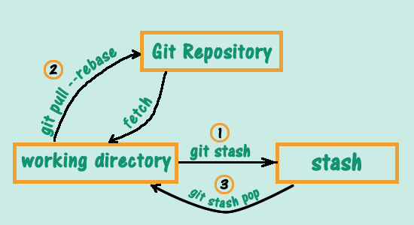
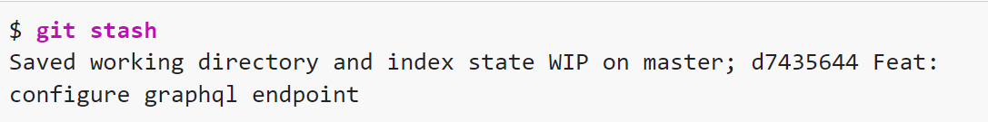
Git stash command. Git stash is extremely useful when you have some changes that you want to save but aren't ready to make a commit. Git stash stores the changes you made to the working directory locally and allows you to retrieve the changes when you need them.
The simplest command to stash your changes is git stash:

Slide 4
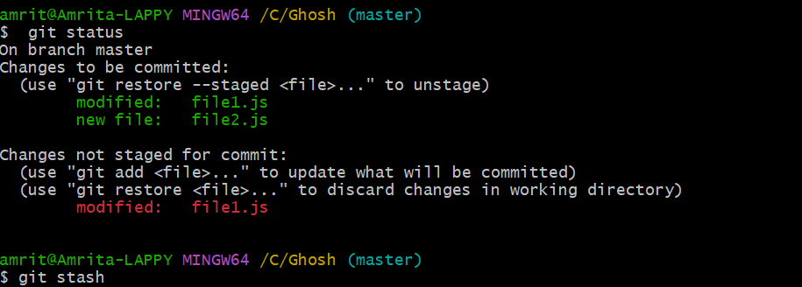
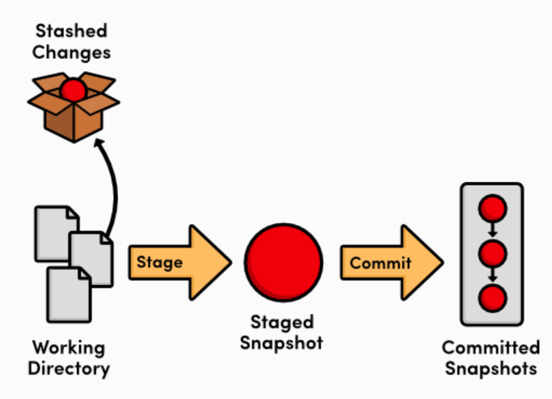
Before you can run git stash, you need to have some uncommitted changes in your Git repository.
By default, git stash stores (or "stashes") the uncommitted changes (staged and unstaged files) and overlooks untracked and ignored files. Usually, you don't need to stash untracked and ignored files, but sometimes they might interfere with other things you want to do in your codebase.
You can use additional options to let git stash take care of untracked and ignored files:
git stash -u or git stash --include-untracked stash untracked files.
git stash -a or git stash --all stash untracked files and ignored files.
To stash specific files, you can use the command git stash -p or git stash –patch:
How Stash command works
1. Save changes to branch A.
2. Run git stash.
3. Check out branch B.
4. Fix the bug in branch B.
5. Commit and (optionally) push to remote.
6. Check out branch A
7. Run git stash pop to get your stashed changes back.

Slide 5
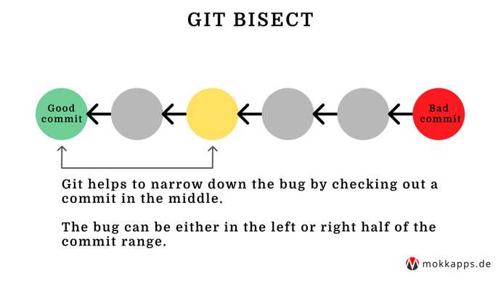
Git Bisect Command git bisect performs a binary search to find the faulty commit
The git bisect command is used to discover the commit that has introduced a bug in the code. It helps track down the commit where the code works and the commit where it does not, hence, tracking down the commit that introduced the bug into the code.

Slide 6
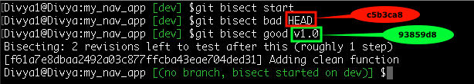
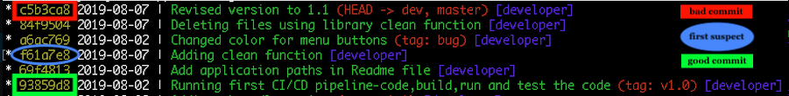
The following code demonstrates the use of git bisect to find the faulty commit.
Initializing the repository
Creating commits to demonstrate git bisect
Finding the log history and narrowing down the bad commit.
We can now categorize the first commit as good and the last commit as bad. We check the contents of the test file.
git bisect now takes us to another commit. We repeat the process till the new commit to being bad.
git bisect finally returns the commit to us where the first error took place.

Slide 7
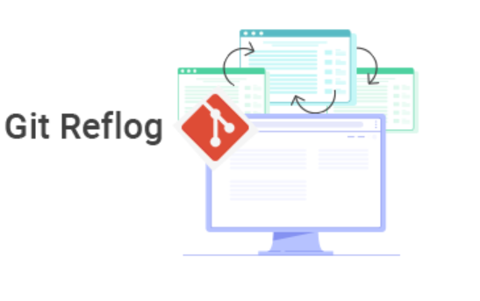

Git reflog Command The git reflog command is used for Git to record updates made to the tip of branches. It allows returning to commits even to the ones that are not referenced by any branch or any tag. After rewriting history, the reflog includes information about the previous state of branches and makes it possible to go back to that state if needed.
Reference logs, or "reflogs", record when the tips of branches and other references were updated in the local repository. Reflogs are useful in various Git commands, to specify the old value of a reference.

Slide 8
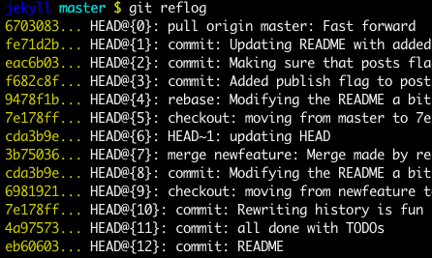
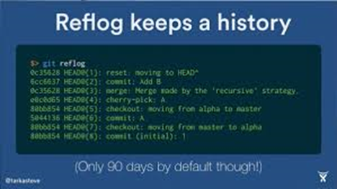
Recover a deleted branch using Git Reflog
Step 1: History logs of all the references
Step 2: Identify the history stamp
Step 3: Recover
Output:

Slide 9
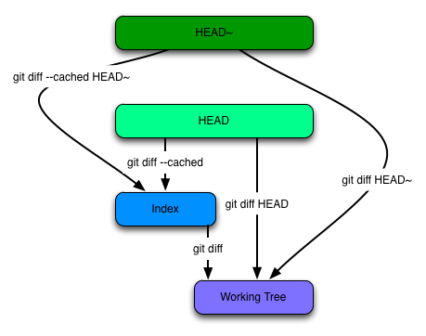
Git diff command Diffing is a function that takes two input data sets and outputs the changes between them. git diff is a multi-use Git command that when executed runs a diff function on Git data sources. These data sources can be commits, branches, files and more.
Diff command is used in git to track the difference between the changes made on a file. Since Git is a version control system, tracking changes are something very vital to it. Diff command takes two inputs and reflects the differences between them.

Slide 10
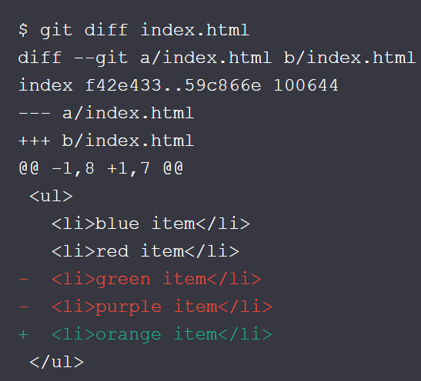
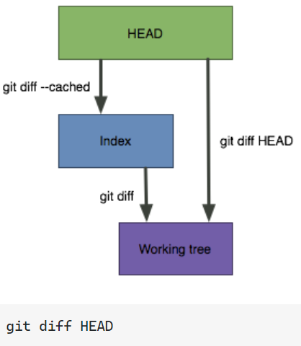
The git diff command is a widely used tool to track the changes.
The git diff command allows us to compare different versions of branches and repositories. To get the difference between branches, run the git diff command as follows:
$ git diff <branch 1> < branch 2>
The above command will display the differences between branch 1 and branch 2. So that you can decide whether you want to merge the branch or not.
Sometimes, you might want to compare how a certain file differs in two branches. You can do this simply by adding the file's path:
$ git diff main feature/login index.html

Slide 11
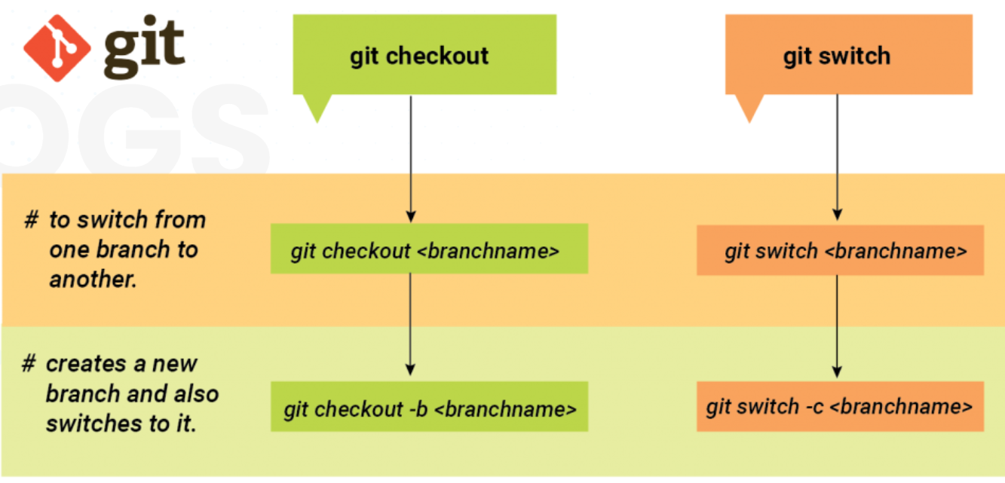
Git switch Command The git checkout command allows you to switch branches by updating the files in your working tree to match the version stored in the branch that you wish to switch to
Switch to a specified branch. The working tree and the index are updated to match the branch. All new commits will be added to the tip of this branch.

Slide 12
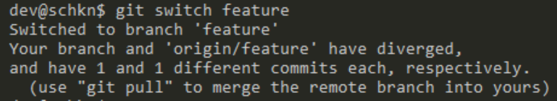
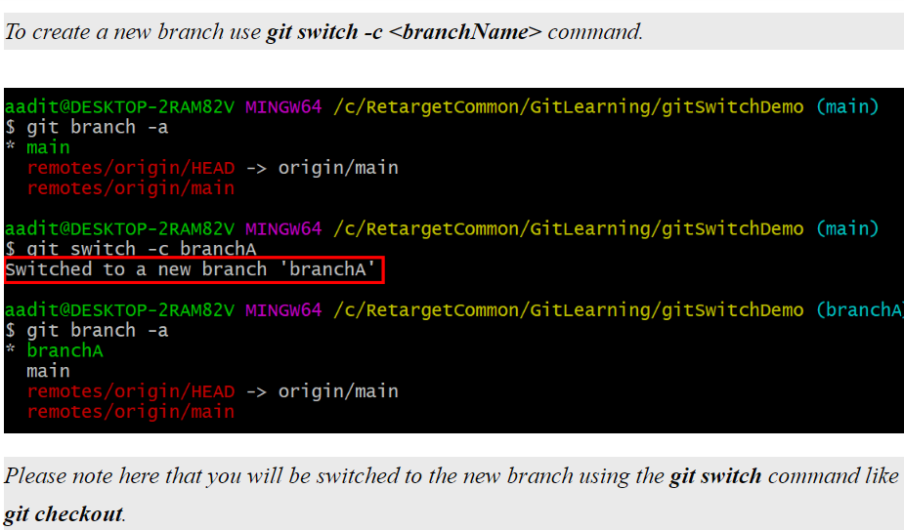
The most common scenario is to simply specify the local branch you want to switch to:
$ git switch other-branch
This will make the given branch the new HEAD branch. If in one go, you also want to create a new local branch, you can use the "-c" parameter:
$ git switch -c new-branch
If you want to check out a remote branch (that doesn't yet exist as a local branch in your local repository), you can simply provide the remote branch's name. When Git cannot find the specified name as a local branch, it will assume you want to check out the respective remote branch of that name:
$ git switch remote-branch
This will not only create a local branch but also set up a "tracking relationship" between the two branches, making sure that pulling and pushing will be as easy as "git pull" and "git push".
If you have local modifications that would conflict with the branch you want to switch to, you can instruct Git to clear your working copy of any local changes
$ git switch other-branch --discard-changes
Finally, if you want to switch back to the previously checked out branch, you can simply do this by specifying only the "-" character:
$ git switch -

Slide 13
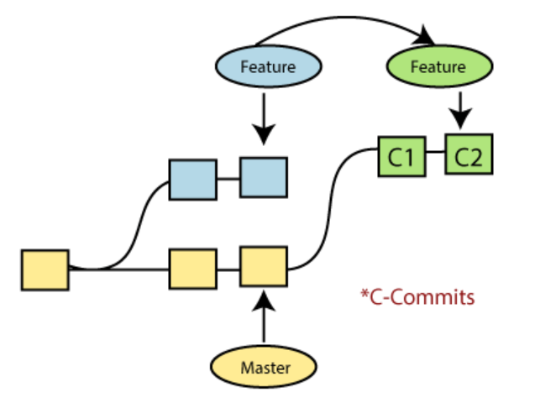
Git rebase command Rebasing is a process to reapply commits on top of another base trip. It is used to apply a sequence of commits from distinct branches into a final commit. It is an alternative of git merge command. It is a linear process of merging.
In Git, the term rebase is referred to as the process of moving or combining a sequence of commits to a new base commit. Rebasing is very beneficial and it visualized the process in the environment of a feature branching workflow.

Slide 14
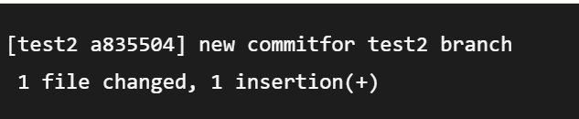
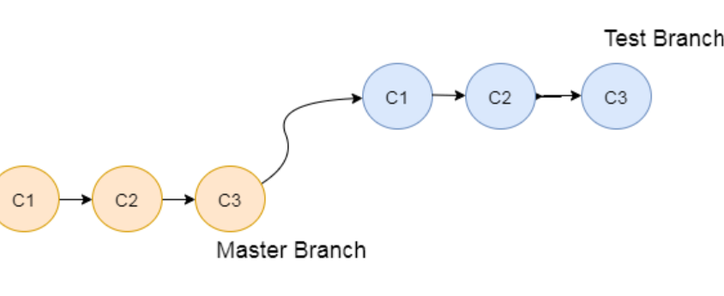
When you made some commits on a feature branch (test branch) and some in the master branch. You can rebase any of these branches.
Syntax:
$git rebase <branch name>
If there are some conflicts in the branch, resolve them, and perform below commands to continue changes:
$ git status
It is used to check the status,
$git rebase --continue
The above command is used to continue with the changes you made. If you want to skip the change, you can skip as follows:
$ git rebase --skip
When the rebasing is completed. Push the repository to the origin. Consider the below example to understand the git merge command.
Suppose that we have a branch say test2 on which you are working. You are now on the test2 branch and made some changes in the project's file newfile1.txt.
Add this file to the repository:
$ git add newfile1.txt
Now, commit the changes. Use the below command:
$ git commit -m "new commit for test2 branch."
The output will look like

Slide 15
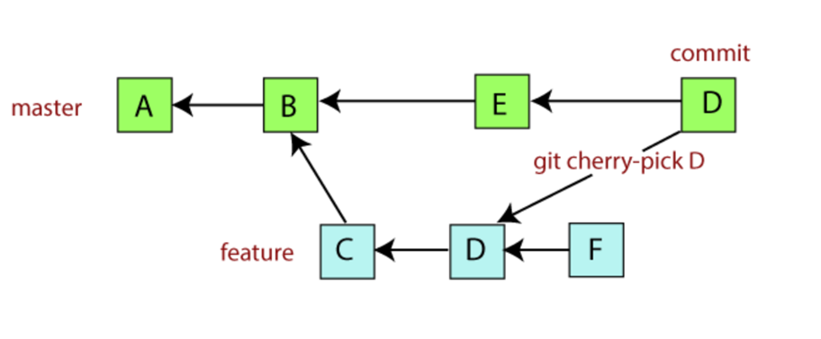
Git cherry-pick Command git cherry-pick is a powerful command that enables arbitrary Git commits to be picked by reference and appended to the current working HEAD. Cherry-picking is the act of picking a commit from a branch and applying it to another. Git cherry-pick can be useful for undoing changes. For example, say a commit is accidentally made to the wrong branch. You can switch to the correct branch and cherry-pick the commit to where it should belong. The git cherry-pick is used to access the changes introduced to a sub-branch, without changing the branch.
The main motive of a cherry-pick is to apply the changes introduced by some existing commit. A cherry-pick looks at a previous commit in the repository history and updates the changes that were part of that last commit to the current working tree.

Slide 16
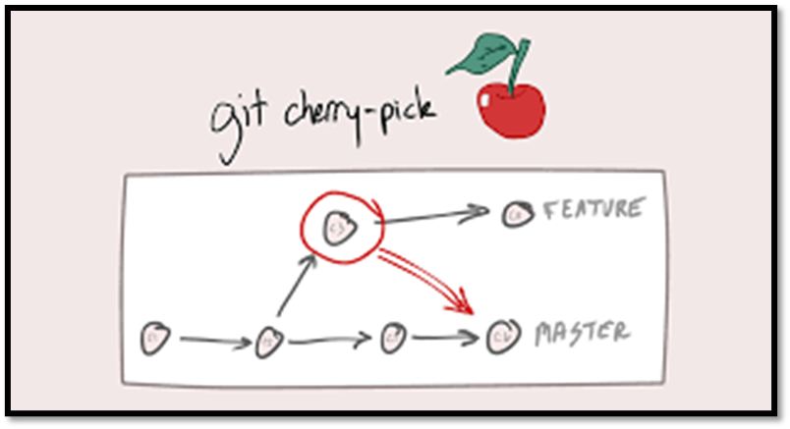
To demonstrate how to use git cherry-pick let us assume we have a repository with the following branch state:
a - b - c - d Main
\
e - f - g Feature
git cherry-pick usage is straightforward and can be executed like:
git cherry-pick commitSha
In this example, commitSha is a commit reference. You can find a commit reference by using the git log. In this example, we have constructed let’s say we wanted to use commit `f` in main. First we ensure that we are working on the main branch.
git checkout main
Then we execute the cherry-pick with the following command:
git cherry-pick f
Once executed our Git history will look like:
a - b - c - d - f Main
\
e - f - g Feature
The f commit has been successfully picked into the main branch

Slide 17
Conclusion: This was a short presentation from my side on git stash git bisect git reflog git diff git switch git rebase git cherry-pick

Slide 18
Thank you

