Slide 1
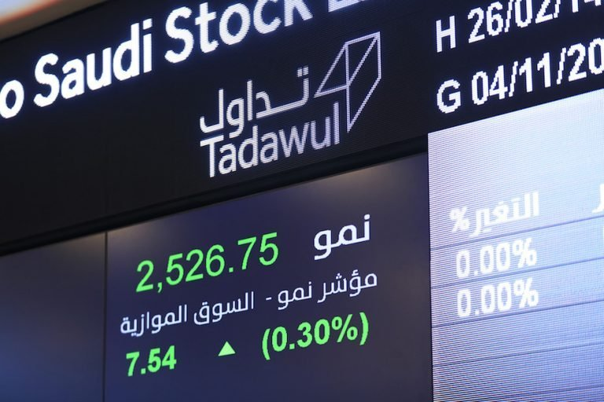

Slide 2
SAUDI STOCK EXCHANGE
predict closing prices using Regression

Slide 3
Contents
DATA DESCRIPTION
QUESTIONS
MODELS
CONCLUSION

Slide 4
Work Process
20%
Data Set pick up
Data Processing
30%
Transformation
80%
30%
DATA MODELING

Slide 5
Data Set Description
This is the data of Saudi stock market companies since 2000-01-01. It was collected from Saudi Stock Exchange (Tadawul). It contains 600,000 rows, each rows and 14 features.
https://www.tadawul.com.sa/wps/portal/tadawul/home/
Data Source
https://www.tadawul.com.sa/wps/portal/tadawul/home/

Slide 6
Data features
Symbol (Integer):
High (Decimal):
The symbol or the reference number of the company.
The highest price of the stock at that day.
Name (String):
low (Decimal):
Name of the company
The lowest price of the stock at that day.
Trading Name (String):
Perc Change (Decimal):
The trading name of the company.
The percentage of the change.
Sector (String):
Volume Traded (Decimal):
The sector in which the company operates.
The volume of trades for the day.
(Date):
Value Traded (Decimal):
The date of the stock price.
Open
No_Trades (Decimal):
The opening price.

Slide 7
UNDERSTANDING THE PROBLEM
Using data science in the stock market is not new, but that doesn't apply for Saudi Stock Exchange (Tadawul), We are trying to explore the Saudi stocks all sector, so we can predict their closing prices using Regression.

Slide 8
QUESTIONS
1. Goal
2. Goal
3. Goal
4. Goal
predict the stocks prices
What is the highest Profit section?
Venus has a beautiful name and is the second planet from the Sun
Mercury is the closest planet from the Sun and the smallest one
100%
20%
40%
40%

Slide 9
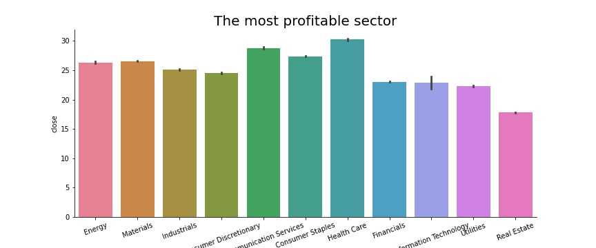
RESULTS

Slide 10
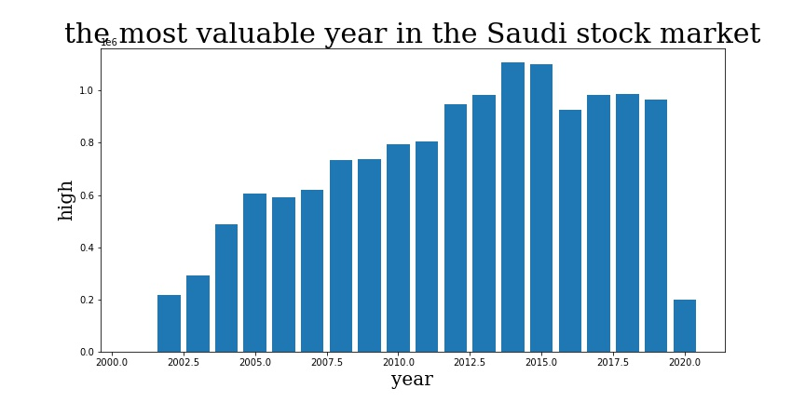
RESULTS

Slide 11
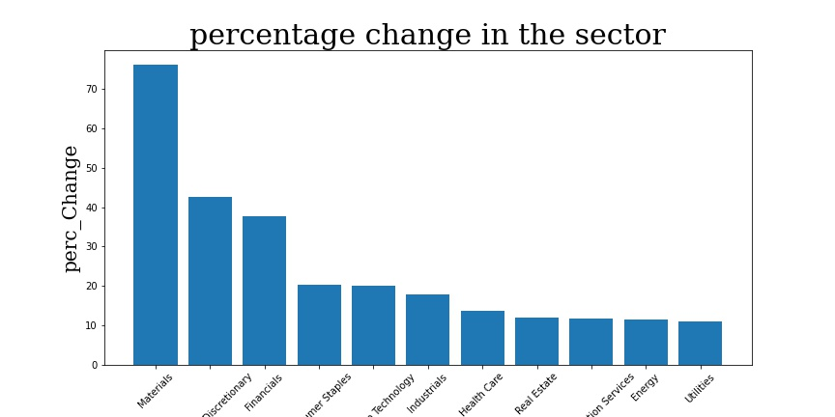
RESULTS

Slide 12

Predict The Stocks Prices
1. Linear Regression
2. Random Forest Model

Slide 13
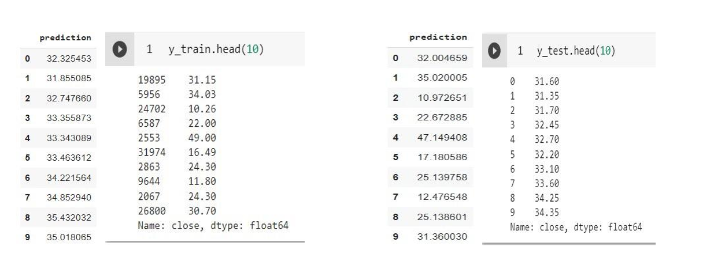
SAMPLE OF OUR RESULTS
Neptune
Venus
Mercury

Slide 14
CONCLUSION
improve the results (try changing the training/test size, transform/scale input features, etc.)
Neptune
The predicted value can eventually be compared with the actual value to check the level of accuracy.
Venus
Mercury
The important step is to evaluate the performance of algorithm to compare how well different algorithms perform on a particular dataset

Slide 15
TOOLS
Jupiter
S-klearn model
Matplotlib
Pandas
100%
30%
50%
50%

Slide 16
THANKS
Prepared by:
ALYA ALMANQOUR
ABDULLAH ALMORISHED
ELAF TALAL

