Slide 1







Data Analyst: Current Technology Usage
Analysis of Job Postings and Programming Languages: A Comprehensive Overview
Adjany Morani Frazão Domingos
16-08-2024

Slide 2
OVERVIEW OF LEARNING OUTCOMES
Module 1: Data Collection
Collecting Data Using APIs
Collecting Data Using Webscraping
Exploring Data
Module 2: Data Wrangling
Finding Missing Values
Determine Missing Values
Finding Duplicates
Removing Duplicates
Normalizing Data
Module 3: Exploratory Data Analysis
Distribution
Outliers
Correlation
Module 4: Data Visualization
Visualizing Distribution of Data
Relationship
Composition
Comparison
Module 5: Dashboard Creation
Dashboards

Slide 3



OUTLINE
Executive Summary
Introduction
Methodology
Results
Visualization – Charts
Dashboard
Discussion
Findings & Implications
Conclusion
Appendix

Slide 4

EXECUTIVE SUMMARY
Data contextualization and analysis goal.
Methodology description.
• Data gathering.
Data analysis.
Data visualizations.
Results presentation supported with graphs and trends. •
Discussion of overall findings and implications regarding the results previously exposed.
Final conclusions of the carried out research.

Slide 5

INTRODUCTION
Point1 Objective: To analyze job postings for various programming languages and their annual average salaries. Data Sources: GitHub Jobs API, Programming Languages Salary Data
Point2
Point3
Point4
Sub Point1
Sub Point2

Slide 6

METHODOLOGY
Point1 Description: Overview of the data collection process. Tools Used: Python, Requests, BeautifulSoup, Pandas Methodology: Scraping data from web pages and APIs.
Point2
Point3
Point4
Sub Point1
Sub Point2

Slide 7
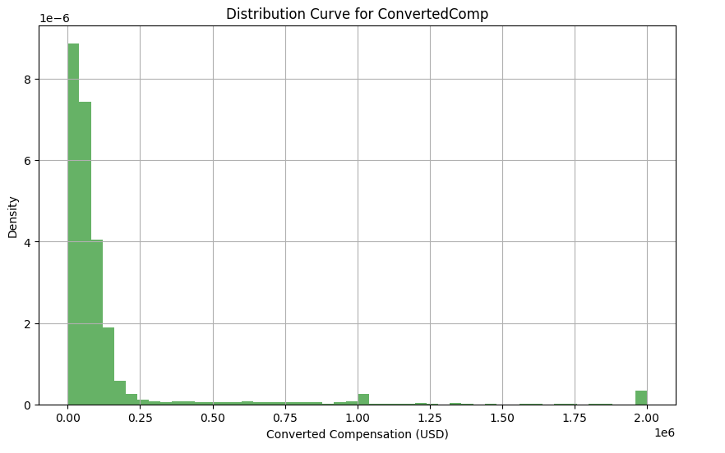
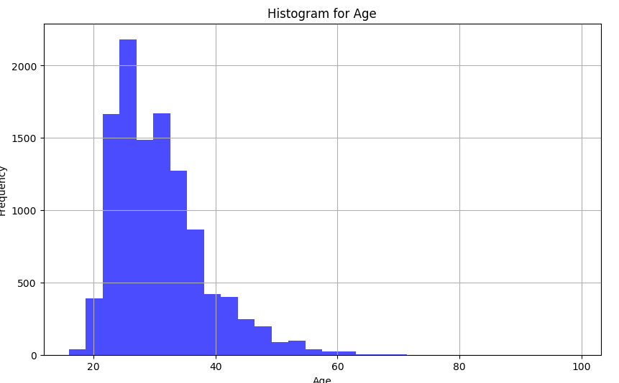
Plot the distribution curve for the column

Slide 8
RESULTS Modeule 1
Chart: Bar chart showing the number of job postings for each technology. Table: Summary table with technologies and their respective job counts.
Bar chart showing the number of job postings for each location. Table: Summary table with locations and their respective job counts.
Technology | Job Postings
Java | 120
Python | 150
MySQL | 80
C++ | 60
C# | 90
Location | Job Postings
Los Angeles | 50
New York | 70
San Francisco | 60
Washington DC | 80
Seattle | 55
Austin | 45
Detroit | 40
Bar chart showing the annual average salaries for different programming languages. Table: Summary table with languages and their respective salaries.
Bullet Points:
Python has the highest number of job postings.
Washington DC has the maximum number of job postings among the listed locations.
JavaScript offers the highest annual average salary.
Language | Annual Average Salary ($)
Java | 85,000
Python | 90,000
JavaScript | 95,000
C++ | 80,000
C# | 87,000

Slide 9
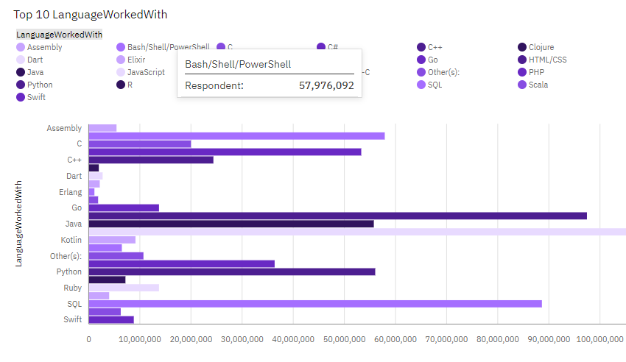
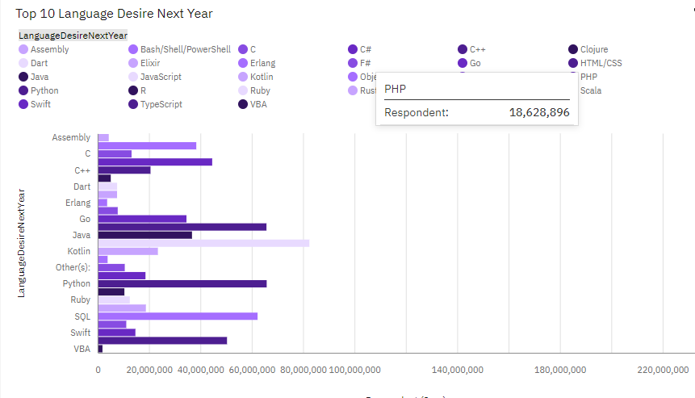
PROGRAMMING LANGUAGE TRENDS
Current Year
Next Year

Slide 10
PROGRAMMING LANGUAGE TRENDS - FINDINGS & IMPLICATIONS
Findings
Finding 1
Finding 2
Finding 3
Implications
Implication 1
Implication 2
Implication 3

Slide 11
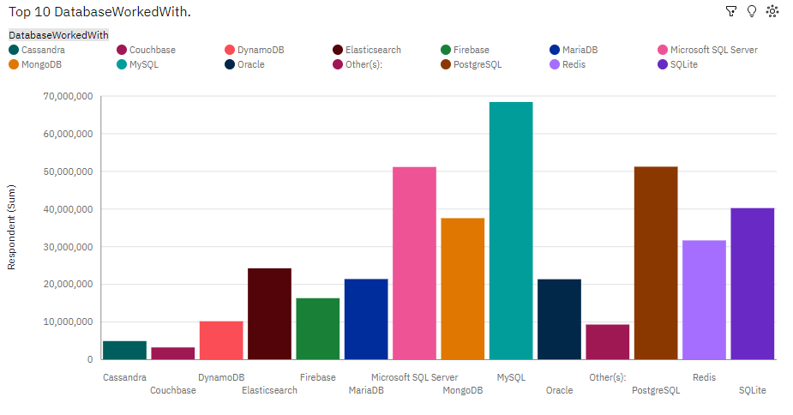
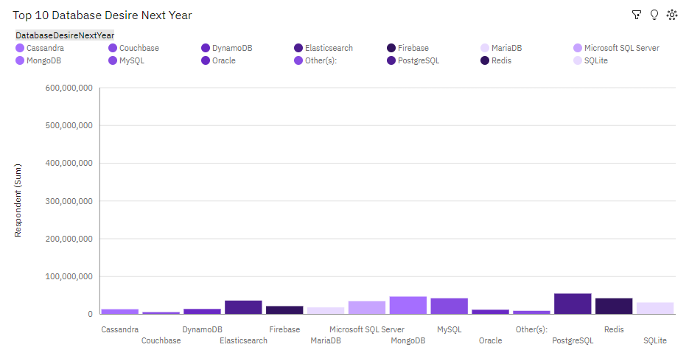
DATABASE TRENDS
Current Year
Next Year
< Bar chart of top 10 databases for the current year goes here >
< Bar chart of top 10 databases for the next year goes here.>

Slide 12
DATABASE TRENDS - FINDINGS & IMPLICATIONS
Findings
Finding 1
Finding 2
Finding 3
Implications
Implication 1
Implication 2
Implication 3

Slide 13

DASHBOARD
<The GitHub link of the Cognos/Looker Studio dashboard goes here.>

Slide 14
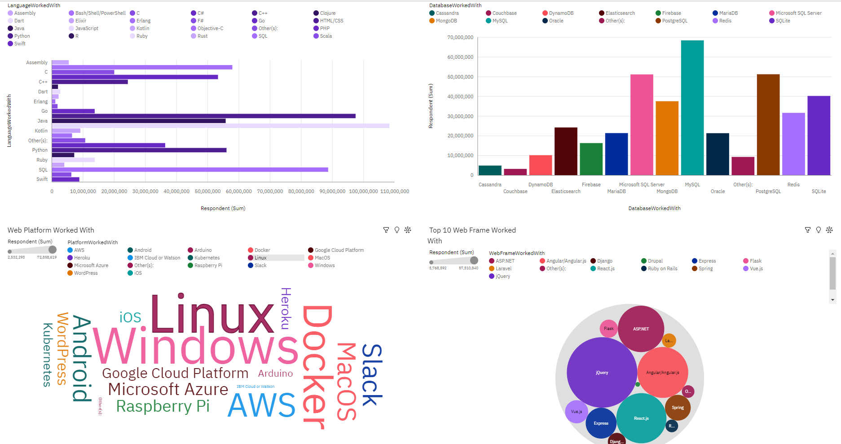
DASHBOARD TAB 1
Screenshot of dashboard tab 1 goes here

Slide 15
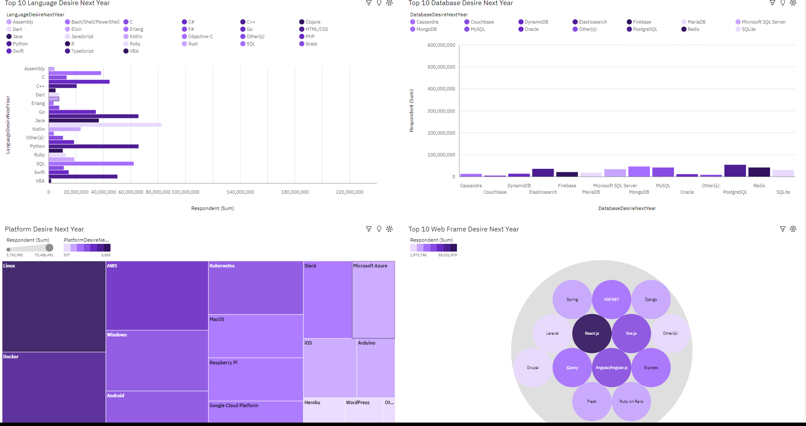
DASHBOARD TAB 2
Screenshot of dashboard tab 2 goes here

Slide 16
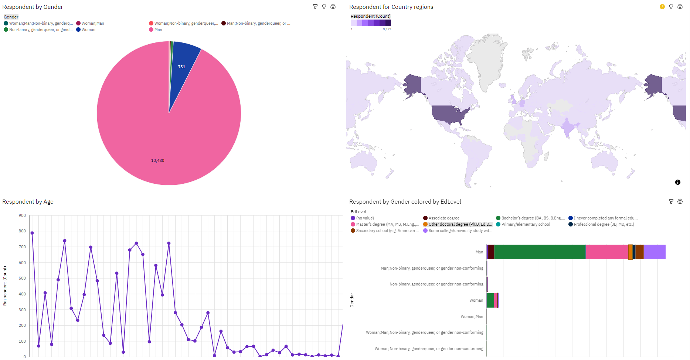
DASHBOARD TAB 3
Screenshot of dashboard tab 3 goes here

Slide 17
DISCUSSION

Slide 18
OVERALL FINDINGS & IMPLICATIONS
Findings
Finding 1
Finding 2
Finding 3
Implications
Implication 1
Implication 2
Implication 3

Slide 19

CONCLUSION
Point 1
Point 2
Point 3
Point 4

Slide 20
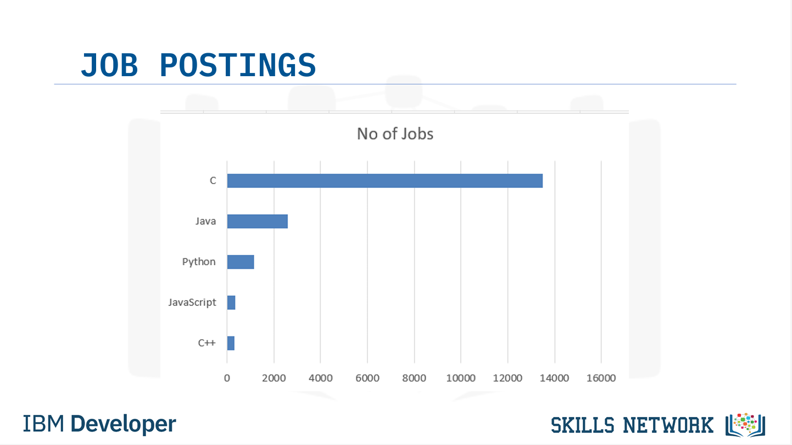
JOB POSTINGS
In Module 1 you have collected the job posting data using Job API in a file named “job-postings.xlsx”. Present that data using a bar chart here. Order the bar chart in the descending order of the number of job postings.

Slide 21
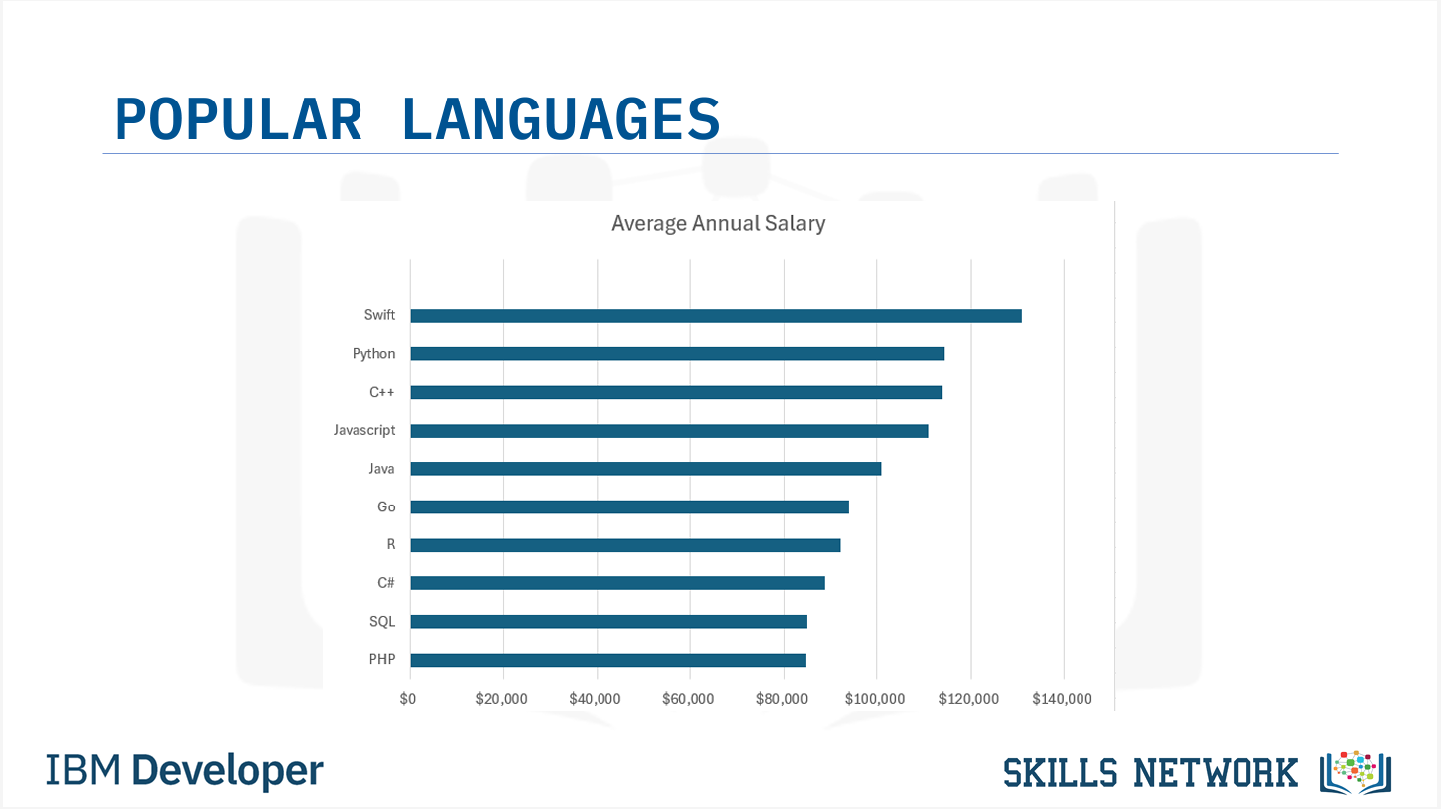
POPULAR LANGUAGES
In Module 1 you have collected the job postings data using web scraping in a file named “popular-languages.csv”. Present that data using a bar chart here. Order the bar chart in the descending order of salary.

