Slide 1
Exploratory Data Analysis & Prediction on Student Performance
Zixuan (Amos) Chen
Xiangyu (Melo) Wang
Zhengpeng Du
Wenjun Liao

Slide 2

Introduction
Modern classroom, especially in colleges, contains over hundreds of student, each vary in learning habits, study interests, family background, and social connections. While grades are usually considered outcomes of individual efforts, some factors might actually have a great impact on a student’s performance at a particular subject.

Slide 3

Motivation
By identifying the contributing factors, schools can reach out and offer help to students before they fail their course.
By having robust predictions over students' performance, instructors are able to make adjustments throughout a course.
Aid future research in formulating better ways for educational resource distribution.

Slide 4
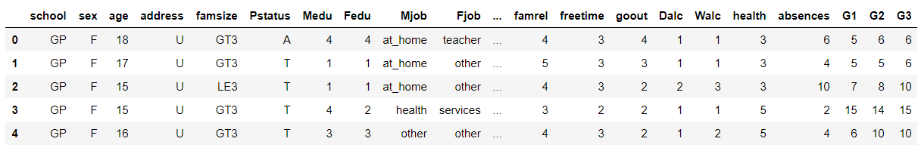
Dataset at Hand
1. Student Performance Data Set
https://archive.ics.uci.edu/ml/datasets/student%2Bperformance
#Data Points: 649
#Attribute: 33
Includes student grades, demographic, social and school related features

Slide 5
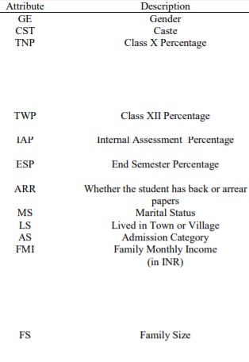
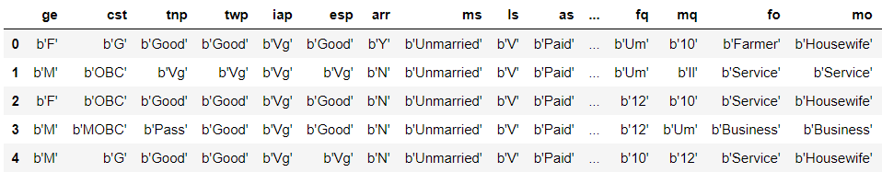
Dataset at Hand
2. Student Academics Performance Data Set
https://archive.ics.uci.edu/ml/datasets/Student+Academics+Performance
#Data Points:300
#Attributes:22 Also Includes social, economic and academic features

Slide 6
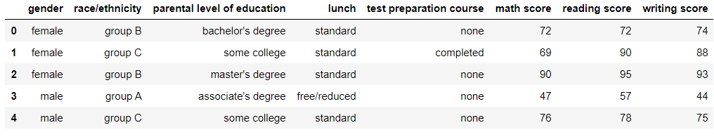
Dataset at Hand
3. Student Performance in Exams
https://www.kaggle.com/spscientist/students-performance-in-exams
#Data Points:1000
#Attributes: 8 Includes ethnicity, parental level of education

Slide 7
Questions
What are the contributing factors to student performance?
Identity pairs or subsets of features that have a significant correlation.
Which Model has the best precision?
Which Model has the shortest training time?
What is the best method to split a leaf in a Decision Tree?

Slide 8
Methodology
Problem Domain: Supervised Learning. Multivariate Classification.
Data Manipulation:
Pandas, Numpy
Visualization:
Matplotlib
Model Selection and Learning:
Sklearn， Self-developed algorithms
Models:
Baseline: KNNeighbors
Regression, Support Vector Machine, Random Forest, Boosting, Neural Network, Ensemble
Evaluation:
Accuracy Rate; Mean Square Error

Slide 9
Past Work
P. Cortez and A. Silva. Using Data Mining to Predict Secondary School Student Performance. In A. Brito and J. Teixeira Eds., Proceedings of 5th FUture BUsiness TEChnology Conference (FUBUTEC 2008) pp. 5-12, Porto, Portugal, April, 2008, EUROSIS, ISBN 978-9077381-39-7.
Hussain S, Dahan N.A, Ba-Alwi F.M, Ribata N. Educational Data Mining and Analysis of Studentsâ€™ Academic Performance Using WEKA. Indonesian Journal of Electrical Engineering and Computer Science. 2018; Vol. 9, No. 2. February. pp. 447~459

