Slide 1
What is Electricity?
Electricity is the flow of tiny charged particles called electrons.
Electrons are present in all substances, but in some materials they are not free to move. These substances are known as insulators.
Substances which permit the flow of electricity are called conductors.
There are three basic electrical characteristics that come into play in every circuit:
Voltage
Current
Resistance

Slide 2
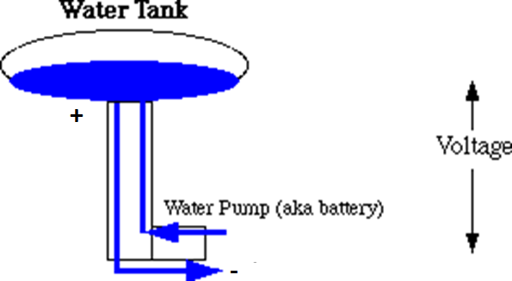
To describe how circuits work, we can compare to how water flows:
Amount flowing = Current
Pressure (difference in level) = Voltage
Things blocking or slowing down flow = Resistance

Slide 3


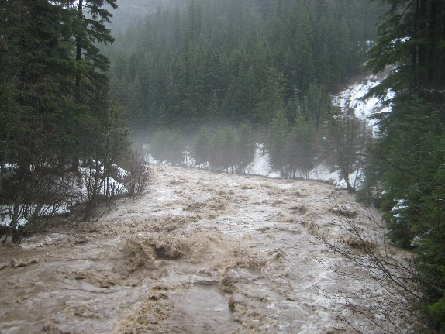
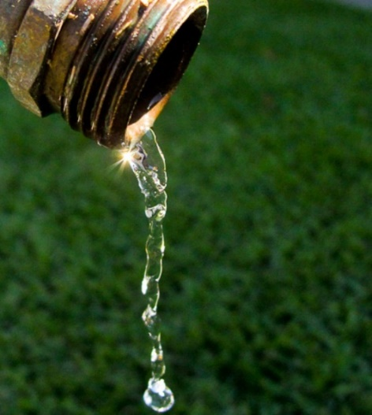
Voltage
Current
Resistance
A force that pushes the current through the circuit (in this picture it would be equivalent to gravity)
Voltage is the relative level of energy between any two points in the circuit (for example between power and ground). You can think of it as height of water above ground level.
Voltage is always measured across two points in a circuit.
Voltage is measured in units of volts
The amount (of electrons) that is flowing through the wires of the circuit
Current is measured at a single point in a circuit (flow thru the point)
Current is measured in units of amperes, shortened to amps
The amount that any component in the circuit resists the flow of current (like rocks or narrows in a river)
Resistance is always measured across two points in a circuit.
Resistance is also called load.
Resistance is measured in units of Ohms

Slide 4
Power Sources
Batteries, power supplies (like for your phone or laptop), and AC outlets act like a pump pumping water up a hill.
They take electrons with low energy (at ground level) and move them to a high energy (like moving water up a hill or into a tall water tower)
Creates electrical pressure – voltage
Current, like water, naturally flows from high energy to low energy (down the hill) unless blocked by resistance and insulators.
The low energy side of a battery is called the negative or ground ( - ), and the high energy side is called the positive (+).
A power source’s stated voltage is the pressure difference between the + and the - sides.

Slide 5
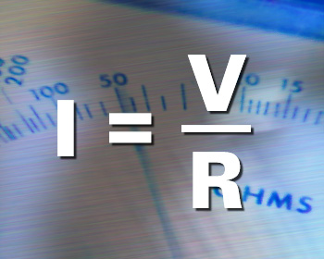
Formulas: Ohm’s Law
Voltage, current and resistance in a circuit (or any part of the circuit) are all related by Ohm’s law.
Voltage = V
Current = I
Resistance = R
The combination of current and voltage is called electrical power. It is measured in watts. The relationship is:
watts = volts x amps (P=V*I)

Slide 6
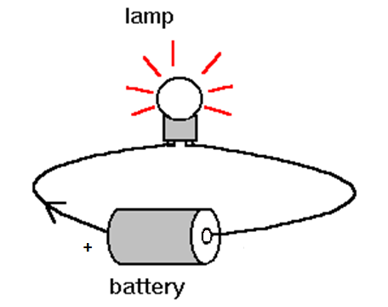
Circuits
A circuit is a closed loop containing a source of electrical energy (e.g., a battery) and a load (e.g., a light bulb)
Electrons naturally flow from the high energy (+) side to the low energy (–) ground side.
Resistive (load) components usually do some work – light up, turn a motor, …
What would the current be if the circuit resistance was 0? (see Ohm’s Law)
Called a short circuit – and is not good!
Conductors (usually wires) are used to move electrons from the battery to the circuit components.

Slide 7
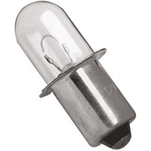
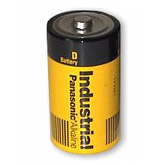
Would This Work?
The Central Concept: Closed Circuit

Slide 8
Resistors
Switches
Diodes & LEDs
Others: Capacitors, Inductors, “Chips”
Circuit in Diagram Form
Circuit Components
battery
_
+
current
bulb
In a closed circuit, current
flows around the loop

Slide 9
Resistors
The value of a resistor is written right next to its schematic symbol in a circuit diagram.
Resistors give electricity something - they convert electrical energy into heat.
Resistors are rated in ohms, indicating how much resistance they offer a circuit, and in watts, indicating the max power they can take.
Fixed Resistors
Variable Resistors
Resistors also are rated for maximum wattage. This is determined by size. The small ones that come with the kit are rated for ¼ watt.

Slide 10
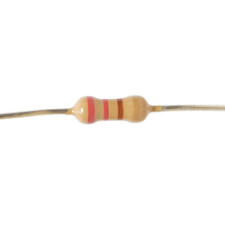
What is the resistance?
Notes:
22 (red-red) x 10 (multiplier brown) = 220 ohms, +/-5% tolerance (gold band)
It can be hard to tell which side to start from on some resistors. Gold and silver colors are only used for tolerance, and are the most common tolerances, so if present that can help make it clearer where to start from.

Slide 11
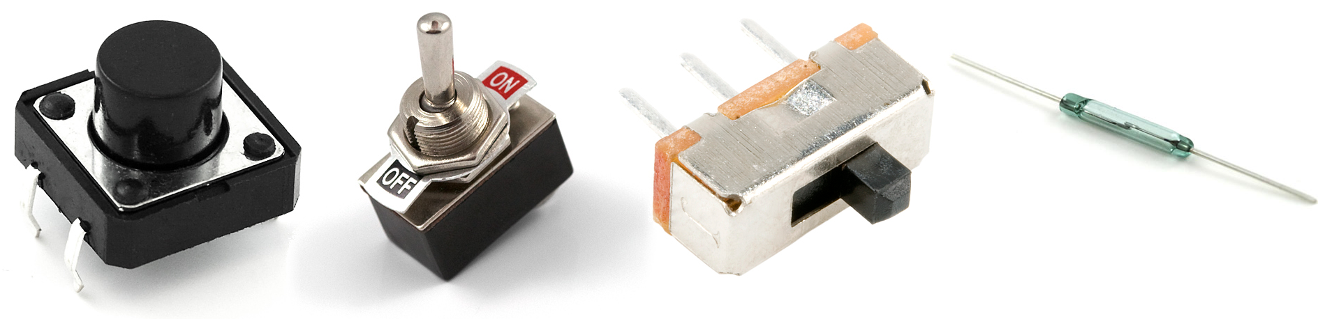
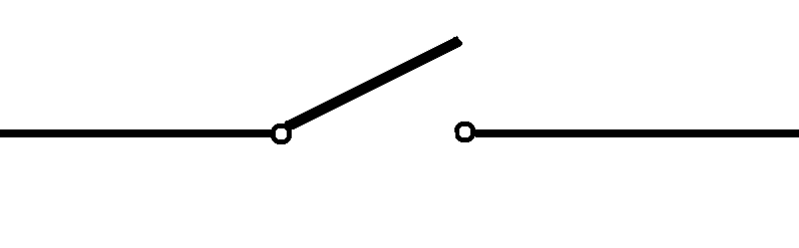
Switches
Switches passes or interrupt the flow of electricity
A simple switch has two interchangeable leads. The leads are attached to two contacts inside the switch that can put them in contact with each other or be separated by the actions of the switch.
Momentary vs. toggle switches

Slide 12
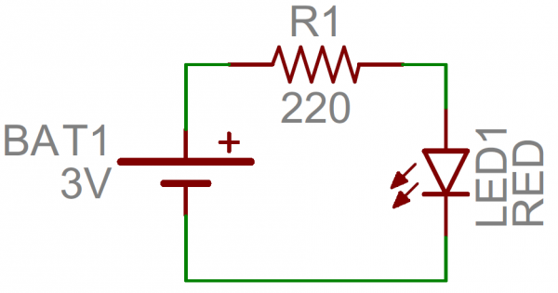
Naming Convention in Circuit Diagrams
Circuit Diagram Example
Identifier | Component
R | Resistors
C | Capacitors
L | Inductors
S | Switches
D | Diodes/LEDs

Slide 13
Simple Circuits
Series circuit
All in a row
1 path for electricity
1 light goes out and the circuit is broken
Parallel circuit
Many paths for electricity
1 light goes out and the others stay on

Slide 14
Formulas for Series Circuits
Using V = I*R, we see that in series the same current must move through both resistors.
The voltage drop across the two resistors adds to give the total voltage drop
(Analogy: Think of each resistor as a waterfall. The total height that the water falls is the addition of the heights of the two waterfalls.)
V_{total} = (V₁ + V₂)
R_{eff} = R₁ + R₂
I = V_{total} / R_{eff}
I
R₁
+
V₁
R₂
V_{bat}
V₂
-

Slide 15
Formulas for Parallel Resistors
In a parallel circuit, the voltage drop for each path is the same, but the current is different
(Think of water in a river that splits with some water flowing over one fall and the rest falling over the other but all the water ending up joining back together again.)
Current into any branch or merge point must be equal to the current leaving the point.
The amount of current that goes down each path depends on its resistance.
Low resistance – more current
High resistance – less current
V_{total} = V₁ = V₂
I_{total} = (I₁ + I₂ )
1/R_{eff} = 1/R₁ + 1/R₂ or R_{eff} = 1 / (1/R₁ + 1/R₂)
I_{total}
+
V_{bat}
I₁
R₁
I₂
R₂
-

Slide 16
Parallel & Series Circuit Examples
Consider two resistors in parallel: a 3Ω and a 6Ω resistor: 1/R_{eff} = 1/R₁ + 1/R₂ =1/3Ω + 1/6Ω = (.333/Ω + .167/Ω) = .5
or R_{eff} = 1/.500 = 2Ω Note that 2Ω is smaller than the smallest single resistor of 3Ω.
5V power supply again.
What is the voltage drop on each branch? 5V (same for all paths)
What is the total current and the current in each branch?
I₁ = V/R₁ = 5 / 3 = 1.67 amps
I₂ = V/R₂ = 5 / 6 = 0.83 amps
I_{total} = I₁+I₂ = 1.67+0.83 = 2.5amps (alternatively, I_{total} = V/R_{eff} = 5/2 = 2.5 amps)
Consider two resistors in series: a 3Ω and a 6Ω resistor: R_{eff} = R₁ + R₂ = 3Ω + 6Ω = 9Ω Note that 9Ω is larger than the largest single resistor of 6Ω.
If the power source is 5V, what is I?
I = V/R_{eff} = 5/9 = 0.5556 amps
What is the voltage drop across each resistor?
V₁ = I*R₁ = 0.5556 * 3 = 1.67V
V₂ = I*R₂ = 0.5556 * 6 = 3.33V
(note these add up to 5V total)
3Ω
3Ω
6Ω
6Ω

Slide 17
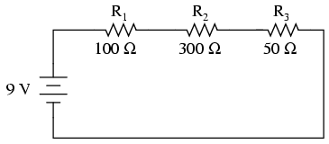
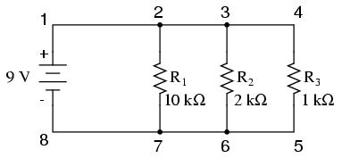
Your Turn!
V?
Voltage drop between points
2 and 7?
3 and 6?
1 and 2?
R_{eff}?
I_{total}?
I₄₋₅?
Will this be larger or smaller than I₂₋₃?
V?
R_{eff}?
I?
Voltage drop across R₂?

Slide 18
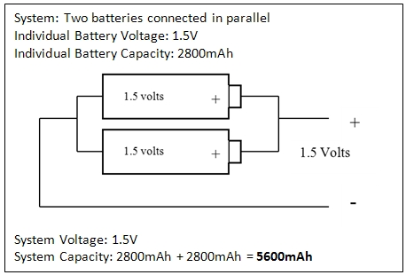
Series or Parallel Power Supplies
Series and parallel also applies to batteries & other power sources.
For batteries in series, the voltage are added. For example, a D cell battery supplies 1.5 volts, so four D cell batteries in series (one after the other) will supply 6 volts but at the same maximum current as a single battery.
Batteries in parallel keep the same voltage, but combine the amount of current they can combine. So 4 D batteries in parallel would still provide 1.5 volts, but could provide 4 times as much current to the circuit if needed.
Two 1.5v batteries with current capacities of up to 1 amp each are arranged as shown
Total voltage?
Total current capacity?
You have a bunch of 1.5v batteries. How would you arrange them in order to have a 6 volt power source?

Slide 19
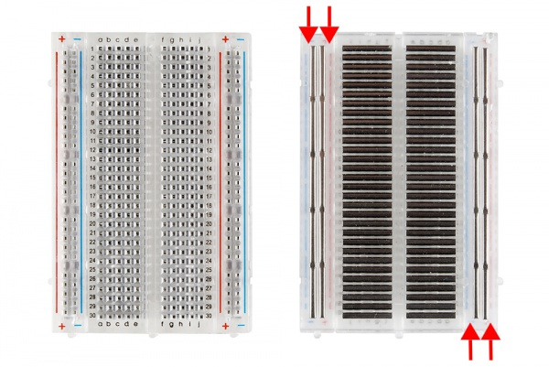
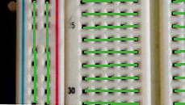
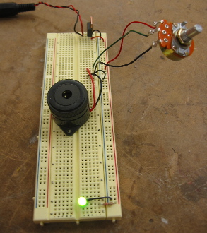
Breadboards
A breadboard is a tool for holding the components of your circuit, and connecting them together.
It’s got holes that are a good size for wires and the ends of most components, so you can push wires and components in and pull them out without much trouble.

Slide 20
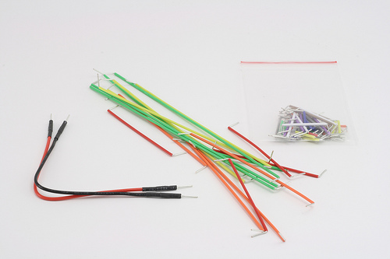
Wires (Conductors!)
Red wires used for + connections
Black (and sometimes green) used for ground ( - ) connections
Other colors used for connecting components

