Slide 1

Audio Recognizer
Team: 13
Report time: March 19, 2019
Team members： 陈柏山 梁骏杰
朱云龙 何鹏程

Slide 2
01
Project Introduction
02
Architecture Design
CONTENTS
Functional Module Design
03
Allocation and schedule
04
05
Project conclusionn

Slide 3

01
PART
Project
Introduction

Slide 4
1.1 Project Introduction
This is a way to find good listening music is also a artifact, so strange music no longer strange.
This product is a simple and easy to use music recognition application, the user can identify the current environment through this function is playing the song information, give people in the break time to bring new surprises and experience.

Slide 5
02
PART
Architecture Design

Slide 6
2.1 System technical architecture
Client Layer
View Layer
Application Layer
Control Layer
Business Layer
Service Interface
Persistence Layer
Date Access
Database Server
Resource Layer

Slide 7
03
PART
Functional Module Design

Slide 8
3.1 Functional module design
The main module of the system
audiorecognition
Page subsystem
Audio processing subsystem
Audio retrieval subsystem

Slide 9
3.2 The subsystem functional module design
Page subsystem
Audio processing subsystem
Start by listening
Return song informati-on
Playback controls
Audio receiving
Audio data conversi -on

Slide 10
3.2 The subsystem functional module design
Audio retrieval subsystem
Database design
Database storage
Audio feature matching

Slide 11
3.2.1 Page terminal system module design
The module 1: audiorecongnition
The module 2 : Song information display
Serial number: CM1
The name of module :audiorecongnition
Function introduction Call the microphone for audio recording and transmission
The input : audio
The output : Audio information
Serial number: CM2
The name of module :Song information display
Function introduction : Display the identified song information
The input : audio
The output : Audio information
The module 3: Play songs
Serial number: CM3
The name of module :Play songs
Function introduction : This module is the playback control module, through which songs can be played to start and stop
The input : audio
The output : Playback of audio

Slide 12
3.2.2 Audio processing subsystem module design
The module 1: Audio receiving
The module 2: audiorecongnition
The name of module : SM
Function introduction :Record and obtain audio
The input : audio
The output : Time-domain audio waves
The name of module : SM1
Function introduction : Discrete Fourier transform, which converts data from the time domain to the frequency domain, and extracts the eigenvalues (fingerprints)
The input : Time-domain audio waves
The output : Frequency domain audio, array

Slide 13
3.2.3 Audio access subsystem design
The module 1 : Audio storage
The module 2 : library retrieval
The name of module : DM1
Function introduction : Save to the database
The name of module : SM2
Function introduction : In the matching process, the sliding fingerprint sequence compares the corresponding substrings of the pattern string and the source string each time. If the fingerprints at the corresponding positions are the same, the comparison similarity value this time is added one. We take the maximum similarity value obtained in the sliding process as the similarity of the two songs.

Slide 14
04
PART
Allocation and schedule

Slide 15
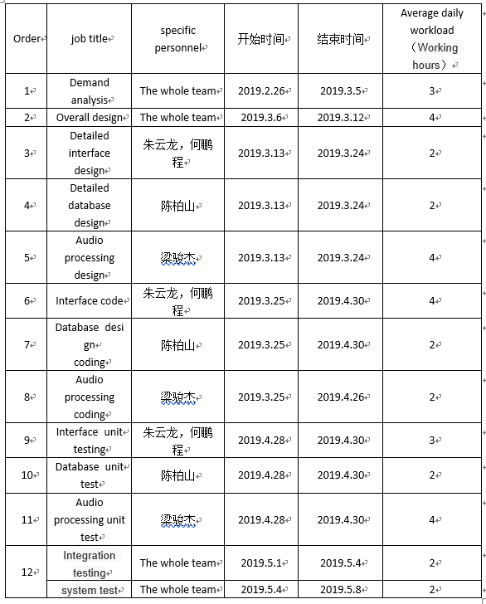
4.1 Personnel allocation

Slide 16
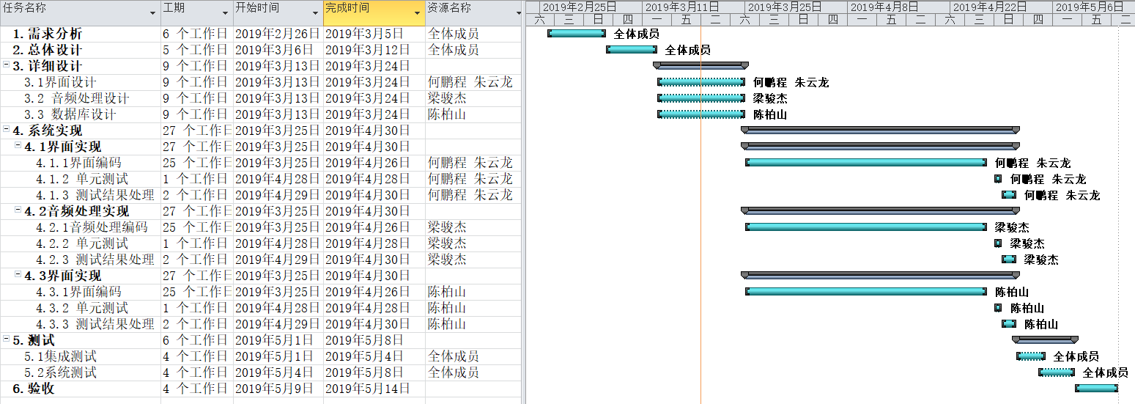
4.2 Project schedule

Slide 17
05
PART
Project conclusion

Slide 18
4.1 conclusion
recording
This project will design a system with audio recognition capabilities. The Fourier transform is used to convert the time domain signal into a frequency domain signal. The fingerprint of the Shazam algorithm is used to obtain the audio fingerprint, and finally the fingerprint fit is used to identify the audio. In order to achieve the effect of identifying the song information displayed in the current environment.
Audio analysis
Search
storage
Audio analysis
databsae
Return result

Slide 19
THANKS

