Slide 1
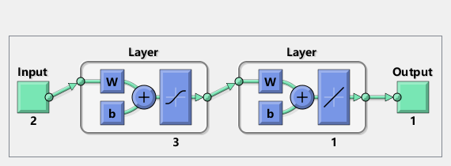
3.0399
-5.7589
-0.5529
3.9230
input1
4.6119
-0.0101
output
1.5403
input2
-3.0213
-0.1262
-3.2947
-3.5562
-0.5979
0.9294

Slide 2
input1
3.1500
-0.7028
output
input2
2.7360
-2.6795
1.0349

