Slide 1

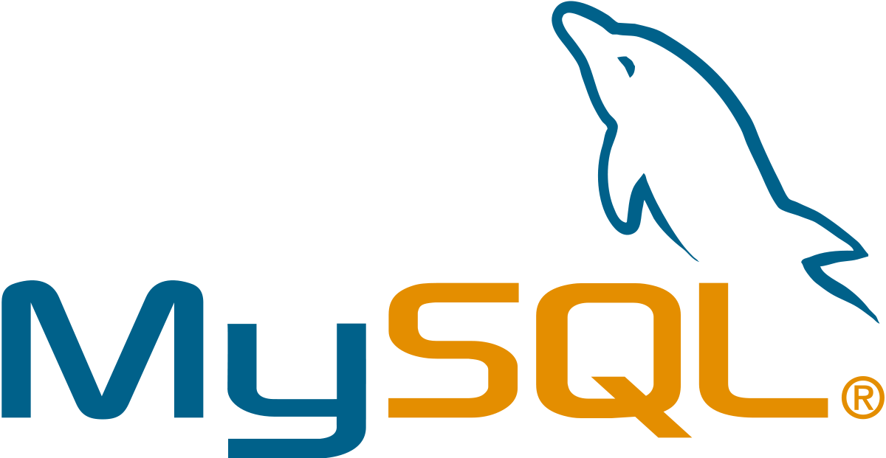
MySQL
MySQL is a relational database management system (RDBMS). It is distributed under a dual GPL and proprietary license. It is one of the most widely used database management software in the world, both by the general public (mainly web applications) and by professionals, in competition with Oracle, PostgreSQL and Microsoft SQL Server.

Slide 2
Features of MySQL
MySQL is a community-driven DBMS system
Compatible with various platforms using all major languages and middleware
It offers support for Multi-version concurrency control
Compliant with the ANSI SQL standard
Allows Log-based and trigger-based replication SSL
Object-oriented and ANSI-SQL2008 compatible
Multi-layered design with Independent modules

Slide 3
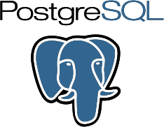
PostgreSQL
PostgreSQL is a relational and object database management system (RDBMS). It is a free tool available under the terms of a BSD-type license.
This system competes with other database management systems, whether free (like MariaDB and Firebird), or proprietary (like Oracle, MySQL, Sybase, DB2, Informix and Microsoft SQL Server). Like the free Apache and Linux projects, PostgreSQL is not controlled by a single company, but is founded on a global community of developers and companies.

Slide 4
Features of PostgreSQL
An active community that is accelerating its development
Most common alternative to Oracle, DB2 and SQL Server
Runs on all major OS platforms that you may have
MVCC supports large numbers of concurrent users
Extensive indexing for high-performance reporting
Support for modern applications (XML and JSON)
Foreign keys support for efficient storage of data

Slide 5
SQL SERVER
Microsoft SQL Server is a database management system (DBMS) in SQL language incorporating, among other things, an RDBMS (relational DBMS ") developed and marketed by the Microsoft company. It works on Windows and Linux OS (since March 2016), but it is possible to launch it on Mac OS via Docker, because there is a download version on the Microsoft website.

Slide 6
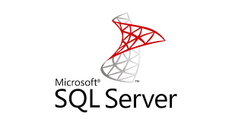
Features of SQL SERVER
Intelligence across all your data with Big Data Clusters
Choice of language and platform
Industry-leading performance
Most secured data platform
Unparalleled high availability
End-to-end mobile BI
SQL Server on Azure

