Slide 1



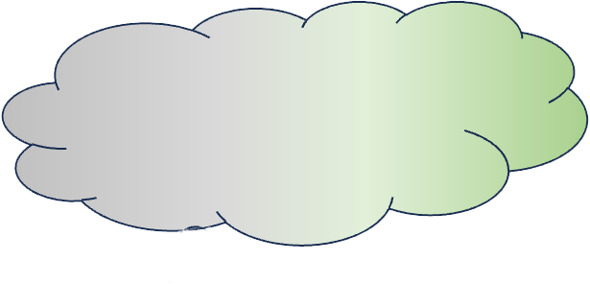


🧑🏻‍💻
What is the capital of France?
It’s London.
🧑🏻‍💻
What is the capital of France?
Unknown
Known
It’s Paris.
My Conf: 50%
· Paris
· London
Vanilla LLM
Uncertainty-Aware Model
LLM using U2Align
Knowledge Boundary

Slide 2






































Known Question 1
CUAlign Dataset
$$𝒟$$
$$𝒬$$
Known Question 1
Certainty Measure $τ$
🎓
Question Set
Few-shot Prompts $𝒫$
Response $y_{1}^{a}$
😀
What’s the capital of the U.S?
What’s the capital of the U.S?
Ques.
Known Question 1
Julie Andrews
Answers
Conf.
Entro.
GT
Known Question 1
Confidence $p_{1}$
Question $x_{1}$
Consistency-based Confidence $c_{1}$
What’s the capital of the U.S?
Examplar $p_{a}$
$$x_{1}$$
$$y_{1}^{a}$$
$$y_{1}^{b}$$
$$y_{1}^{c}$$
$$c_{1}$$
$$e_{1}$$
$${\hat{y}}_{1}$$
What’s the capital of the U.S?
Which actress wrote the novel The Last of the Really Great Whangdoodles?
Known Question 1
Known Question 1
Response $y_{1}^{b}$
$$x_{2}$$
$$y_{2}^{a}$$
$$y_{2}^{b}$$
$$y_{2}^{c}$$
$$c_{2}$$
$$e_{2}$$
$${\hat{y}}_{2}$$
What’s the capital of the U.S?
What’s the capital of the U.S?
Examplar $p_{b}$
Julie Andrews
🤔
Uncertainty Measure $μ$
···
···
···
Vanilla
LLM
Known Question 1
Examplar $p_{c}$
Known Question 1
Response $y_{1}^{c}$
Semantic
Entropy $e_{1}$
$$y_{n}^{a}$$
$$y_{n}^{b}$$
$$y_{n}^{c}$$
$$c_{n}$$
$$e_{n}$$
$${\hat{y}}_{n}$$
What’s the capital of the U.S?
$$x_{n}$$
What’s the capital of the U.S?
Quinn Cummings

Slide 3


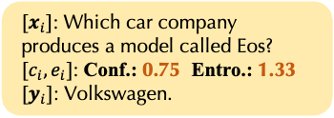




CUAlign Dataset
Stage1: SFT
Vanilla
$$𝒟$$
Sampling
What’s the capital of the U.S?
It’s New York.
($x_{i}$, $y_{i}$, $c_{i}$, $e_{i}$, $z_{i}$)
Vanilla LLM
SFT
${[c}_{i}]$: Conf. 0.75
${[e}_{i}]$: Entro. 1.33
(a)
${[x}_{i}]$: Which car company produces a model called Eos?
SFT
Certainty and Uncertainty Estimation Models
What’s the capital of the U.S?
SFT
Washington D.C
${[x}_{i}]$: Which car company produces a model called Eos? ${[c}_{i},e_{i}]$: Conf.: 0.75 Entro.: 1.33
${[y}_{i}]$: Volkswagen.
SFT
SFT LLM
True
(b)
(a)
Reward Model
SFT + PPO
What’s the capital of China?
It’s Beijing
SFT
True
Which Shakespeare comedy is set in Messina, Italy?
Stage2: PPO
Reward Model
Reference LLM
PPO
Conf. 0.5
Entro. 0.69
Reward Model
What’s the capital of France?
Reference LLM
PPO
Certainty and Uncertainty Estimation Models
Policy LLM
with gradient descent
Policy LLM
Reward Model
(b)
no gradient descent
(c)

Slide 4
Prompt-based
ICL prompts
+
What part of the body does caffeine stimulate?
Central nervous system.
(a) ICL
Vanilla LLM
SFT-based
What part of the body does caffeine stimulate?
Central nervous system.
SFT LLM
(c) Standard SFT
What part of the body does caffeine stimulate?
Central nervous system.
😉 known
Sorry, I don’t know.
What two ways do fruits mainly disperse seeds?
SFT LLM
🤔 unknown
(d) R-Tuning
RL-based
What part of the body does caffeine stimulate?
+
Central nervous system.
True
(e) Reward Model of RLHF
Reward Model
What part of the body does caffeine stimulate?
Internal State
Known
Vanilla LLM
Reward Model
(f) Reward Model of RLKF
What two ways do fruits mainly disperse seeds?
Reference LLM
PPO
Policy LLM
Reward Model
(h) PPO for RL-PPO and RLKF
Peripheral nervous system.
What part of the body does caffeine stimulate?
Central nervous system.
DPO
Policy LLM
(h) RL-DPO
Inference-based
What part of the body does caffeine stimulate?
🛠️
Central nervous system.
SFT LLM
Central
nervous
system
Peripheral
nervous
system
Central
nervous
system
Peripheral
nervous
system
(h) Inference Intervention

Slide 5

Confidence & Uncertainty Estimation Methods on LLMs
Disadvantages
Requires normalization due to variable sequence length;
Requires access to token-level probabilities, inapplicable to black-box LLMs;
Fails to capture semantic meaning over token-level probabilities.
Input: What's the capital of France?
Output
It
is
Paris
Norm(·)
Conf.
LLM
Prob.
0.8
0.9
0.6
0.75
① Likelihood-based method.
Prompt: Is your answer True?
True
Conf.
Relies on prompting strategies to elicit confidence estimation, varying in different methods (Is True probability, numerical confidence, and word expressions, etc.);
Cannot improve LLM’s intrinsic confidence estimation ability.
Prone to be over-confident.
Input: What's the capital of France?
Output: It is Paris
0.9
0.9
LLM
0.85
Conf.
0.85
Prompt: Your confidence is
② Prompting-based method.
Output: It is Paris
✅
Requires additional inference time cost;
Varying in different aggregation methods;
Cannot improve LLM’s intrinsic confidence estimation ability.
Input: What's the capital of France?
Output: It is Berlin
Agg(·)
Conf.
LLM
❌
0.66
Output: Paris.
✅
③ Sampling-based method.
Input: What's the capital of France?
Output: It is Paris
Evaluator
Conf.
Requires training an additional evaluator;
Difficult to learn LLM’s intrinsic confidence estimation on unseen domains.
LLM
0.72
④ Training-based method.
Training

Slide 6


Which country has the fourth largest land area in the world?
Perceived Knowledge Boundary
Uncertainty Measures
(a)
Question
Response
🧑🏻‍💻
· The U.S.
· It’s U.S.
· China.
· It’s Brazil.
· Canada.
I’m not sure.
Certainty and Uncertainty
Models
Conf. 40%
Policy LLM
Which country has the fourth largest land area in the world?
(b)
· The U.S.
· It’s U.S.
· China.
· It’s Brazil.
· Canada.
Conf. 40%
Entro. 1.33
It’s the U.S.
🧑🏻‍💻
Certainty and Uncertainty
Models
Policy LLM
Which Asian country hosted the 2018 Winter Olympics?
$$SE=−(0.4×\log{0.4}+3×0.2×\log{0.2})$$
$=1.33$
(c)
· It’s Korea.
· China.
· It’s Japan.
· Canada.
· India.
Conf. 20%
Entro. 1.6
I’m not sure.
👩‍💻
Certainty and Uncertainty
Models
Policy LLM
$$SE=−(5×0.2×\log{0.2})$$
$=1.6$
Which country has the fourth largest land area in the world?
Perceived Knowledge Boundary
Uncertainty Measures
(a)
Question
Response
🧑🏻‍💻
· The U.S.
· It’s U.S.
· China.
· It’s Brazil.
· Canada.
I’m not sure.
Certainty and Uncertainty
Models
Conf. 40%
Policy LLM
Which country has the fourth largest land area in the world?
(b)
· The U.S.
· It’s U.S.
· China.
· It’s Brazil.
· Canada.
Conf. 40%
Entro. 1.33
It’s the U.S.
🧑🏻‍💻
Certainty and Uncertainty
Models
Policy LLM
$$SE=−(0.4×\log{0.4}+3×0.2×\log{0.2})$$
$=1.33$

Slide 7
Which country has the fourth largest land area in the world?
Perceived Knowledge Boundary
Uncertainty Measures
(a)
Question
Response
🧑🏻‍💻
0.4
0.3
0.3
I’m not sure.
Uncertainty-Aware
Model
Conf. 40%
Policy LLM
Which country has the fourth largest land area in the world?
U.S
China
Russia
Knowledge Spectrum
(b)
0.4
0.3
0.3
Conf. 40%
SE 1.33
It’s the U.S.
🧑🏻‍💻
Uncertainty-Aware
Model
Policy LLM
(c)
Which Asian country hosted the 2018 Winter Olympics?
U.S
China
Russia
$$SE=−(0.4×\log{0.4}+3×0.2×\log{0.2})$$
$=1.33$
0.33
0.33
0.33
Conf. 20%
SE 1.6
I’m not sure.
👩‍💻
Uncertainty-Aware
Model
Policy LLM
Korea
China
Japan
$$SE=−(5×0.2×\log{0.2})$$
$=1.6$

Slide 8
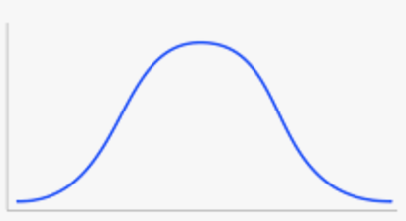
What was the pseudonym of author John Griffith Chaney?
🧑🏻‍💻
What was the pseudonym of author John Griffith Chaney?
Jules Verne.
Spectrum of Knowledge Distribution
(a)
Highly Known
Weakly Known
Unknown
🧑🏻‍💻
Conf. 0.2
Entro. 1.6
Jack London.
Vanilla LLM
Certainty and Uncertainty Estimation Models
(b)
LLM using CUAlign

Slide 9


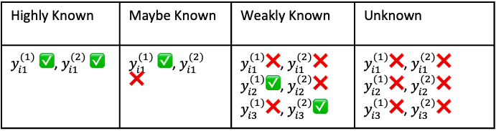



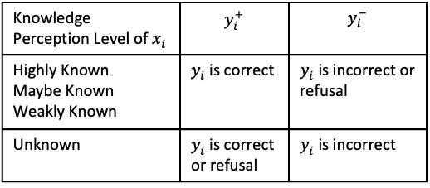


Knowledge Perception Level Illustration
Evaluation Illustration
Greedy Search ➡️
$$y_{i1}^{(1)}$$
$$x_{i}$$
Few-shot 1
LLM
Temperature 🔀
$$y_{i2}^{(1)},y_{i3}^{(1)}$$
$$x_{i}$$
Few-shot 3
Greedy Search ➡️
$$y_{i}^{ }$$
Few-shot 2
$$y_{i1}^{(2)}$$
🎲
Sample
LLM
Greedy Search ➡️
Few-shot 3, 4, 5, …
LLM
Temperature 🔀
$$y_{i2}^{(2)},y_{i3}^{(2)}$$
Highly Known | Maybe Known | Weakly Known | Unknown
$y_{i1}^{(1)}$ ✅, $y_{i1}^{(2)}$ ✅ | $y_{i1}^{(1)}$ ✅, $y_{i1}^{(2)}$ ❌ | $y_{i1}^{(1)}$❌, $y_{i1}^{(2)}$❌ $y_{i2}^{(1)}\text{✅}$, $y_{i2}^{(2)}$❌ $y_{i3}^{(1)}$❌, $y_{i3}^{(2)}\text{✅}$ | $y_{i1}^{(1)}$❌, $y_{i1}^{(2)}$❌ $y_{i2}^{(1)}\text{❌}$, $y_{i2}^{(2)}$❌ $y_{i3}^{(1)}$❌, $y_{i3}^{(2)}\text{❌}$
Knowledge Perception Level of $x_{i}$ | $$y_{i}^{+}$$ | $$y_{i}^{−}$$
Highly Known Maybe Known Weakly Known | $y_{i}^{ }$ is correct | $y_{i}^{ }$ is incorrect or refusal
Unknown | $y_{i}^{ }$ is correct or refusal | $y_{i}^{ }$ is incorrect

Slide 10





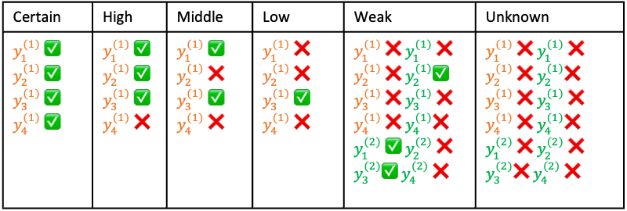
Difficulty Level Illustration
$$x_{ }$$
4 Few-shot Examples
Greedy Search ➡️
$$y_{1}^{(1)},y_{2}^{(1)},y_{3}^{(1)},y_{4}^{(1)}$$
LLM
Temperature 🔀
$$y_{1}^{(1)},y_{2}^{(1)},y_{3}^{(1)},y_{4}^{(1)}$$
$$y_{1}^{(2)},y_{2}^{(2)},y_{3}^{(2)},y_{4}^{(2)}$$
Certain | High | Middle | Low | Weak | Unknown
$y_{1}^{(1)}$ ✅ $y_{2}^{(1)}$ ✅ $y_{3}^{(1)}$ ✅ $y_{4}^{(1)}$ ✅ | $y_{1}^{(1)}$ ✅ $y_{2}^{(1)}$ ✅ $y_{3}^{(1)}$ ✅ $y_{4}^{(1)}$ ❌ | $y_{1}^{(1)}$ ✅ $y_{2}^{(1)}$ ❌ $y_{3}^{(1)}$ ✅ $y_{4}^{(1)}$ ❌ | $y_{1}^{(1)}$ ❌ $y_{2}^{(1)}$ ❌ $y_{3}^{(1)}$ ✅ $y_{4}^{(1)}$ ❌ | $y_{1}^{(1)}$ ❌ $y_{1}^{(1)}$ ❌ $y_{2}^{(1)}$ ❌ $y_{2}^{(1)}$✅ $y_{3}^{(1)}$ ❌ $y_{3}^{(1)}$ ❌ $y_{4}^{(1)}$ ❌ $y_{4}^{(1)}$❌ $y_{1}^{(2)}$ ✅ $y_{2}^{(2)}$ ❌ $y_{3}^{(2)}$✅ $y_{4}^{(2)}$ ❌ | $y_{1}^{(1)}$ ❌ $y_{1}^{(1)}$ ❌ $y_{2}^{(1)}$ ❌ $y_{2}^{(1)}$❌ $y_{3}^{(1)}$ ❌ $y_{3}^{(1)}$ ❌ $y_{4}^{(1)}$ ❌ $y_{4}^{(1)}$❌ $y_{1}^{(2)}$ ❌ $y_{2}^{(2)}$ ❌ $y_{3}^{(2)}$❌ $y_{4}^{(2)}$ ❌

Slide 11
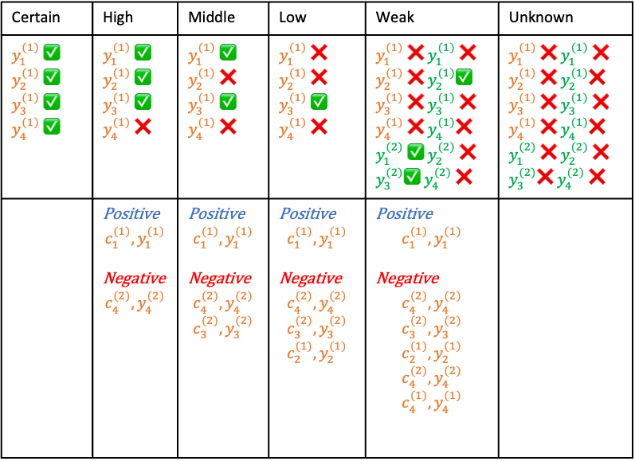
Certain | High | Middle | Low | Weak | Unknown
$y_{1}^{(1)}$ ✅ $y_{2}^{(1)}$ ✅ $y_{3}^{(1)}$ ✅ $y_{4}^{(1)}$ ✅ | $y_{1}^{(1)}$ ✅ $y_{2}^{(1)}$ ✅ $y_{3}^{(1)}$ ✅ $y_{4}^{(1)}$ ❌ | $y_{1}^{(1)}$ ✅ $y_{2}^{(1)}$ ❌ $y_{3}^{(1)}$ ✅ $y_{4}^{(1)}$ ❌ | $y_{1}^{(1)}$ ❌ $y_{2}^{(1)}$ ❌ $y_{3}^{(1)}$ ✅ $y_{4}^{(1)}$ ❌ | $y_{1}^{(1)}$ ❌ $y_{1}^{(1)}$ ❌ $y_{2}^{(1)}$ ❌ $y_{2}^{(1)}$✅ $y_{3}^{(1)}$ ❌ $y_{3}^{(1)}$ ❌ $y_{4}^{(1)}$ ❌ $y_{4}^{(1)}$❌ $y_{1}^{(2)}$ ✅ $y_{2}^{(2)}$ ❌ $y_{3}^{(2)}$✅ $y_{4}^{(2)}$ ❌ | $y_{1}^{(1)}$ ❌ $y_{1}^{(1)}$ ❌ $y_{2}^{(1)}$ ❌ $y_{2}^{(1)}$❌ $y_{3}^{(1)}$ ❌ $y_{3}^{(1)}$ ❌ $y_{4}^{(1)}$ ❌ $y_{4}^{(1)}$❌ $y_{1}^{(2)}$ ❌ $y_{2}^{(2)}$ ❌ $y_{3}^{(2)}$❌ $y_{4}^{(2)}$ ❌
 | Positive $$c_{1}^{(1)},y_{1}^{(1)}$$ Negative $$c_{4}^{(2)},y_{4}^{(2)}$$ | Positive $$c_{1}^{(1)},y_{1}^{(1)}$$ Negative $$c_{4}^{(2)},y_{4}^{(2)}$$ $$c_{3}^{(2)},y_{3}^{(2)}$$ | Positive $$c_{1}^{(1)},y_{1}^{(1)}$$ Negative $$c_{4}^{(2)},y_{4}^{(2)}$$ $$c_{3}^{(2)},y_{3}^{(2)}$$ $$c_{2}^{(1)},y_{2}^{(1)}$$ | Positive $$c_{1}^{(1)},y_{1}^{(1)}$$ Negative $$c_{4}^{(2)},y_{4}^{(2)}$$ $$c_{3}^{(2)},y_{3}^{(2)}$$ $$c_{2}^{(1)},y_{2}^{(1)}$$ $$c_{4}^{(2)},y_{4}^{(2)}$$ $$c_{4}^{(1)},y_{4}^{(1)}$$
Difficulty Level
Preference Data

Slide 12
Training Set Split
Iterative Post-training
①
②
①
③
②
③
Difficulty-aware SFT
Difficulty-aware SFT ReST
Enhanced-Difficulty-Aware SFT ReST
Difficulty-aware DPO
Difficulty-aware DPO ReST
Enhanced-Difficulty-Aware DPO ReST

Slide 13






Original Dataset
Easy
Middle
Hard
Standard
×1
×1
×1
×1
Sampling
×1
×1
Fine-tuning
×1
Difficulty-aware
×1
×1.5
×2
Sampling
×1.5
×2
Fine-tuning
×1
Difficulty-aware ReST
Step 1
×1
×1.5
×2
Sampling
×1.5
×2
Fine-tuning
×1
Step 2
×1
×1.5
×2
Sampling
×1.5
×2
Fine-tuning
×1
Step 3
×1
×1.5
×2
Sampling
×1.5
×2
Fine-tuning
×1
Enhanced-Difficulty-Aware ReST
Step 1
×1
×1.5
×2
Sampling
×1.5
×2
Fine-tuning
×1
Step 2
×1
×2
×3
Sampling
×2
×3
Fine-tuning
×1
Step 3
×1
×2.5
×4
Sampling
×2.5
×4
Fine-tuning

Slide 14
=
70%
Original Dataset
Easy
Middle
Hard
20%
10%
70%
Rejection-Sampling ReST
Step 1
70%
70%
10%
2%
20%
10%
Sampling
10%
2%
Fine-tuning
70%
Step 2
70%
70%
12%
5%
20%
10%
Sampling
12%
5%
Fine-tuning
70%
Difficulty-Aware ReST
Step 1
70%
70%
30%
20%
20%
10%
Sampling
30%
20%
Fine-tuning
70%
Step 2
70%
70%
30%
20%
20%
10%
Sampling
30%
20%
Fine-tuning

Slide 15
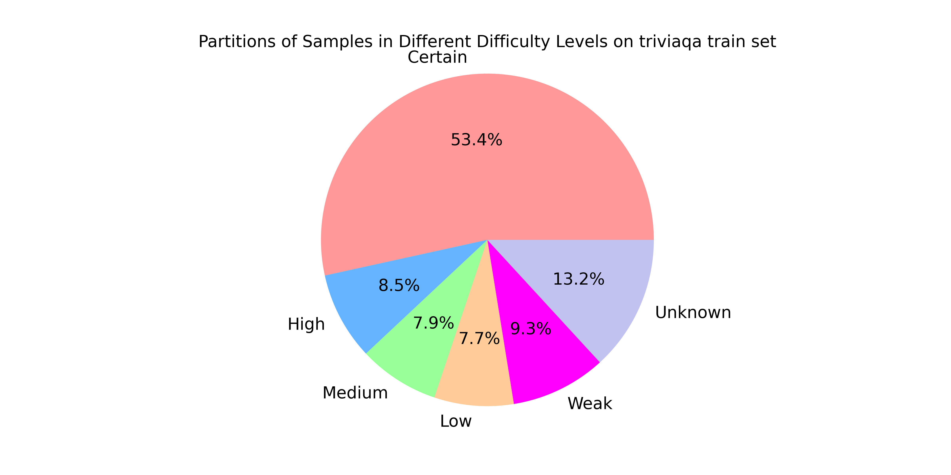
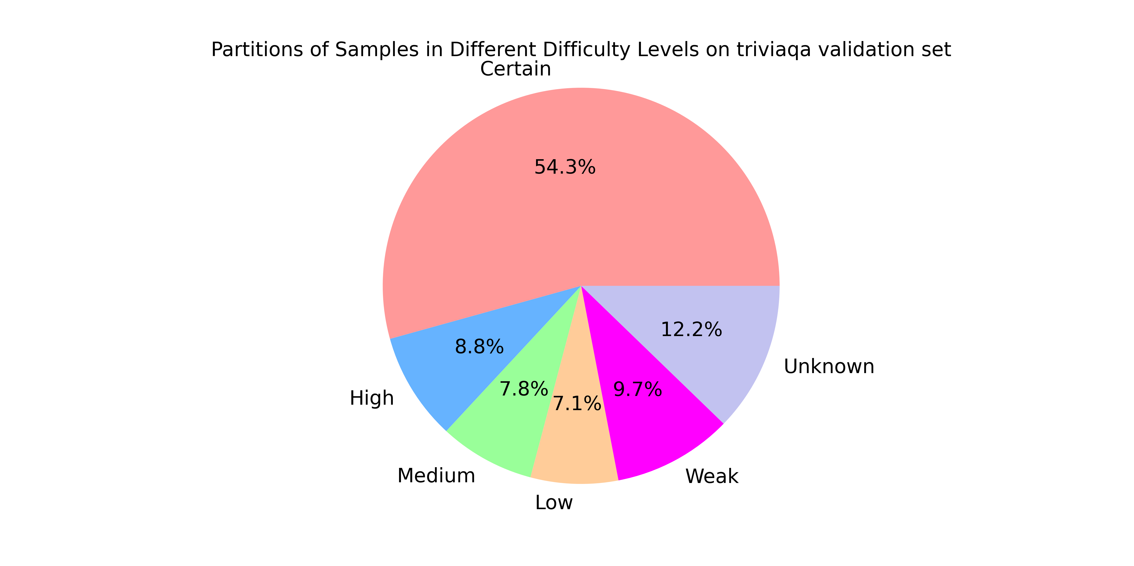
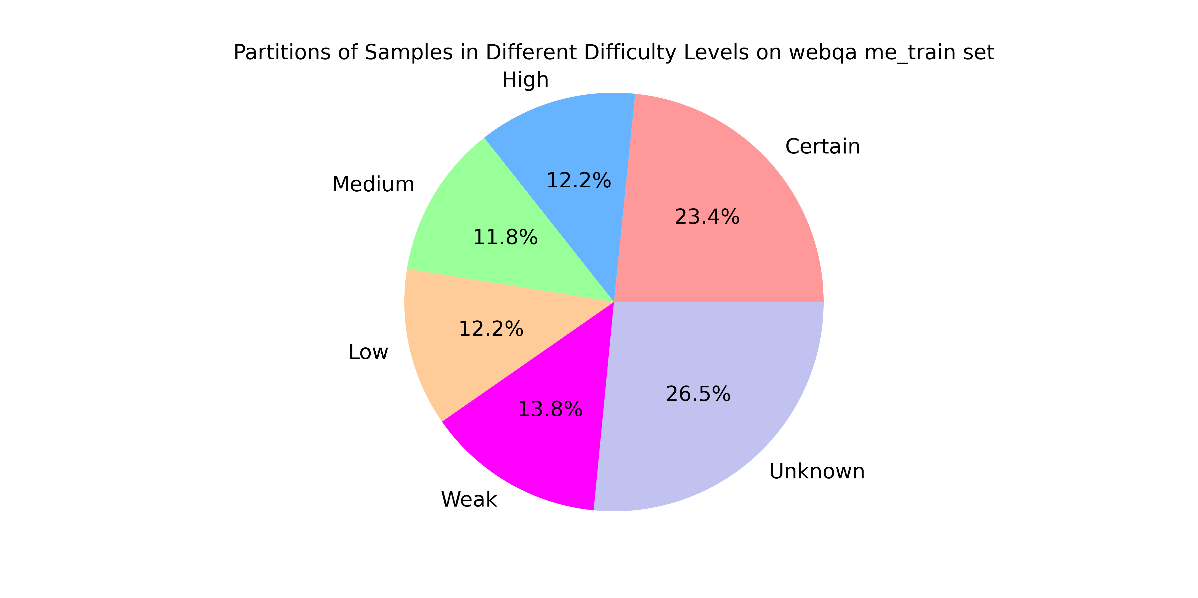
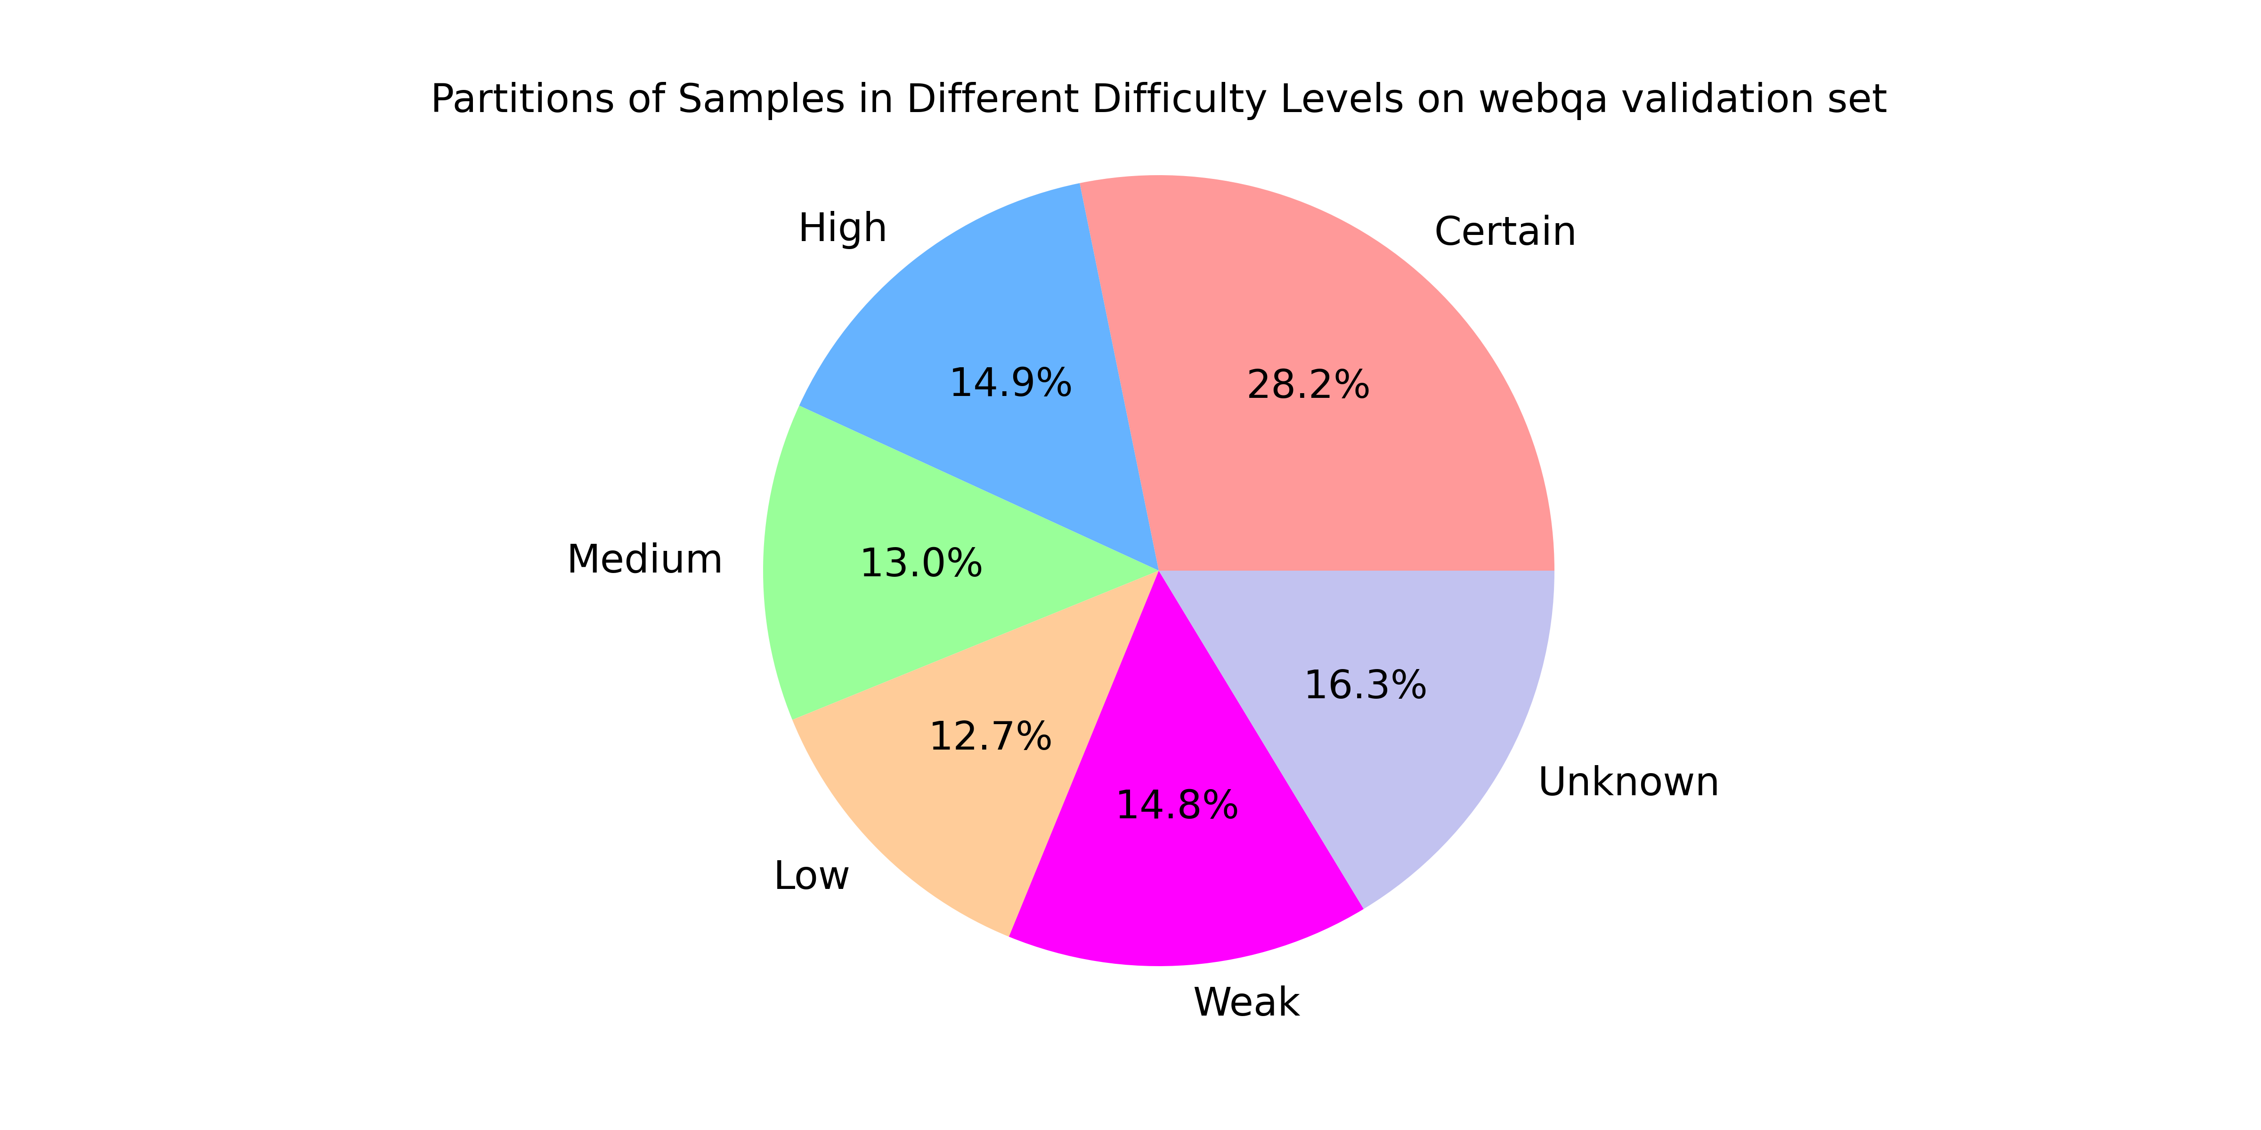
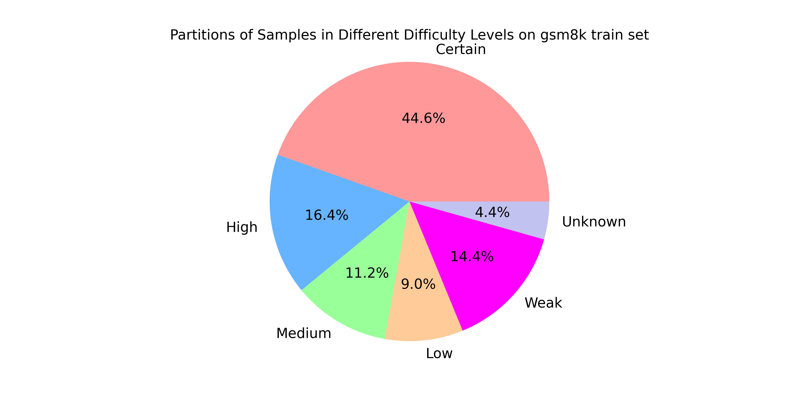
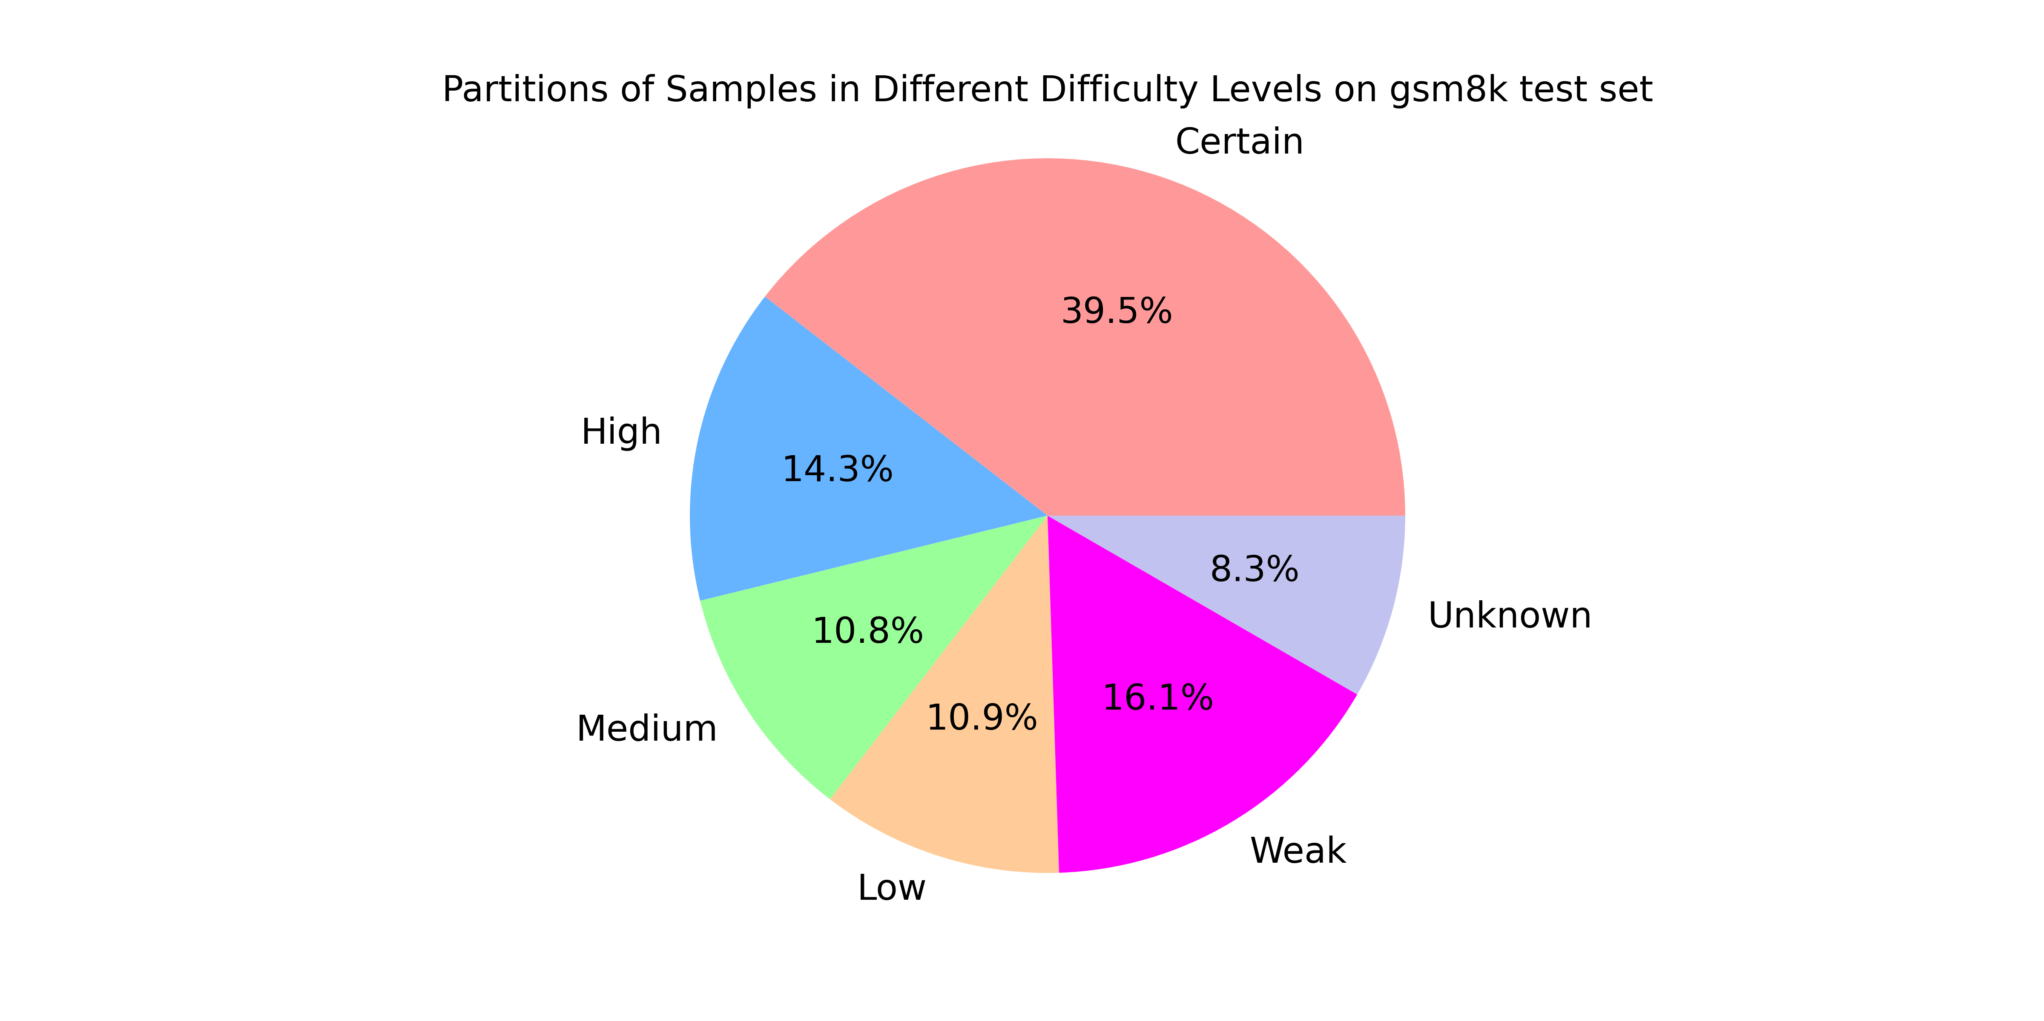
LLaMA-3 TriviaQA Training Num = 21235
LLaMA-3 TriviaQA Training Num = 1992
Qwen-2 WebQA Training Num = 19135
Qwen-2 WebQA Training Num = 2014
LLaMA-3 GSM8K Training Num = 7473
LLaMA-3 GSM8K Test Num = 1319

Slide 16

LLM
Data Difficulty Spectrum
Vanilla
Easy
Middle
Hard
Unknown
Easy
Middle
Hard
Unknown
Improved
Knowledge Spectrum
Highly Known
Weakly Known
Unknown

