Slide 1
What is a Algorithm?
??
An algorithm is a finite set of unambiguous instructions for solving a problem.
  An algorithm is correct if on all legitimate inputs, it outputs the right answer in a finite amount of time
Can be expressed as
  pseudocode
  flow charts
  text in a natural language (e.g. English)
  computer code

Slide 2
Algorithm Design
The theoretical study of how to solve computational problems
sorting a list of numbers
finding a shortest route on a map
scheduling when to work on homework
answering web search queries
and so on...

Slide 3
The Importance of Algorithms
Their impact is broad and far-reaching.
  Internet. Web search, packet routing, distributed file sharing, ...
  Biology. Human genome project, protein folding, ...
  Computers. Circuit layout, file system, compilers, ...
  Computer graphics. Movies, video games, virtual reality, ...
  Security. Cell phones, e-commerce, voting machines, ...
  Multimedia. MP3, JPG, DivX, HDTV, face recognition, ...
  Social networks. Recommendations, news feeds, advertisements, ...
  Physics. N-body simulation, particle collision simulation, ...

Slide 4
The Top 10 Algorithms of the 20th Century
Ten algorithms having "the greatest influence on the development and practice of science and engineering in the 20th century".
  Dongarra and Sullivan
  Top Ten Algorithms of the Century
  Computing in Science and Engineering
  January/February 2000
  Barry Cipra
  The Best of the 20th Century: Editors Name Top 10 Algorithms
  SIAM News
  Volume 33, Number 4, May 2000
    http://www.siam.org/pdf/news/637.pdf

Slide 5
What are the Top 10?
1946: The Metropolis (Monte Carlo) Algorithm.
Uses random processes to find answers to problems that are too complicated to solve exactly.
1947: Simplex Method for Linear Programming.
A fast technique for maximizing or minimizing a linear function of several variables, applicable to planning and decision-making.
1950: Krylov Subspace Iteration Method.
A technique for rapidly solving the linear equations that are common in scientific computation.

Slide 6
1951: The Decompositional Approach to Matrix Computations. A collection of techniques for numerical linear algebra.
1957: The Fortran Optimizing Compiler.
1959: QR Algorithm for Computing Eigenvalues.
A crucial matrix operation made swift and practical. Application areas include computer vision, vibration analysis, data analysis.
1962: Quicksort Algorithm.
We will look at this.

Slide 7
1965: Fast Fourier Transform (FFT). It breaks down waveforms (like sound) into periodic components. Used in many different areas (e.g. digital signal processing , solving partial differential equations, fast multiplication of large integers.)
1977: Integer Relation Detection. A fast method for finding simple equations that explain collections of data.
1987: Fast Multipole Method. Deals with the complexity of n-body calculations. It is applied in problems ranging from celestial mechanics to protein folding.

Slide 8
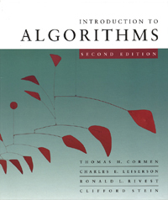
Books
Introduction to Algorithms
Thomas Cormen, Charles Leiserson, Ronald Rivest, Clifford Stein
McGraw Hill, 2003, 2nd edition
  mathematical, advanced, the standard text
  now up to version 3 (MIT)
  lots of resources online;
  see video section
continued

Slide 9
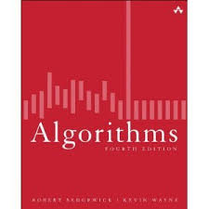
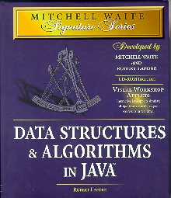
Algorithms
Robert Sedgewick, Kevin Wayne
Addison-Wesley, 2011, 4th ed.
  implementation (Java) and theory
  intermediate level
Data Structures and Algorithms in Java
Robert Lafore
Sams Publishing, 2002, 2nd ed.
  Java examples; old
  basic level; not much analysis

Slide 10
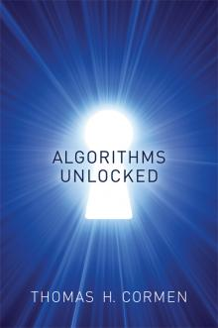
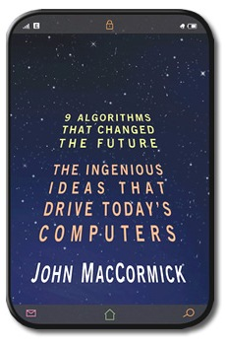
Fun Overviews
Algorithms Unlocked
Thomas H. Cormen
MIT Press, March 2013
Nine Algorithms that Changed the Future
John MacCormick
Princeton University Press, 2011
  http://users.dickinson.edu/~jmac/9algorithms/
    search engine indexing, pagerank, public key cryptography, error-correcting codes, pattern recognition, data compression, databases, digital signatures, computablity

Slide 11
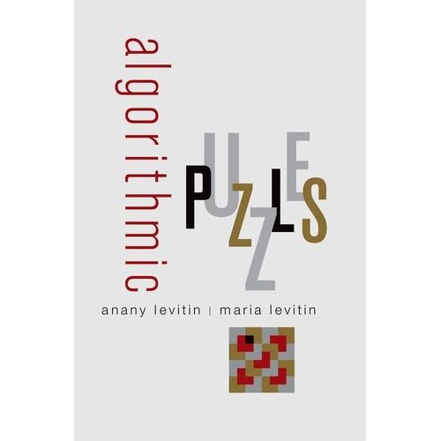
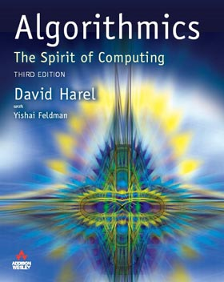
Algorithmic Puzzles
Anany Levitin, Maria Levitin
Oxford University Press, , 2011
Algorithmics: The Spirit of Computing
David Harel, Yishai Feldman
Addison-Wesley; 3 ed., 2004
(and Springer, 2012)
  http://www.wisdom.weizmann.ac.il/~harel/algorithmics.html

Slide 12
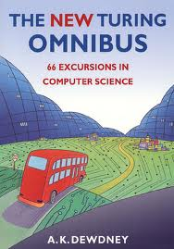
The New Turing Omnibus: Sixty-Six
Excursions in Computer Science
A. K. Dewdney
Holt, 1993
  66 short article; e.g. detecting primes, noncomputable functions, self-replicating computers, fractals, genetic algorithms, Newton-Raphson Method, viruses

