Slide 1
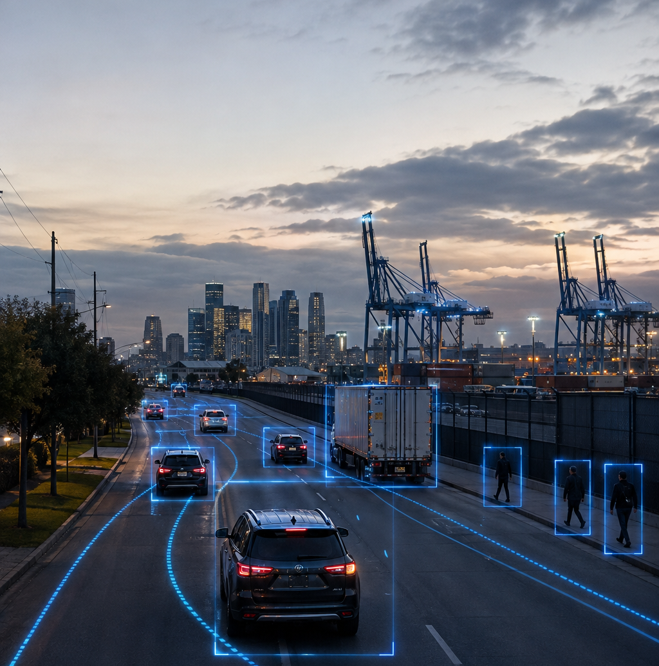
APPLIED AI & ROBOTICS
Applied AI Portfolio
Ebunola Amoye
Computer vision • intelligent automation • field systems
github.com/Amoyeola/Peter-Amoye-AI-Portfolio
1
Notes:
Introduce the portfolio as evidence of practical AI skills connected to real operating environments.
The GitHub repository link is displayed on the opening slide.
[Sources] Hero visual: original AI-generated image created for this portfolio; no external source.

Slide 2
My experience connects AI models with real operating systems
Practical focus
I combine applied AI training with electrical, telecommunications, field-service, and technical-operations experience.
My goal is to build reliable systems that support transportation, infrastructure, safety, and automation.
VISION
YOLO • OpenCV • tracking
MODELS
PyTorch • CLIP • BLIP
TOOLS
Python • Colab • GitHub
DOMAIN
Traffic • ports • field systems
2
Notes:
Explain that the portfolio is not only a list of software tools; it connects AI with prior field and infrastructure experience.
[Sources] Skills are based on the student's completed coursework and professional background.

Slide 3
Tracker comparison turns raw IDs into an engineering finding
YOLO VIDEO OBJECT TRACKING
I ran ByteTrack and BoT-SORT on the same ten-second video, counted people manually, and investigated short tracks and identity switches. BoT-SORT came closest to the observed count.
73
74
79
Manual count
BoT-SORT IDs
ByteTrack IDs
3
Notes:
Emphasize that 74 is close to the manual count of 73, while 79 suggests more track fragmentation or reassignment.
One likely switch occurred around frames 81–83, when ID 19 disappeared and ID 135 appeared nearby.
[Sources] Student's executed ITAI 1378 Lab 10 notebook and manual video review.

Slide 4
Three projects demonstrate breadth across modern computer vision
Featured work
Each repository folder includes the executed notebook, a clear README, dataset guidance, key findings, and representative results.
The work progresses from visual understanding to temporal tracking and decision-oriented analytics.
01
SmartFlow Traffic Agent
02
YOLO Video Tracking
03
CLIP & BLIP VLMs
VALUE
Documented • reproducible • applied
4
Notes:
Traffic Monitoring Agent is the capstone and primary showcase.
YOLO tracking demonstrates evidence-based comparison; the VLM project demonstrates multimodal AI.
[Sources] Student's ITAI 1378 portfolio project documentation.

Slide 5
NEXT STEP
Explore the work
Open my GitHub portfolio
View my LinkedIn profile
amoyeola@gmail.com
Notes:
Invite the reviewer to open the public GitHub repository and inspect the executed notebooks and project documentation.
The GitHub, LinkedIn, and email links are included for follow-up.
[Sources] Contact details to be supplied by the student.

