Slide 1
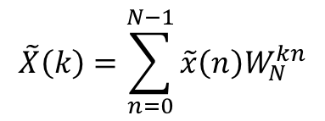
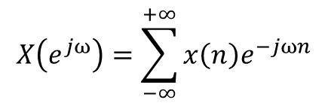
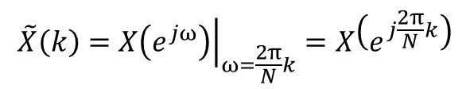
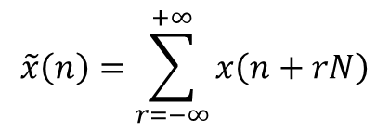
$$X\left(e^{jω}\right)=\sum_{−∞}^{+∞}{x\left(n\right)e^{−jωn}}$$
序列
DTFT
$$\tilde{x}\left(n\right)=\sum_{r=−∞}^{+∞}{x\left(n+rN\right)}$$
$$\tilde{X}\left(k\right)={\left.X\left(e^{jω}\right)\right|}_{ω=\frac{2π}{N}k}=X\left(e^{j\frac{2π}{N}k}\right)$$
$$\tilde{X}\left(k\right)=\sum_{n=0}^{N−1}{\tilde{x}\left(n\right)W_{N}^{kn}}$$
周期序列
DFS

Slide 2












$$Im\left[z\right]$$
$$X\left(k\right)$$
$$e^{j2\frac{2π}{N}}$$
$$e^{j\frac{2π}{N}}$$
$[0,2π)$上
等间隔采样
$单位圆$上
等间隔采样
单位圆$e^{jω}$
$$Re\left[z\right]$$
$$x\left(t\right)$$
DTFT
z变换
$$e^{j\left(N−1\right)\frac{2π}{N}}$$
$$X\left(e^{jω}\right)$$
z平面的单位圆
$$X\left(z\right)$$

Slide 3









$$h\left(n\right)$$
$$x\left(n\right)$$
$$1 2 0 1$$
$$2 2 1 1$$
$$6$$
$$7$$
$$6$$
$$5$$
$$x\left[\left(0−n\right) mod 4\right]$$
$$x\left[\left(1−n\right) mod 4\right]$$
$$x\left[\left(2−n\right) mod 4\right]$$
$$x\left[\left(3−n\right) mod 4\right]$$

Slide 4




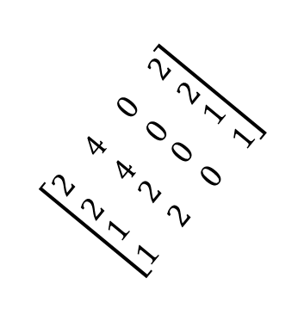
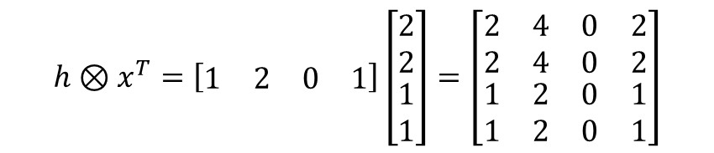

$$h=\left[\begin{matrix}\begin{matrix}1 & 2\end{matrix} & \begin{matrix}0 & 1\end{matrix}\end{matrix}\right]$$
$$h⊗x^{T}=\left[\begin{matrix}\begin{matrix}1 & 2\end{matrix} & \begin{matrix}0 & 1\end{matrix}\end{matrix}\right]\left[\begin{matrix}\begin{matrix}2 \\ 2\end{matrix} \\ \begin{matrix}1 \\ 1\end{matrix}\end{matrix}\right]=\left[\begin{matrix}\begin{matrix}2 & 4 \\ 2 & 4\end{matrix} & \begin{matrix}0 & 2 \\ 0 & 2\end{matrix} \\ \begin{matrix}1 & 2 \\ 1 & 2\end{matrix} & \begin{matrix}0 & 1 \\ 0 & 1\end{matrix}\end{matrix}\right]$$
$$x=\left[\begin{matrix}\begin{matrix}2 & 2\end{matrix} & \begin{matrix}1 & 1\end{matrix}\end{matrix}\right]$$
$$\left(h∗x\right)=\left[2 6 5 5 4 1 1\right]$$
$$\left[\begin{matrix}\begin{matrix}2 & 4 \\ 2 & 4\end{matrix} & \begin{matrix}0 & 2 \\ 0 & 2\end{matrix} \\ \begin{matrix}1 & 2 \\ 1 & 2\end{matrix} & \begin{matrix}0 & 1 \\ 0 & 1\end{matrix}\end{matrix}\right]$$
$$\left[\begin{matrix}\begin{matrix}2 & 6 \\ 4 & 1\end{matrix} & \begin{matrix}5 & 5 \\ 1 & \end{matrix}\end{matrix}\right]$$
$$\left(h Ⓝ x\right)=\left[\begin{matrix}\begin{matrix}6 & 7\end{matrix} & \begin{matrix}6 & 5\end{matrix}\end{matrix}\right]$$
$$\left(h∗x\right)=\left[2 6 5 5 4 1 1\right]$$

