Slide 1
ZKLang – Implementation and Standardization
Jan Camenisch¹, Manu Drijvers¹, Maria Dubovitskaya ¹,
Nathan George², Lovesh Harchandani², Jason Law²
¹ IBM Research – Zurich
² Evernym

Slide 2
W3C Verifiable Claims (VC)
An effort for standardizing protocols and languages for authentication and identity management
Supports different levels of privacy preservation
A holder collects credentials from different issuers
A verifiable credential reveals multiple claims about the holder to service providers
A claim can reveal different attributes (e.g., email address) or just facts (e.g., Older18) about the holder
Revocation and Inspection are supported

Slide 3
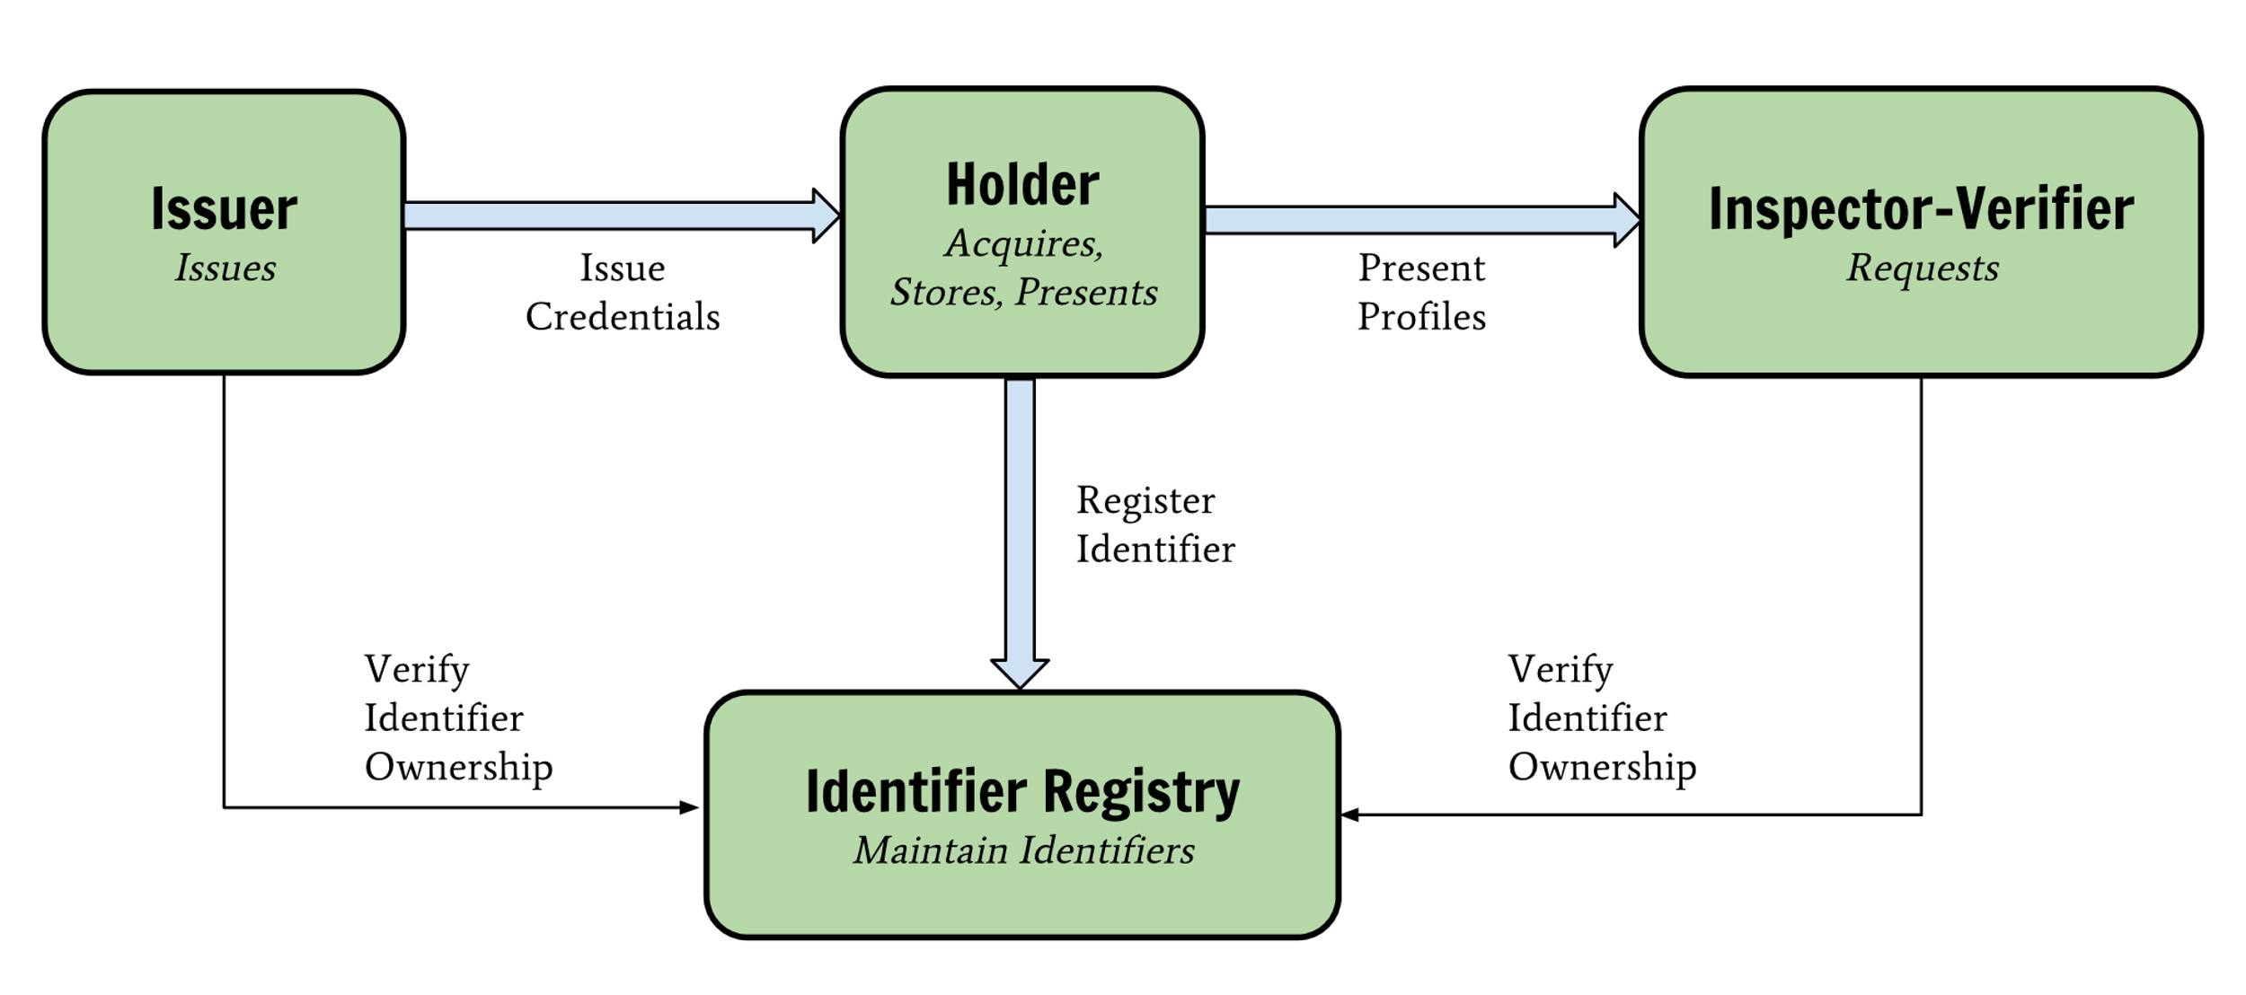
W3C Verifiable Claims: Entities

Slide 4
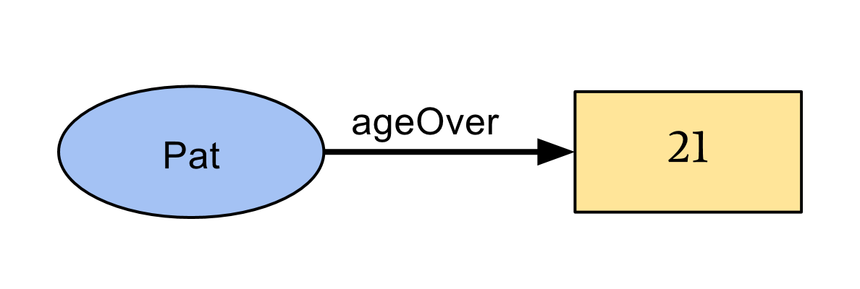
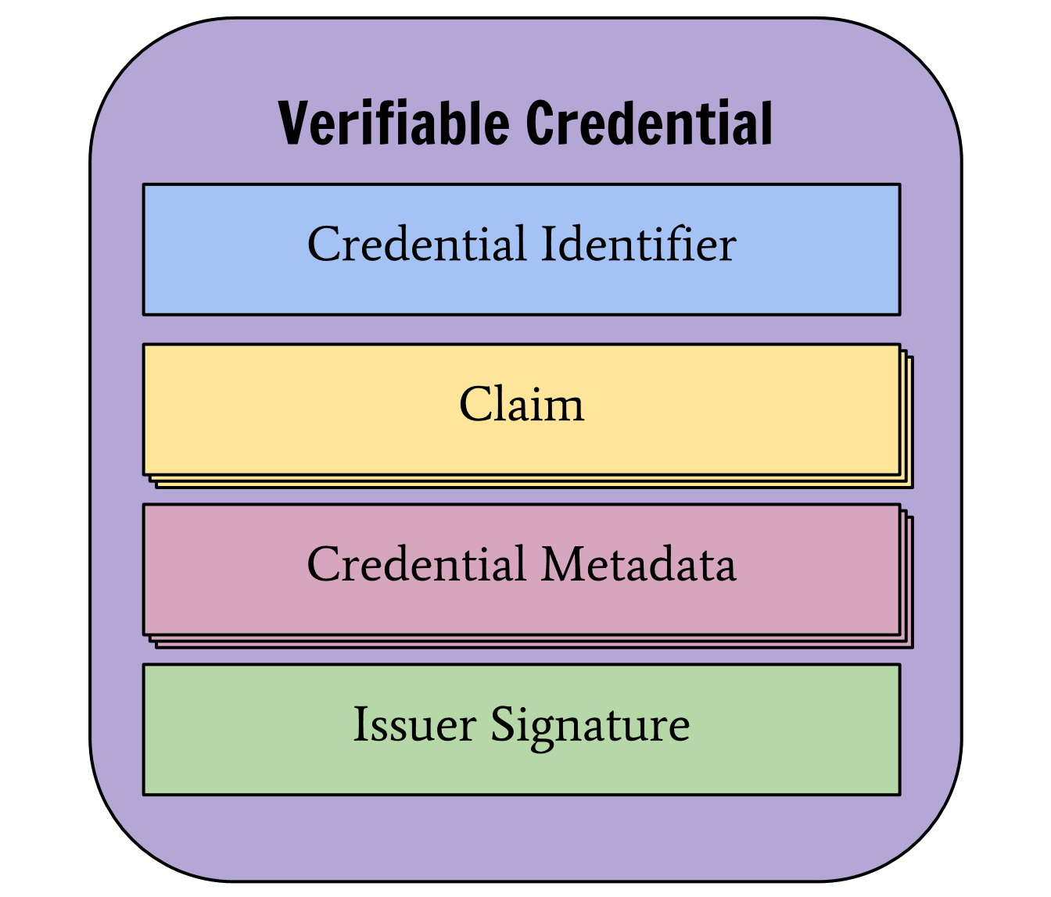
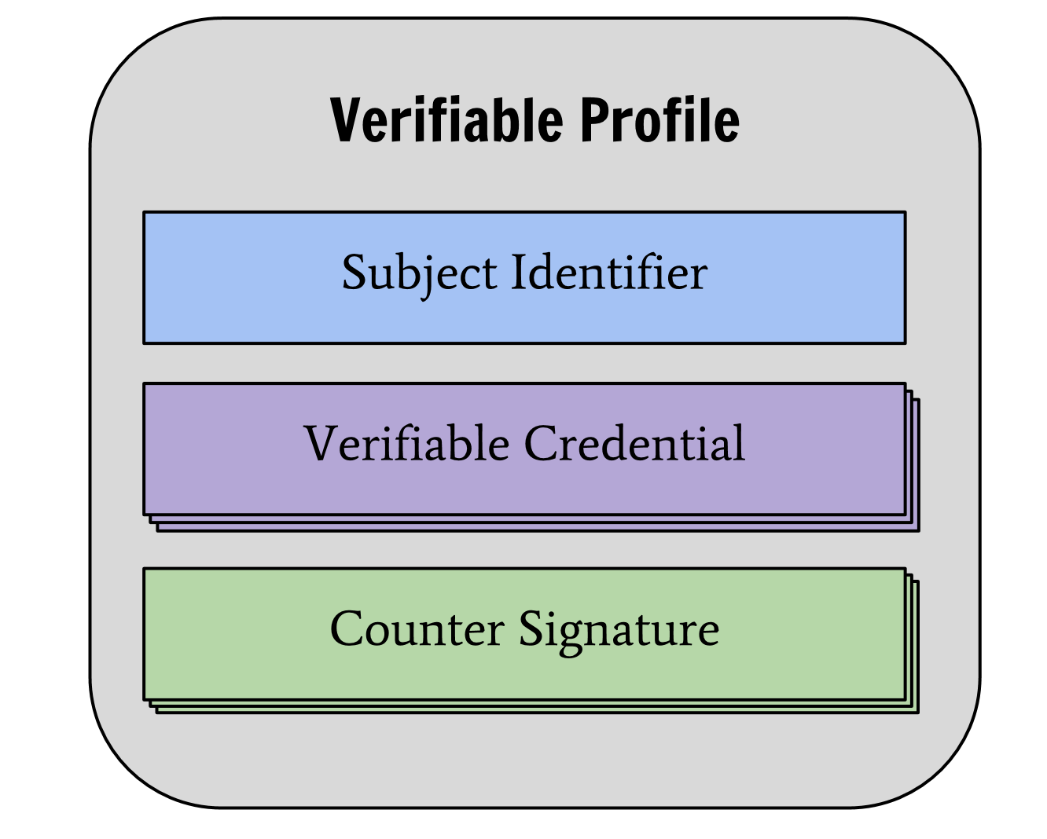
W3C Verifiable Claims: Data Model
Claim
Verifiable Credential
Verifiable Profile

Slide 5
Cryptographic Protocols to Realize VC
We can use advanced crypto to get privacy-friendly VC
Issuer signs subject’s attributes using special type of signature (CL signature)
Non-Interactive Zero-Knowledge Proofs (NIZK) to generate verifiable credentials/profiles
Verifiable Encryption to conditionally reveal attributes only to certain entities (revocation/auditability)

Slide 6
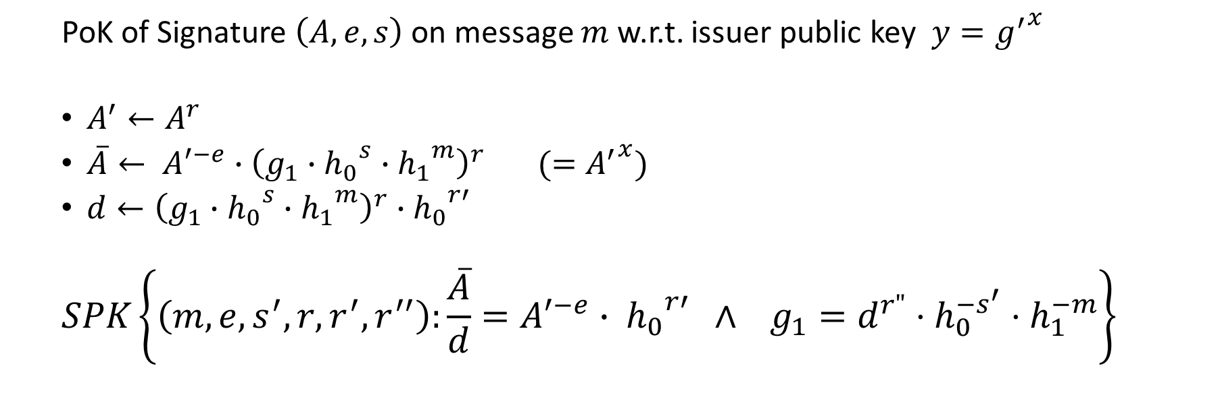
Example: Proving Knowledge of BBS+ Signature
PoK of Signature $\left(A, e, s\right)$ on message $m$ w.r.t. issuer public key ${{y=g}^{′}}^{x}$
$A^{′}←A^{r}$
$\overline{A}← {A′}^{−e}∙{\left(g_{1}∙{h_{0}}^{s}∙{h_{1}}^{m}\right)}^{r} (={A^{′}}^{x})$
$d←{\left(g_{1}∙{h_{0}}^{s}∙{h_{1}}^{m}\right)}^{r}∙{h_{0}}^{r′}$
$$SPK\left\{\left(m, e, s^{′}, r, r^{′}, r^{′′}\right):\frac{\overline{A}}{d}={A′}^{−e}{∙ h_{0}}^{r′} ∧ g_{1}=d^{r"}⋅h_{0}^{−s^{′}}⋅h_{1}^{−m}\right\}$$
Implementing even a simple verifiable claim results in a complicated NIZK statement and requires orchestration of different cryptographic building blocks

Slide 7
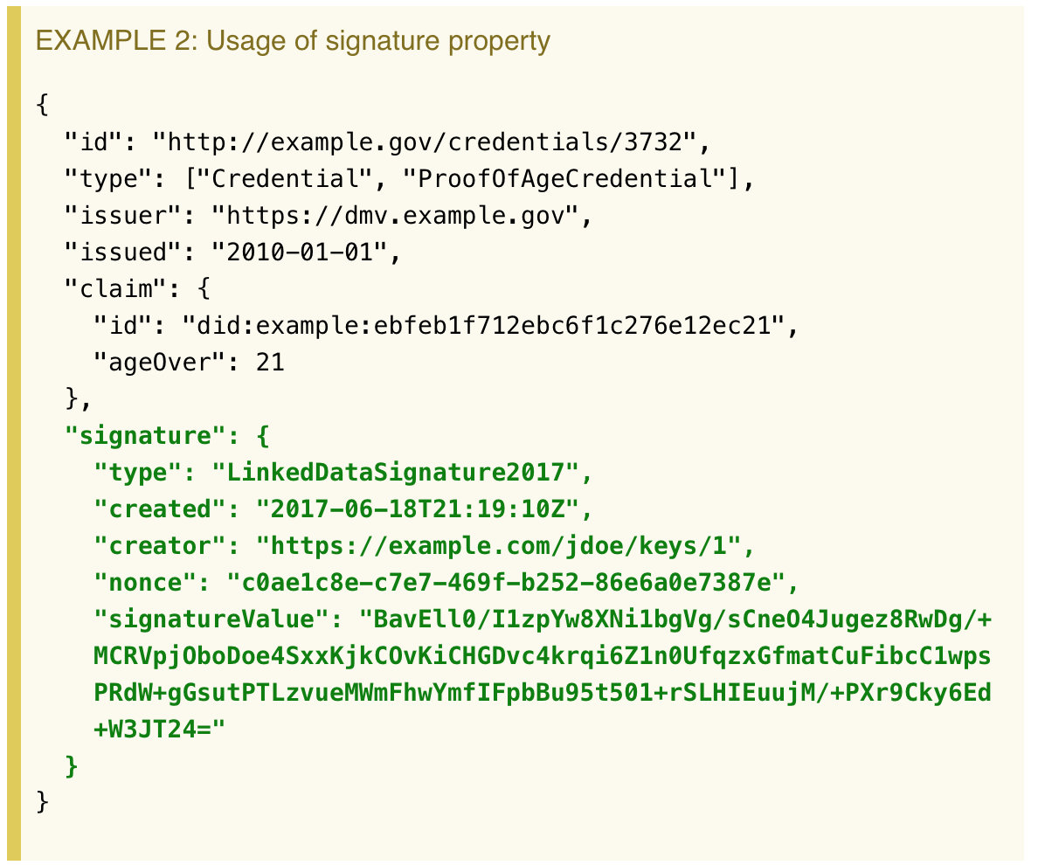

Problem: Gap Between high-level W3C VC language and Complex Cryptographic Algorithms
Signature $\left(A, e, s\right)$
$A^{′}←A^{r}$
$\overline{A}← {A′}^{−e}∙{\left(g_{1}∙{h_{0}}^{s}∙{h_{1}}^{m}\right)}^{r} (={A^{′}}^{x})$
$d←{\left(g_{1}∙{h_{0}}^{s}∙{h_{1}}^{m}\right)}^{r}∙{h_{0}}^{r′}$
$$SPK\left\{\left(m, e, s^{′}, r, r^{′}, r^{′′}\right):\frac{\overline{A}}{d}={A′}^{−e}{∙ h_{0}}^{r′} ∧ g_{1}=d^{r"}⋅h_{0}^{−s^{′}}⋅h_{1}^{−m}\right\}$$
?

Slide 8
Solution: ZKLang
Signature $\left(A, e, s\right)$
$A^{′}←A^{r}$
$\overline{A}← {A′}^{−e}∙{\left(g_{1}∙{h_{0}}^{s}∙{h_{1}}^{m}\right)}^{r} (={A^{′}}^{x})$
$d←{\left(g_{1}∙{h_{0}}^{s}∙{h_{1}}^{m}\right)}^{r}∙{h_{0}}^{r′}$
$$SPK\left\{\left(m, e, s^{′}, r, r^{′}, r^{′′}\right):\frac{\overline{A}}{d}={A′}^{−e}{∙ h_{0}}^{r′} ∧ g_{1}=d^{r"}⋅h_{0}^{−s^{′}}⋅h_{1}^{−m}\right\}$$
ZKLang

Slide 9
Overview and Goal
ZKLang: language mapping W3C verifiable claims to cryptographic algorithms
Prove claims in a privacy-preserving way (using ZKP)
Abstracts cryptographic algorithms
(mapping to crypto algorithms needs to be specified)
Translates verifiable claims
(mapping between verifiable claims and ZKLang needs to be specified)
Goal: define and implement ZKLang and present to W3C & Hyperledger

Slide 10
ZKLang: Notation and Examples
Non Interactive Zero-knowledge proof of Knowledge (NIZK) statements:
NIZK{(m₁,m₂,m₃)[m₄]: Credential(PK_{issuer}, m₁,m₂,m₃,m₄)} – possession of a credential
(m₁, m₂, …) are hidden messages (encoded as integers);
[m₄] are messages (attributes) that are revealed
NIZK{(m₂): Smaller/Larger(m₂, constant)} – range proof
NIZK{(m₃): Enc(PK_{auditor}, ciphertext,m₃)} – verifiable encryption for auditing
Terms can be combined
NIZK{(m₁,m₂,m₃)[m₄]: Credential(PK_{issuer}, m₁,m₂,m₃,m₄) AND
Enc(PK_{auditor}, ciphertext, m₃)}
- prove possession of a credential with four attributes issued by an issuer with Pk_{issuer},
- reveal attribute #4,
- verifiably encrypt attribute #3 under auditor’s key PK_{auditor}

Slide 11
Mapping to Verifiable Claims
Map Issuer name to issuer public key (PK_{issuer})
Map higher level data format (strings, dates, names, etc) to integers
Translate predicates such as Over18 into Larger(today-m₂,18)
m₂ is an attribute that encodes the year of birth

Slide 12
Mapping to Cryptographic algorithms
Multiple options possible (RSA, ECC, DL)
Different cryptographic assumptions
Different implementations
Different building blocks are realized in different groups
Need to be carefully defined to allow for interoperability
Signatures:
CL-signatures (RSA/ECC), U-Prove (Brands) signatures
Range proofs:
Smaller/Larger can be realized in RSA groups

Slide 14
Backup slides

Slide 15
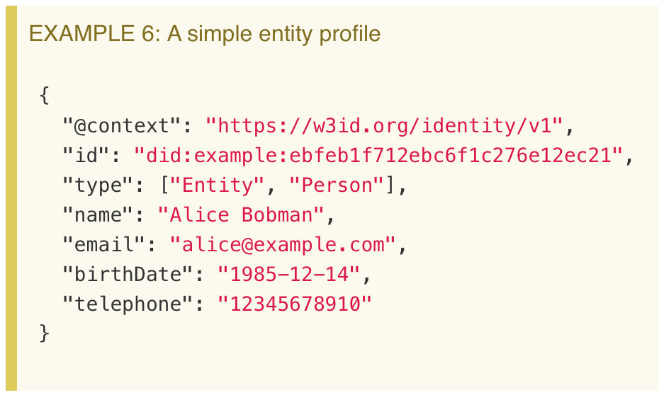
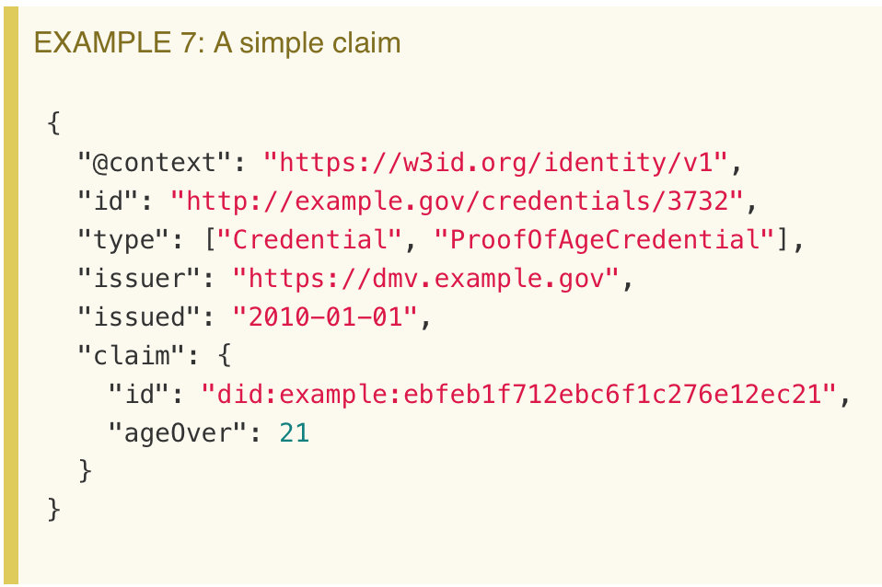
W3C Verifiable Claims: Examples

Slide 16
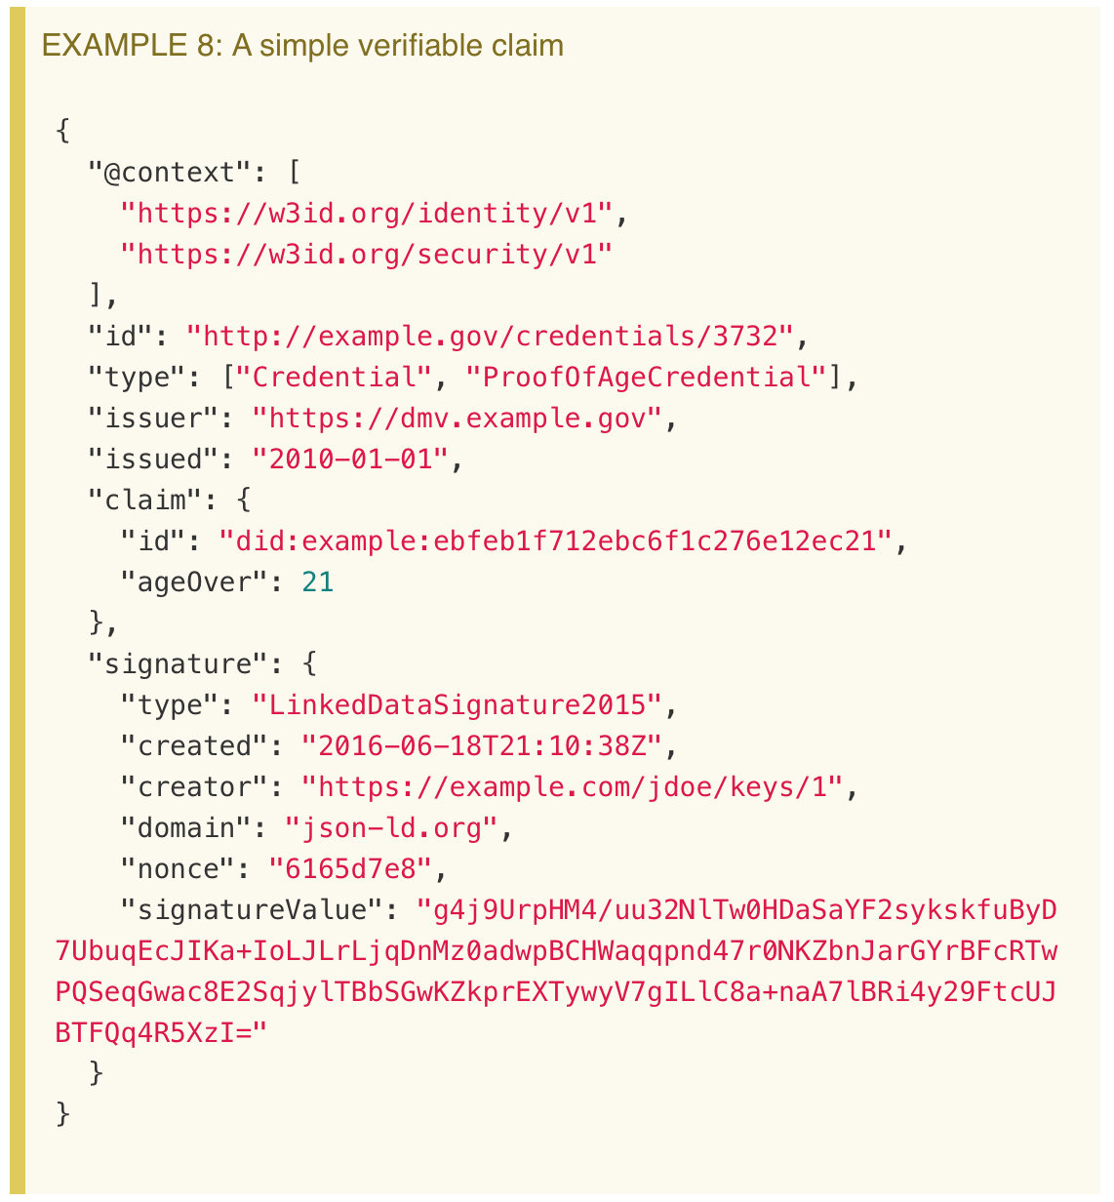
W3C Verifiable Claims: Examples

