Slide 1
Ghana Electricity Information
By Ogundele Adekunle Tobi
Data Mining
Lecturer: Dr. Charles Jackson

Slide 2
Background
Recent Load shedding problem faced by the Republic of Ghana.
Nigerians are very adaptive – they got used to the load shedding issue
An average Ghanaian might not be used to this
Can Past Information about Ghanaian Electricity Consumption, generation, import and export, help understand the current situation ?

Slide 3
Dataset Sources
U.S Energy Information Administrator
Website - http://www.eia.gov/cfapps/ipdbproject/IEDIndex3.cfm
Data Obtained
Worlds Electricity Generation Information (XLS extension)
Worlds Electricity Consumption Information (XLS extension)
Worlds Electricity Import Information (XLS extension)
Worlds Electricity Export Information (XLS extension)

Slide 4
Explorations of Data
Convert XLS to CSV
Removed commas
Removed spaces
Removed Periods
Included “Country” cell, to help identify all countries
Query to obtain Ghana’s information from all datasets
Query to obtain other West African countries information from datasets

Slide 5
Formulating Questions
How has the generation of electricity over the years met the needs of national consumption?
Does Ghana Import more than export to other countries?
Does Ghana import, export, and consume electricity compared to other West African countries (Nigeria, Benin, Togo, Ivory Coast)?
How can the consumption rate of electricity be predicted for the next (7) years, (2013 - 2020)?

Slide 6
Formulating Analysis
R programming language was a useful tool in analyzing electricity information.
Bar plots and Simple Plots were used to graphically analyze data
library(forecast) was used to generate predictions
Three forecast approaches were used
Exponential Model
Time series Model
ARIMA Model

Slide 7
Results
Consumed
Generation

Slide 8
Results
Export
Import

Slide 9
Results
Ghana
Nigeria
Benin
Togo
Ivory Coast

Slide 10
Results
Ghana
Nigeria
Benin
Togo
Ivory Coast

Slide 11
Results
Ghana
Nigeria
Benin
Togo
Ivory Coast

Slide 12
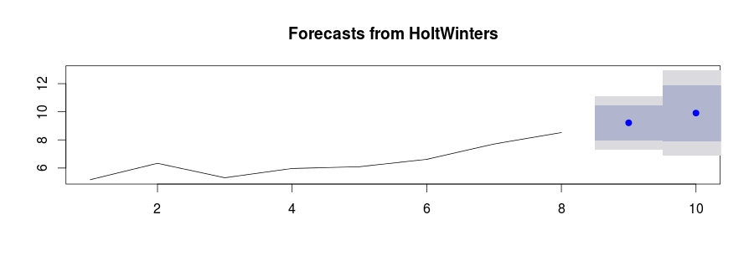
Results
Exponential Forecast Model
Point | Forecast | Lo 80 | Hi 80 | Lo 95 | Hi 95
9 | 9.216639 | 7.964786 | 10.46849 | 7.302096 | 11.13118
10 | 9.912278 | 7.921267 | 11.90329 | 6.867289 | 12.95727

Slide 13
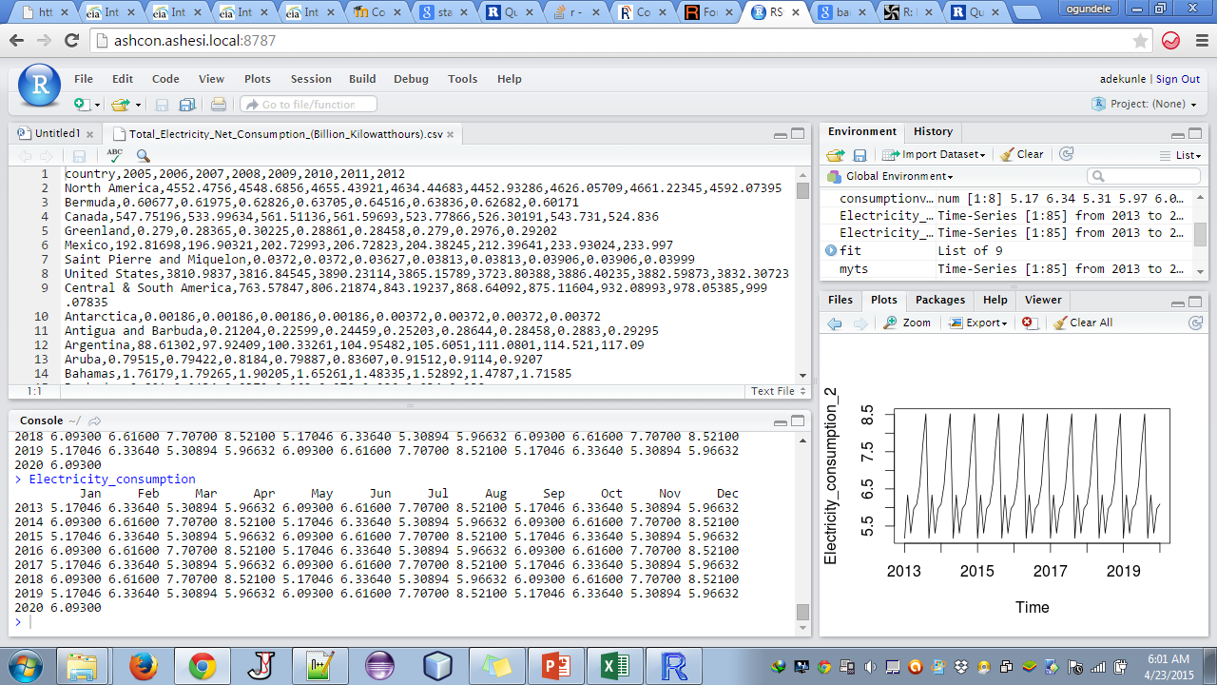
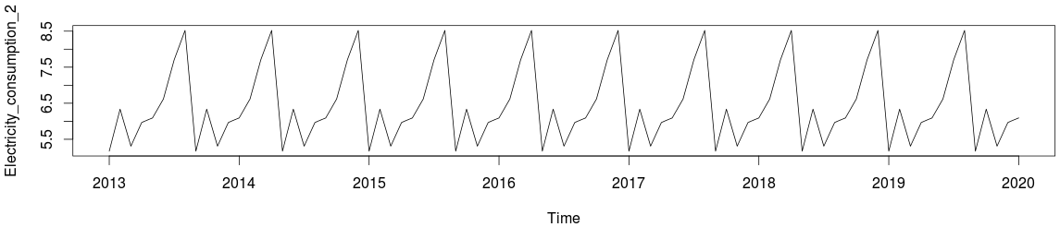
Results
Time Series Forecast Model

Slide 14
Conclusion
Ghana’s electricity consumption grows simultaneously with amount generated.
Benin and Togo imported more electricity, Nigeria never imported, Ghana has a decreasing importation rate.
Ghana and Ivory Coast are the top exporter of electricity. Nigeria, Benin and Togo never exported Electricity.
Ghana, Benin, Togo have low consumption rate, Ivory Coast has an increasing consumption rate, Nigeria consumed a lot.
Between 2013 and 2020, Ghana’s electricity consumption will not go Above 8.5 Bkw based on the time series model.
Based on the exponential model, consumption will increase as the years go by.

Slide 15
Conclusion
Thank you

