Slide 1

Exploratory Data Analysis
G2M Case Study
Amr Osama
Egypt
Data Analytics Team
4-Mar-2021

Slide 2
Agenda
Executive Summary
Problem Statement
Approach
EDA
EDA Summary

Slide 3
Background – G2M Case Study
XYZ is a private equity firm in US. Due to remarkable growth in the Cab Industry in last few years and multiple key players in the market, it is planning for an investment in Cab industry.
Objective : Provide actionable insights to help XYZ firm in identifying the right company for making investment.
The analysis has been divided into four parts:
Data loading and Understanding
Forecasting profit and number of rides for each cab type
Finding the most profitable Cab company

Slide 4
Data Exploration
12 Features( including 9 derived features)
Timeframe of the data: 2016-01-31 to 2018-12-31
Total data points : 359,392
Assumptions:
Outliers are present in Price_Charged feature but due to
unavailability of trip duration details ,we are not treating this as outlier.
Profit of rides are calculated keeping other factors constant and only
Price_Charged and Cost_of_Trip features used to calculate profit.
Users feature of city dataset is treated as number of cab users in the city.
we have assumed that this can be other cab users as well(including Yellow and
Pink cab)

Slide 5
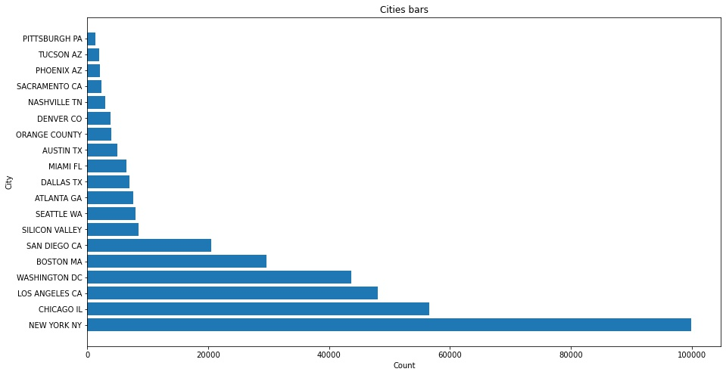
Profit Analysis
Cities and number of clients Analysis

Slide 6
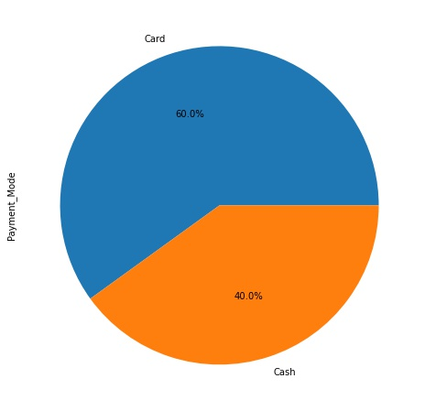
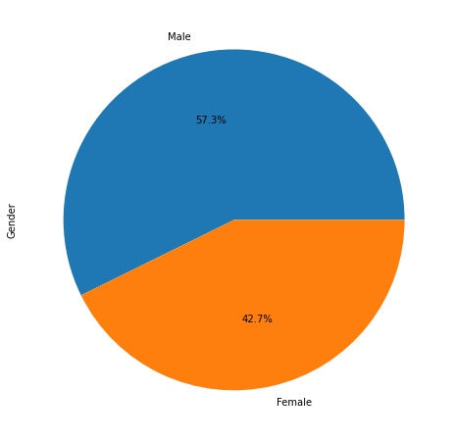
Payment mode & Gender Analysis
As we can see, number of clients who pay using Cards are more.
Same for Males but the margin between them is not that large.

Slide 7
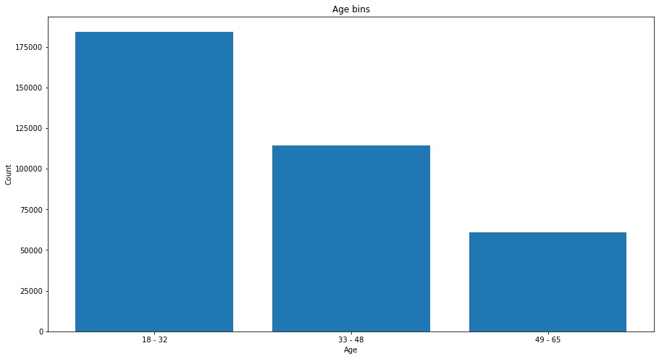
Age Analysis
As shown in figure, clients who have 18 – 32 years old are the majority.

Slide 8
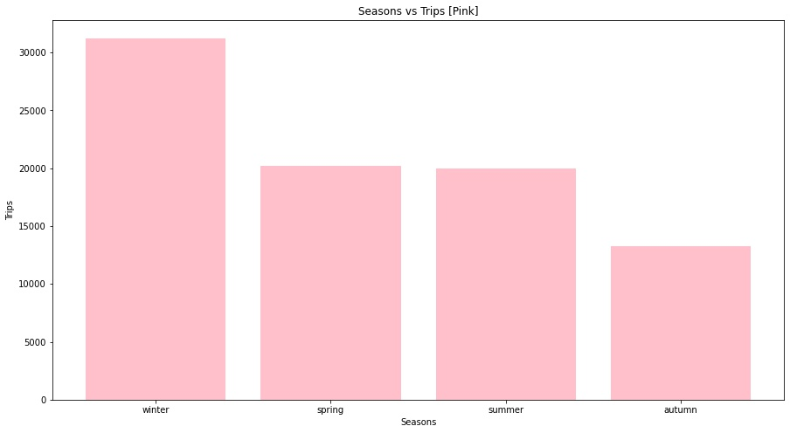
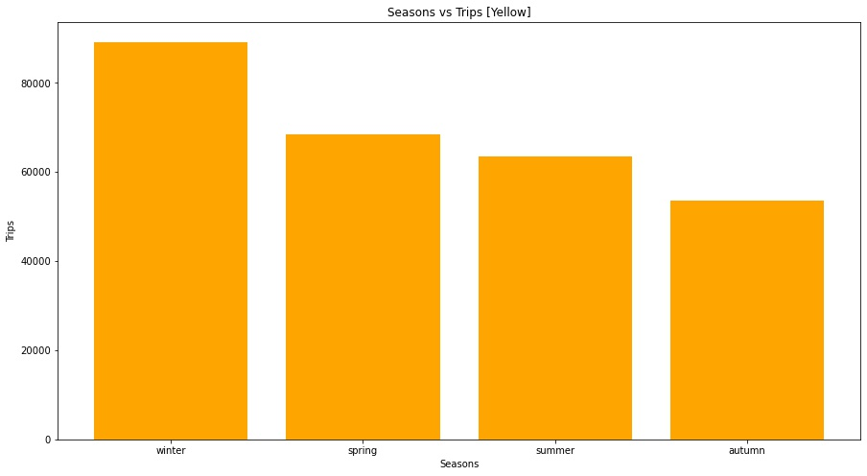
Seasonally trips Analysis
Winter has the highest number of trips.

Slide 9
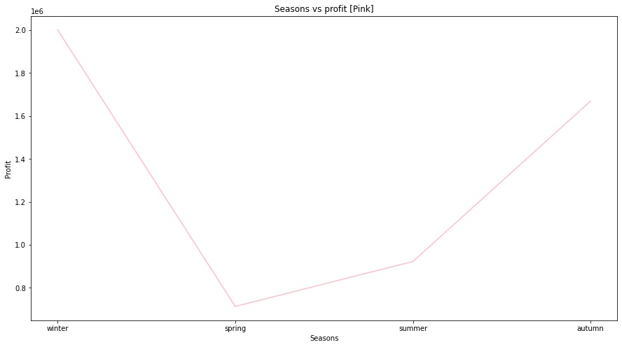
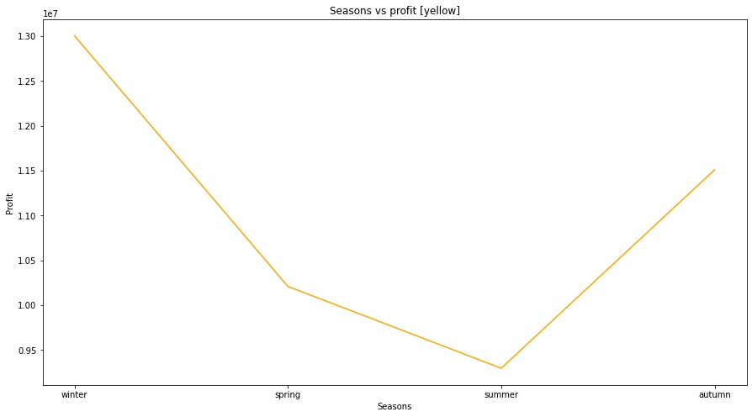
Yearly Profit Analysis

Slide 10
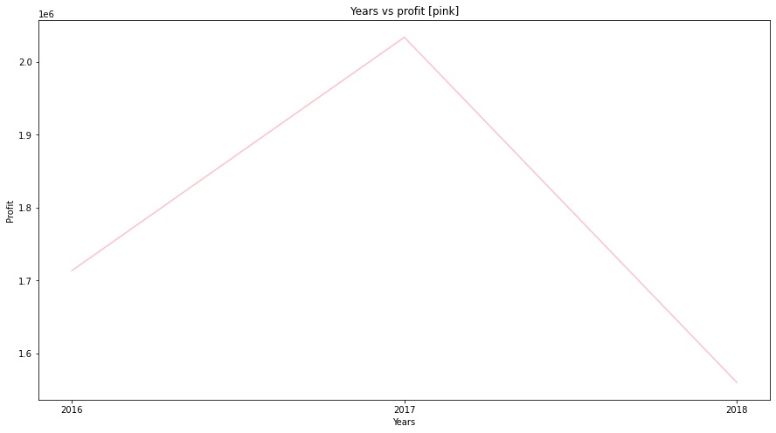
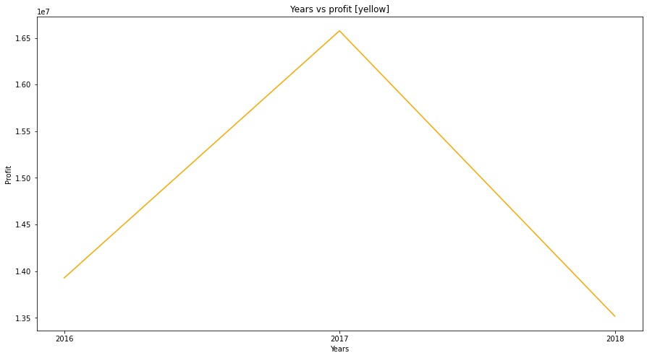
Yearly profit
The Profit in 2017 is greater than 2016 and 2018 in both companies.

Slide 11
Thank You

