Slide 1

Project: G2M insight for Cab Investment firm
Data Science Virtual Internship
Submitted by: Amr Hacoglu
Date: 12-June-2024

Slide 2
Problem Statement
XYZ is a private equity firm in US. Due to remarkable growth in the Cab Industry in last few years and multiple key players in the market, it is planning for an investment in Cab industry.
Objective : Provide actionable insights to help XYZ firm in identifying the right company for making investment.
The analysis has been divided into four parts:
Data Understanding
Forecasting profit and number of rides for each cab type
Finding the most profitable Cab company
Recommendations for investment

Slide 3
Data Exploration
24 Features( including 9 derived features)
Timeframe of the data: 2016-01-31 to 2018-12-31
Total data points :355,032
Assumptions:
Outliers are present in Price_Charged feature but due to
unavailability of trip duration details ,we are not treating this as outlier.
Profit of rides are calculated keeping other factors constant and only
Price_Charged and Cost_of_Trip features used to calculate profit.
Users feature of city dataset is treated as number of cab users in the city.
we have assumed that this can be other cab users as well(including Yellow and
Pink cab)
Cab_Data.csv
Customer_ID.csv
Transaction_ID.csv
City.csv
USholiday.csv
Final cab data

Slide 4
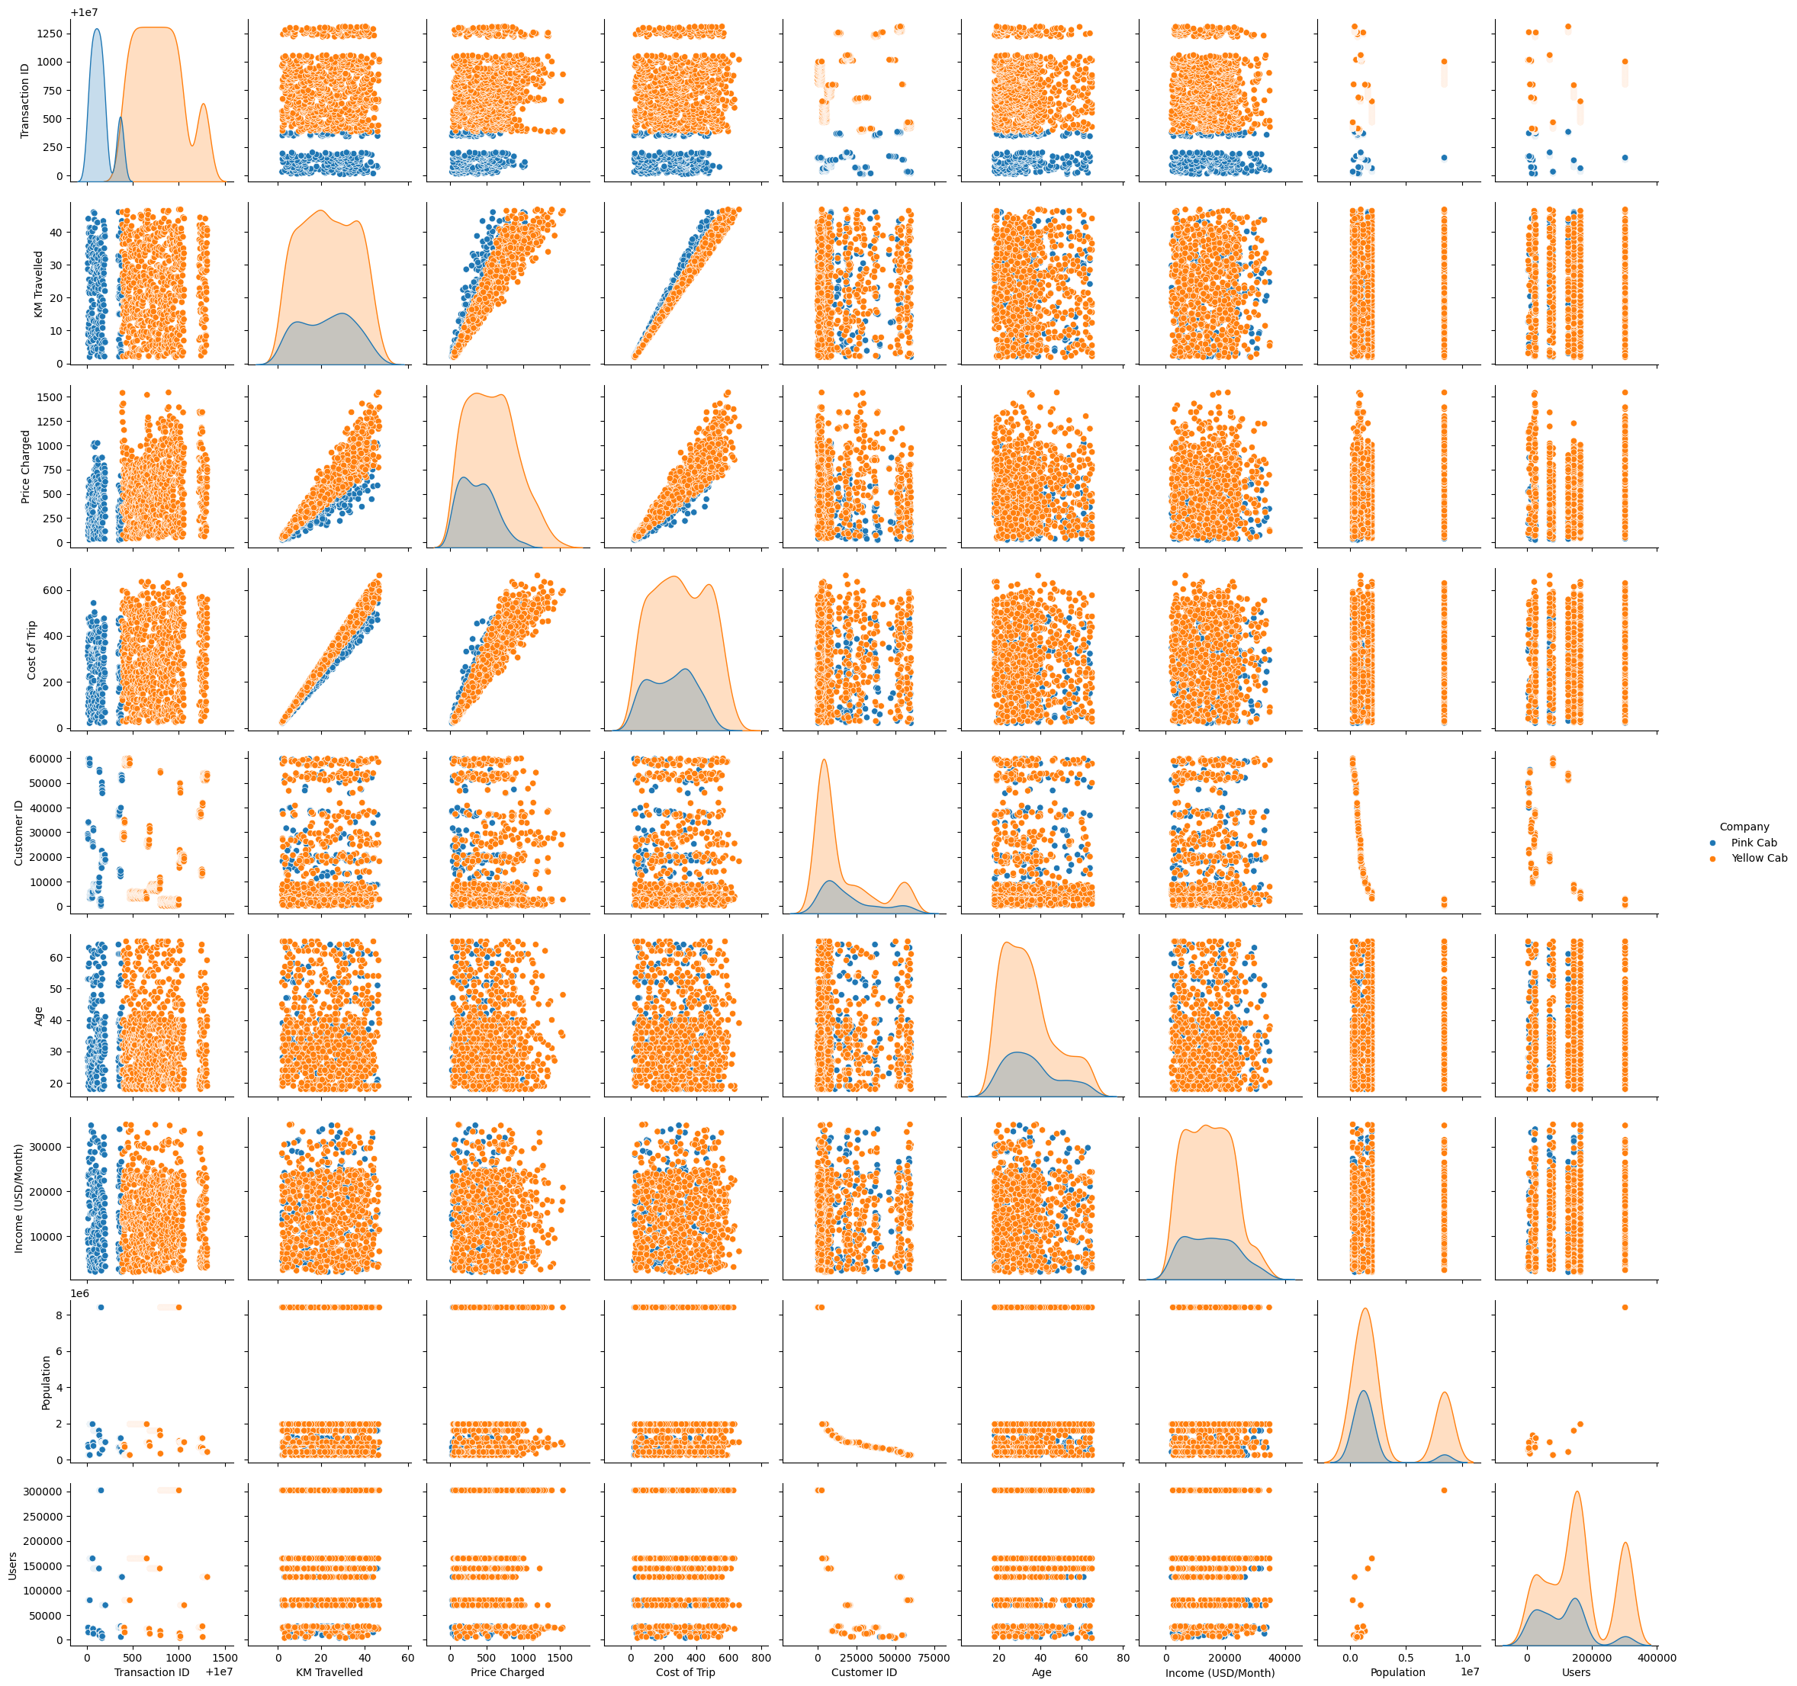
Profit Analysis
Visualize the Data

Slide 5
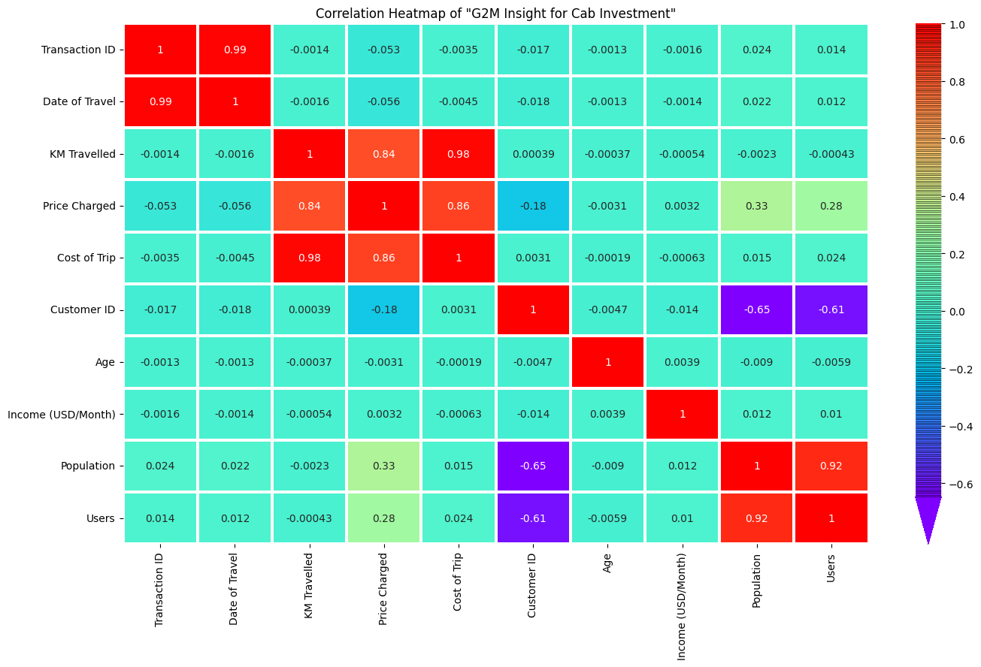
Check the Correlation

Slide 6
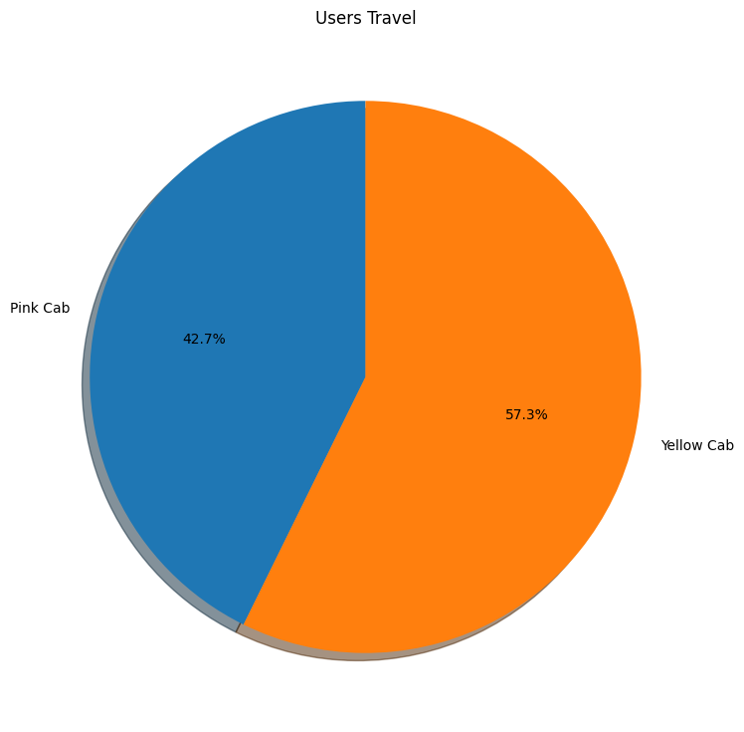
Investigate the Data

Slide 7
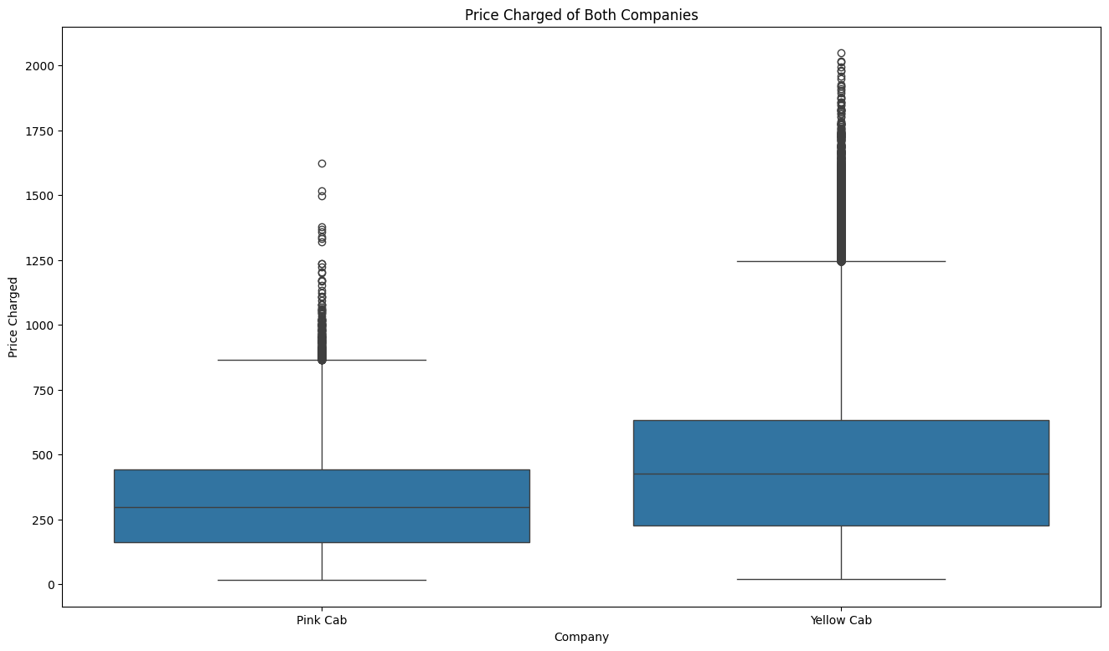
Price Charged

Slide 8
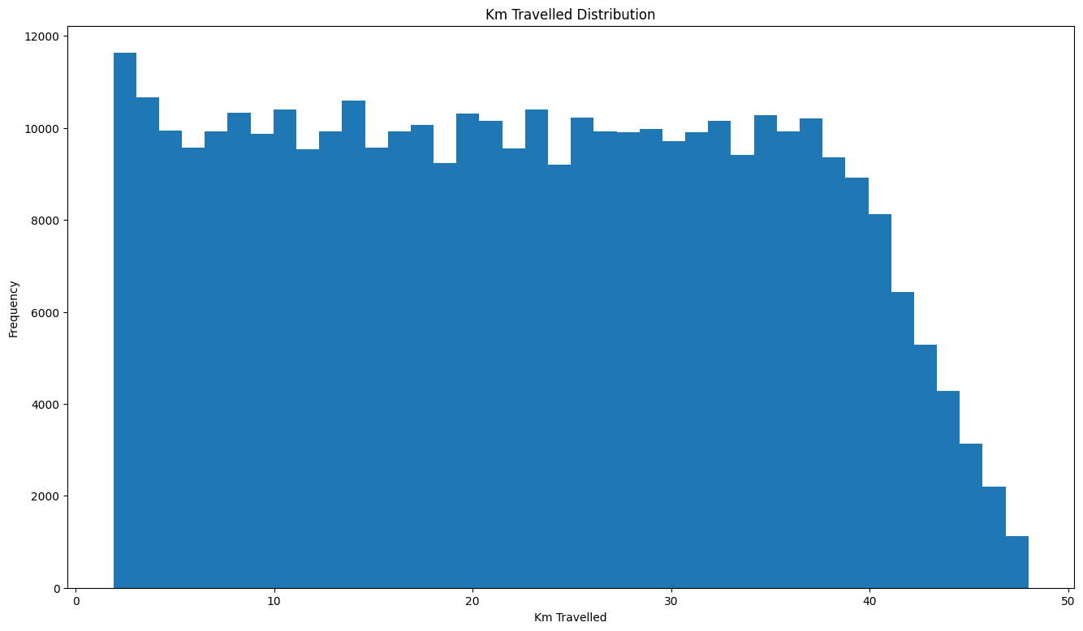
KM Travelled Distribution

Slide 9
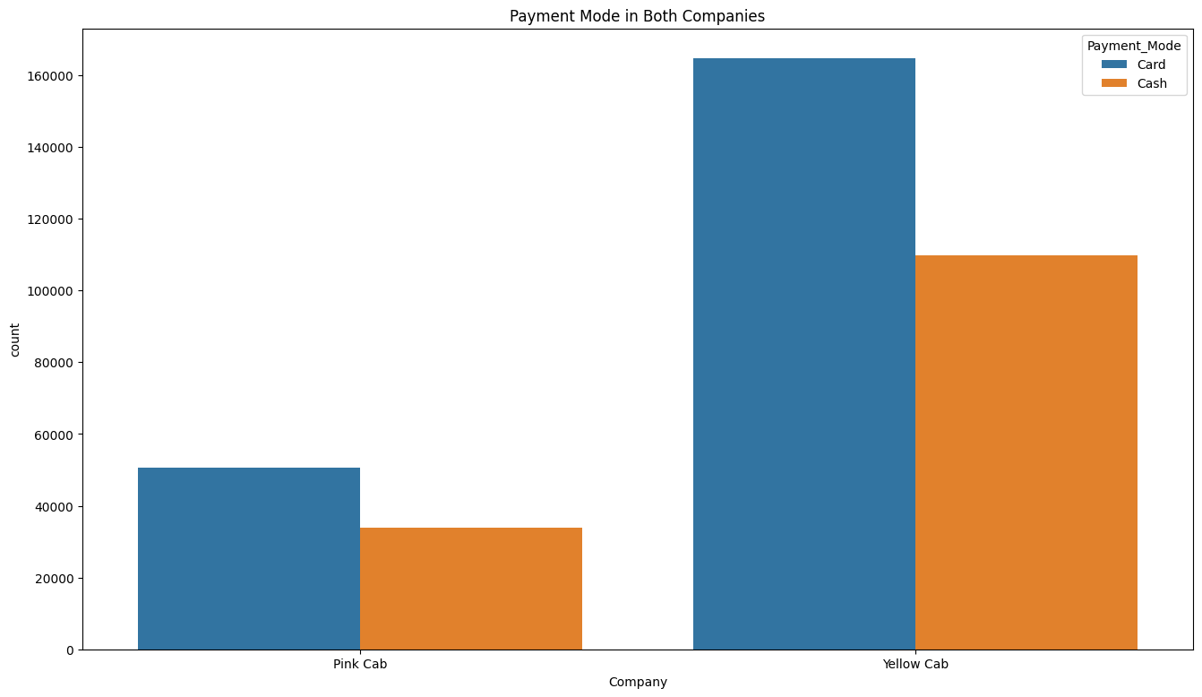
Payment Mode

Slide 10
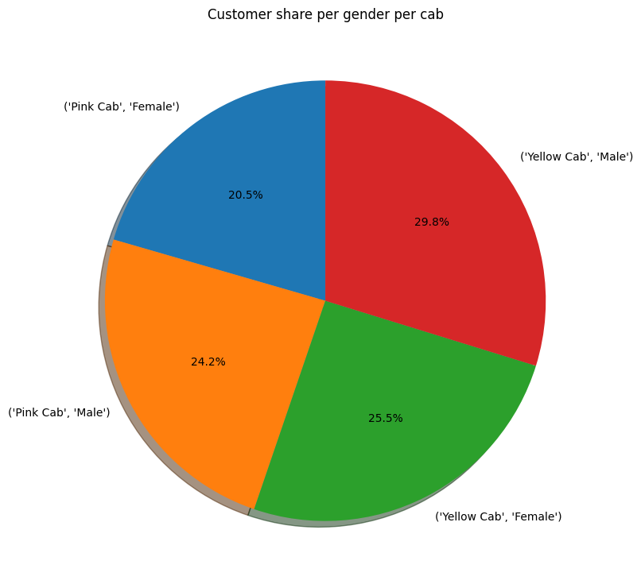
Gender

Slide 11
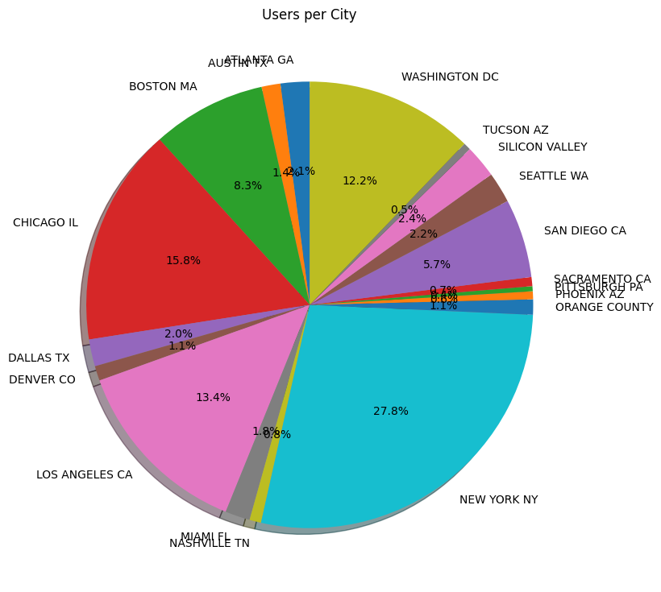
Users Respective Cities

Slide 12
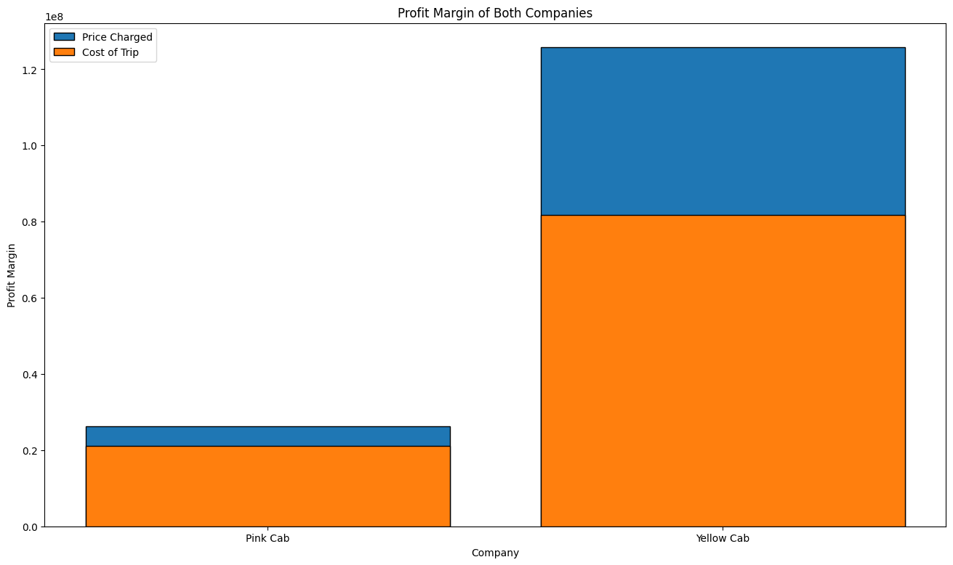
Profit Margin

Slide 13
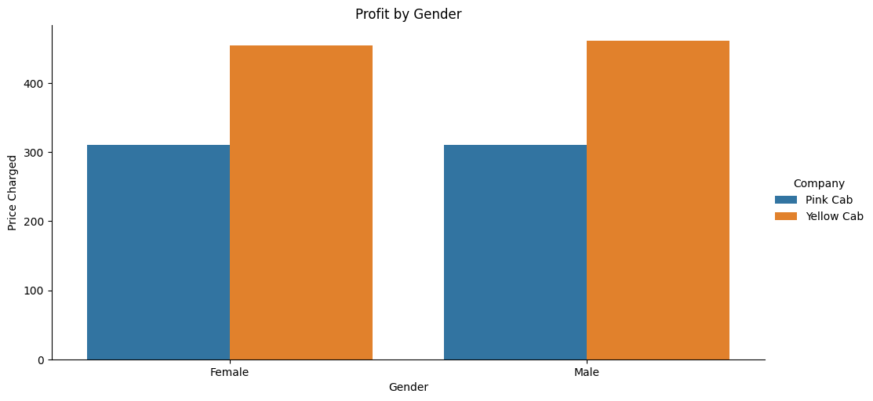
Profit by Gender

Slide 14
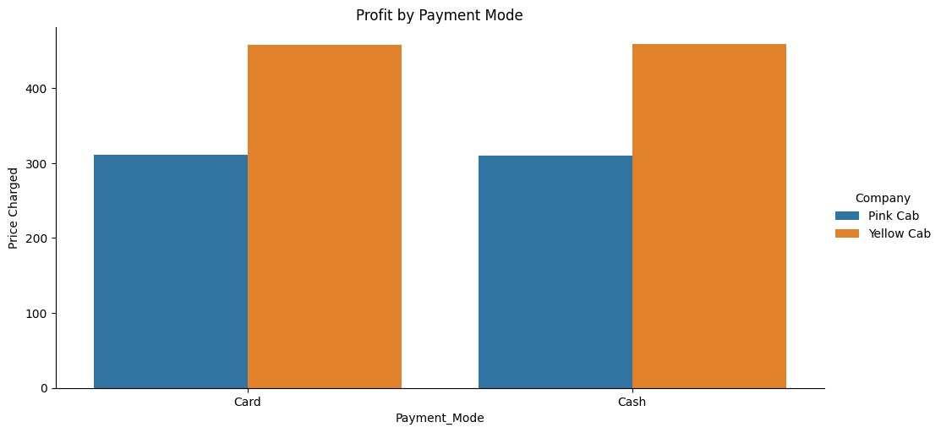
Profit by Payment Mode

Slide 15
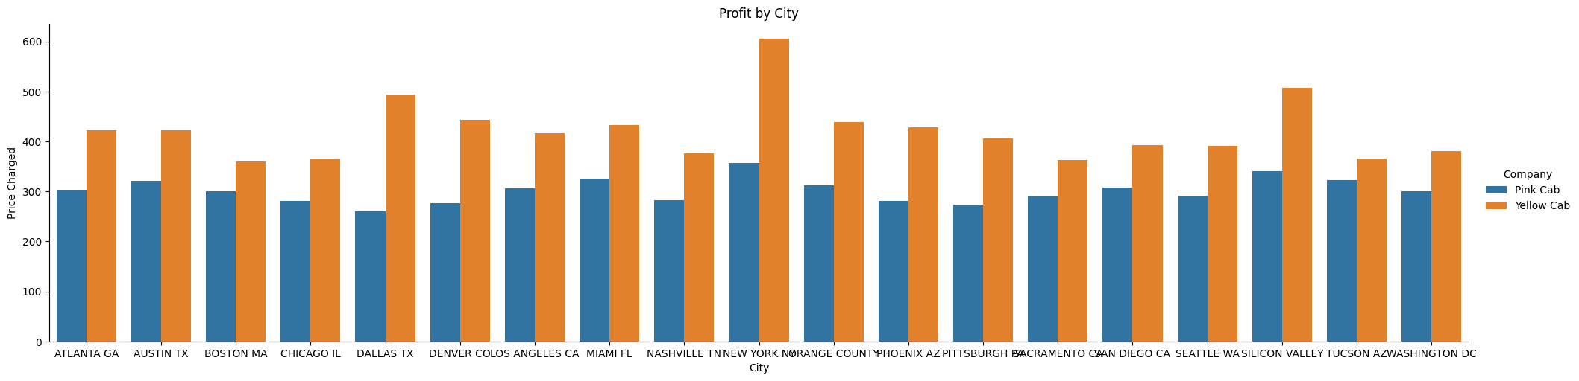
Profit by City

Slide 16
Recommendation for Investment
Company to Invest In: Yellow Cab
Reasoning:
1- Profit Margins:
Yellow Cab has consistently shown higher profit margins compared to Pink Cab. This indicates better cost management and revenue generation, making it a more financially robust and efficient company.
2-User Base:
Yellow Cab attracts a significant number of users, reflecting strong market presence and customer preference. While Pink Cab also has a substantial user base, Yellow Cab's financial performance with these users is more impressive.
3- Geographic Distribution:
Yellow Cab performs well across various cities, suggesting a well-distributed market presence and potential for sustained growth in diverse regions.
4- Pricing Strategy:
Yellow Cab maintains a more stable and potentially higher pricing strategy, which could contribute to its higher revenue and profit margins per trip.
5- Customer Demographics and Preferences:
Yellow Cab shows a balanced gender distribution and diverse payment mode preferences, indicating a broader and more adaptable customer appeal.

Slide 17
Thank You

