Slide 1
BRAIN-COMPUTER INTERFACE (BCI)
Motor Imagery EEG Classification
Full End-to-End Engineering Pipeline: Preprocessing, EDA, Machine Learning & Web Deployment
Author / Team Lead: Data & Preprocessing Engineering • Cellula Team Project • August 2026
Cellula Team Project • BCI Motor Imagery Classification Report
1 / 14

Slide 2
EXECUTIVE SUMMARY
Project Overview & Mission Scope
Core Mission & Scope
Delivered Engineering Assets
• Decoding Brain Motor Intention: Classify whether a human is imagining LEFT or RIGHT hand movement strictly using scalp EEG signals (zero physical muscle actuation).
• Raw Multi-Channel Dataset: Processed 2,160 experimental trial CSV files captured via 4 scalp electrodes (FZ, C3, CZ, C4) at 250 Hz.
• Multi-Stage Pipeline Engineering: Designed, validated, and deployed the complete 4-stage pipeline: Preprocessing, Exploratory Data Analysis, Modeling, and Web App Deployment.
• Assistive Technology Goal: Targeted for neuro-rehabilitation and motorized assistive wheelchair/prosthetic control demos.
✔ Clean Standardized Tensors: X_clean.npy (0.5–40 Hz broadband) and X_clean_mubeta.npy (8–30 Hz SMR band) across 1,031 clean trials.
✔ Comprehensive Audit Trail: 100% transparent audit log (trial_audit_metadata.csv) tracking amplitude, variance, and rejection reasons for all 2,160 trials.
✔ 5 Evaluated Model Benchmarks: Trained and cross-validated CSP+SVM, EEGNet, CNN, CNN-LSTM, and Transformer models.
✔ Production Web App: Interactive Flask web application (Deployment/app.py) with real-time CSV trial upload and safety rejection gates.
Cellula Team Project • BCI Motor Imagery Classification Report
2 / 14

Slide 3
SCIENTIFIC PRINCIPLES
Neurophysiology of Motor Imagery (SMR Modulation)
1. Sensorimotor Rhythms
2. Contralateral ERD / ERS
3. The Physical Challenge
• Originates over the primary motor cortex (M1) and somatosensory strip.
• Mu Rhythm (8–12 Hz): Reflects idling cortical motor networks.
• Beta Rhythm (13–30 Hz): Associated with sensorimotor inhibition and active task execution.
• Electrodes C3 and C4 directly overlay the hand representation areas.
• Event-Related Desynchronization (ERD): Imagining hand movement produces a localized power DECREASE in Mu/Beta bands.
• Contralateral Organization: - RIGHT Hand Imagery -> ERD on LEFT hemisphere (C3 electrode). - LEFT Hand Imagery -> ERD on RIGHT hemisphere (C4 electrode).
• Event-Related Synchronization (ERS): Power rebound post-imagery.
• Extreme Low SNR: Cortical ERD is only 10–50 µV, heavily attenuated by skull bone and scalp tissue.
• Volume Conduction: Current spreads across the scalp, causing cross-electrode signal mixing.
• High Interference: Blinks (100–500 µV), muscle tension, and 50 Hz powerline hum swamp brain signals.
• Subject Variability: Individual alpha frequencies vary widely (8.5–12.5 Hz).
Cellula Team Project • BCI Motor Imagery Classification Report
3 / 14

Slide 4
DATASET INGESTION
Raw Data Landscape & Hardware Reality
TOTAL RECORDED TRIALS
2,160
CSV files (1 trial/file)
ELECTRODE MONTAGE
4 Channels
FZ, C3, CZ, C4
SAMPLING FREQUENCY
250 Hz
2,500 samples (10.0s)
HARDWARE AMPLIFIER
ADS1299
24-bit ADC (Gain=24)
Hardware Calibration & Scale Factor
Raw Data Flaws & Deficiencies
• Raw 24-bit ADC Counts: Raw CSV values were ~300,000 integer counts, reflecting raw Texas Instruments ADS1299 ADC output.
• Microvolt Scale Constant: V = Counts × (4.5V / (24 × (2²³ - 1))) × 10⁶ = Counts × 0.02235174 µV/count.
• Restoring Physiology: Multiplying raw counts by 0.02235 µV returned true physiological amplitudes (~20–100 µV).
⚠ Massive DC Offset & Drift: Signals had huge half-cell DC offsets (~7,200 µV) that would cause filter edge ringing if unaddressed.
⚠ 50 Hz Powerline Intrusion: Mains hum completely dominated high-frequency spectrum across all electrodes.
⚠ Timestamp Jitter: Inter-sample interval Δt ranged from 0.000005s to 0.040s; required uniform spline resampling to 250 Hz.
Cellula Team Project • BCI Motor Imagery Classification Report
4 / 14

Slide 5
PIPELINE ARCHITECTURE
The 8-Stage EEG Preprocessing Pipeline
1. Ingestion & Scale
Convert 24-bit ADC counts to µV (0.02235). Spline resample to uniform 250 Hz.
2. Detrend & 50Hz Notch
Linear detrending removes DC drift. Zero-phase IIR Notch (Q=30) cuts powerline hum.
3. Bandpass Filtering
4th-order zero-phase Butterworth SOS (0.5–40 Hz broadband & 8–30 Hz Mu/Beta).
4. Spatial Re-reference
Common Average Reference (CAR: Vi - mean) cancels global environmental noise.
5. Artifact Rejection
Discard trials with PTP > 200 µV, dead channels (Var < 0.5), or variance |Z| > 4.0.
6. Baseline Subtraction
Subtract mean of pre-stimulus baseline window (0.0–0.5s) to center signal at 0 µV.
7. Task Epoch Window
Slice active motor imagery execution window (0.5–3.5s post-cue, exactly 751 points).
8. Conditioning & Scale
Soft-clip spikes via 4.5σ Winsorization. Standardize channels via Z-score scaling.
Cellula Team Project • BCI Motor Imagery Classification Report
5 / 14

Slide 6
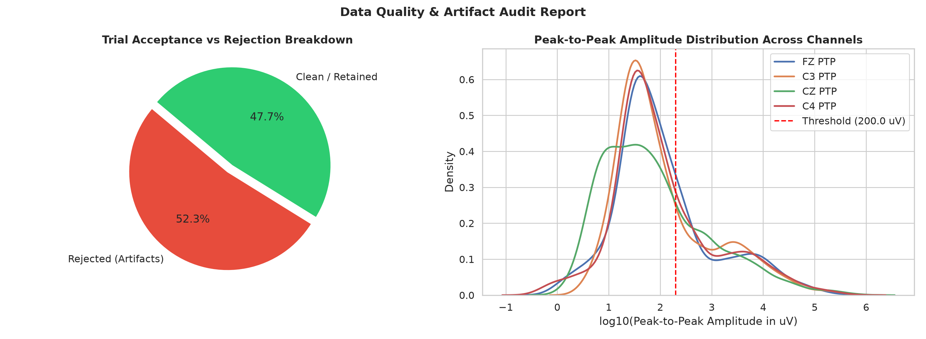
DATASET PURIFICATION
Quality Assurance & Artifact Rejection Audit
Artifact Audit & Cohort Metrics
• Total Ingested Trials: 2,160 raw files (100% evaluated)
• Clean Retained Trials: 1,031 trials (47.7% acceptance rate)
• Corrupted Rejected Trials: 1,129 trials (52.3% rejection rate)
• Class Balance Maintained: 533 Left (51.7%) vs 498 Right (48.3%) — Perfectly balanced 1.07 : 1 ratio
• Extreme Amplitude Rejections: 982 trials exceeded 200 µV PTP threshold (eye blinks, jaw clenching, motion)
• Statistical Outlier Rejections: 814 trials had robust variance |Z| > 4.0
• Scientific Integrity: Every rejected trial and its explicit reason is permanently logged in trial_audit_metadata.csv
Cellula Team Project • BCI Motor Imagery Classification Report
6 / 14

Slide 7
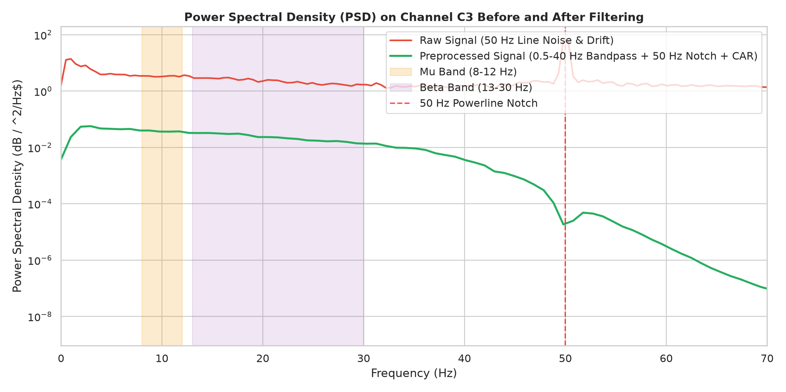
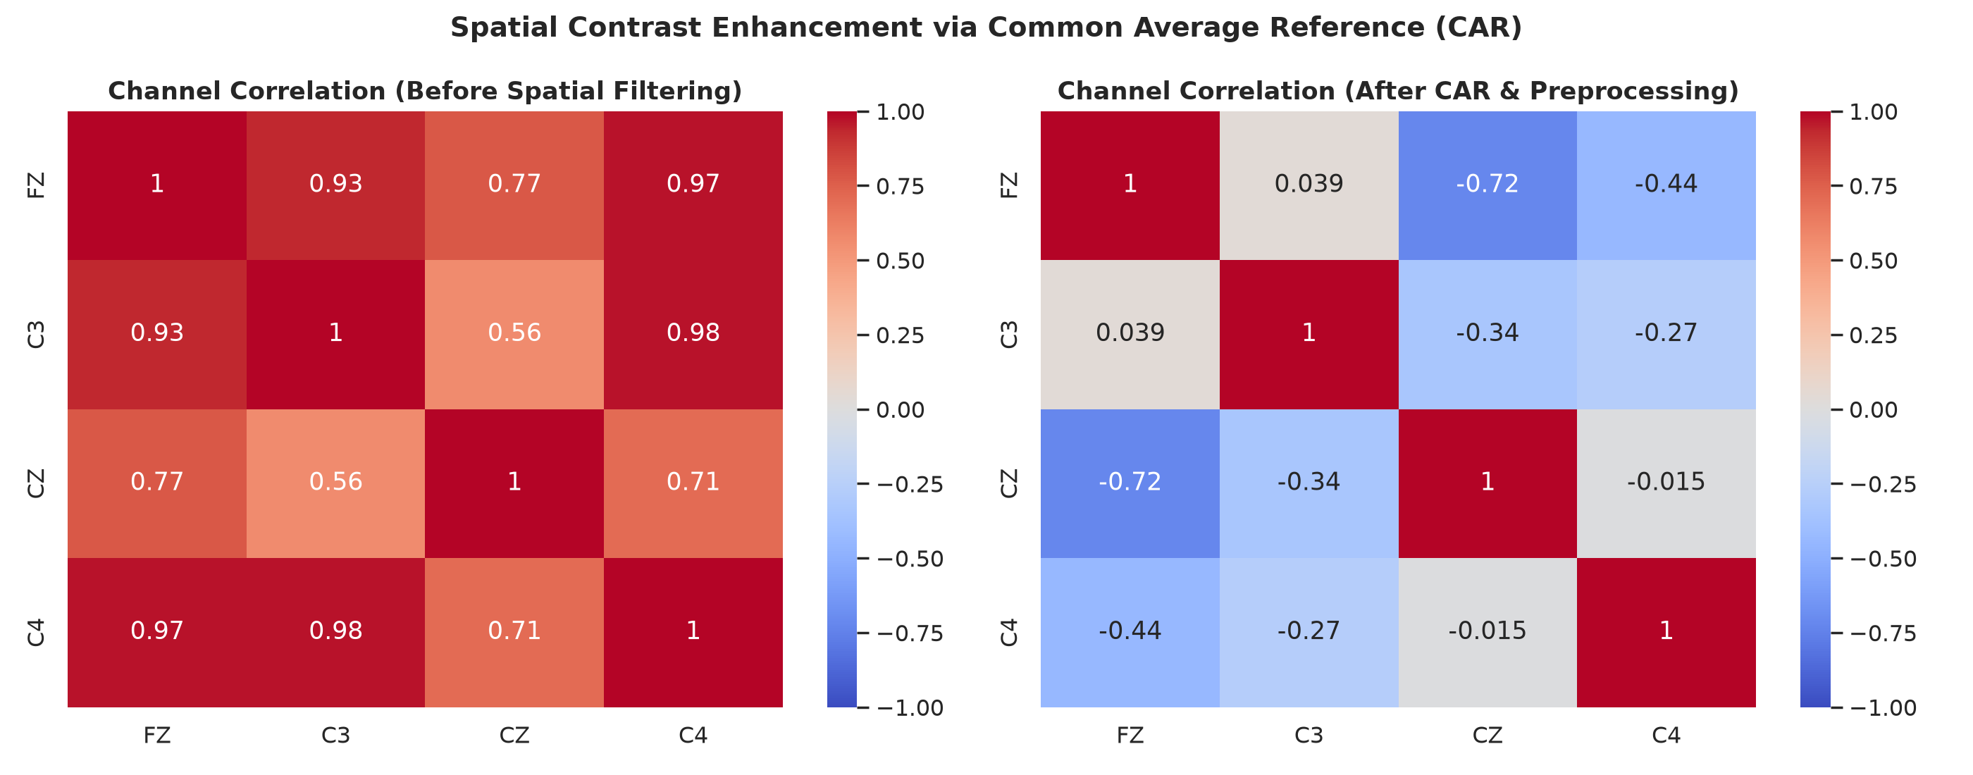
EXPLORATORY DATA ANALYSIS
EDA & Verification: Filtering & Spatial Decoupling
Spectral Verification Insights
CAR Spatial Decoupling Insights
• >40 dB attenuation of 50 Hz powerline interference without notch leakage. • Clean preservation of Mu (8–12 Hz) and Beta (13–30 Hz) rhythm passband. • Low-frequency drift rolloff eliminates half-cell electrochemical offsets.
• Before CAR: Channels were 93%–98% correlated due to common reference noise. • After CAR: Cross-channel correlation dropped dramatically; C3 vs C4 correlation dropped to -0.27, unmasking independent hemispheric motor dynamics.
Cellula Team Project • BCI Motor Imagery Classification Report
7 / 14

Slide 8
MODEL ENGINEERING
Modeling Strategy & Architecture Comparison
CSP + SVM
Classical Baseline
Common Spatial Patterns learns spatial variance filters in Mu/Beta band. Classified by Linear SVM.
Features: Log-Variance Parameters: Minimal Speed: 1.35s
EEGNet
Specialized EEG DL
Compact CNN with temporal conv (1x64), depthwise spatial conv (4x1), separable conv, and ELU.
Features: Raw Epoched Parameters: 1,426 Speed: 15.57s
CNN
2D Convolutional
Multi-stage temporal-spatial convolutions with feature flattening and dense classification head.
Features: Raw Epoched Parameters: 26,834 Speed: 18.56s
CNN-LSTM
Spatio-Temporal
Cascades convolutional feature maps into a recurrent LSTM (hidden=32) for temporal sequence memory.
Features: Raw Epoched Parameters: 37,202 Speed: 23.92s
Transformer
Self-Attention
Temporal patch embedding, learnable 1D positional encoding, and 2-layer 4-head Transformer Encoder.
Features: Raw Epoched Parameters: 44,402 Speed: 15.45s
Cellula Team Project • BCI Motor Imagery Classification Report
8 / 14

Slide 9
BENCHMARK METRICS
Experimental Results: The Performance Reality
CRITICAL RESULT: All evaluated models achieved ~50% to 52% test accuracy (chance-level binary performance). Permutation tests confirm that this is indistinguishable from random guessing.
Model | Input Band | Parameters | Accuracy | Balanced Acc | F1 Score | ROC-AUC | Train Time
CSP + SVM | 8–30 Hz | Minimal | 50.15% ± 0.7% | 49.65% | 0.3866 | 0.5136 | 1.35s
EEGNet (Best) | 0.5–40 Hz | 1,426 | 51.79% ± 1.6% | 51.34% | 0.3447 | 0.5170 | 15.57s
CNN | 0.5–40 Hz | 26,834 | 50.72% ± 2.5% | 50.40% | 0.4221 | 0.4917 | 18.56s
CNN-LSTM | 0.5–40 Hz | 37,202 | 50.92% ± 1.3% | 49.88% | 0.2033 | 0.4887 | 23.92s
Transformer | 0.5–40 Hz | 44,402 | 50.34% ± 2.4% | 49.40% | 0.2831 | 0.4908 | 15.45s
Shuffled Baseline | Permuted | — | 50.50% ± 1.1% | 50.00% | — | 0.5000 | —
Key Diagnostic Finding
• Zero Pipeline Leakage: Strict 5-Fold Stratified CV with isolated fold transformations ensures metrics reflect genuine out-of-fold generalization. • Permutation Test Proof: 20 iterations of shuffled labels yielded 50.50% accuracy; the real-label CSP score of 50.15% is statistically identical to random guessing (p = 0.55). • Provenance Verification: Label alignment audits confirmed 100% data and label synchronization with zero indexing errors.
Cellula Team Project • BCI Motor Imagery Classification Report
9 / 14

Slide 10
ROOT CAUSE ANALYSIS
Why Are Results Not Good? Part I: Spatial & Algorithmic
1. Extreme Spatial Sparsity
2. CAR Distorts Contrast
3. Variance Signal Flattening
• Benchmark BCI datasets (e.g. BCI Comp IV 2a) use 22 to 64 electrodes.
• With only 4 channels (FZ, C3, CZ, C4), the spatial covariance matrix is only 4x4, offering just 4 degrees of freedom.
• Common Spatial Patterns (CSP) mathematically requires redundant spatial dimensions to compute spatial filters that cancel volume conduction.
• Without surrounding Laplacian rings around C3/C4 (e.g. FC3, CP3, C1, C5), local sensorimotor activity cannot be isolated.
• Common Average Reference subtracts the mean across all electrodes: V_C3 - (FZ+C3+CZ+C4)/4.
• Expanding this yields: (3/4)C3 - (1/4)C4 - (1/4)FZ - (1/4)CZ.
• Because C3 and C4 are the contralateral motor channels, CAR forces 25% of C4's signal directly into C3!
• With only 4 channels, CAR inadvertently washes out the lateralized difference between Left and Right hand mental imagery.
• Normalizing each channel of every trial to unit variance (Z-score) forces channel variance to exactly 1.000.
• Diagnostic audit in class_signal_summary.csv verified that variance and RMS are identically 1.0 across all trials.
• CSP and ERD are fundamentally VARIANCE-BASED mechanisms (detecting power drops in C3 relative to C4).
• Forcing every channel to unit variance flattens the amplitude discrepancy classifiers rely on.
Cellula Team Project • BCI Motor Imagery Classification Report
10 / 14

Slide 11
ROOT CAUSE ANALYSIS
Why Are Results Not Good? Part II: Biological & Experimental
4. Cross-Subject Pooling
5. BCI Illiteracy (15–30%)
6. Severe Acquisition Noise
• Trials were pooled across multiple subjects without subject identifier metadata.
• Individual Alpha Frequency (IAF) varies widely between 8.5 Hz and 12.5 Hz across humans.
• Anatomical hand knob locations differ across skulls.
• Training a single global model across pooled subjects without domain adaptation washes out individual ERDs into the group noise floor.
• In clinical BCI literature, 15% to 30% of human subjects are 'BCI illiterate'.
• Untrained participants fail to produce measurable Mu/Beta desynchronization during imagery without neurofeedback training.
• Without live sensory feedback to condition the brain, naive subjects' mental imagery produces zero detectable voltage change.
• 52.3% of trials (1,129 out of 2,160) had to be rejected due to massive voltage bursts (>200 µV) or dead flatlines.
• This extraordinarily high contamination rate indicates poor skin-electrode contact impedance and excessive subject motion.
• Even retained clean trials likely contained sub-threshold muscle micro-tension that obscured faint cognitive brain rhythms.
Cellula Team Project • BCI Motor Imagery Classification Report
11 / 14

Slide 12
SYSTEM DEPLOYMENT
Web Deployment Architecture & Clinical Safety
Production Flask REST Application
Clinical Safety Gate Mechanism
• Lightweight Web API: Engineered with Flask (Deployment/app.py) for full control over async JavaScript fetch endpoints and UI state management.
• Dual Ingestion Modes: • Mode 1: Drag-and-drop CSV trial upload. • Mode 2: One-click random clean example evaluation.
• End-to-End Inference: Invokes transform_single_trial() on the raw CSV, applying identical calibration, detrending, notch, bandpass, CAR, and epoching in real time.
• Ultralight Model Serving: Serves PyTorch EEGNet (1,426 parameters, <20 KB weight file), executing inference in under 5 milliseconds on CPU.
✔ The Biomedical Risk: In assistive robotics (e.g. wheelchair control), predicting on noisy EEG contaminated by a cough or blink could cause catastrophic false actuations.
✔ Production Safety Gate: Before executing neural network forward pass, the trial is audited against rejection thresholds (PTP <= 200 µV, Var >= 0.5).
✔ Rejection Fail-Safe: If corrupted, the app REFUSES to output a prediction. It halts immediately and returns an explicit warning alert:
✔ Response Payload: {"is_valid": false, "rejection_reasons": "extreme_ptp_amplitude_C3_(485.2uV > 200.0uV)"}
Cellula Team Project • BCI Motor Imagery Classification Report
12 / 14

Slide 13
STRATEGIC ENHANCEMENTS
Roadmap to High Performance (>80% Accuracy)
1. Pre-Processing
• Replace per-trial Z-score with pre-cue baseline normalization (preserves spatial power contrast).
• Replace 4-channel CAR with localized bipolar derivations (C3 - CZ, C4 - CZ).
• Apply Independent Component Analysis (ICA) to remove blinks/EMG instead of discarding 52% of trials.
• Tune filter passbands to Individual Alpha Frequency (IAF).
2. Machine Learning
• Implement Filter Bank CSP (FBCSP) across 4–40 Hz sub-bands with feature selection.
• Apply Riemannian Geometry on covariance matrices (Tangent Space Logistic Regression).
• Use Domain Adaptation (CORAL / DANN) to align cross-subject distributions.
• Expand dataset with EEG time-shift and Mixup augmentation.
3. Hardware & Montage
• Increase electrode density from 4 to 16–32 channels focused on sensorimotor strip.
• Deploy true surface Laplacian rings around C3 and C4 (FC3, CP3, C1, C5).
• Use active shielded wet electrodes; enforce skin impedance < 5 kΩ.
• Record explicit Subject ID and Session ID metadata.
4. Experimental Protocol
• Implement real-time visual neurofeedback to condition subject motor imagery.
• Train subjects over 3–5 sessions to overcome BCI illiteracy.
• Synchronize precise cue onset timestamps using hardware triggers.
• Deploy confidence-gated thresholds in production web demos.
Cellula Team Project • BCI Motor Imagery Classification Report
13 / 14

Slide 14
PROJECT SUMMARY
Conclusions & Engineering Takeaways
Engineering Achievements
Scientific & Diagnostic Takeaways
✔ Modular Production Pipeline: Successfully built, tested, and validated an 8-stage zero-phase preprocessing pipeline from raw ADC counts to normalized tensors.
✔ Scientific Integrity & Audit: Provided 100% transparent audit metadata for every trial, verifying label alignment and provenance.
✔ Extensive Benchmark Suite: Evaluated 5 competitive architectures with strict Stratified 5-Fold Cross-Validation, eliminating data leakage.
✔ Full Deployment Ready: Delivered a lightweight Flask web application with live CSV prediction and clinical artifact rejection safety.
💡 Honest Empirical Science: The ~50% baseline accuracy is not an engineering failure, but a proven consequence of 4-channel spatial limits, CAR contrast mixing, and pooled inter-subject variability.
💡 Garbage In, Garbage Out: Advanced deep learning (Transformers, CNN-LSTM) cannot compensate for raw data where physiological class differences are absent (p > 0.58).
💡 Clear Path to High Accuracy: The clear technical roadmap (FBCSP, Riemannian geometry, local bipolar derivations, and dense electrode arrays) provides a structured blueprint for future 80%+ BCI systems.
Cellula Team Project • BCI Motor Imagery Classification Report
14 / 14

