Slide 1
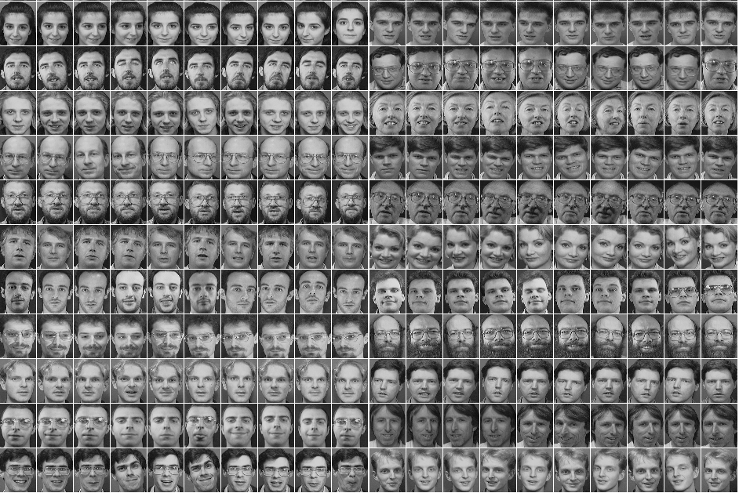
Face Recognition on Low-Dimensional Datasets
Prepared by Amr Mustafa and Mostafa Mahmoud

Slide 2
The Dataset The Database Of Faces (AT&T)
[ ]
400
40
|
|
samples
classes
400
|
92x112
pixels
10304

Slide 3
The Dataset Downloading/Importing
drive.mount('/content/gdrive')

Slide 4

The Dataset Reading the Samples
from PIL import Image
img = Image.open(folder_path + str(j) + '.pgm')
vec = np.array(img).reshape(10304)

Slide 5
The Dataset Data Matrix
D = np.array([example for example in dataset])
D = D.reshape((400, 10304))

Slide 6
The Dataset Label Vector
for i in range(1, 41):
labels.append(i * np.ones((10, 1)))
y = np.stack(labels, axis=0).reshape(400, 1)

Slide 7
The Dataset Splitting The Dataset
D[start:end:step]
# Keep the odd rows for training.
X_train = D[::2]
y_train = y[::2]
# And the even rows for testing.
X_test = D[1::2]
y_test = y[1::2]

Slide 8
Linear Discriminant Analysis Numerical Issues
# Compute the dominant eigenvectors.
print("[6] Solving for the eigenvectors...")
eigen_vals, eigen_vecs = np.linalg.eigh(np.linalg.pinv(S_w).dot(S_b))
# Make a list of (eigenvalue, eigenvector) tuples
eig_pairs = [(np.abs(eigen_vals[i]), eigen_vecs[:,i].real) for i in range(len(eigen_vals))]

Slide 9
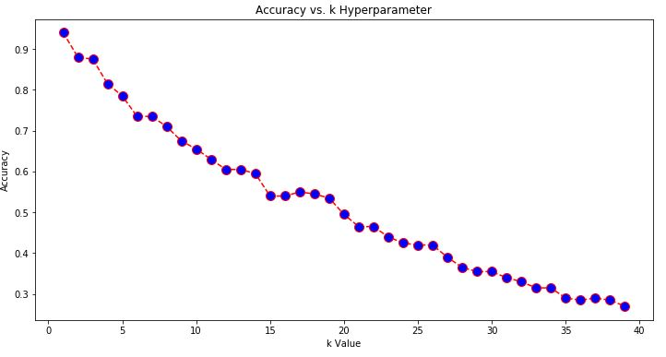
Linear Discriminant Analysis kNN Classifier Tuning
94%
accuracy

Slide 10
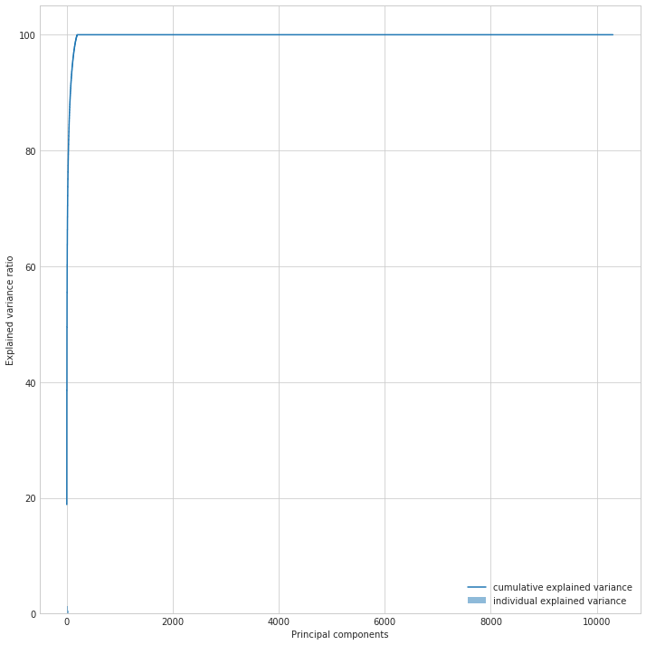
Principal Component Analysis Explained Variance

Slide 11
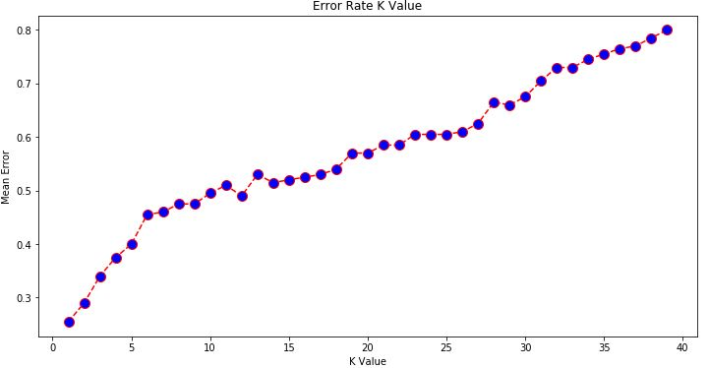
Principal Component Analysis Error Rate

Slide 12
Thank You!

