Slide 1
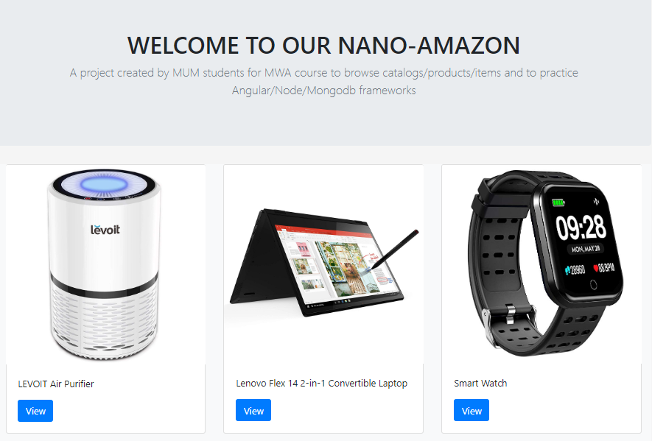
Nanozon (Nano-Amazon)
E-commerce platform
2 Apps: Client + Server
ID Token Based
Features
Login + Register
Browse Products
Search for Products
View Product Details
Products CRUD (Admin)

Slide 2
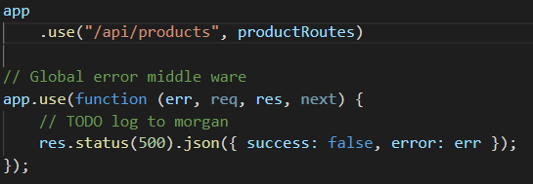
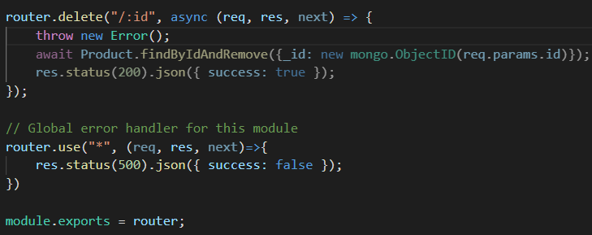
Problem + Solution
Global error handlers won’t work for sub-modules/routes
Solution: Add an extra route to handle errors per module/router

Slide 3
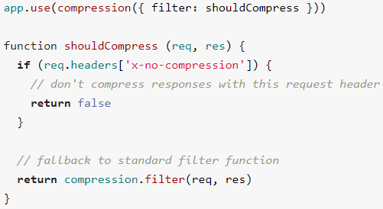
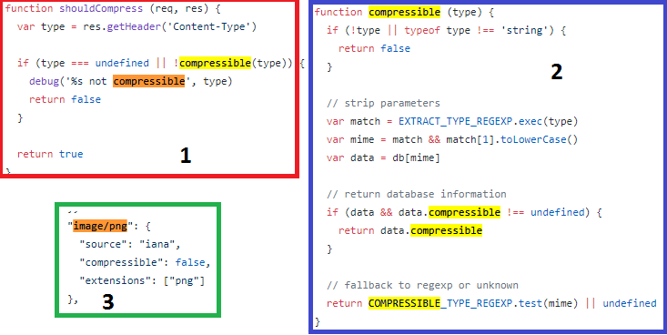
Compression

