Slide 1
Logistic Regression
CAD
Implementation From Scratch

Slide 2
Agenda
01
02
03
LR Overview
IRIS data description
Sigmoid LR & Results.
04
05
Softmax LR & Results.
Code Implementation

Slide 3
01
LR Overview
You can enter a subtitle here if you need it

Slide 4
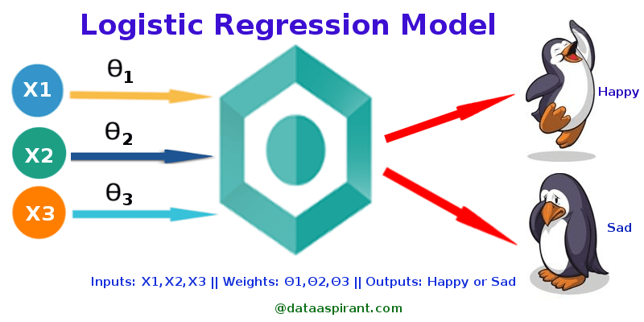
Introduction
Logistic regression is a statistical method used to analyze the relationship between a dependent variable and one or more independent variables. It is a type of regression analysis used when the response variable is binary.

Slide 5
02
IRIS Dataset Description

Slide 6
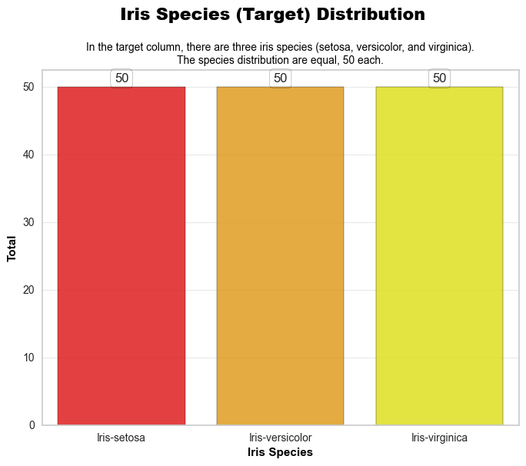
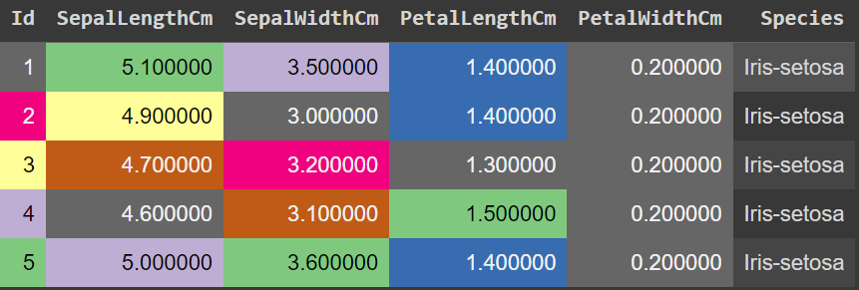

Slide 7
03
Sigmoid LR & Results.

Slide 8
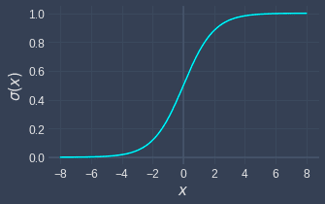
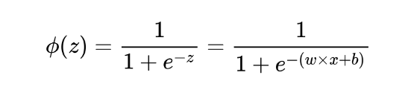
Sigmoid Function
An S-shaped curve.
Used to model the probability of a certain class or event.
Used when the data is linearly separable, and the outcome is dichotomous.

Slide 9
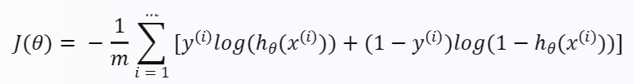
LR Cost Function
J(θ) is the cost function
m is the number of training examples
hθ(x(i)) is the predicted output for the i-th training example
y(i) is the actual output for the i-th training example
Θ is the vector of parameters

Slide 10
One Vs All Strategy
the dataset is transformed into a binary format for each class
The binary classifier is trained using the Adam optimization algorithm
The result is a collection of binary classifiers
The training process involves iterating over each unique class

Slide 11
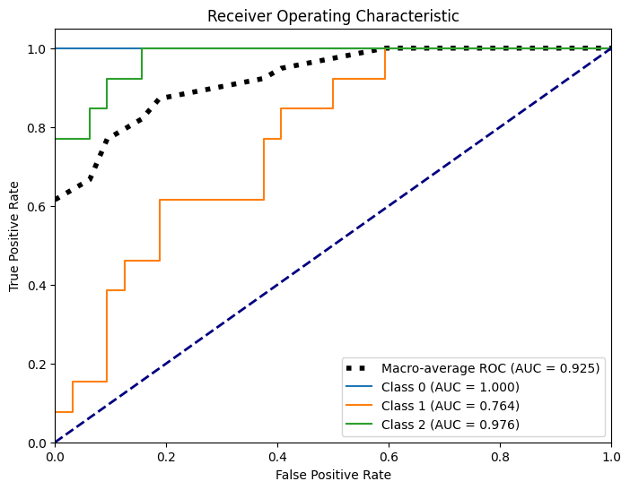
Result

Slide 12
Classification Report
setosa
versicolor
virginica
accuracy
macro avg
precision | recall
1.00 | 1.00
1.00 | 0.46
0.65 | 1.00
0.88 | 0.82
f1-score | Support
1.00 | 19
0.63 | 13
0.79 | 13
0.84 | 45
0.81 | 45
weighted avg
0.90 | 0.84
0.83 | 45

Slide 13
04
Softmax LR & Results.

Slide 14
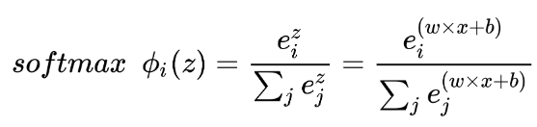
Softmax Function
An S-shaped curve.
converts a vector of K real numbers into a probability distribution of K possible outcomes

Slide 15
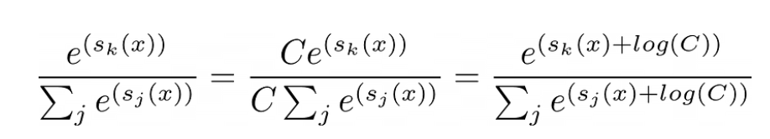
Softmax Function
Implementing it is a little bit tricky (Numerical Stability)
Normalizing is required by multiplying by a constant (negative of the max of the instance x )

Slide 16

LR Cost Function
J(θ) is the cost function
m is the number of training examples
hθ(x(i)) is the predicted output for the i-th training example
y(i) is the actual output for the i-th training example
Θ is the vector of parameters

Slide 17
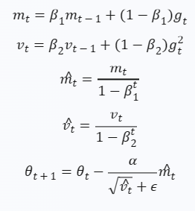
ADAM Optimizer
It combines ideas from two other optimization algorithms: RMSprop and Momentum
Adapts the learning rates of individual parameters by computing adaptive learning rates for each parameter.

Slide 18
ADAM Optimizer
It combines ideas from two other optimization algorithms: RMSprop and Momentum
Adapts the learning rates of individual parameters by computing adaptive learning rates for each parameter.

Slide 19
Implementation Steps
01
02
03
04
05
Standarizing
Encoding
Getting the probabilities
Fitting
Predicting
Normalizing X,y
Label Encoding the Data
SoftMax function is used to convert raw scores into probabilities.
Minimizng the error
finding the (class) with the highest probability for each data

Slide 20
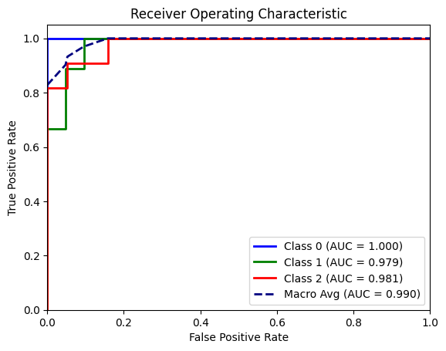
Results

Slide 21
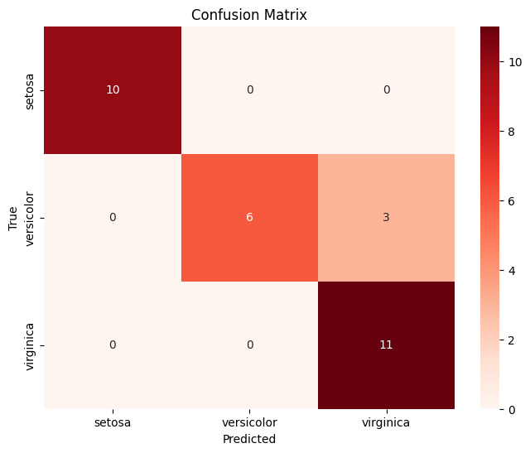
Results

Slide 22
Classification Report
setosa
versicolor
virginica
accuracy
macro avg
precision | recall
1.00 | 1.00
1.00 | 0.67
0.79 | 1.00
0.93 | 0.89
f1-score | support
1.00 | 10
0.80 | 9
0.88 | 11
0.90 | 30
0.89 | 30
weighted avg
0.92 | 0.90
0.90 | 30

Slide 23
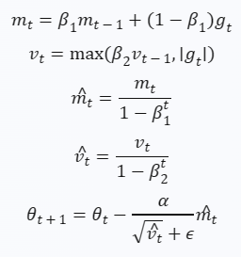
ADAMAX Optimizer
ADAM on Steroids
Is a variant of the Adam optimizer that uses the infinity norm for computing the second moment estimate
More robust in the presence of sparse gradients

Slide 24
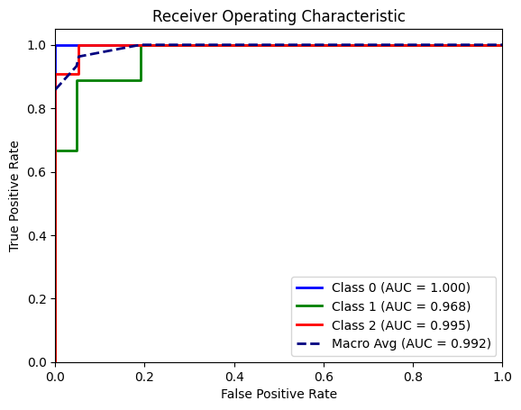
Results

Slide 25
Results

Slide 26
Classification Report
setosa
versicolor
virginica
accuracy
macro avg
precision | recall
1.00 | 1.00
1.00 | 0.67
0.79 | 1.00
0.93 | 0.89
f1-score | support
1.00 | 10
0.80 | 9
0.88 | 11
0.90 | 30
0.89 | 30
weighted avg
0.92 | 0.90
0.90 | 30

Slide 27
05 Code Implemetaton

Slide 28
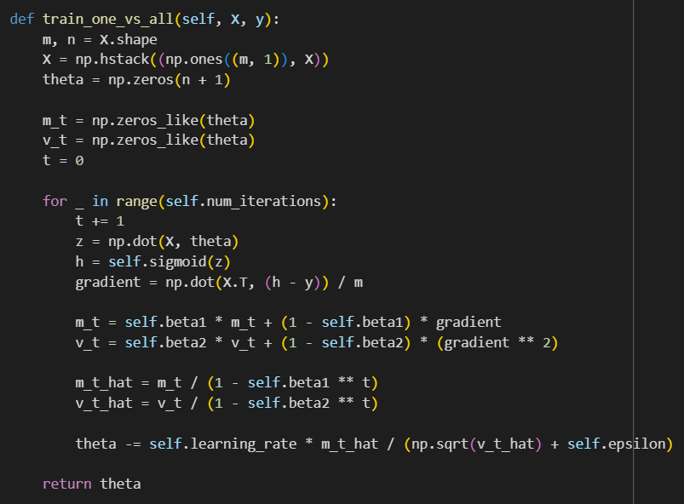

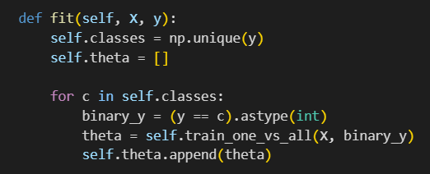
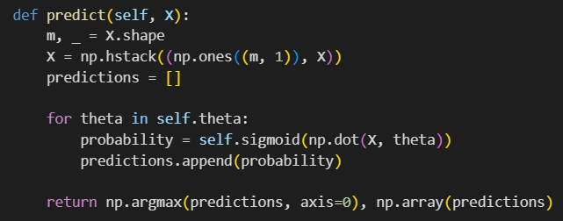
Binary LR with ADAM

Slide 29
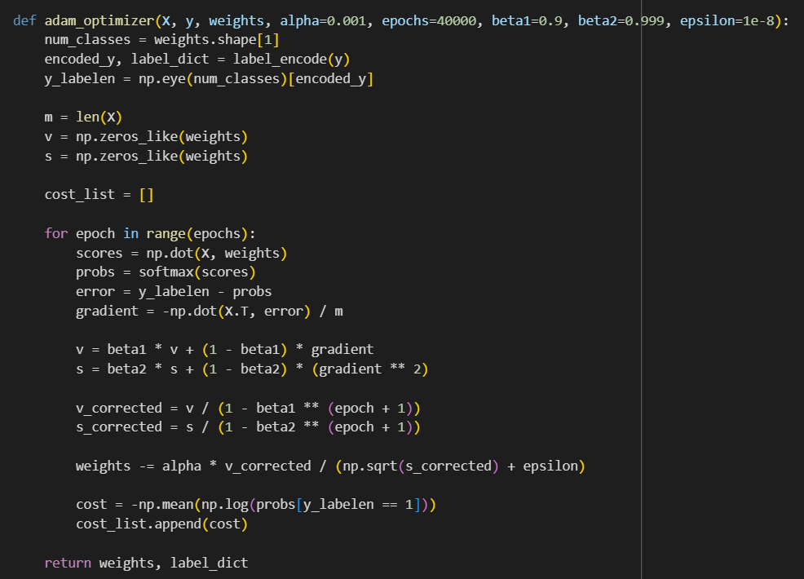
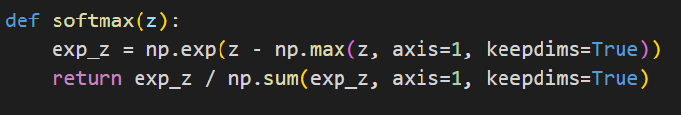
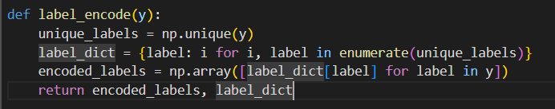
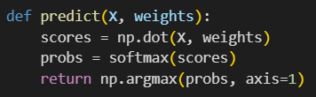
Multiclass LR with ADAM

Slide 30
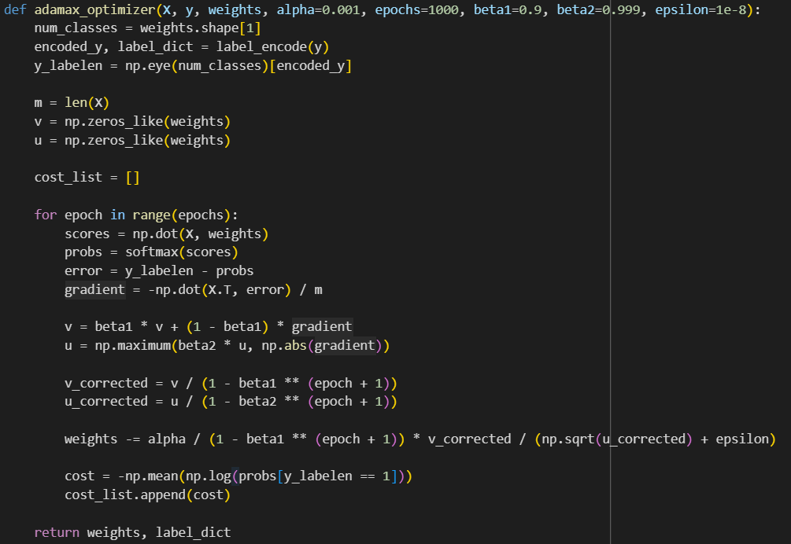
Multiclass LR with ADAMAX

Slide 31
Thanks

