Slide 1
Task 1
Visualization Challenge Concepts
Ali Haydar Özdağ
Amr Salah

Slide 2
In Task 5, we will use Horizon Chart to visualize the data .
We tried to understand the horizon chart in Task 1.

Slide 3
Some Graphs Types
Line Chart
Area Chart
Horizon Graph

Slide 4
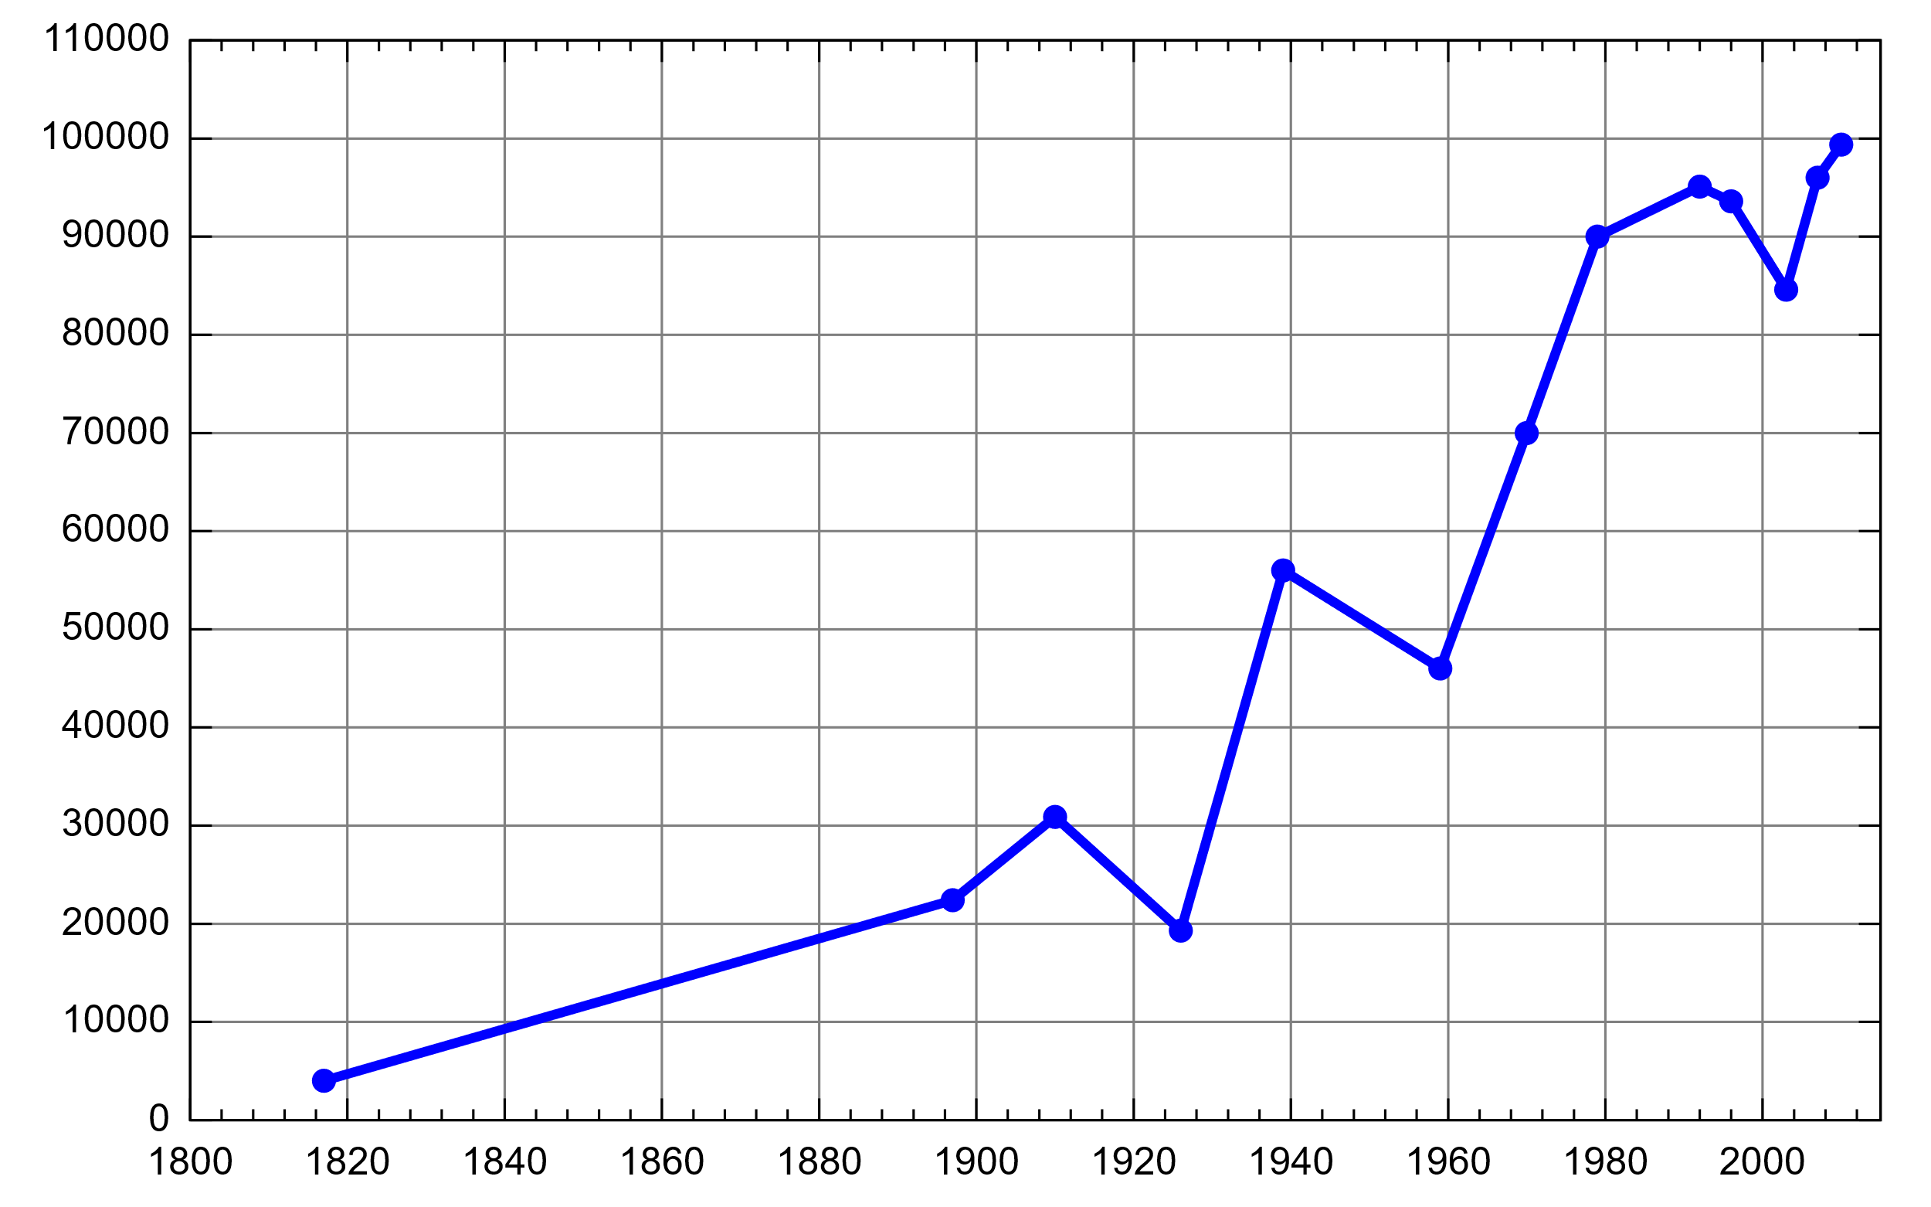
Line Chart
A Line Chart is a type of data visualisation that displays information as a series of data points connected by line.
Source: https://en.wikipedia.org/wiki/Line_chart

Slide 5
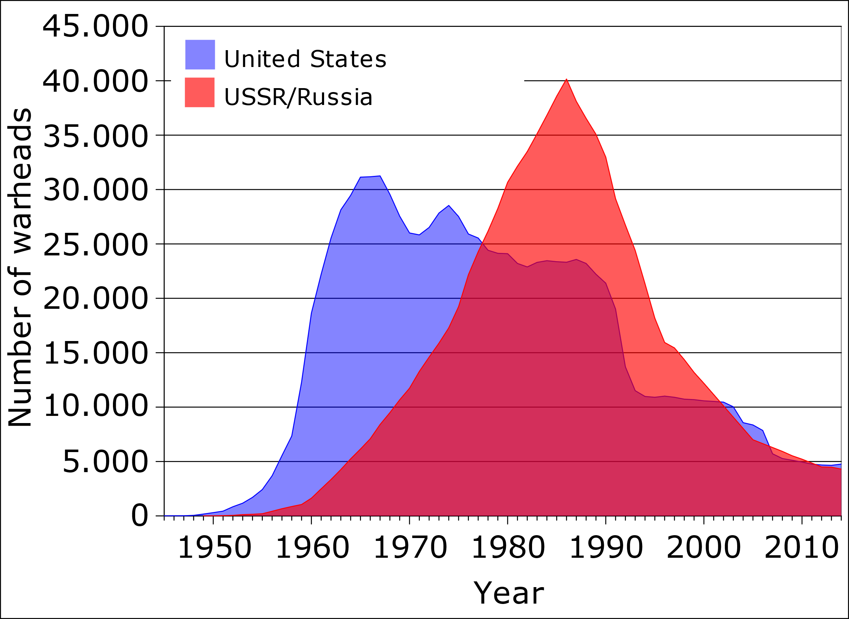
Area Chart
An Area Chart (or Area graph) displays graphically quantitative data. It is based on the line chart.
The area between axis and line are commonly emphasized with colors, textures and hatchings.
Source: https://en.wikipedia.org/wiki/Area_chart

Slide 6
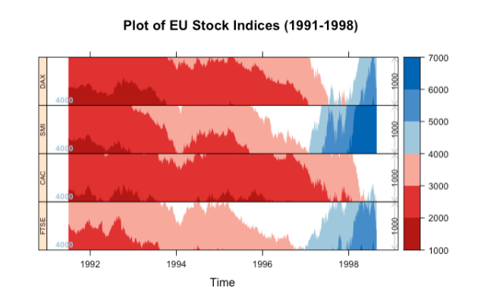
Horizon Graph
A Horizon Graph is a compact version of an area chart.
It is type of graph that increases the density of time series graphs by dividing and layering filled line charts.
source:https://datavis.blog/2022/04/30/horizon-charts-in-tableau/

Slide 7
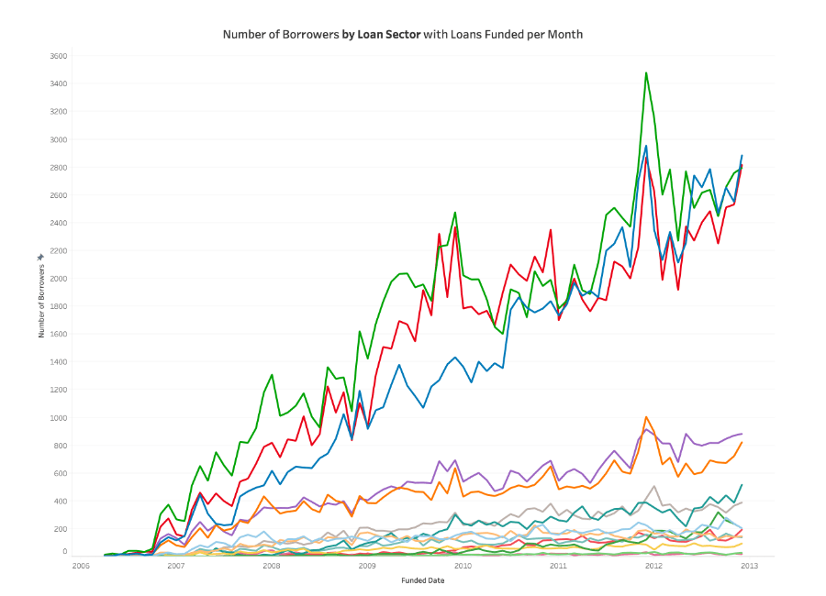
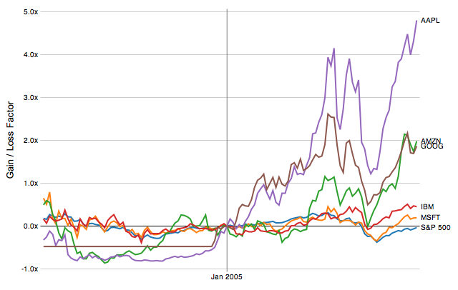
When we compare multiple data in a line chart, the chart becomes difficult to understand.
Source: https://www.tableau.com/data-insights/reference-library/visual-analytics/charts/line-charts
Source:https://homes.cs.washington.edu/~jheer/files/zoo/

Slide 8
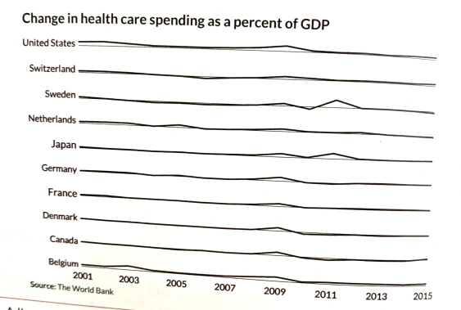
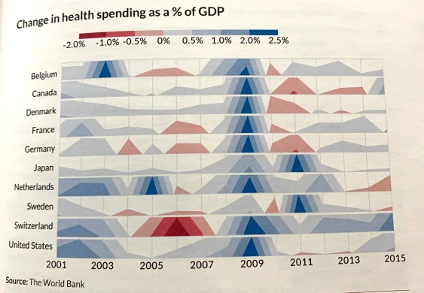
Compare public health spending (as a percentage of GDP)
source:https://datavis.blog/2022/04/30/horizon-charts-in-tableau/

Slide 9
Jonathan Schwabish:
...the purpose of the horizon chart is not necessarily to enable readers to pick out specific values, but instead to easily spot general trends and identify extreme values.
Schwabish, J. (2021). Better Data Visualizations. (page 164)
(Economist, Professor at American University)

Slide 10
Horizon chart can be preferred instead of line chart in the following situations:
Large amounts of data: Horizon charts are ideal for visualizing large amounts of data in a compact way.
Wide range of data: Horizon charts can better represent datasets with a large data range.
Highlighting general trends : Horizon charts can more clearly highlight overall trends and changes.
Comparisons: Horizon charts can be used to compare multiple datasets on the same chart.
Data point-dense situations: Horizon charts can present a more organized view than line charts in data-point-heavy situations.

Slide 11
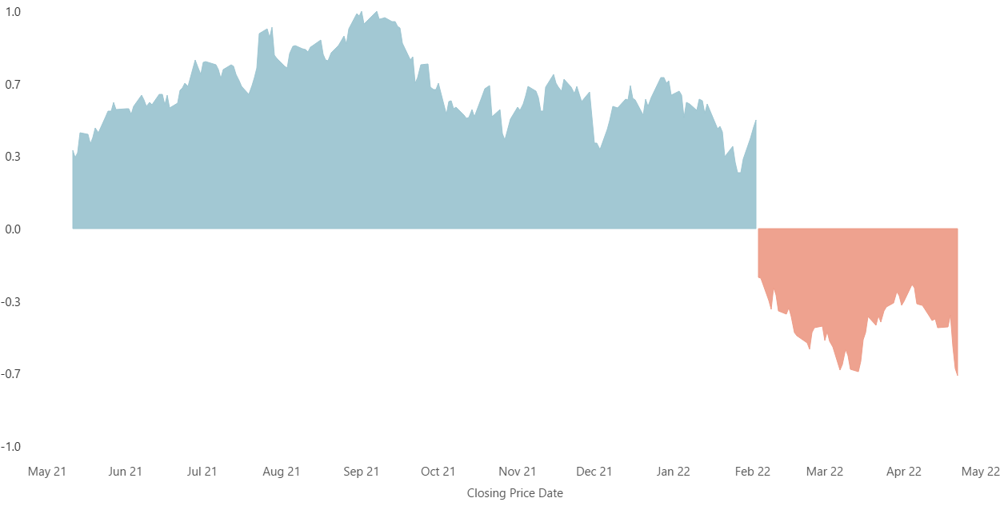

How to plot a horizon graph
A horizon chart can be created by ;
1) first dividing a filled line chart into uniformly sized, non-overlapping bands along the vertical axis.
source: https://datavis.blog/2022/04/30/horizon-charts-in-tableau/

Slide 12
source: https://datavis.blog/2022/04/30/horizon-charts-in-tableau/

Slide 13
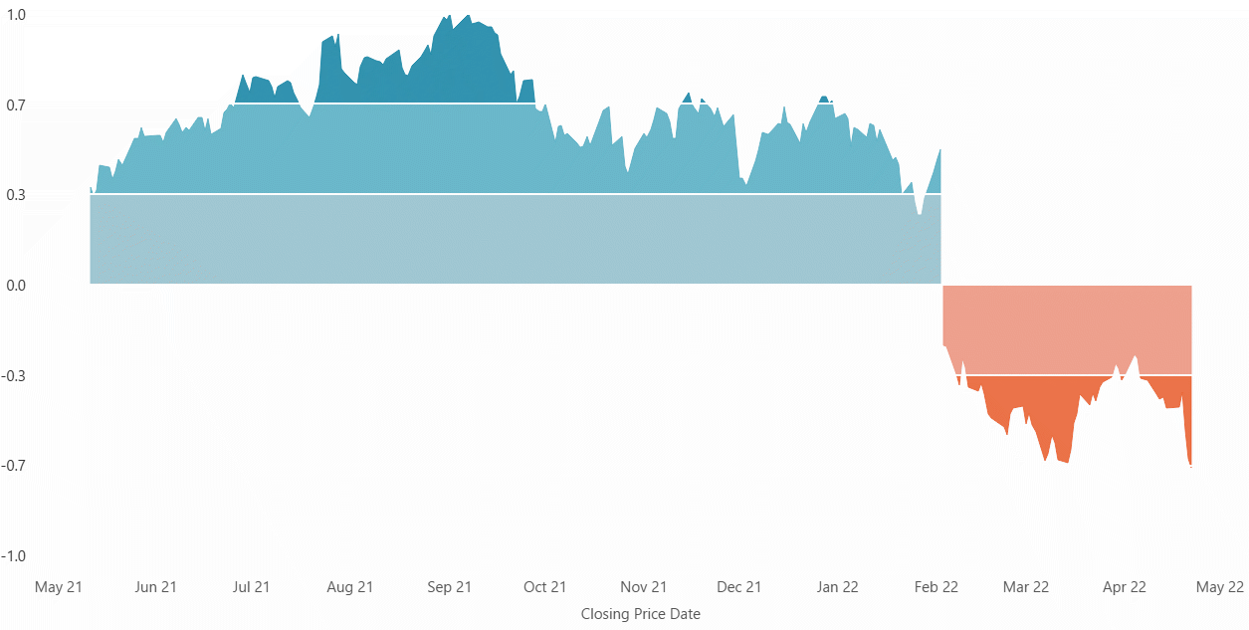
2) Each slice is then given a darker shade of colour based on the values contained within that slice:
source: https://datavis.blog/2022/04/30/horizon-charts-in-tableau/

Slide 14
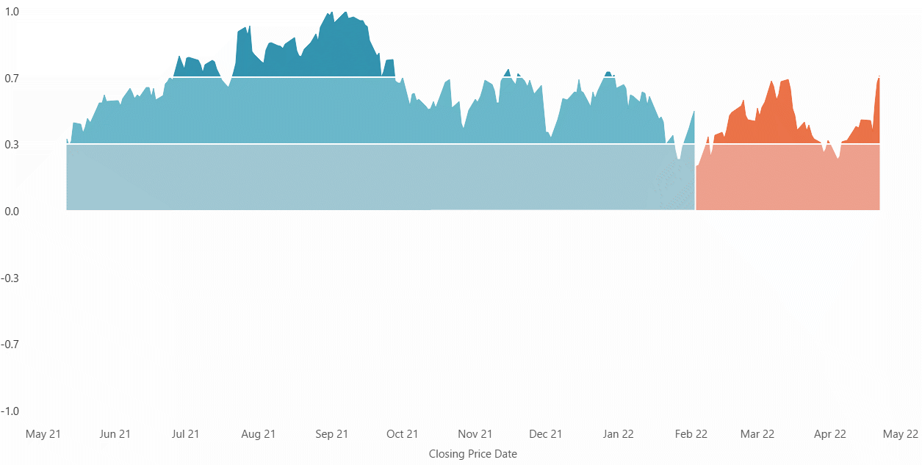
3) The negative values are then made positive so all areas are shown above the baseline with positive and negative values distinguished by colour:
source: https://datavis.blog/2022/04/30/horizon-charts-in-tableau/

Slide 15
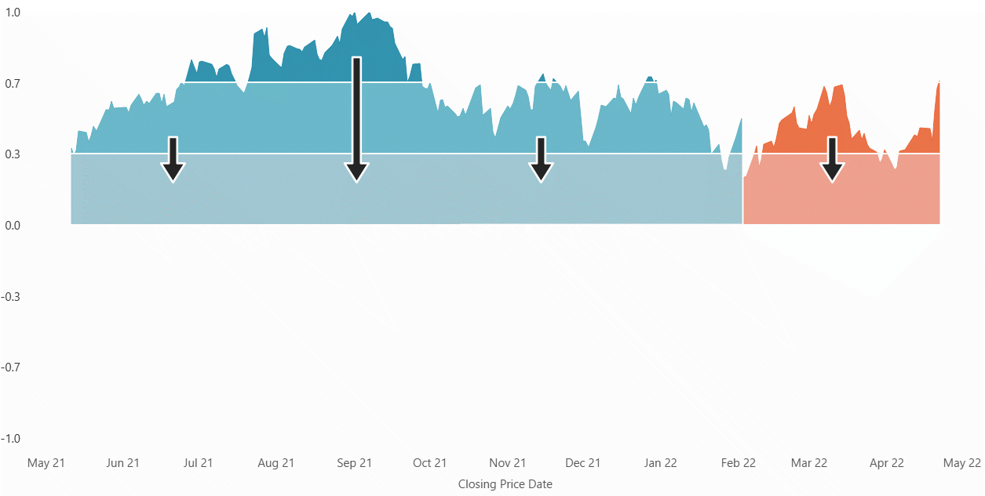
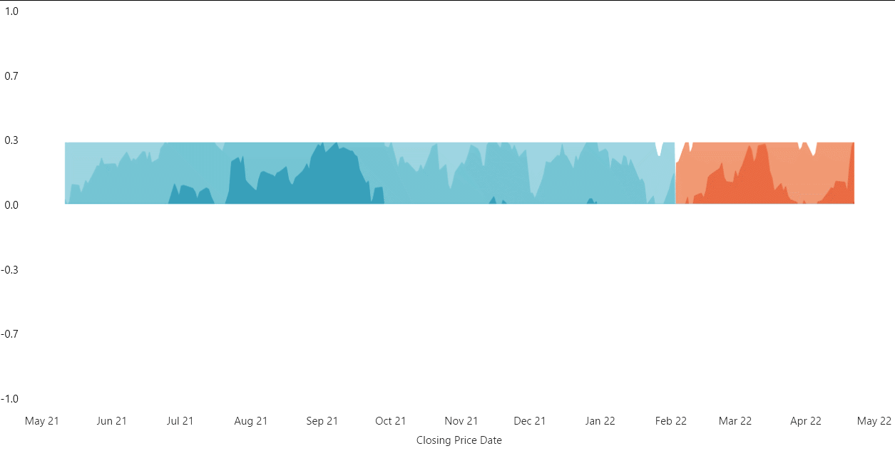
4)The upper slices then are then moved down and place on top each other, with the highest absolute value slices at the top:
source: https://datavis.blog/2022/04/30/horizon-charts-in-tableau/

Slide 16
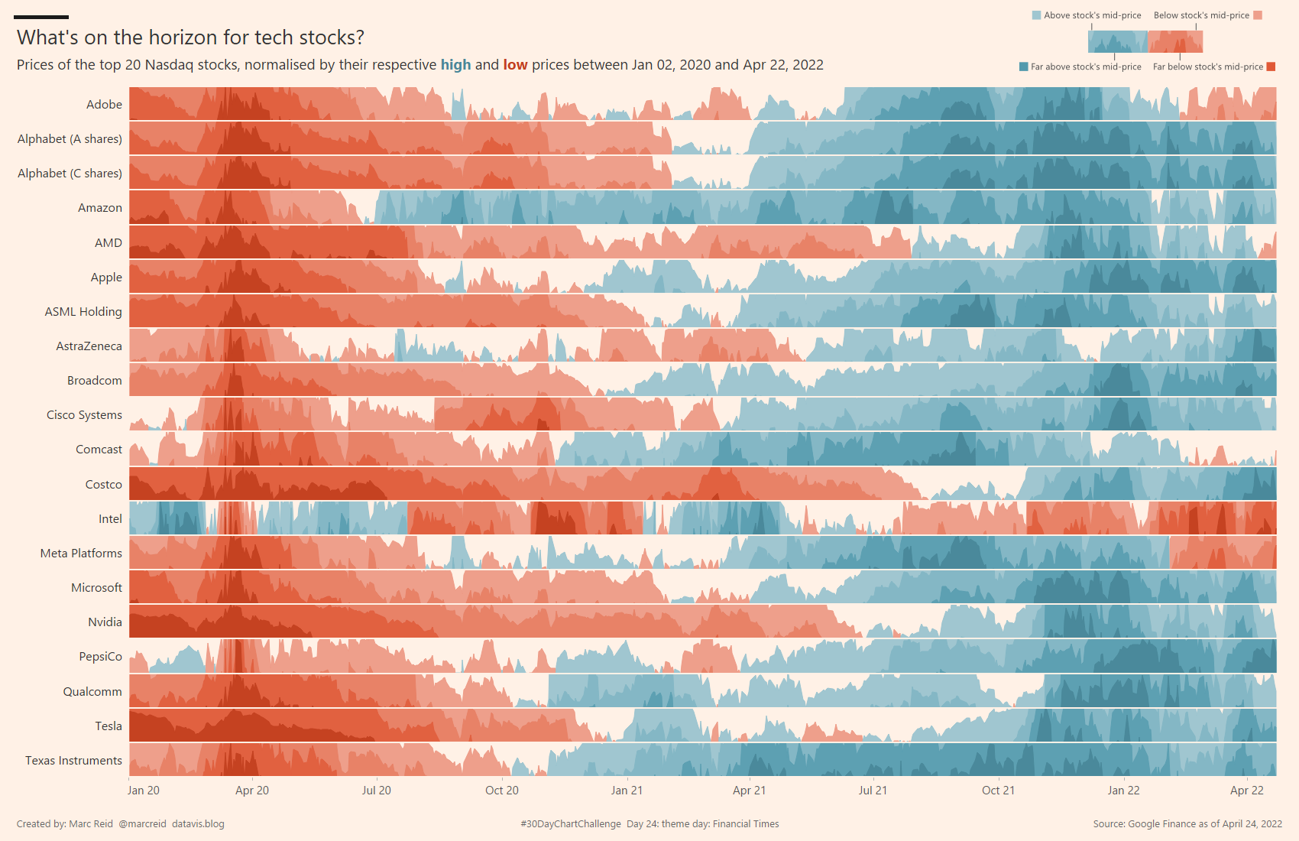
source: https://datavis.blog/2022/04/30/horizon-charts-in-tableau/

Slide 17
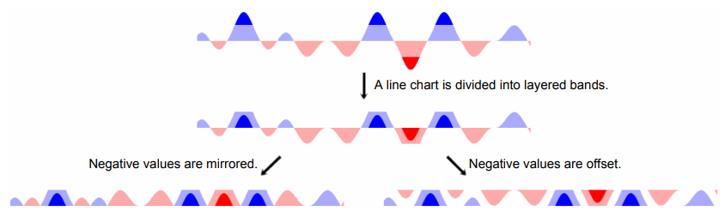
It is called a mirrored graphing because negative values reflected around the zero point.
There is also an alternative approach called offset graphing.
(We slide up the negative values.)
As a result, slopes the negative values are preserved, but the positive and negative values no longer share a common zero point.
source: Sizing the Horizon: The Effects of Chart Size and Layering on the Graphical Perception of Time Series Visualizations

Slide 18
EXPERIMENT 1: HORIZON GRAPH COMPARISON
(a) How does the choice of mirrored or offset horizon graph affect estimation time or accuracy?
(b) How does the number of bands in a horizon chart affect estimation time or accuracy?

Slide 19
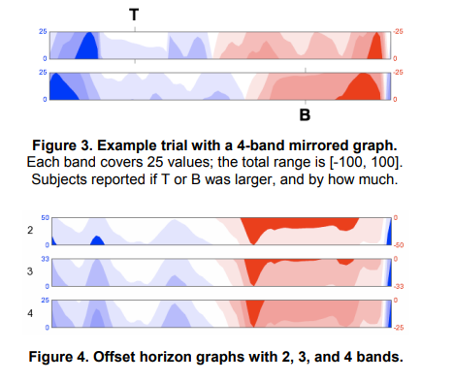
source: Sizing the Horizon: The Effects of Chart Size and Layering on the Graphical Perception of Time Series Visualizations

Slide 20
a) How does the choice of mirrored or offset horizon graph affect estimation time or accuracy?
RESULTS
No differences in prediction time or accuracy were found between chart types.

Slide 21
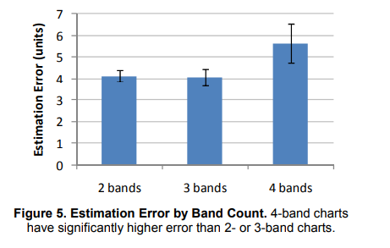
b-1)How does the number of bands in a horizon chart affect accuracy?
Pair-wise comparison of the band counts found that estimation accuracy was not significantly different across the 2 and 3 band cases but that the 4 band case was less accurate than both the 2 band and 3 band cases.
If the number of bands is increased to 4 or more, the Estimation Error may also increase.
source: Sizing the Horizon: The Effects of Chart Size and Layering on the Graphical Perception of Time Series Visualizations

Slide 22
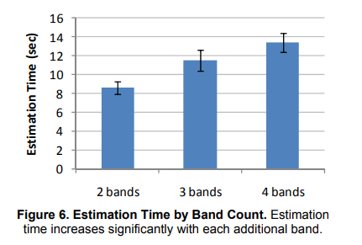
b-2) How does the number of bands in a horizon chart affect estimation time?
Pair-wise comparison of the band counts found significant differences between all levels, with a mean increase of 2.89 seconds between 2 and 3 bands and an increase of 1.91 seconds between 3 and 4 bands.
As the number of bands increases, the time to understand the graph becomes longer.
source: Sizing the Horizon: The Effects of Chart Size and Layering on the Graphical Perception of Time Series Visualizations

Slide 23
EXPERIMENT 2: CHART SIZE AND LAYERING
How do mirroring and layering affect estimation time and accuracy compared to line charts?
How does chart size affect estimation time and accuracy?
Note: In this experiment;
They compared line charts, mirrored charts without banding, and mirrored charts with two bands.

Slide 24
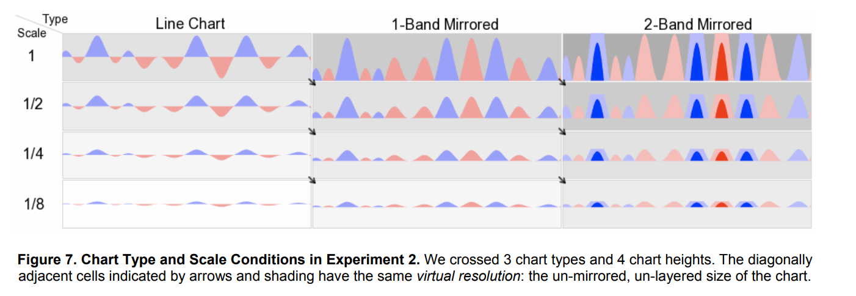
source: Sizing the Horizon: The Effects of Chart Size and Layering on the Graphical Perception of Time Series Visualizations

Slide 25
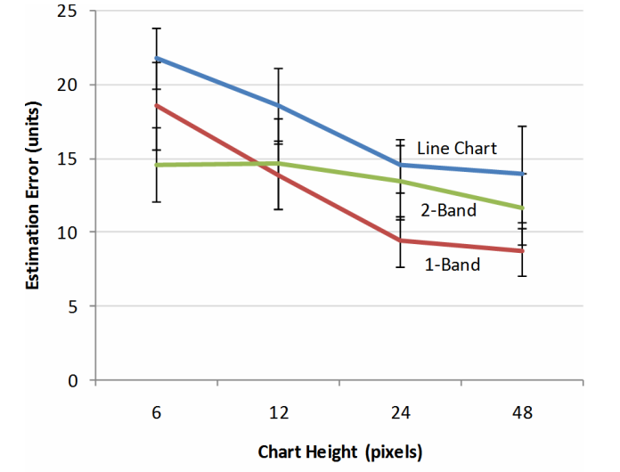
Results
Estimation Error Increases as Chart Height Decreases
Pair-wise comparisons showed a disadvantage for line charts against both 1- and 2-band mirror charts.
As the chart height increases, the estimation error decreases.

Slide 26
Layering Increases Estimation Time, Mirroring Does Not
2-band mirror charts were slower than normal time series by 2.05 seconds on average and 1-band mirror charts by 1.91 on average sec. 1-band charts faster than 2-band charts.
The result is consistent with Experiment 1, where increasing the band count slowed estimation.
There is no difference between 1- band mirror charts and line charts

Slide 27
Estimation Time Decreases with Chart Height
As the chart height decreases, the estimation time decreases.

Slide 28
How do mirroring and layering affect estimation time and accuracy compared to line charts?
At the two largest chart sizes, 1-band charts were faster and more accurate than 2-band charts.
1-band mirror charts exhibited equal or better speed and accuracy than normal line charts that were twice as tall.

Slide 29
How does chart size affect estimation time and accuracy?
The smaller the chart size, the greater the estimation error, and this happens unevenly across chart types.
The smaller the chart size, the faster the subjects made their predictions.

Slide 30
Layered Bands Are Beneficial As Chart Size Decreases
It has been found that dividing a chart into layered bands reliably increased estimation time and increased estimation error at constant chart heights.
Optimal Chart Sizing
For each chart type there is at least one size that minimized estimation time while preserving accuracy.
For both normal line charts and 1-band mirror charts, it has been found a chart height of 24 pixels (6.8 mm on our 14.1” 1024 × 768 pixel displays) to be optimal.

Slide 31
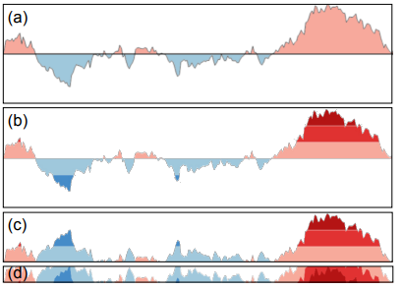
Interactive Horizon Graphs
IHG are inspired by pan and zoom techniques and unify Reduced Line Charts (RLC) and Horizon Graphs (HG), two of the most effective techniques for visualizing multiple time series.
IHG has designed it to increase the number of time series that can be viewed and explored efficie

Slide 32
Reduced Line Charts
Reduced Line Charts (RLC): RLC are small multiples for time series using line charts. ntly.

Slide 33
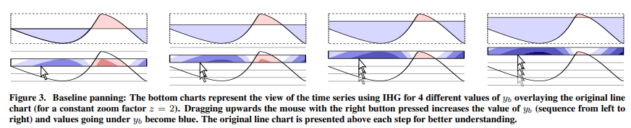
Baseline Panning

Slide 34
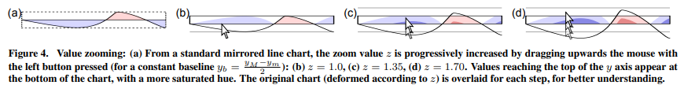
Zoom

Slide 35
SUMMARY AND DISCUSSION: Interactive Horizon Graphs
The results confirm the hypothesis that IHG were better than RLC and HG for large numbers of LSV(small scale variations) time series.

