Slide 1
Skill 1: Ransomware Tabletop Exercise Template
Manual + AI Agent

Slide 2
Part 1: Manual

Slide 3
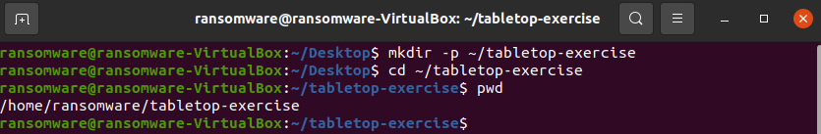
Step 1: Create the project folder
A folder dedicated to the Tabletop Exercise was created to document the scenario and decisions.

Slide 4
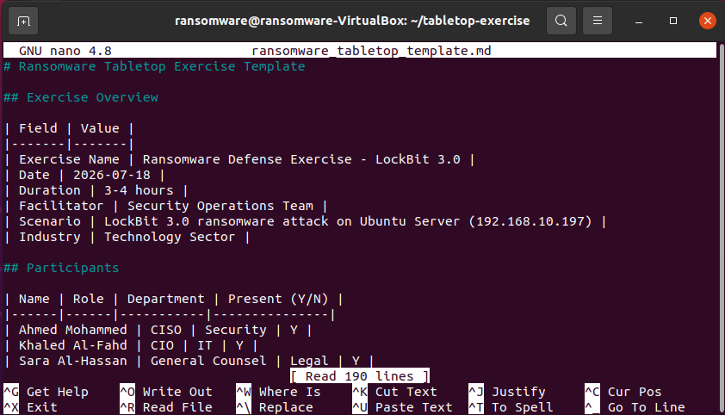
Step 2: Create the master template file
A Markdown file containing the complete ransomware exercise template has been created.

Slide 5
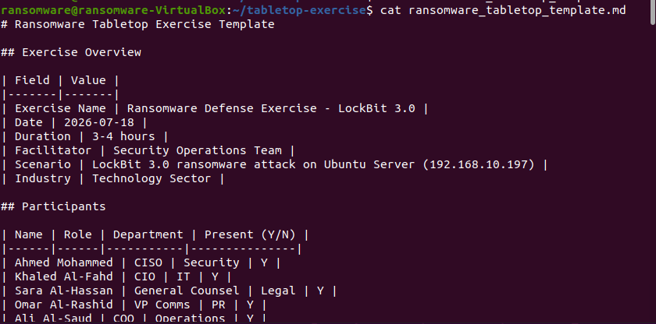
Step 3: View the file content

Slide 6
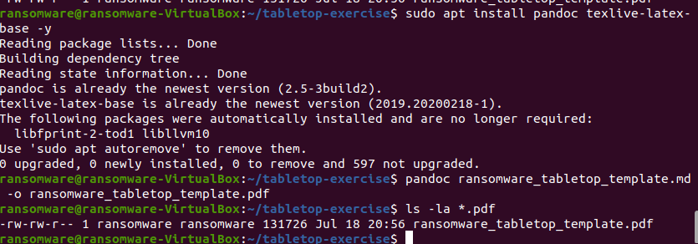
Step 4: Convert the file to PDF & view the content

Slide 7
Part 2: AI Agent
An AI Agent is a program (script) written in Python or Bash that performs tasks automatically without human intervention.

Slide 8
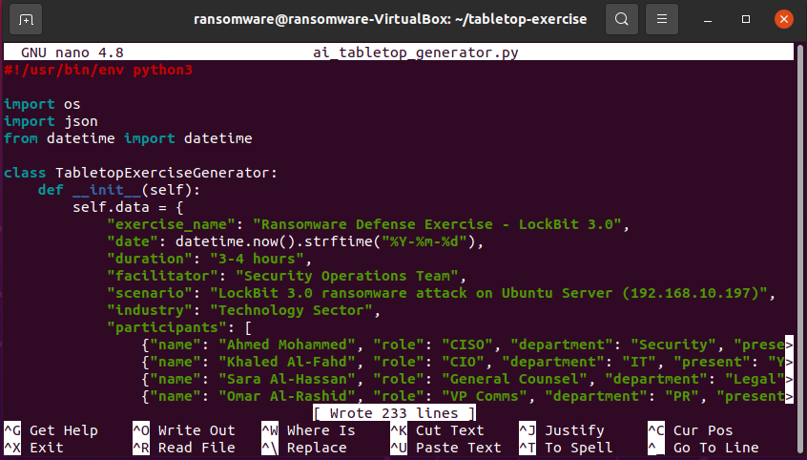
Step 5: Create an AI Agent to automatically fill in the template & Writing code
An AI Agent (Python script) was created to:
Storage all exercise data (scenario, participants, decisions, evaluation) in a data structure.
Automatically generate a complete Markdown file.
Export data in JSON format.
Display an exercise summary.

Slide 9
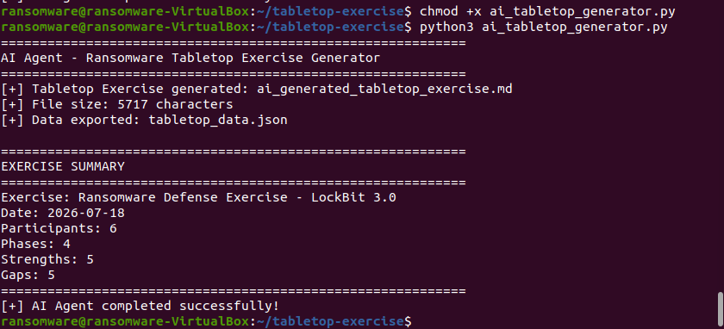
Step 6: Grant execution permissions & run the AI ​​Agent
The AI ​​Agent that generated the entire Tabletop Exercise was run automatically.

Slide 10
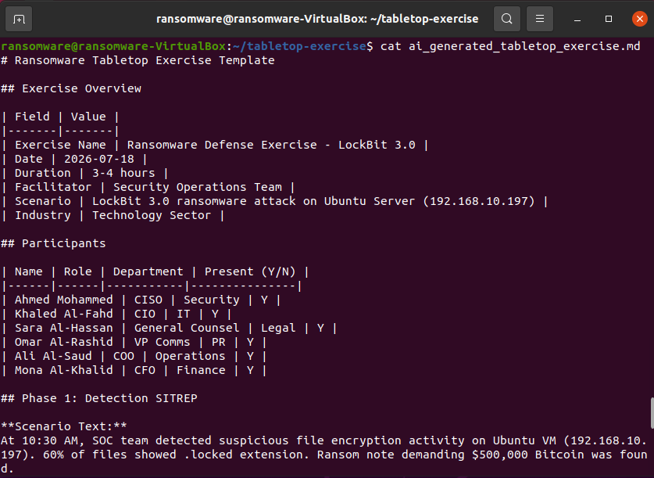
Step 7: Display the file generated by the AI ​​Agent
The file that was automatically generated by the AI ​​Agent was displayed to ensure its completeness and quality.

Slide 11
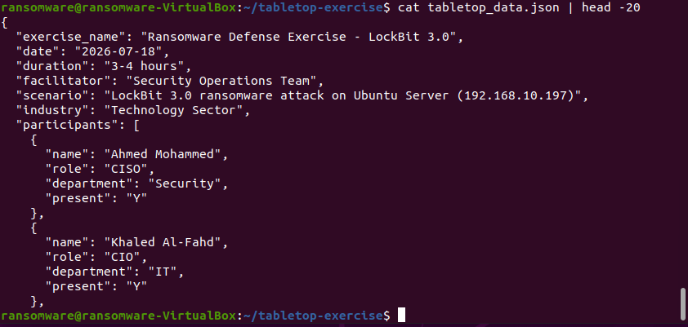
Step 8: Display the exported JSON data
The JSON data exported by the AI ​​Agent was displayed (containing all the exercise data).

Slide 12
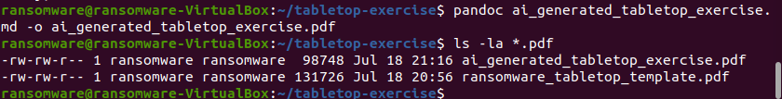
Step 9: Convert the generated file to PDF
The automatically generated exercise file was converted to PDF for the final report.

Slide 13
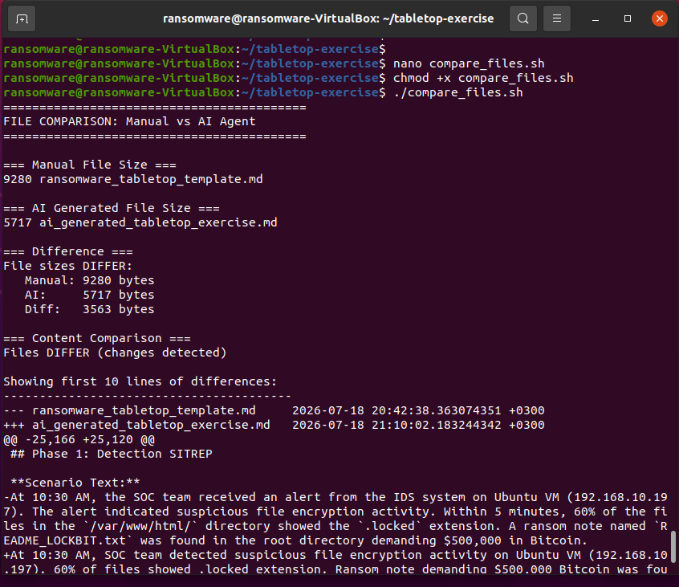
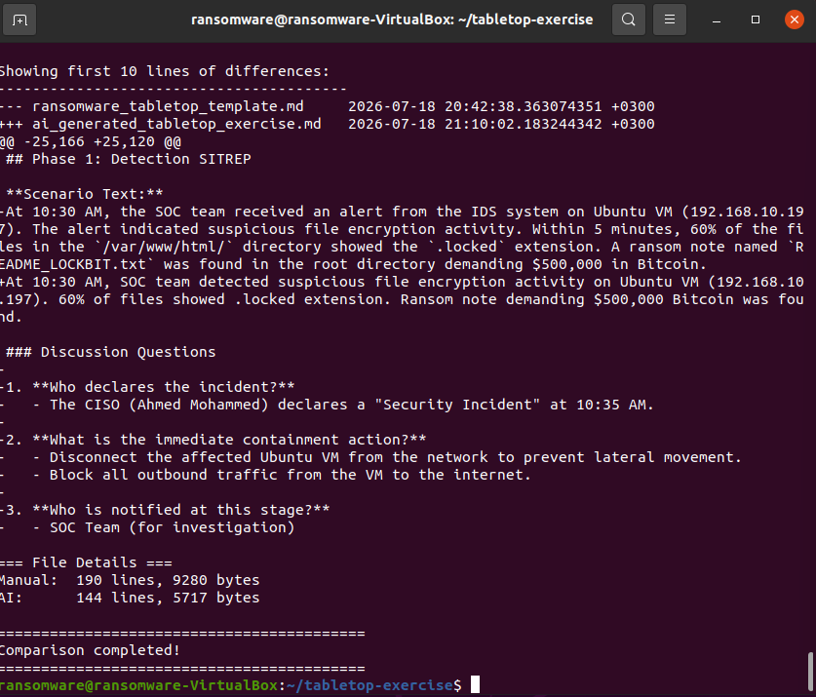
Step 10: Comparing the manual and automated files
The manual file and the automatically generated file were compared to ensure the completeness of the content.

Slide 14
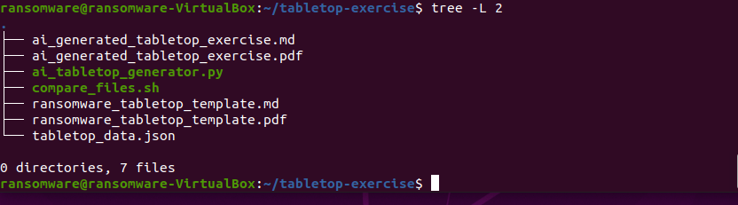
Step 11: View the final project structure
The final project structure, which includes manual and automated files, was presented.

