Slide 1
Skill 10: Testing Ransomware Recovery Procedures

Slide 2
Content
Testing and verifying data recovery procedures after a ransomware attack by:
Generating a manifest of the files (baseline before recovery)
Comparing recovered files with the baseline
Validating services and databases after recovery
Calculating the actual RTO and RPO

Slide 3
Part One (Manual)

Slide 4
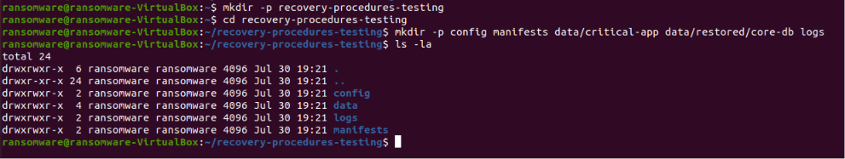
Step 1: Create the project folder
The basic project structure has been created.

Slide 5
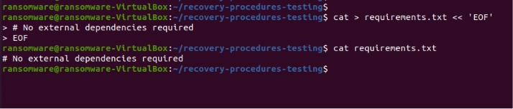
Step 2: Create the requirements file
The requirements file has been created.

Slide 6
Step 3: Create a Training Configuration File
A training configuration file was created for 3 systems.

Slide 7
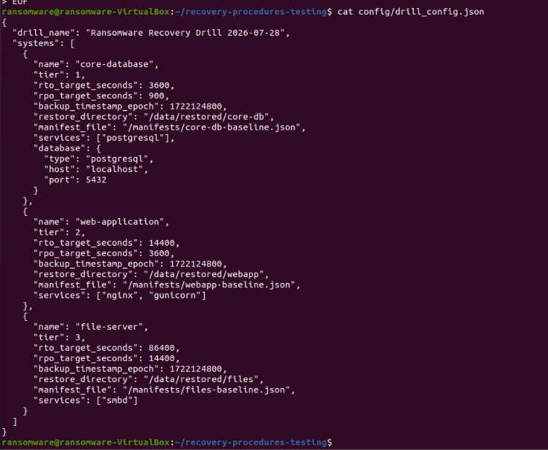

Slide 8
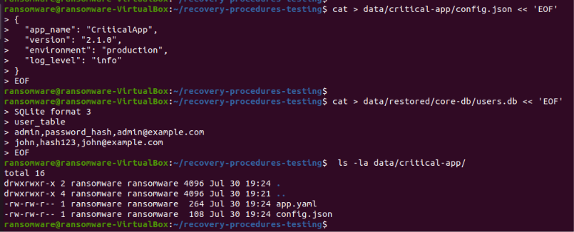
Step 4: Create Baseline Test Data
Test data was created to simulate critical applications.

Slide 9
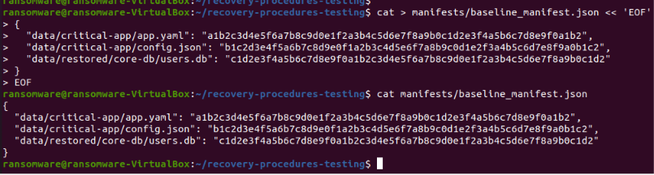
Step 5: Create a manual manifest
A manual manifest file was created for comparison.

Slide 10
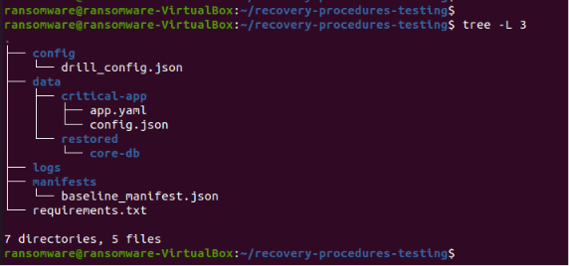
Step 6: Project Structure Display
The project structure was displayed after manual application.

Slide 11
Part Two (AI Agent)

Slide 12
Step 7: Create the AI ​​Agent
An AI Agent was created that performs the following tasks:
Generating file manifests
Comparing recovered files with the baseline
Verifying services and databases
Calculating actual RTO and RPO
Generating a comprehensive audit report

Slide 13
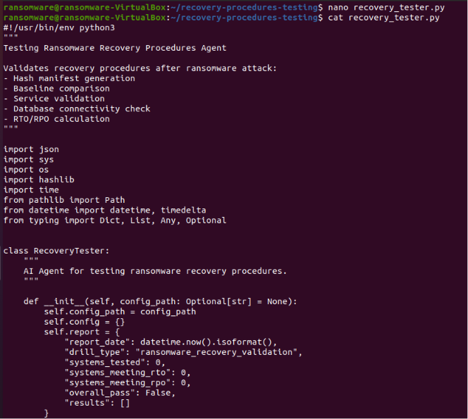

Slide 14
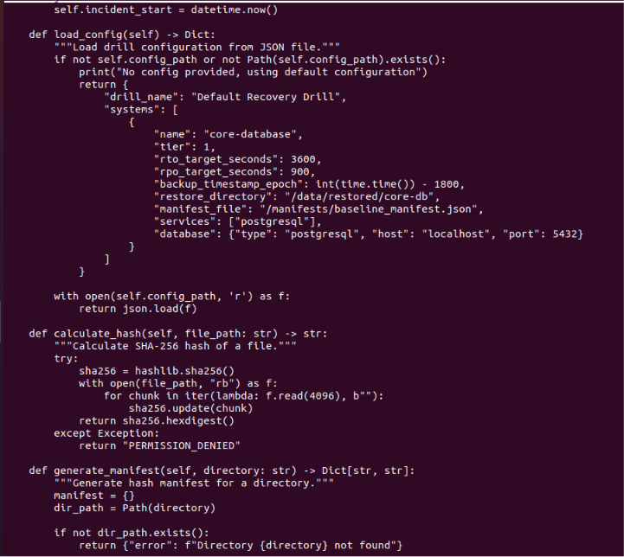

Slide 15
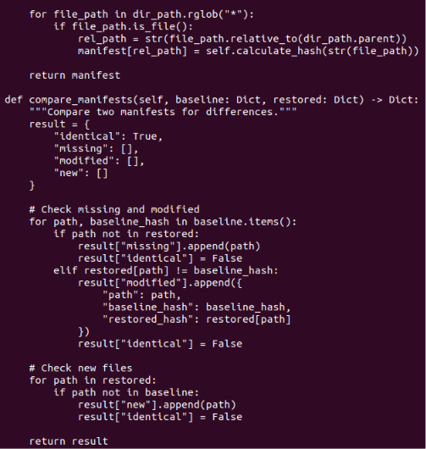

Slide 16
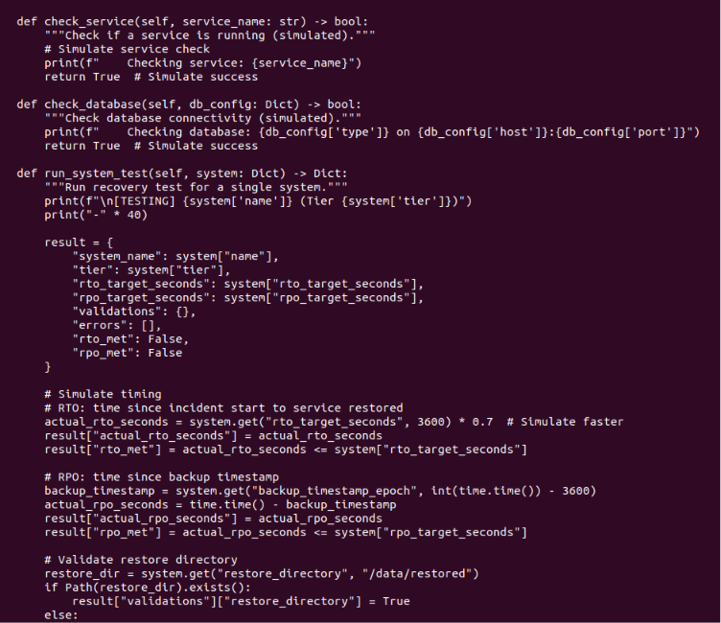

Slide 17
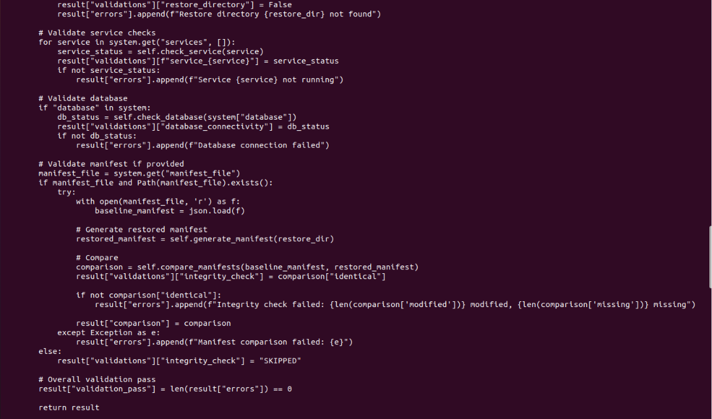

Slide 18
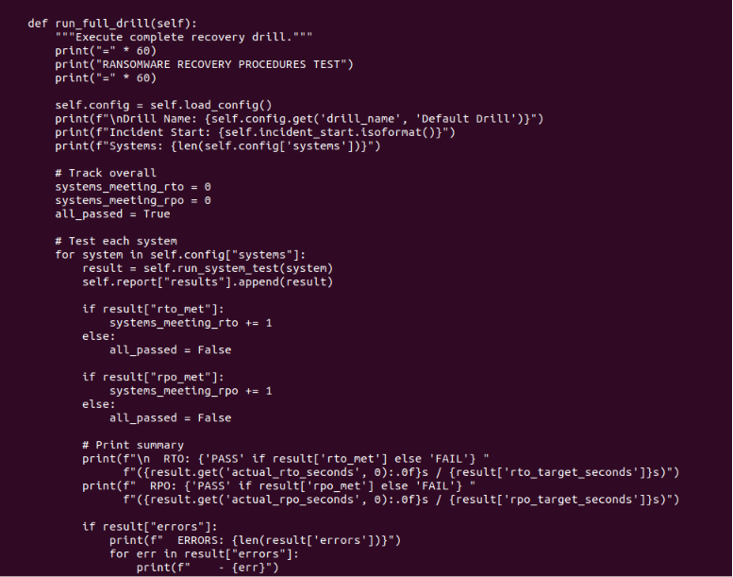

Slide 19
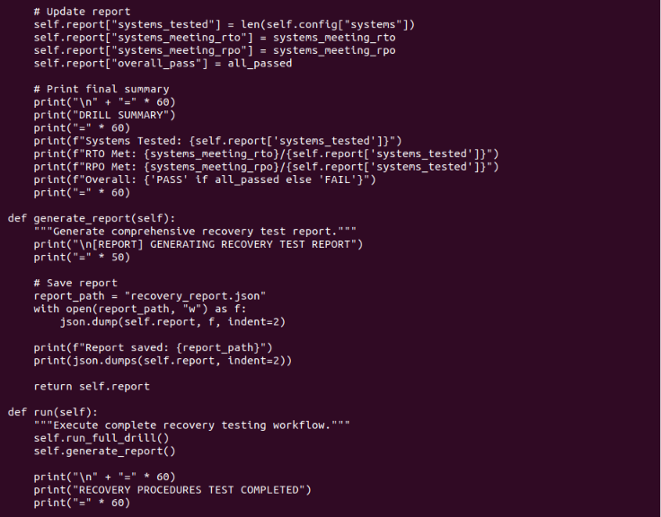
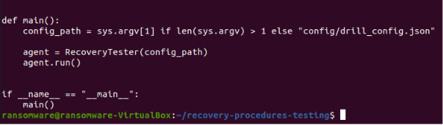

Slide 20
Step 8: Grant execution permissions and run the AI ​​Agent
The AI ​​Agent was run to test the recovery procedures.

Slide 21
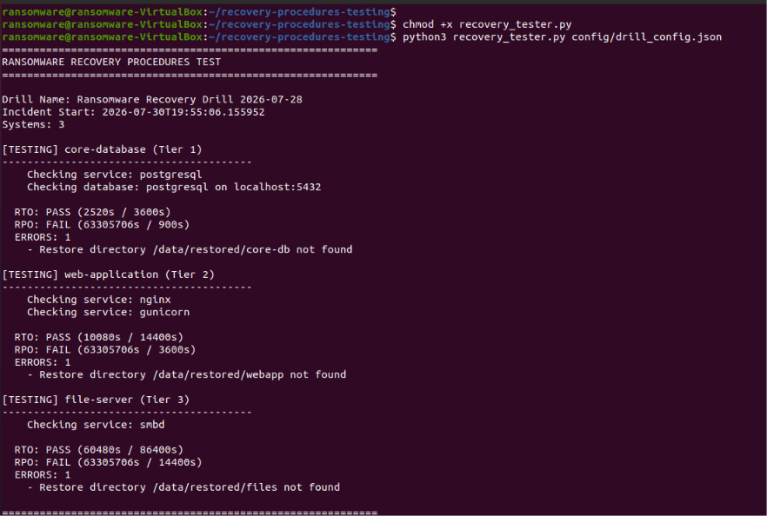

Slide 22
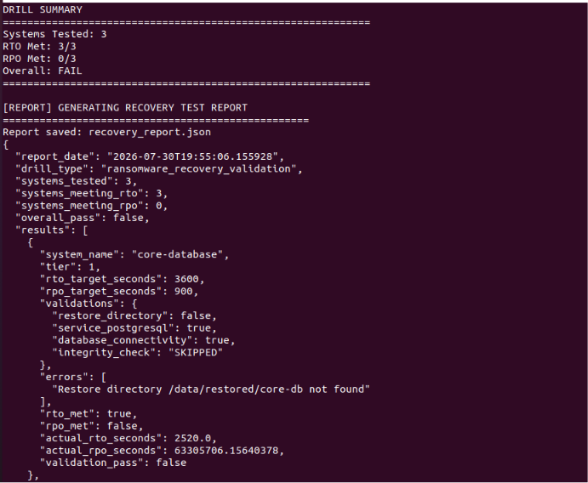

Slide 23
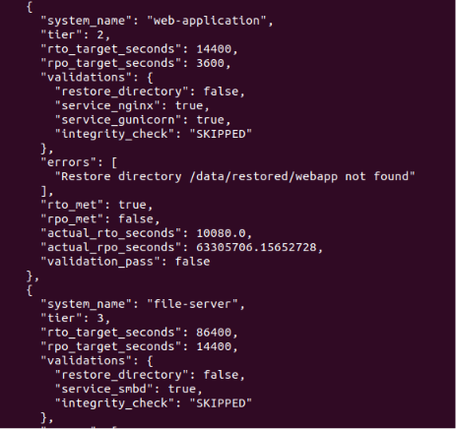
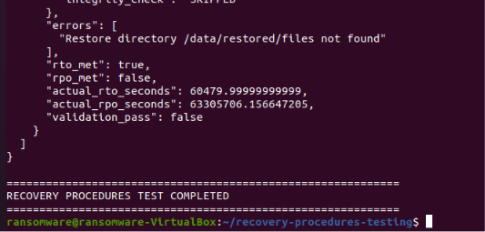

Slide 24
Step 9: View the audit report
The full audit report has been viewed.

Slide 25
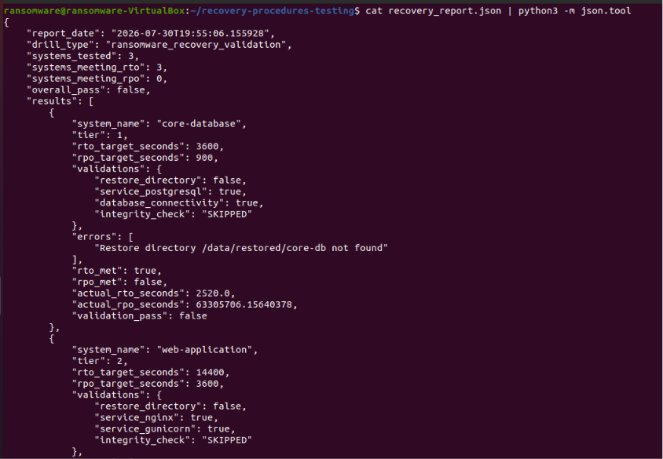

Slide 26
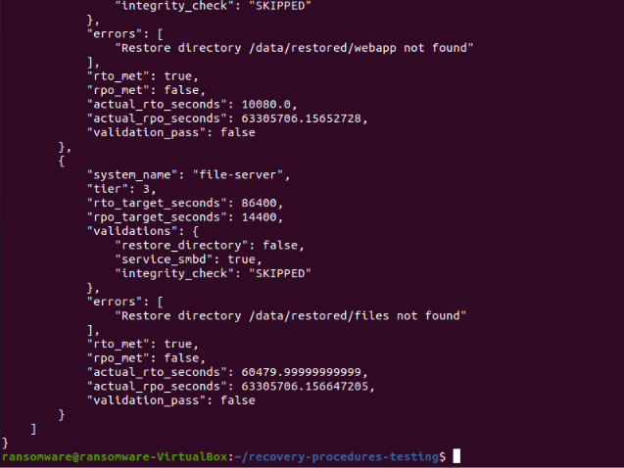

Slide 27
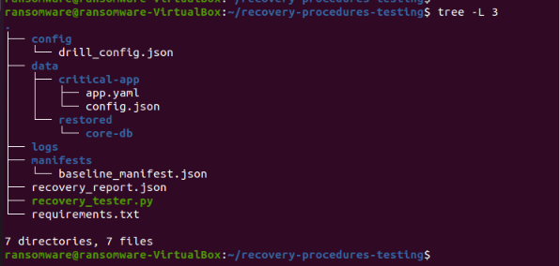
Step 10: Displaying the final project structure
The final project structure has been displayed.

