Slide 1
Skill 2: Ransomware Playbook Automation Agent

Slide 2
The goal of the skill
Developing an AI Agent automates the ransomware response process by:
Ransomware Identification
Host Isolation
Indications of Compromise (IOC) Extraction
Enterprise-wide IOC Scanning

Slide 3
Part One: Manual Application

Slide 4
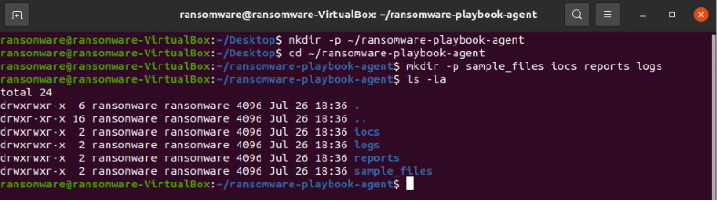
Step 1: Create the project folder
The basic project structure for the volumes has been created.

Slide 5
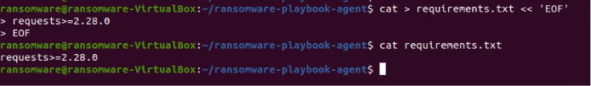
Step 2: Create the requirements file
A requirements.txt file was created to specify the required libraries.

Slide 6
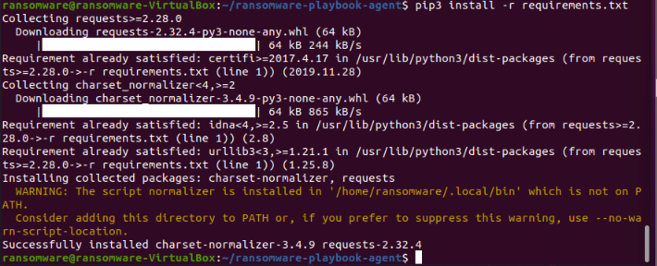
Step 3: Install Libraries
The requests library has been installed to communicate with the APIs.

Slide 7
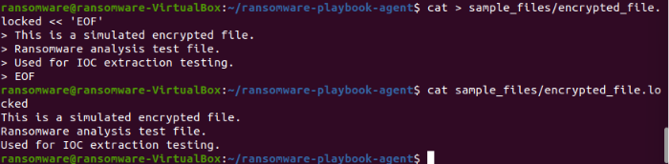
Step 4: Create a ransomware test file
A test file was created to simulate a ransomware-encrypted file.

Slide 8
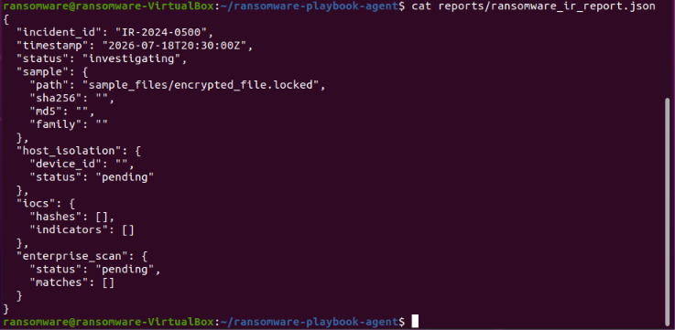
Step 5: Create the Report Structure File
A JSON report structure for incident response has been created.

Slide 9
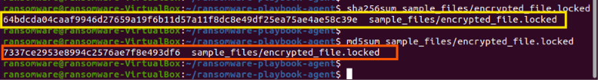
Step 6: Manually Calculate the File Hash
The hashes of the encrypted file were calculated manually.

Slide 10
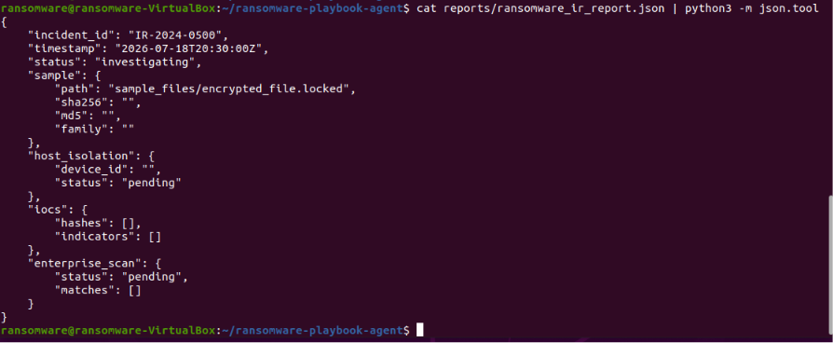
Step 7: Display the final report
The JSON report was displayed in an organized manner.

Slide 11
Part Two: AI Agent

Slide 12
Step 8: Create the AI ​​Agent + Grant Execution Permissions
The AI ​​Agent has been written and performs the following tasks:
Identifies the ransomware type from the file (Simulated)
Extracts IOC (Hashes, Indicators)
Isolates the host using CrowdStrike (Simulated)
Searches for IOCs within the organization using Splunk (Simulated)
Generates a full JSON report

Slide 13
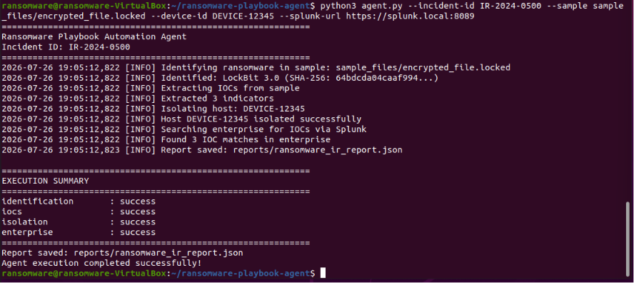
Step 9: Running the AI ​​Agent
The AI ​​Agent has been run with the required data.

Slide 14
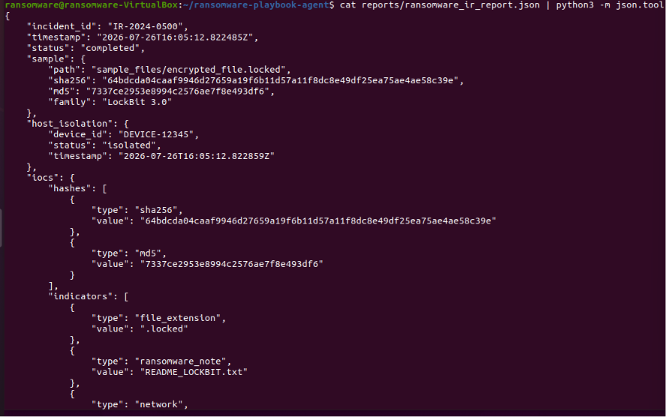
Step 10: Display the generated report
The complete report generated by the AI ​​Agent was displayed.

Slide 15
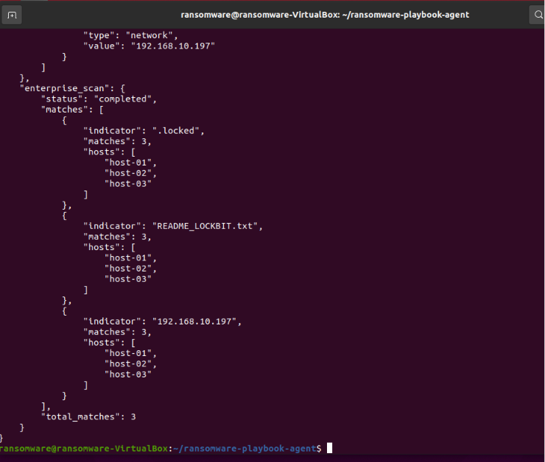

Slide 16
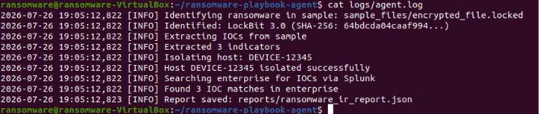
Step 11: View the Operation Log
The operation log was displayed to track the AI ​​Agent's progress.

Slide 17
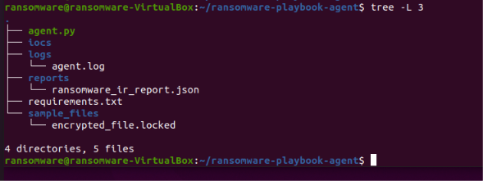
Step 12: Present the final project structure

