Slide 1
Skill 3: Ransomware Honeypot Deployment Template

Slide 2
The Skill's Objective
To deploy a honeypot system to detect ransomware attacks early by:
Creating canary files to attract attackers
Monitoring access to these files
Immediately triggering an alert upon detecting any access attempt
Integration with security systems (SIEM, NAC, EDR)

Slide 3
Part One: Manual Application

Slide 4
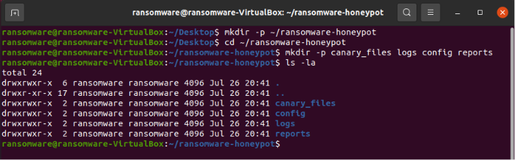
Step 1: Create the project folder
The basic project structure for the Honeypot system has been created.

Slide 5
Step 2: Creating the Deployment Template
The Honeypot deployment template was created and contains:
Deployment Plan (4 posts)
Bait File List (5 files)
Alarm Integration (SIEM, NAC, EDR)
Verification Test Results

Slide 6
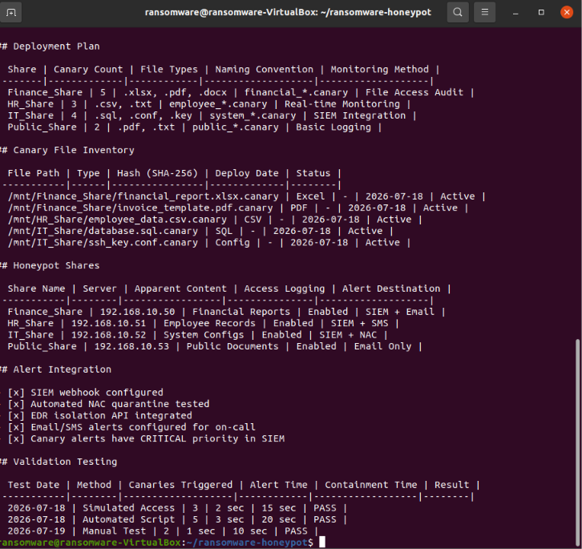

Slide 7
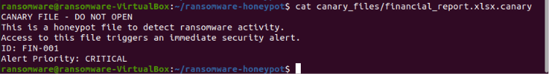
Step 3: Creating Bait Files
Four bait files (canary files) were created, each containing a clear warning.

Slide 8
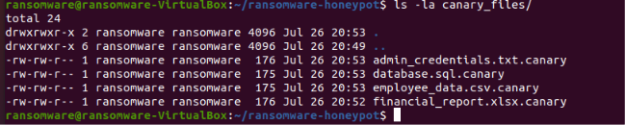
Step 4: View Bait Files
A list of created bait files is displayed.

Slide 9
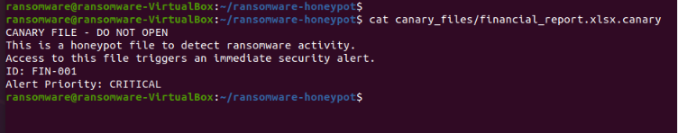
Step 5: View the bait file contents
The contents of one of the bait files were viewed to verify that it was created correctly.

Slide 10
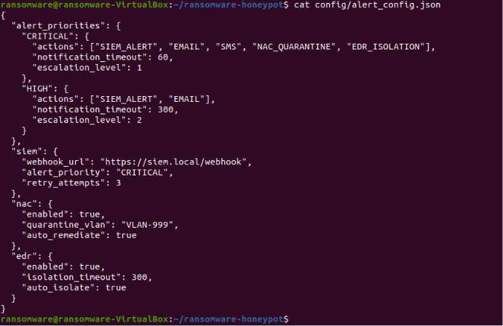
Step 6: Create an alarm configuration file
An alarm configuration file has been created that defines alarm priorities and actions to be taken.

Slide 11
Step 7: Run the monitoring script
The monitoring script was run in the background to monitor the bait files.

Slide 12

Step 8: Simulate Access to a Bait File
An unauthorized access to a bait file (Canary File) was simulated to test the alarm system.

Slide 13
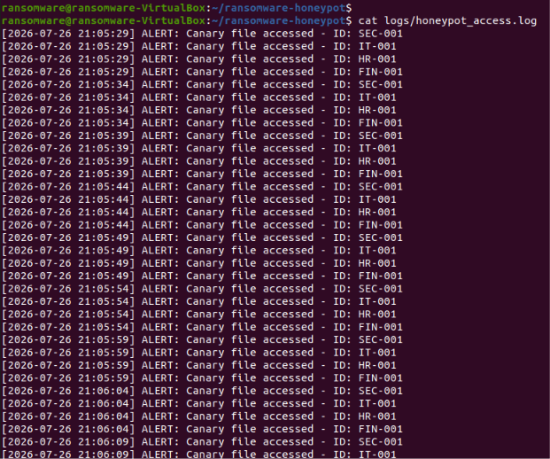
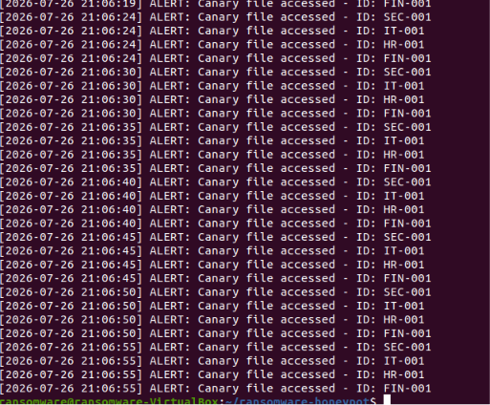
Step 9: View Monitoring Log
The log of access to the bait files was viewed to confirm that alarms were recorded.

Slide 14
Part Two: (AI Agent)

Slide 15
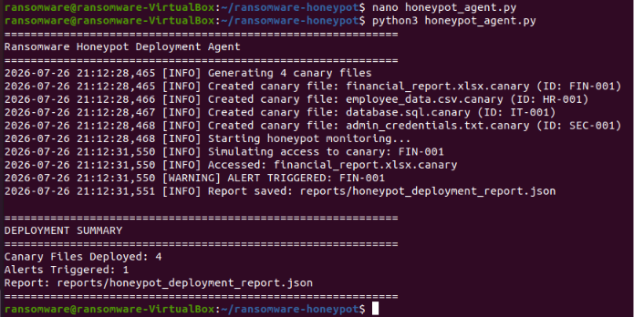
Step 10: Creating and Running the AI ​​Agent
The AI ​​agent has been created and will:
Automatically generate canary files
Monitor file access
Simulate unauthorized access
Generate a full JSON report

Slide 16
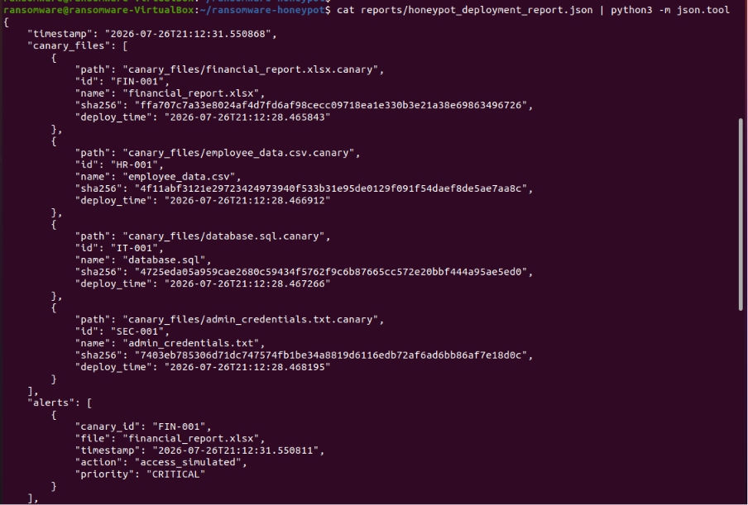
Step 11: Display the generated report
The complete report generated by the AI ​​Agent was displayed.

Slide 17
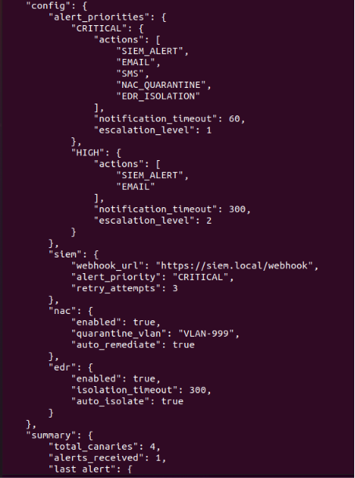
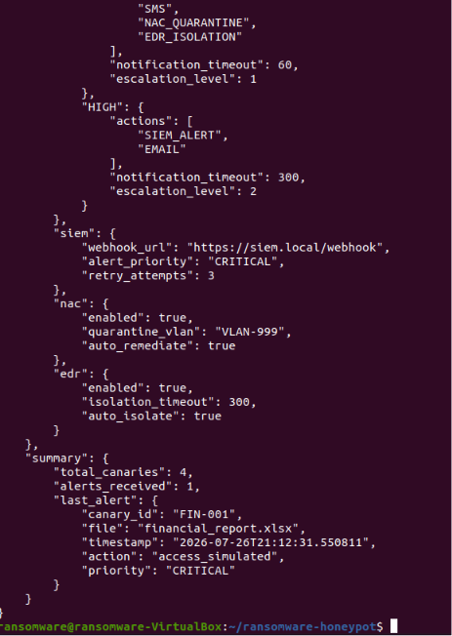

Slide 18
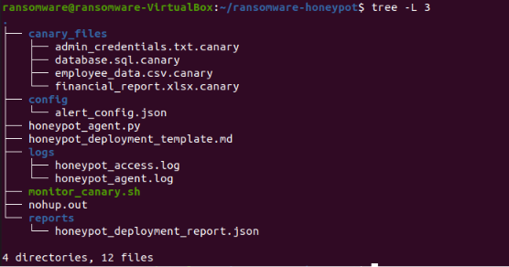
Step 12: View the final project structure

