Slide 1
Skill 4: Ransomware Response Agent

Slide 2
The objective of this skill is to develop an AI agent that automates the ransomware incident response process by:
Identifying the type of ransomware
Verifying the availability of decryptor tools
Conducting an impact assessment
Creating a containment checklist
Creating a recovery plan

Slide 3
Part One: Manual

Slide 4
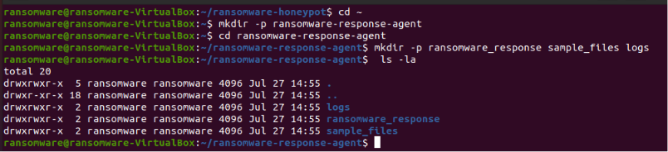
Step 1: Create the project folder
The basic project structure has been created.

Slide 5
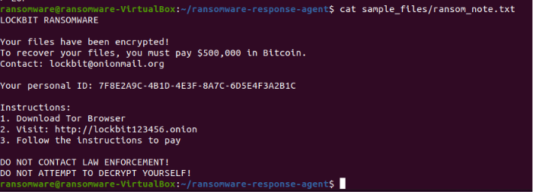
Step 2: Create the ransom note file
A file simulating a "Lockbit" ransom note has been created.

Slide 6
Step 3: Create a Dummy Encrypted File
A file simulating a ransomware-encrypted file was created.

Slide 7

Step 4: Manually Calculate the File Hash
The SHA-256 and MD5 hash values ​​of the encrypted file were calculated.

Slide 8
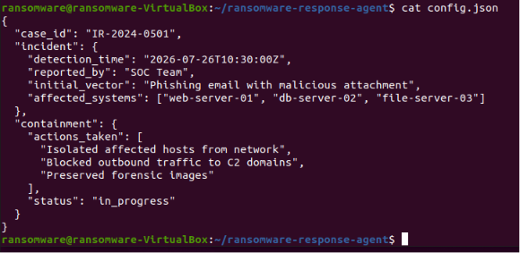
Step 5: Create a manual configuration file
A manual configuration file was created to document the incident.

Slide 9
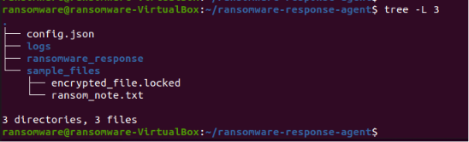
Step 6: Display the project structure (manual)
The project structure was displayed after the manual application.

Slide 10
Part Two: AI Agent

Slide 11
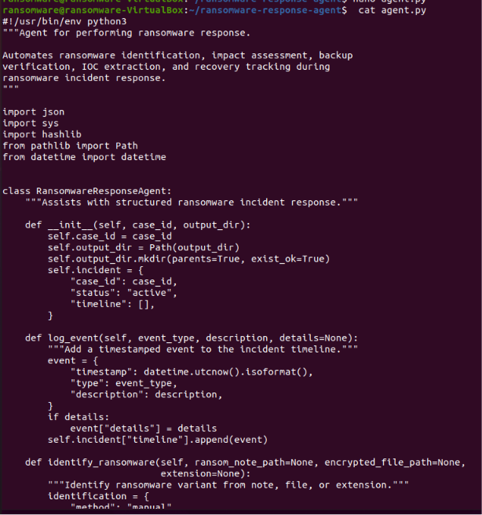
Step 7: Creating the AI ​​Agent
The AI ​​Agent has been created and will:
Identify the ransomware type from the note or file
Verify the availability of decryption tools
Assess the impact
Create a containment list (8 actions)
Create a recovery plan
Generate a complete JSON report

Slide 12
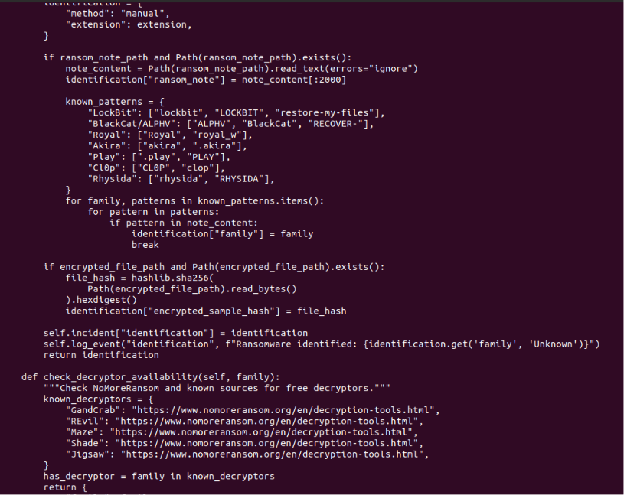

Slide 13
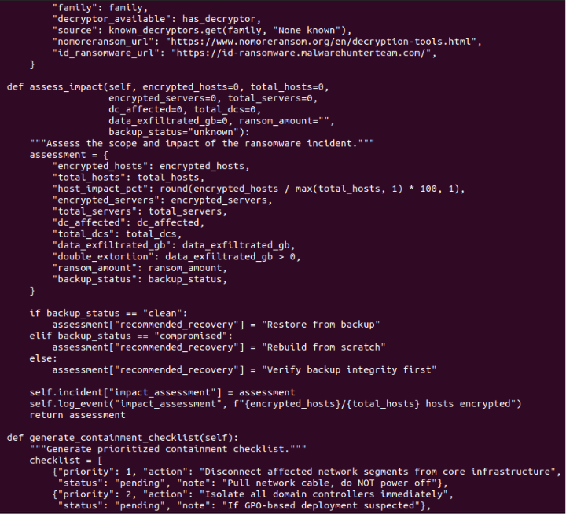

Slide 14
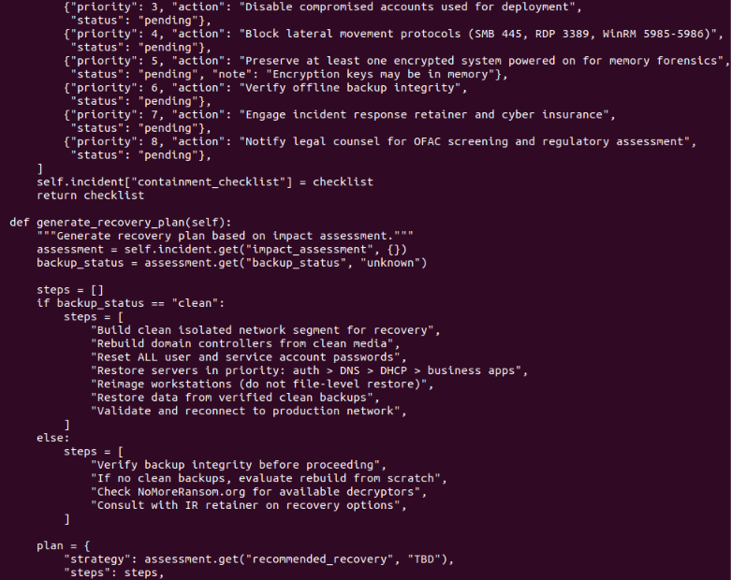

Slide 15
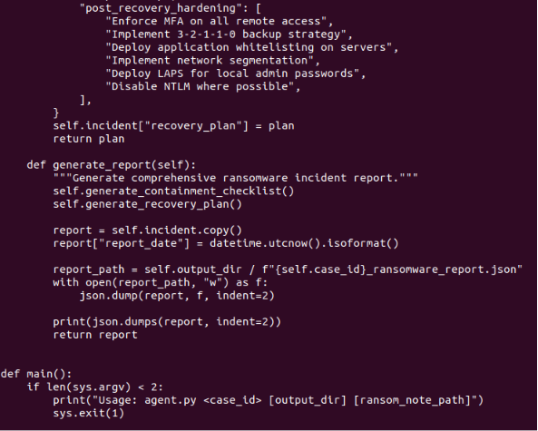
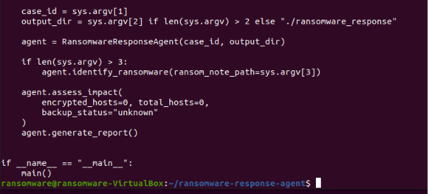

Slide 16
Step 8: Grant Execution Permission
Execution permission has been granted to the AI ​​Agent file.

Slide 17
Step 9: Run the AI ​​Agent
The AI ​​Agent has run with the following parameters:
Case ID: IR-2024-0501
Output Directory: ./ransomware_response
Ransom Note Path: sample_files/ransom_note.txt

Slide 18
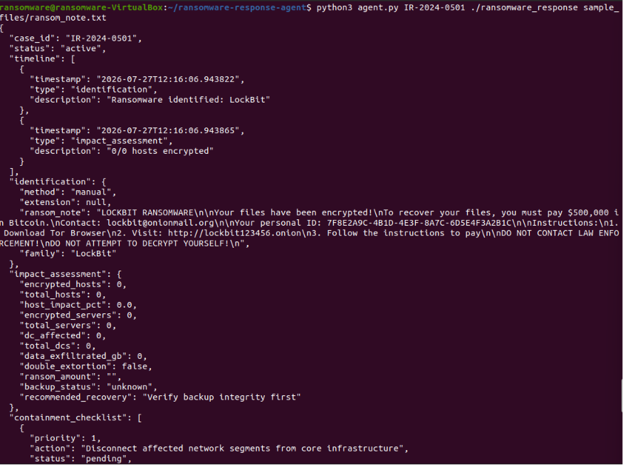

Slide 19
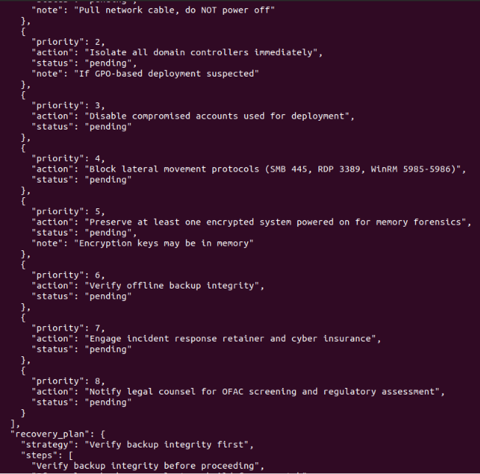
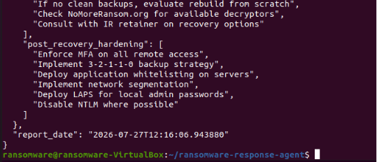

Slide 20
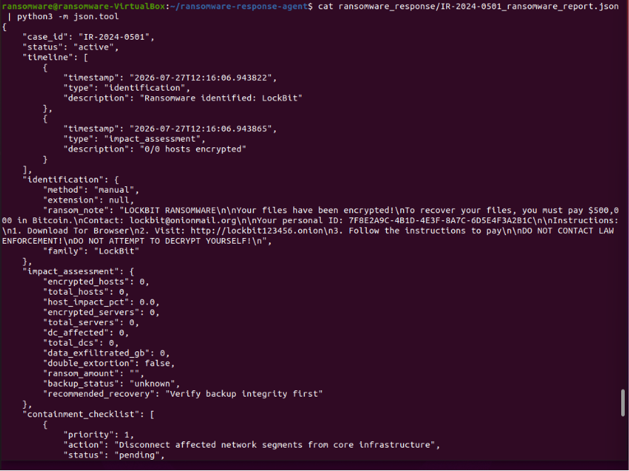
Step 10: Display the generated report
The complete report generated by the AI ​​Agent is displayed.

Slide 21
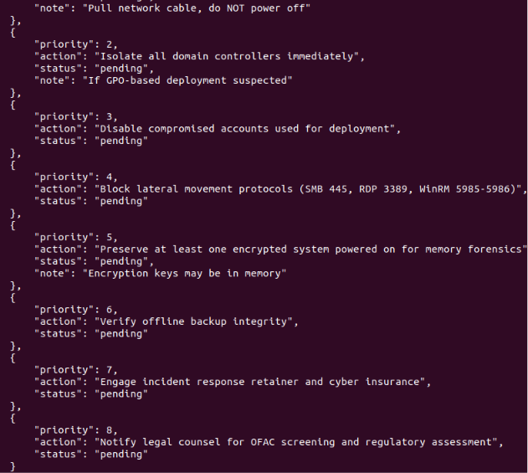
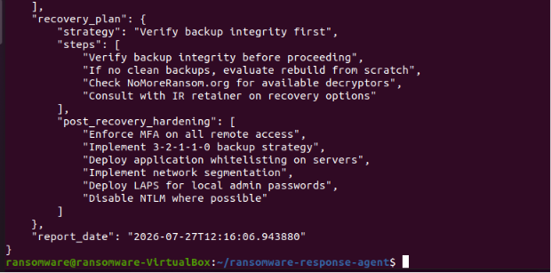

Slide 22
Step 11: Display the operation log
The AI ​​Agent operation log is displayed.

Slide 23
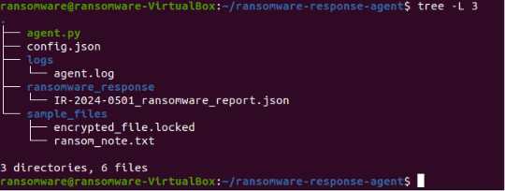
Step 12: Displaying the final project structure
The final project structure has been displayed.

