Slide 1
Skill 5: Performing Ransomware Response

Slide 2
The purpose of the skill
Implementing a systematic ransomware incident response from initial detection through containment, forensic analysis, decryption assessment, recovery, and post-incident improvements.

Slide 3
Part One: (Manual)

Slide 4
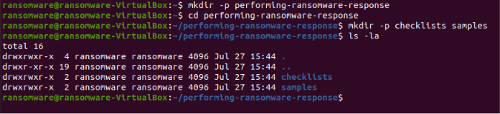
Step 1: Create the project folder
The basic project structure has been created.

Slide 5
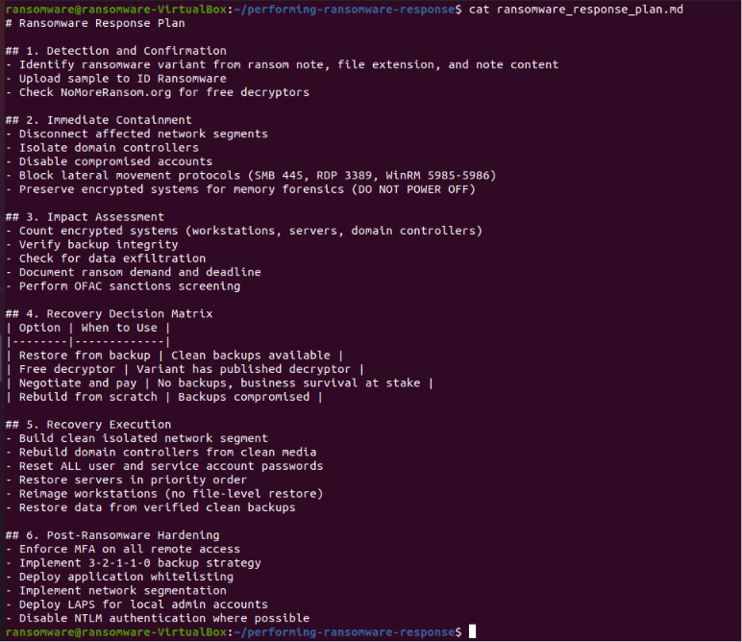
Step 2: Create a ransomware response plan
A structured ransomware incident response plan has been created.

Slide 6
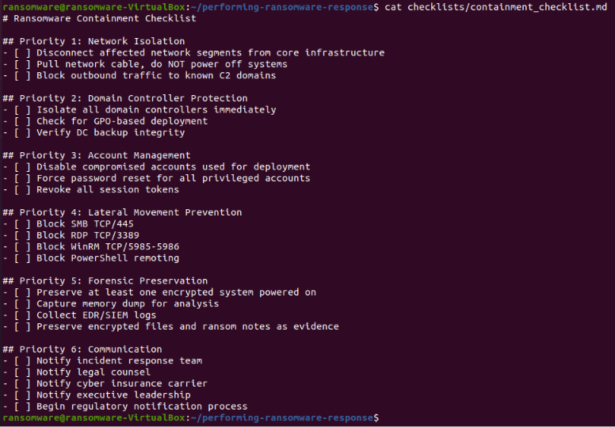
Step 3: Create a containment checklist
A containment checklist with 6 priorities was created.

Slide 7
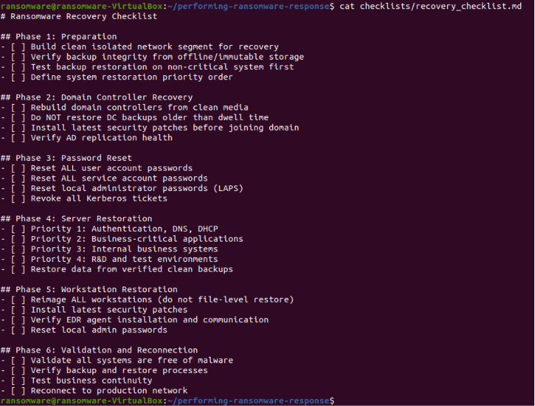
Step 4: Create a recovery checklist
A recovery checklist with 6 stages was created.

Slide 8
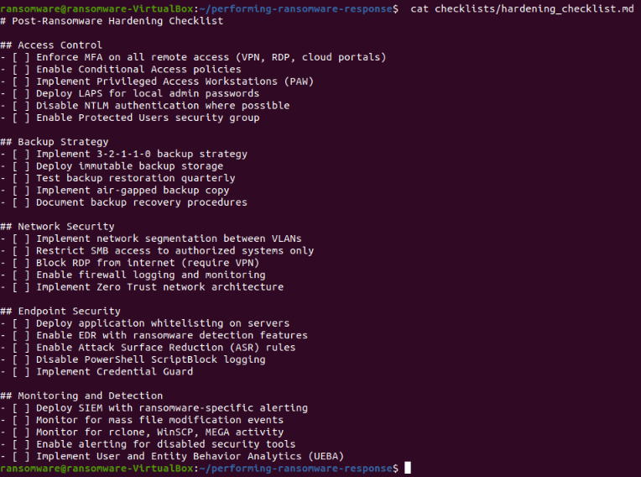
Step 5: Create Improvement Checklist
A checklist for post-incident improvements has been created.

Slide 9
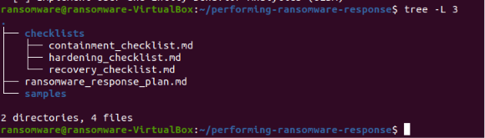
Step 6: View Project Structure (Manual)
The project structure has been viewed after manual application.

Slide 10
Part Two: (AI Agent)

Slide 11
Step 7: Creating the AI ​​Agent
The AI ​​Agent has been created and performs the following:
Ransomware detection and confirmation
Immediate containment
Impact and damage assessment
Recovery decision matrix
Recovery implementation
Post-incident improvements
Generation of a comprehensive report

Slide 12
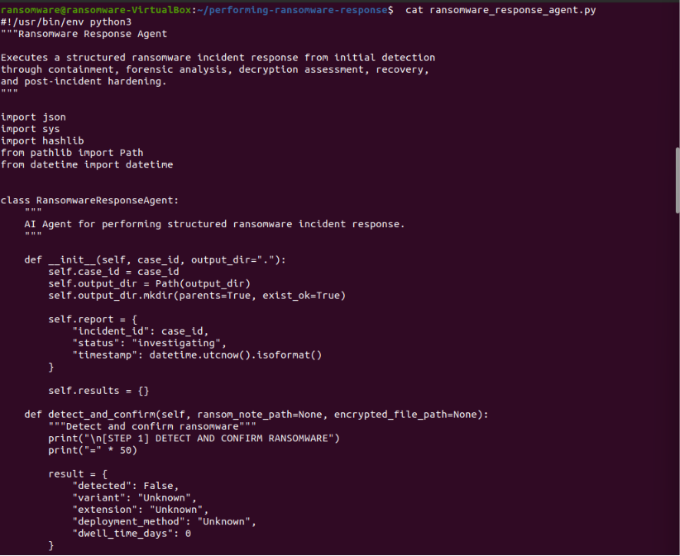

Slide 13
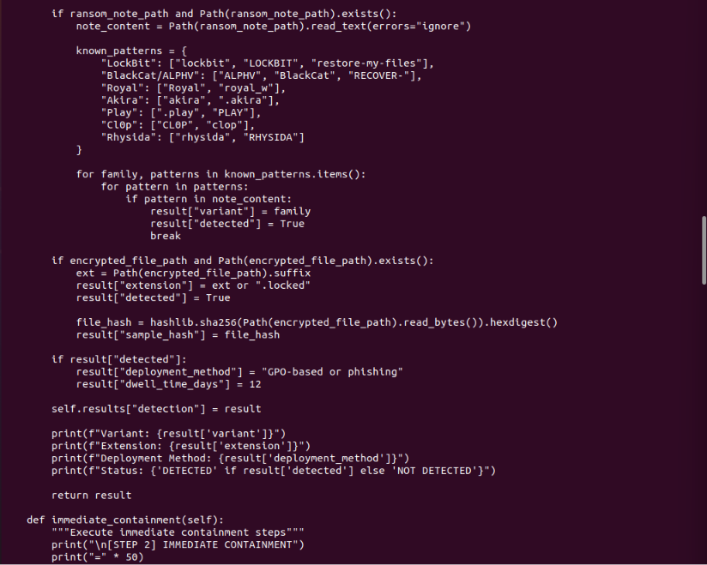

Slide 14
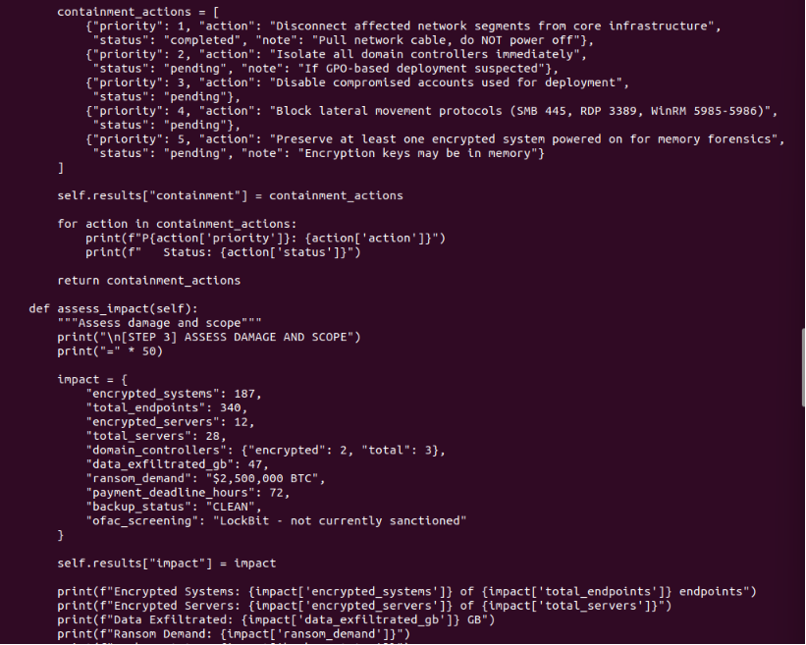

Slide 15
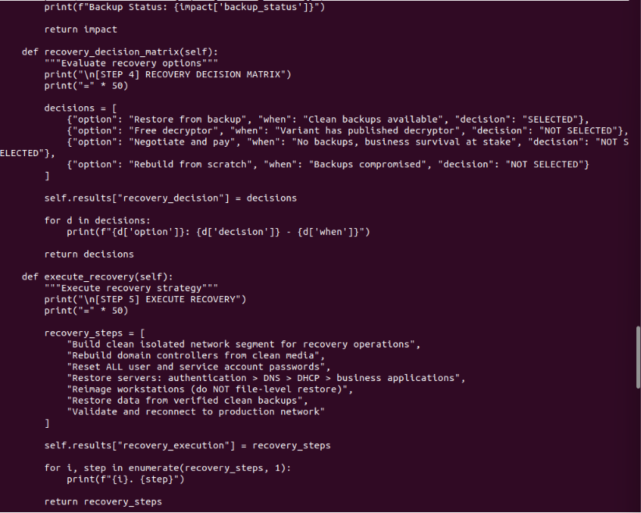

Slide 16
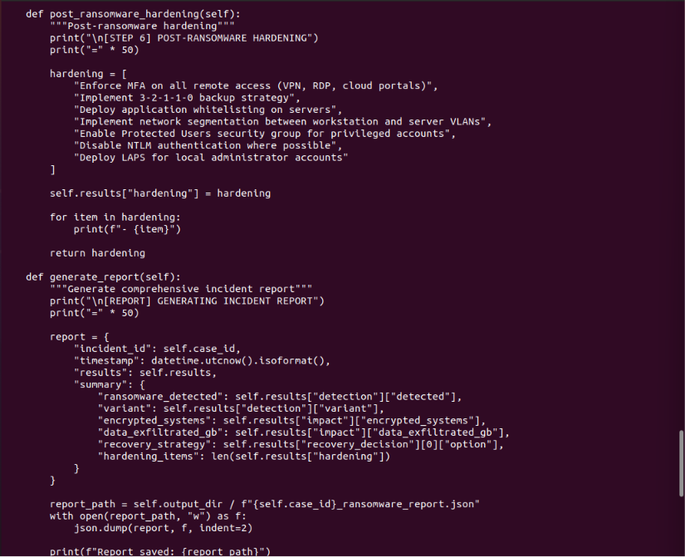

Slide 17
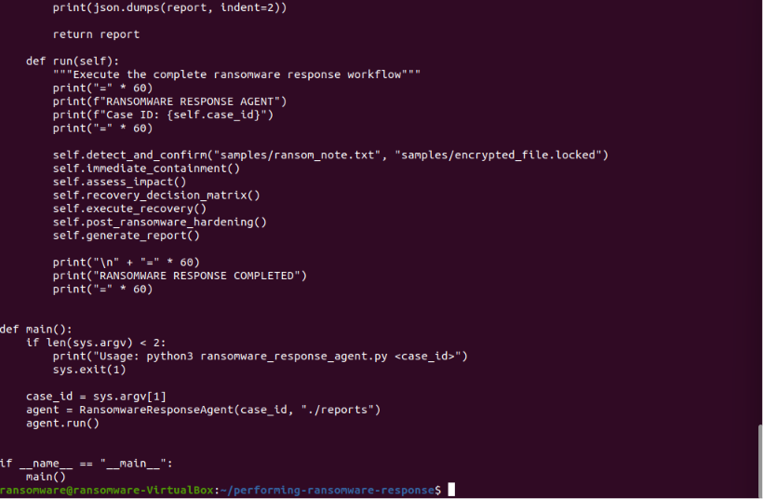

Slide 18
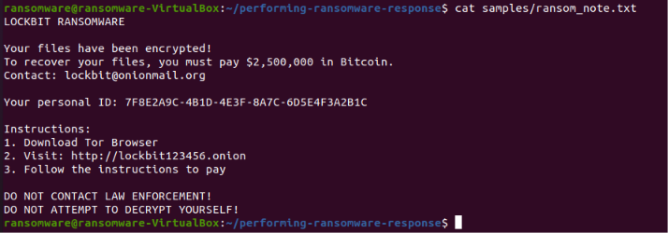
Step 8: Create a Sample Ransom Note File
A sample file for the "LockBit" ransom note has been created.

Slide 19
Step 9: Create an encrypted sample file
An encrypted sample file has been created.

Slide 20
Step 10: Grant execution permissions and run the AI ​​Agent
The AI ​​Agent has been run with Case ID: INC-2025-1892.

Slide 21
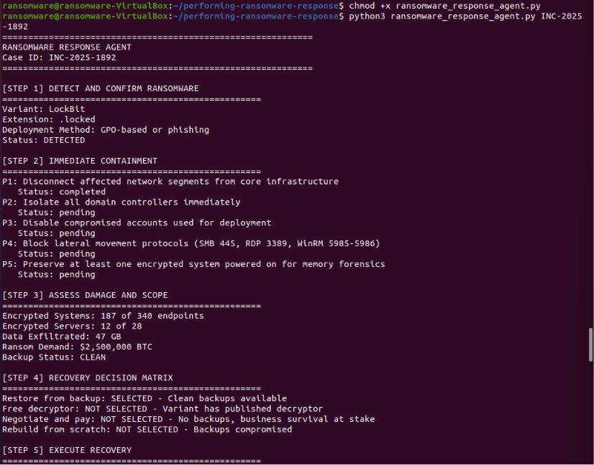

Slide 22
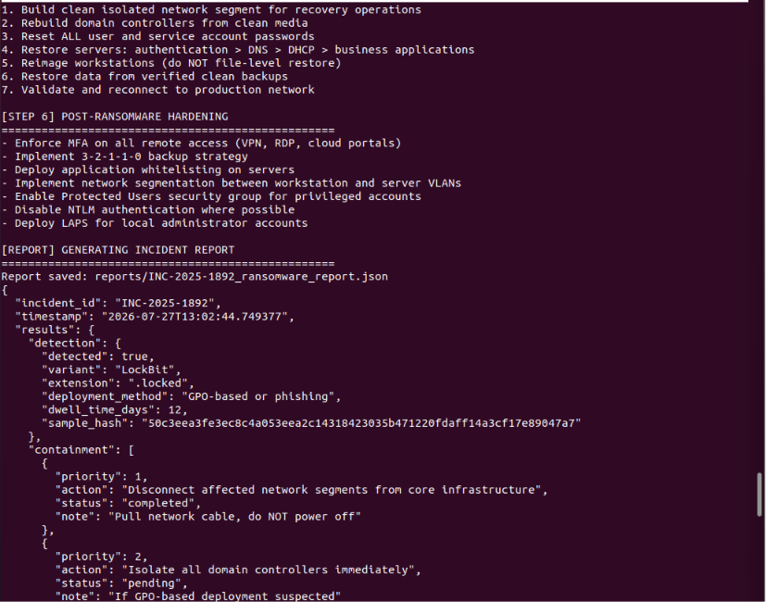

Slide 23
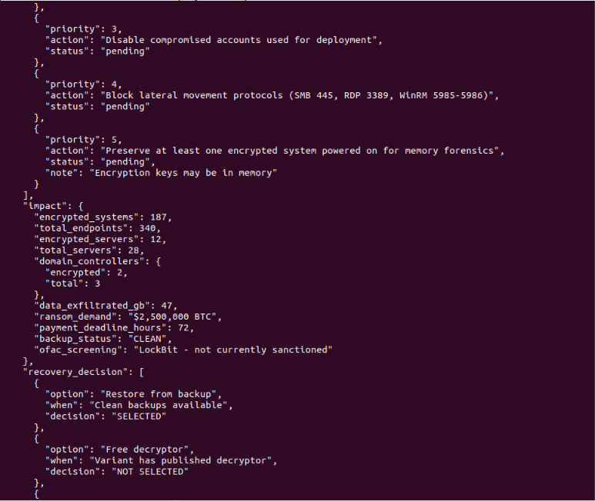

Slide 24
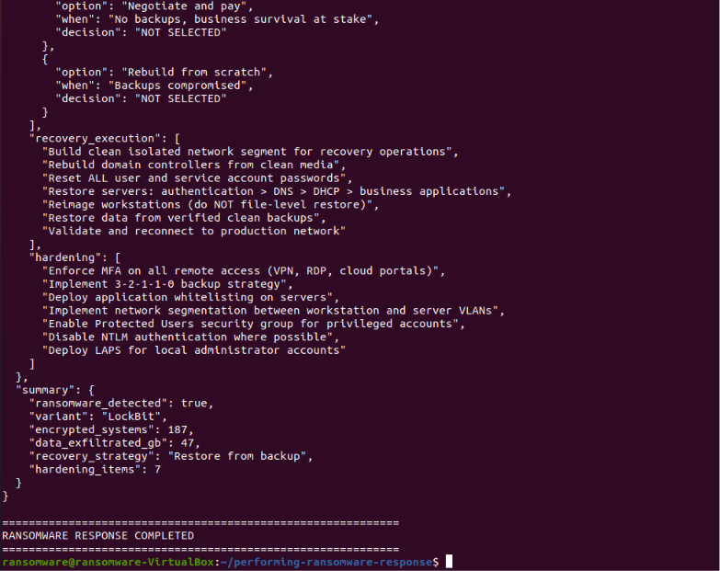

Slide 25
Step 11: Display the generated report
The complete report generated by the AI ​​Agent was displayed.

Slide 26
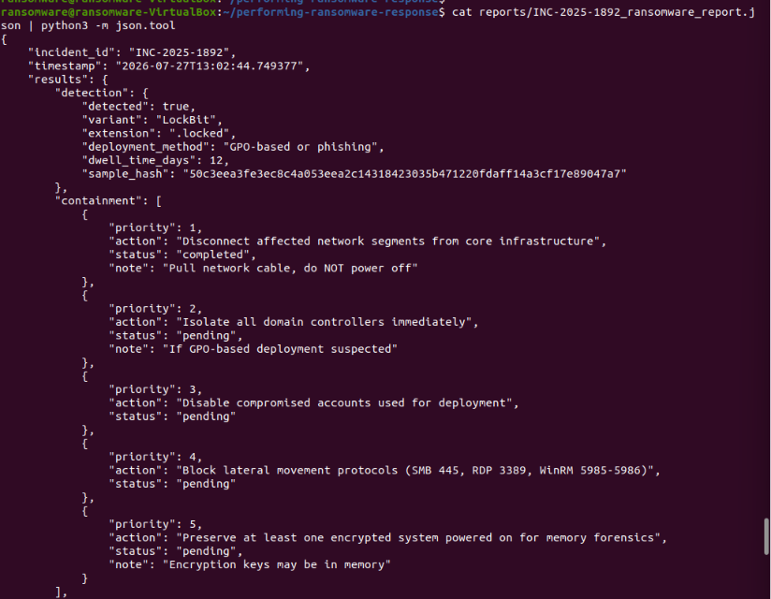

Slide 27
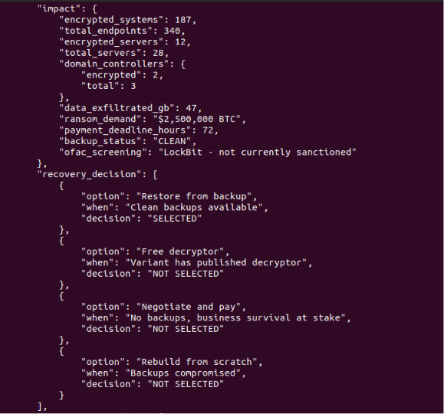
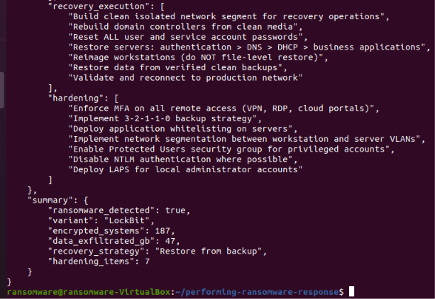

Slide 28
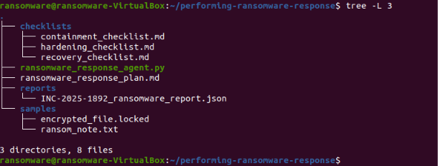
Step 12: Displaying the final project structure
The final project structure has been displayed.

