Slide 1
Skill 6: Ransomware Recovery Orchestration and Tracking Tool

Slide 2
Objective
To develop a tool for coordinating and tracking the system recovery process after a ransomware attack by:
Tracking recovery phases with dependency management
Monitoring compliance with RTO (Recovery Time Objective) standards
Implementing system validation checklists

Slide 3
Part One: (Manual)

Slide 4
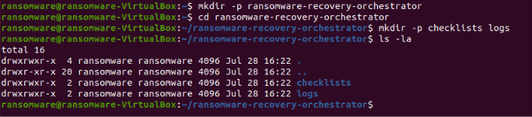
Step 1: Create the project folder
The basic project structure has been created.

Slide 5
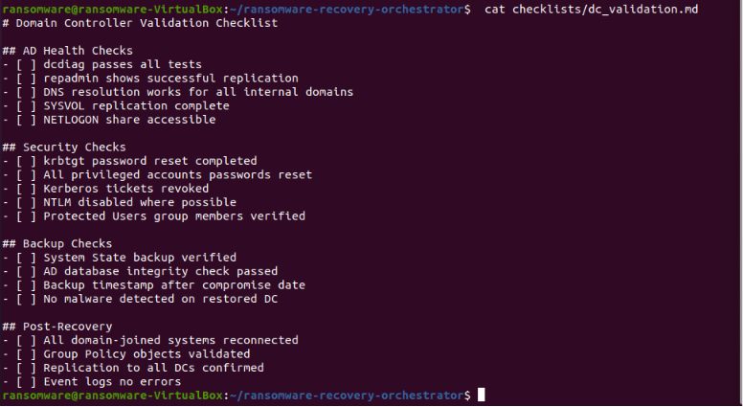
Step 2: Create the DC recovery checklist
A checklist has been created to restore the Domain Controller.

Slide 6
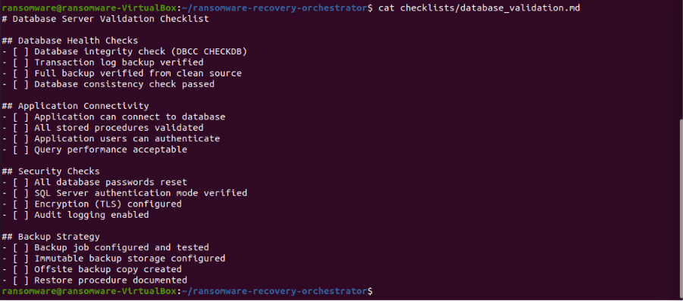
Step 3: Create a Database Recovery Checklist
A database recovery checklist has been created.

Slide 7
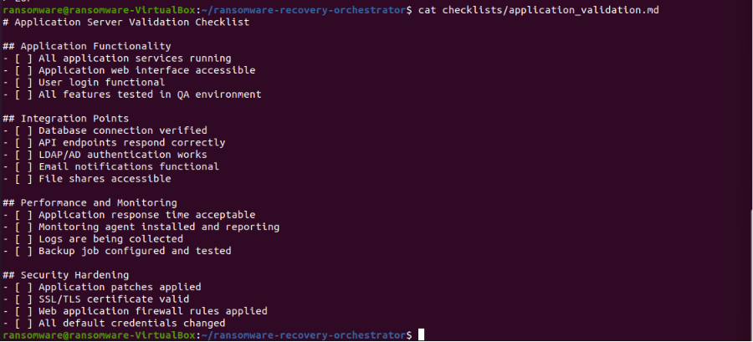
Step 4: Create an Application Recovery Checklist
An application recovery checklist has been created.

Slide 8
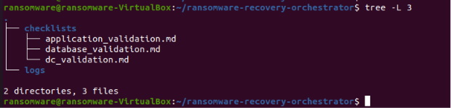
Step 5: Project Structure Display
The project structure was displayed after manual application.

Slide 9
Part Two: (AI Agent)

Slide 10
Step 6: Creating the AI ​​Agent
The AI ​​Agent has been created and will perform the following tasks:
Manage recoverable systems with dependencies
Track recovery stages (pending, restoring, validating, online, failed)
Monitor compliance with RTO standards
Verify system validity after recovery
Calculate progress percentage
Identify systems ready for recovery
Generate a comprehensive report
Export the recovery plan as a JSON file

Slide 11
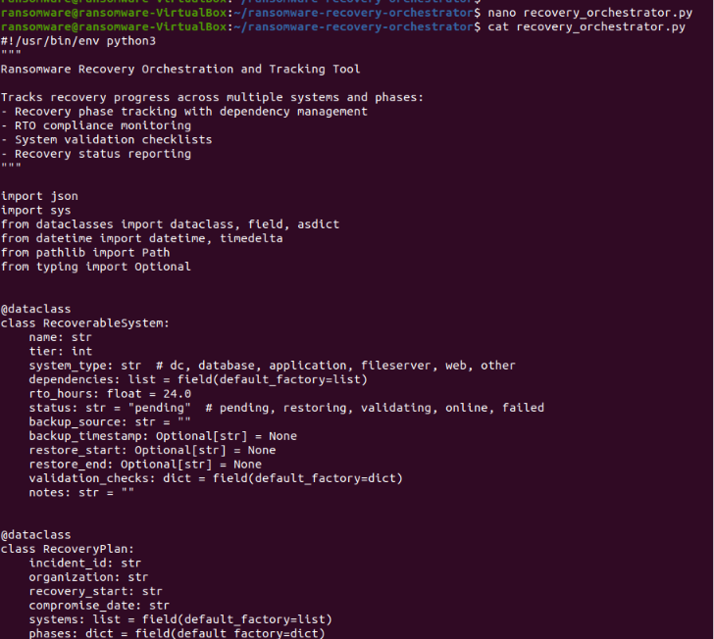

Slide 12
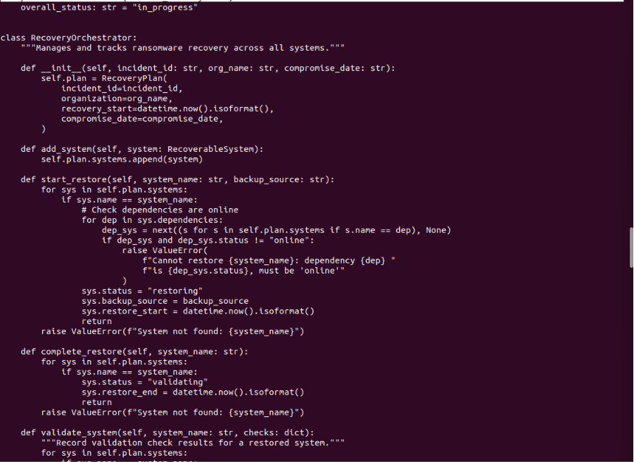

Slide 13
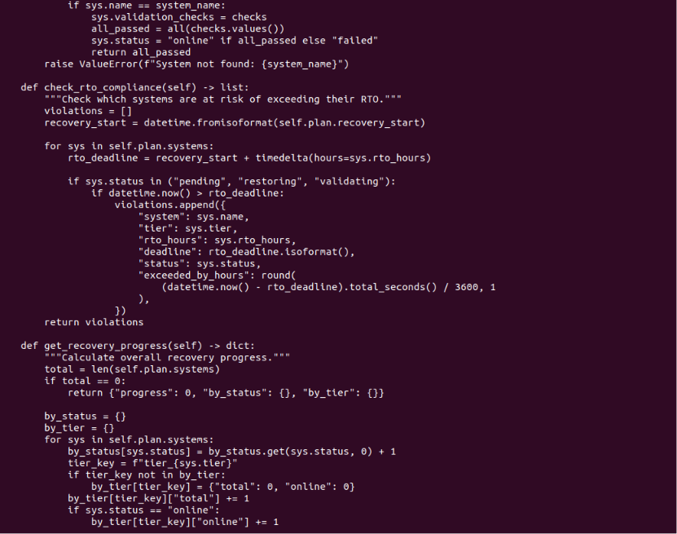

Slide 14
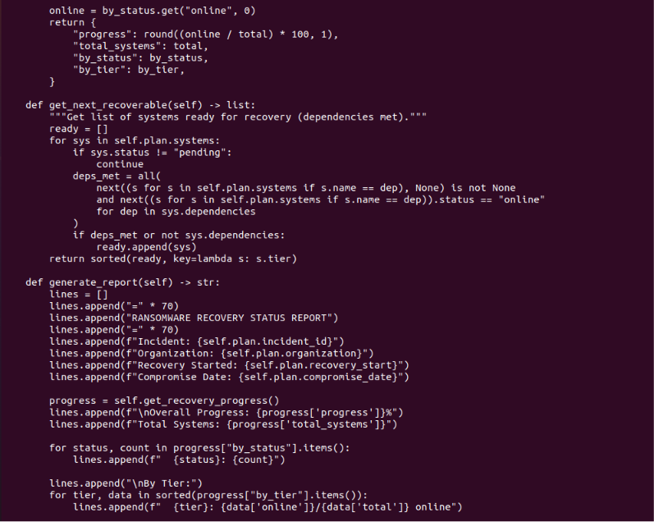

Slide 15
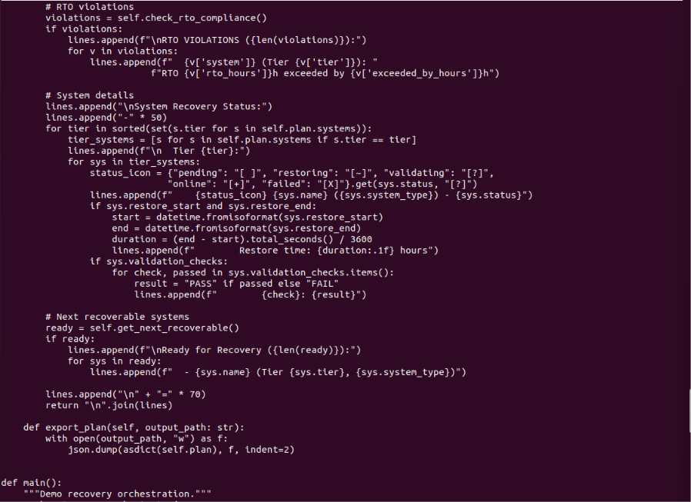

Slide 16
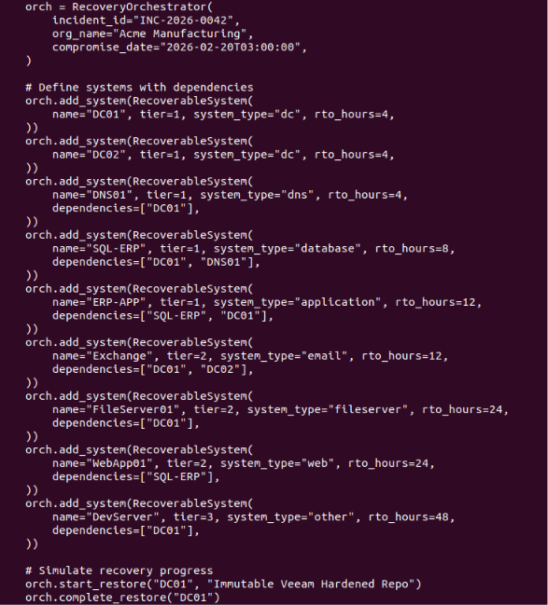
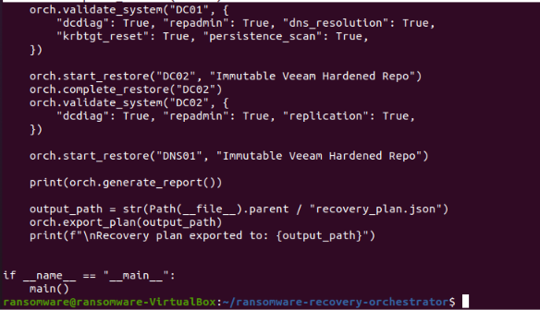

Slide 17
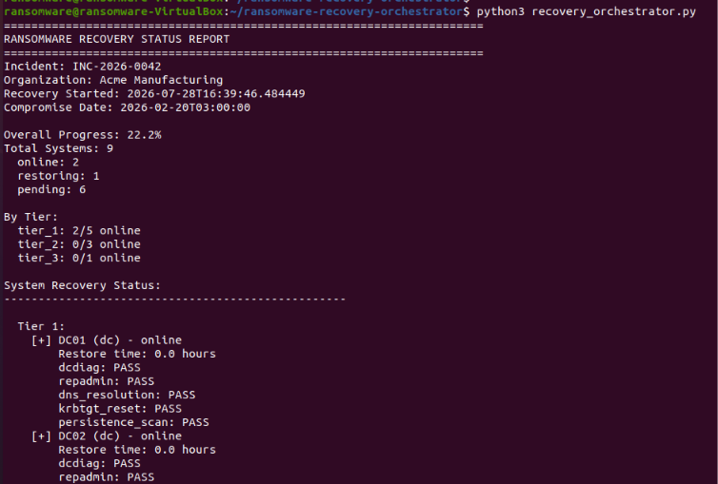
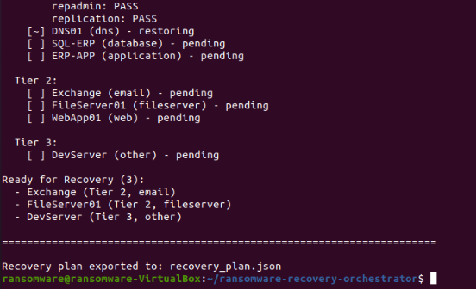
Step 7: Run the AI ​​Agent
The AI ​​Agent was run with a simulated system recovery of 9 systems.

Slide 18
Step 8: Display the exported recovery plan
The exported recovery plan was displayed in JSON format.

Slide 19
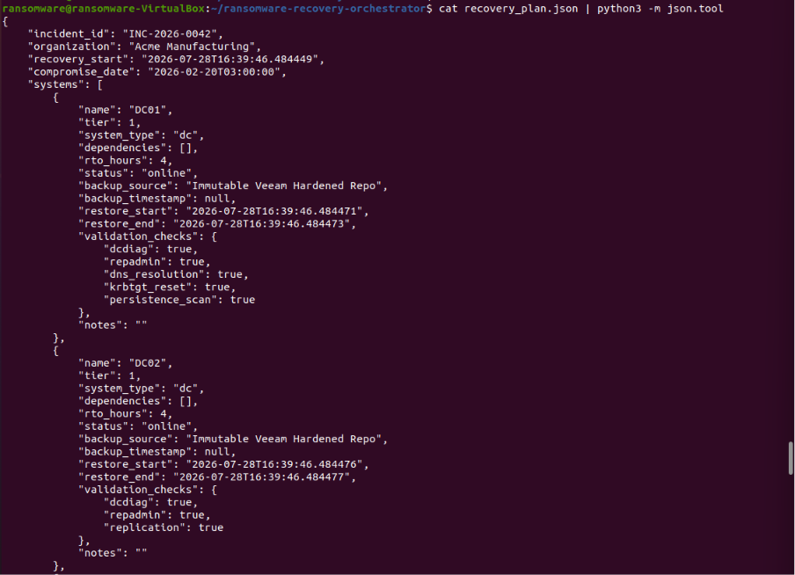

Slide 20
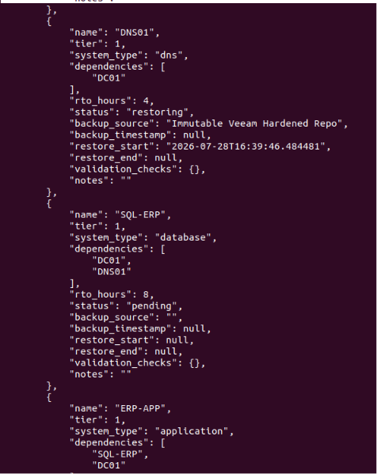
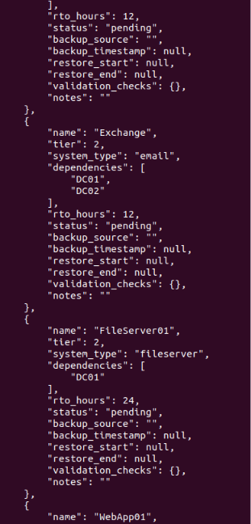

Slide 21
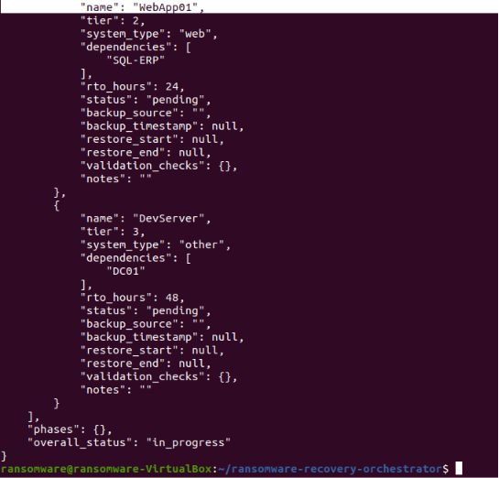

Slide 22
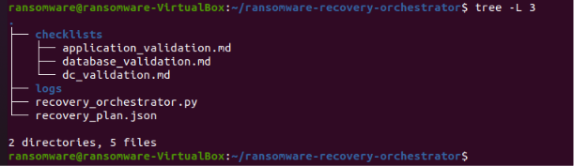
Step 9: Displaying the final project structure
The final project structure has been displayed.

