Slide 1
Skill 7: Ransomware Backup Strategy Audit

Slide 2
Content
Ransomware Backup Strategy Audit:
S3 Bucket Versioning Audit
Object Lock Verification (Non-Modifiable Backups)
Cross-Region Replication Verification
AWS Backup Plans Audit
3-2-1 Backup Rule Verification
Backup Freshness Verification

Slide 3
Part One: (Manual)

Slide 4
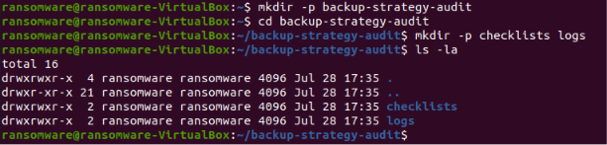
Step 1: Create the project folder
The basic project structure has been created.

Slide 5

Step 2: Create the requirements file
The requirements file for installing boot3 has been created.

Slide 6
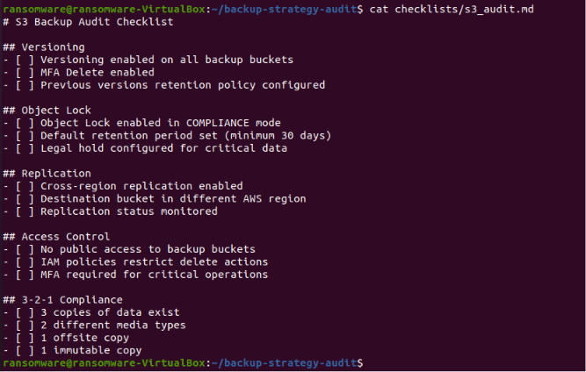
Step 3: Create the S3 checklist
The S3 Backup checklist has been created.

Slide 7
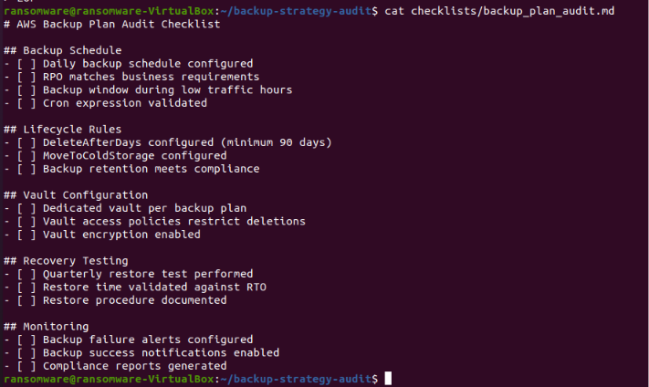
Step 4: Create a Backup Plans Checklist
An AWS Backup Plans checklist has been created.

Slide 8
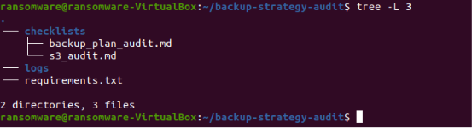
Step 5: Project Structure Display
The project structure was displayed after manual application.

Slide 9
Part Two: (AI Agent)

Slide 10
Step 6: Creating the AI ​​Agent
The AI ​​Agent has been created and performs the following:
S3 Versioning Check
Object Lock Check
Cross-Region Replication Check
Backup Plans Check
3-2-1 Backup Rule Check
Verify Backup Freshness
Generate a Comprehensive Check Report

Slide 11
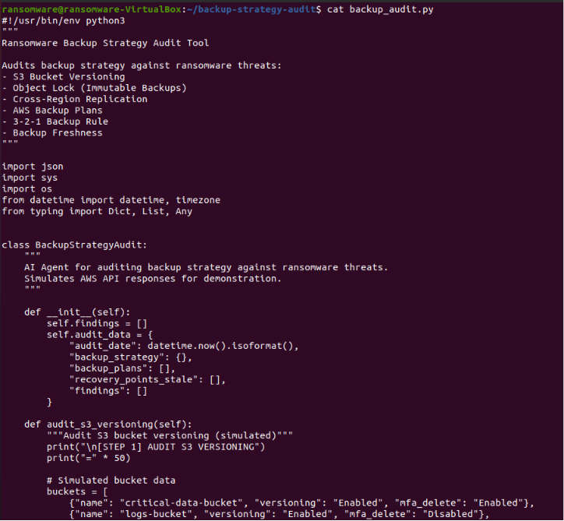

Slide 12
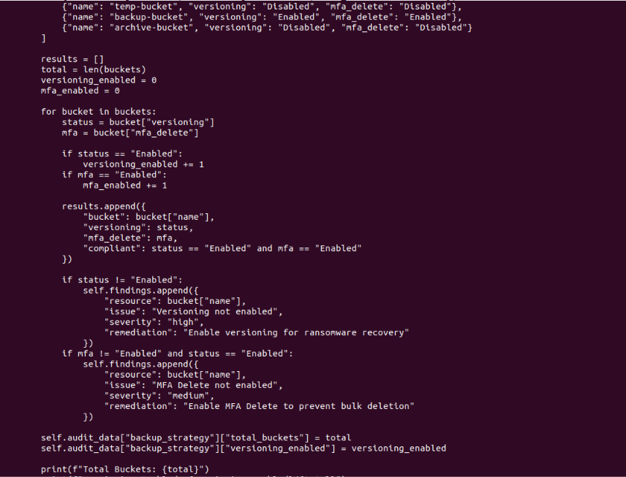

Slide 13
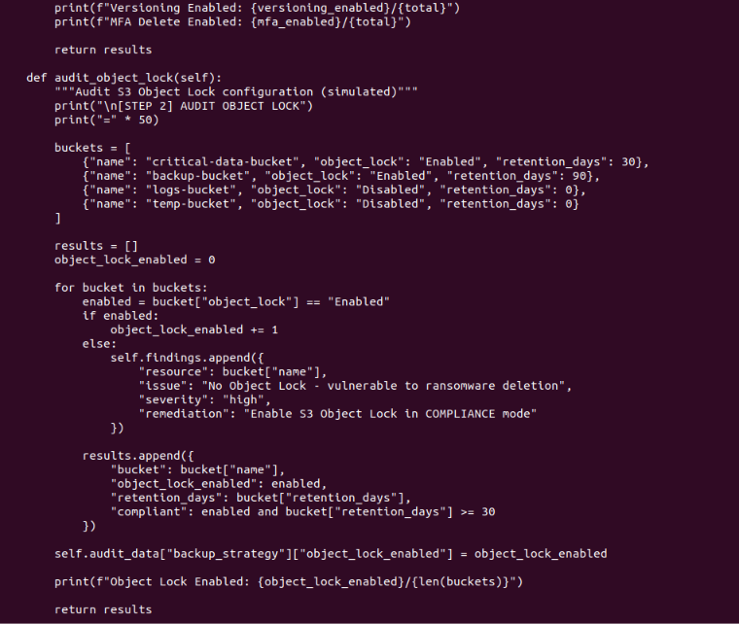

Slide 14
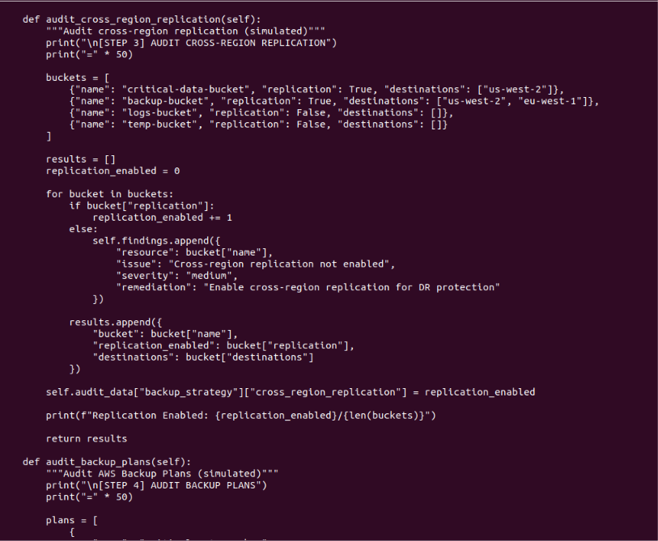

Slide 15
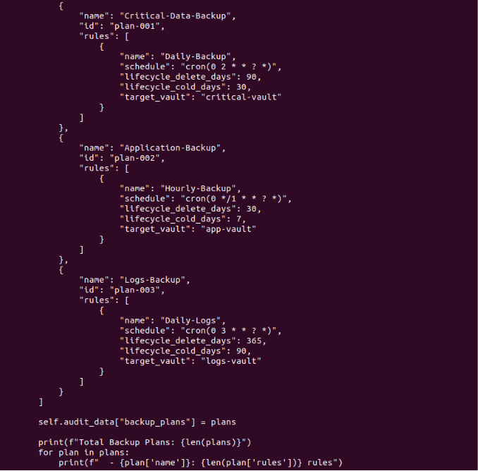

Slide 16
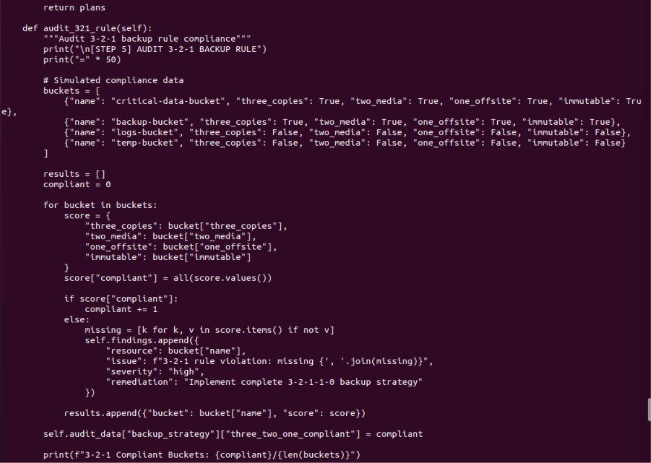

Slide 17
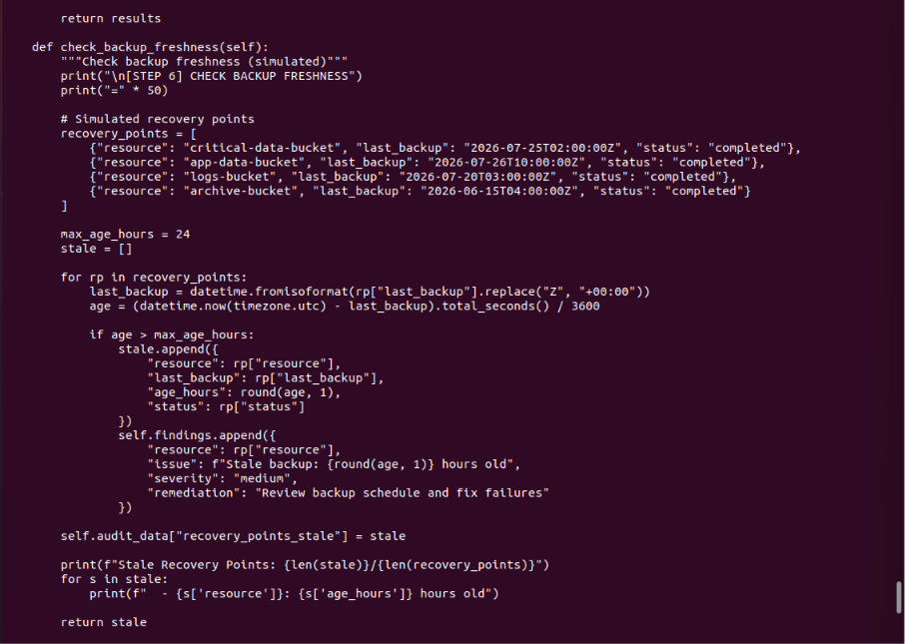

Slide 18
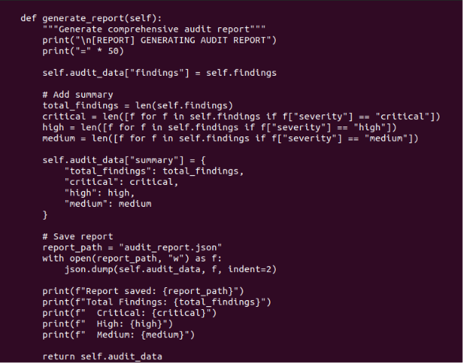
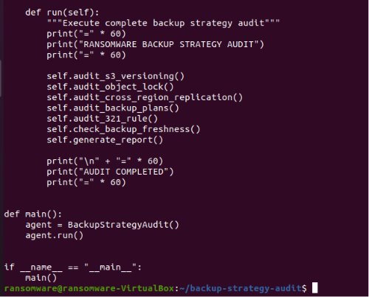

Slide 19
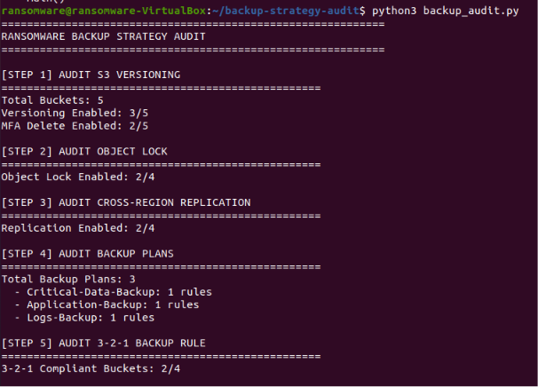
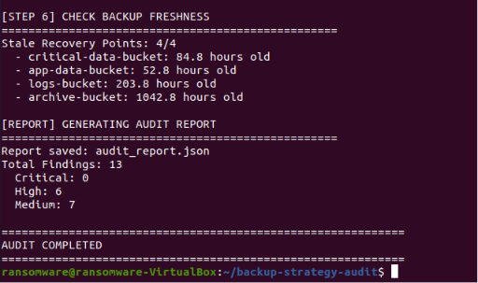
Step 7: Run the AI ​​Agent
The AI ​​Agent was run to audit the backup strategy.

Slide 20
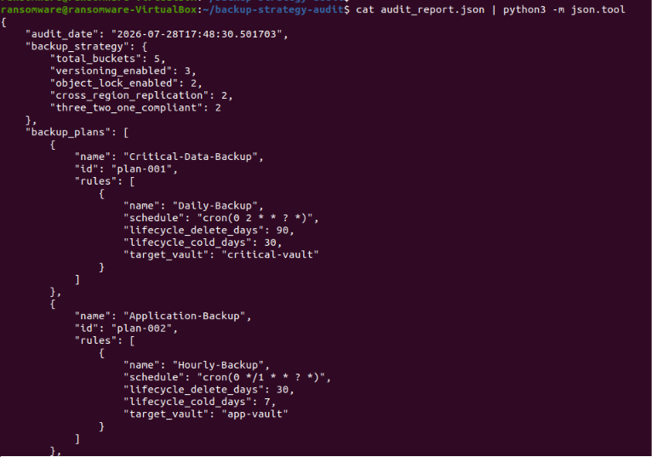
Step 8: View the audit report
The full audit report has been viewed.

Slide 21
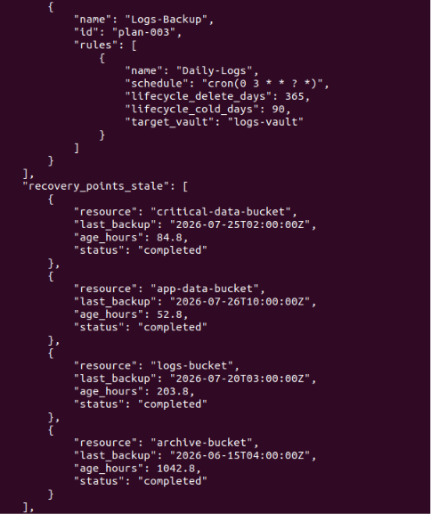
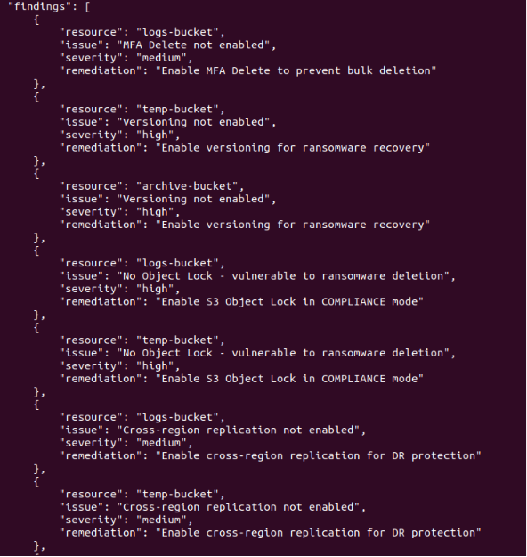

Slide 22
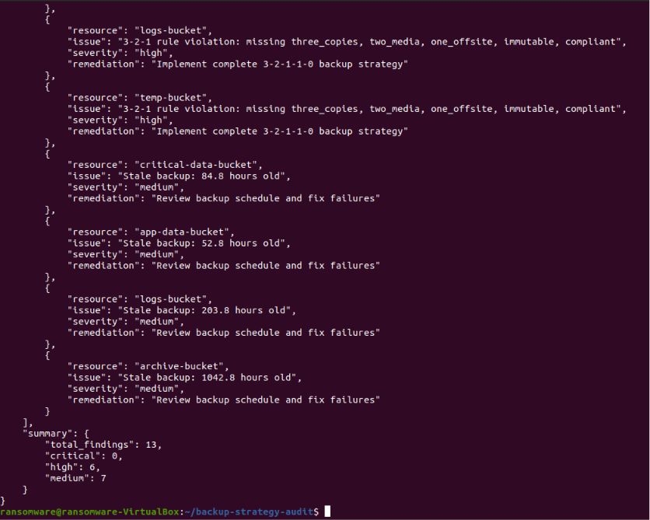

Slide 23
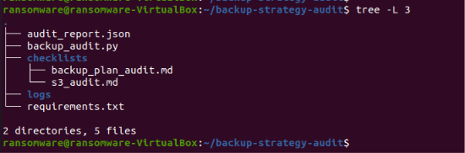
Step 9: Displaying the final project structure
The final project structure has been displayed.

