Slide 1
Skill 8: Ransomware Encryption Analysis Report

Slide 2
Content
Analyzing the encryption mechanism used in the ransomware attack and assessing decryption potential through:
Analyzing the algorithms used (Symmetric + Asymmetric)
Evaluating the quality of key generation (PRNG)
Identifying implementation vulnerabilities
Assessing decryption capabilities
Providing recovery recommendations

Slide 3
Part One: (Manual)

Slide 4
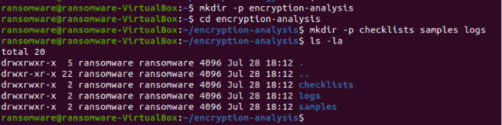
Step 1: Create the project folder
The basic project structure has been created.

Slide 5
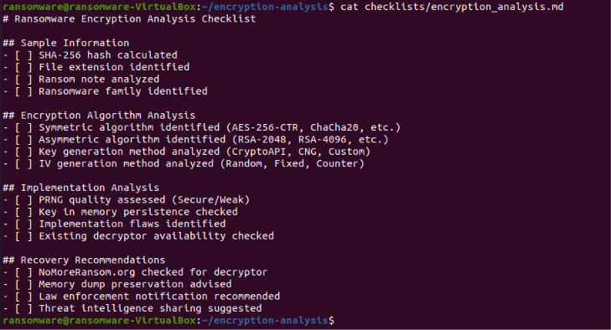
Step 2: Create a Cryptogram Analysis List
A cryptographic analysis list has been created.

Slide 6
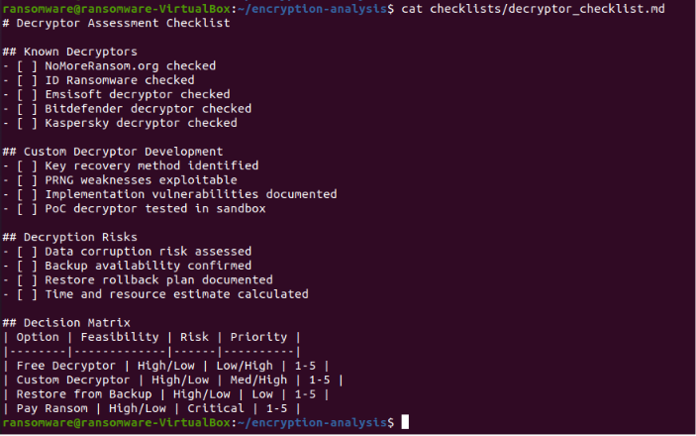
Step 3: Create a decryption list
A decryption evaluation list has been created.

Slide 7
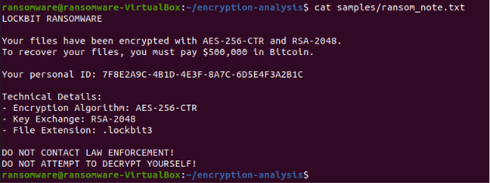
Step 4: Create a Ransom Note Sample File
A Ransom Note file simulating LockBit 3.0 has been created.

Slide 8
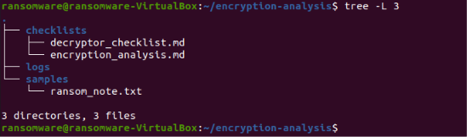
Step 5: Project Structure Presentation
The project structure was displayed after manual application.

Slide 9
Part Two: (AI Agent)

Slide 10
Step 6: Creating the AI ​​Agent
An AI agent has been created that performs the following tasks:
Calculates the SHA-256 of the encrypted file
Analyzes the ransom note to identify the family and algorithms
Evaluates the encryption mechanism
Checks for vulnerabilities in the implementation
Assesses decryption capabilities
Provides recovery recommendations

Slide 11
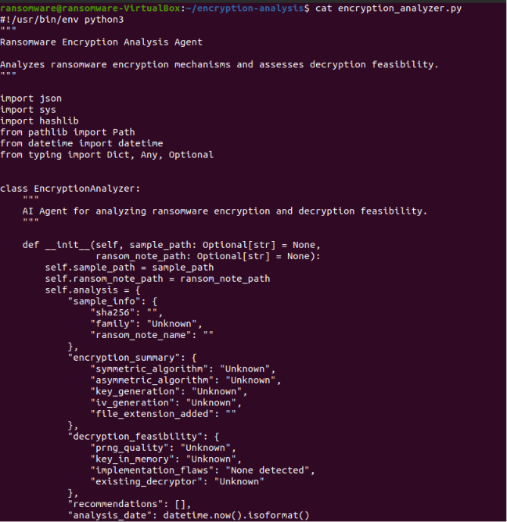

Slide 12
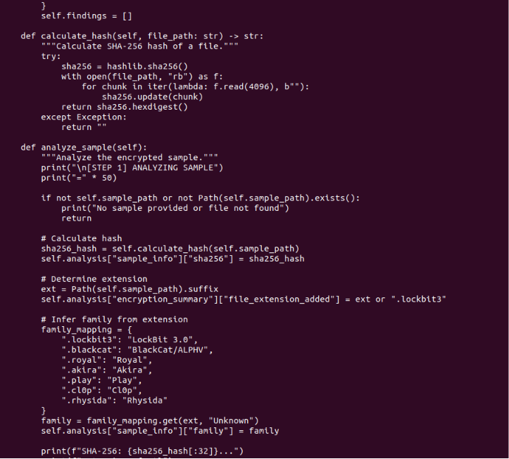

Slide 13
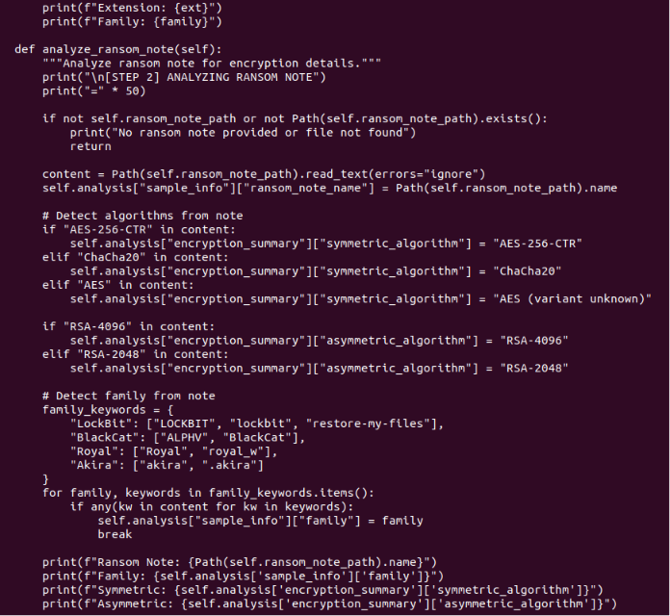

Slide 14
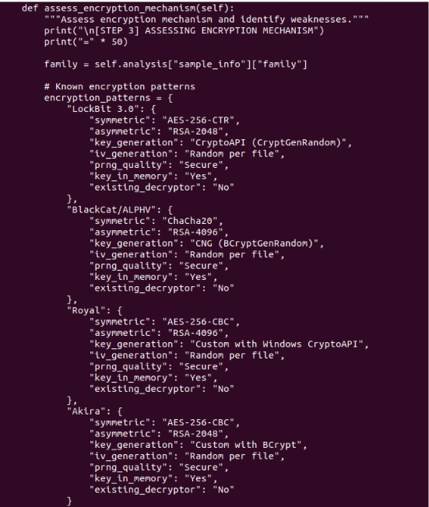

Slide 15
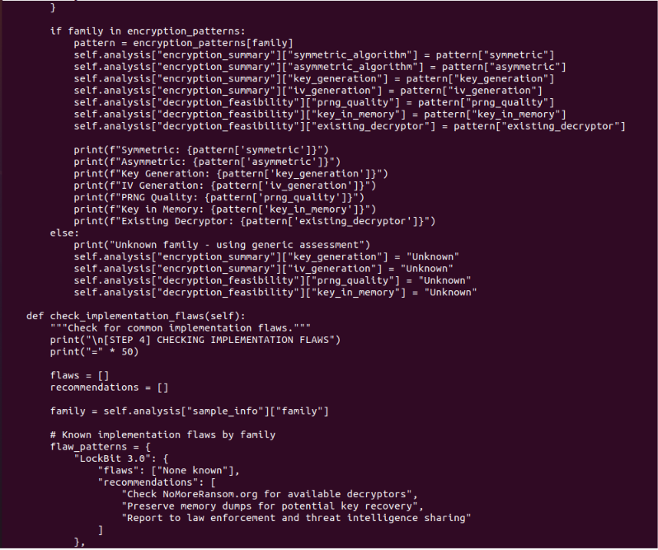

Slide 16
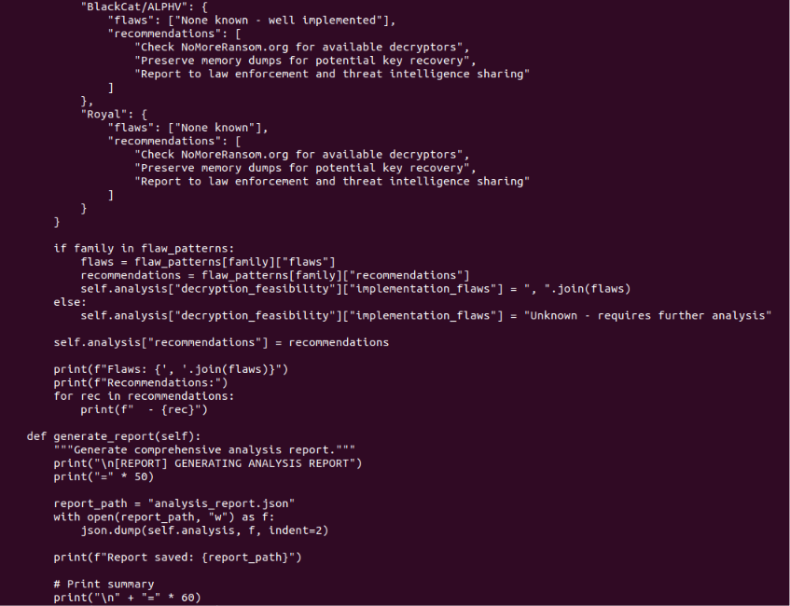

Slide 17
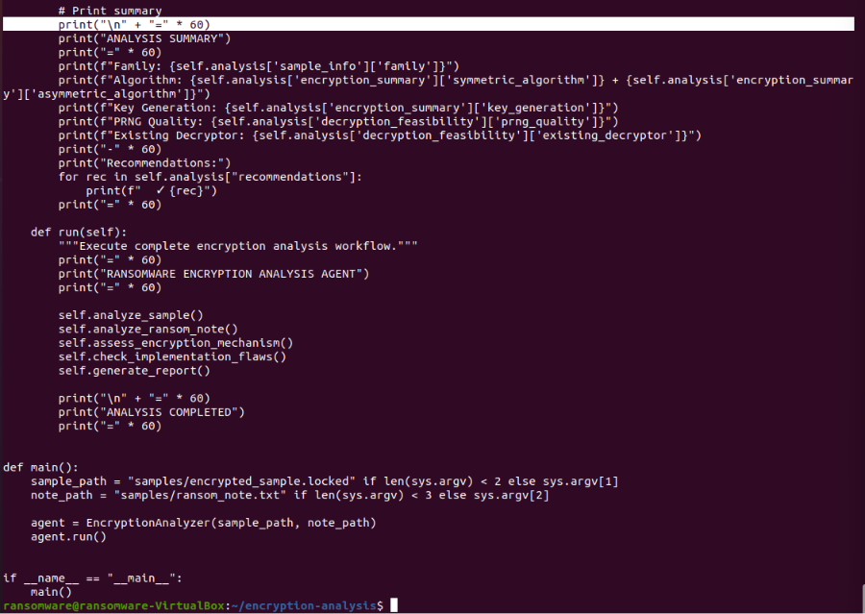

Slide 18
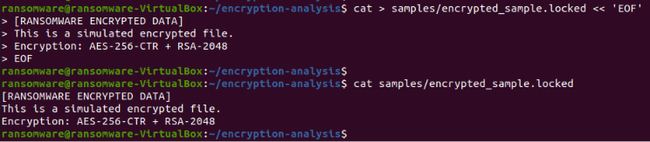
Step 7: Create an encrypted sample file
An encrypted sample file has been created.

Slide 19
Step 8: Grant execution permissions and run the AI ​​Agent
The AI ​​Agent was run to analyze the encryption mechanism.

Slide 20
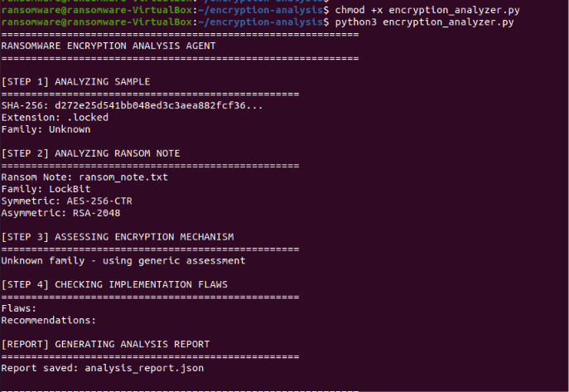
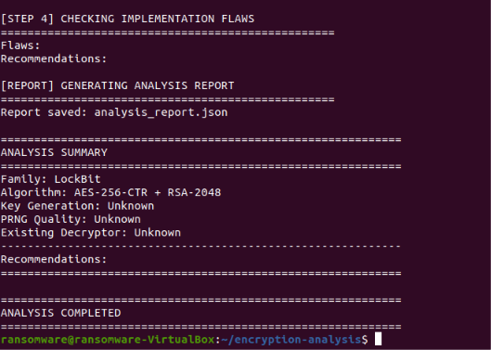

Slide 21
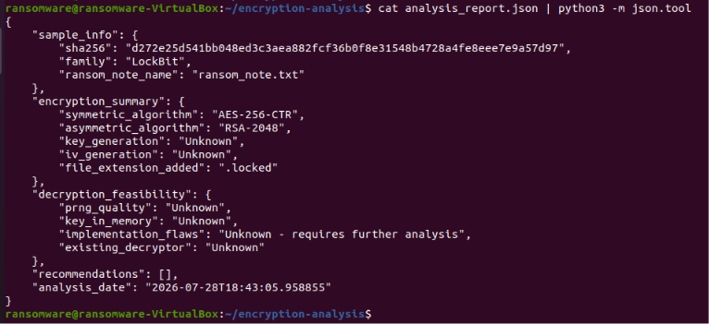
Step 9: View the Analysis Report
The full analysis report has been viewed.

Slide 22
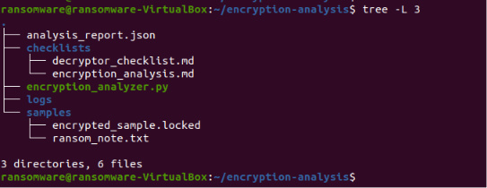
Step 10: Displaying the final project structure
The final project structure has been displayed.

