Slide 1
Skill 9: Investigating Ransomware Attack Artifacts

Slide 2
Content
Investigating ransomware attack artifacts involves:
Analyzing encrypted files and ransom note data
Extracting indicators of compromise (IOCs) such as Bitcoin and Tor addresses
Searching for samples in VirusTotal and MalwareBazaar
Identifying the ransomware type using the Ransomware ID
Checking for the availability of decryption tools

Slide 3
Part One: (Manual)

Slide 4
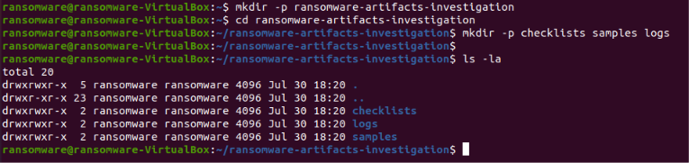
Step 1: Create the project folder
The basic project structure has been created.

Slide 5
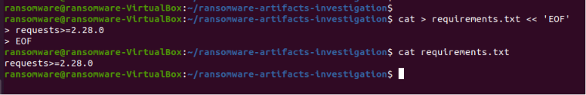
Step 2: Create the requirements file
A requirements file has been created to install requests.

Slide 6
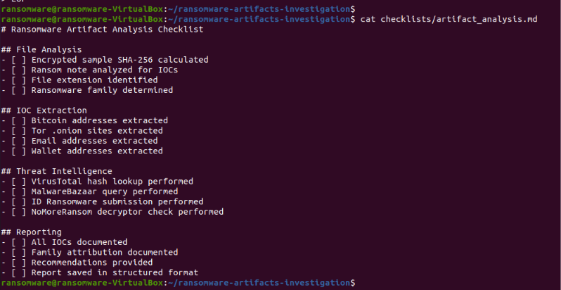
Step 3: Create an Indicators Analysis List
The Indicators Analysis List has been created.

Slide 7
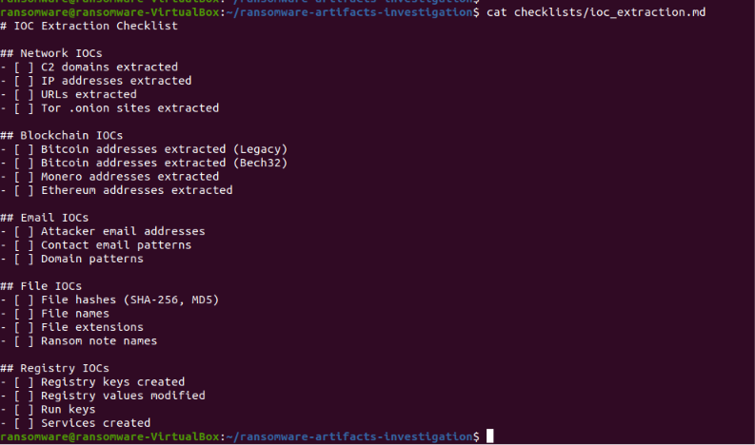
Step 4: Create an IOC Extraction List
An IOC extraction list has been created.

Slide 8
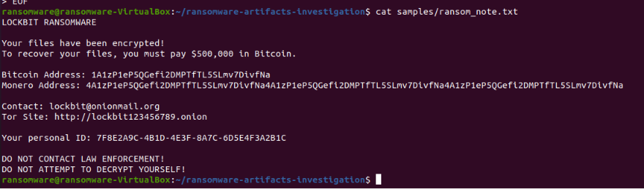
Step 5: Create a Ransom Note Sample File with IOCs
A Ransom Note file containing various IOCs has been created.

Slide 9
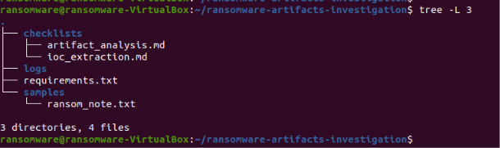
Step 6: Project Structure Display
The project structure was displayed after manual application.

Slide 10
Part Two: (AI Agent)

Slide 11
Step 7: Creating the AI ​​Agent
An AI agent has been created that performs the following:
Analyzes the encrypted sample
Analyzes the ransom note and extracts IOCs (Bitcoin, Tor, Emails)
Checks for Threat Intelligence (VirusTotal, MalwareBazaar)
Checks for the availability of decryption tools
Provides recovery recommendations

Slide 12
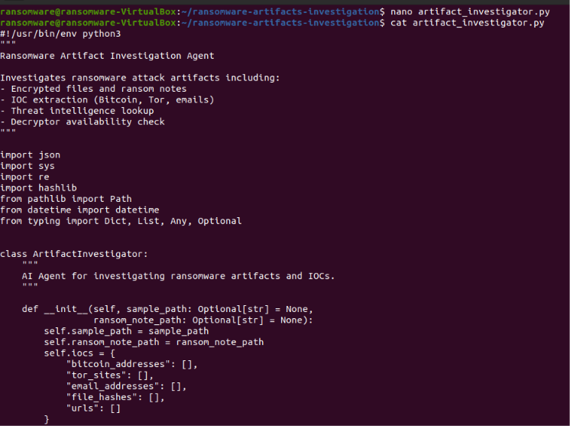

Slide 13
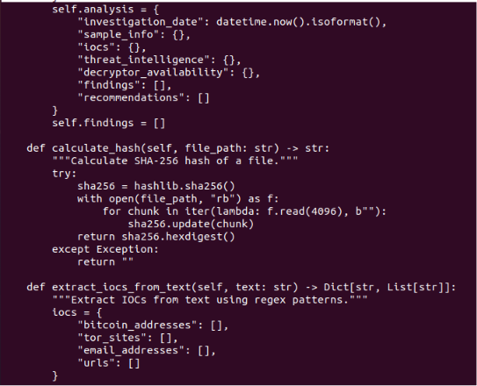
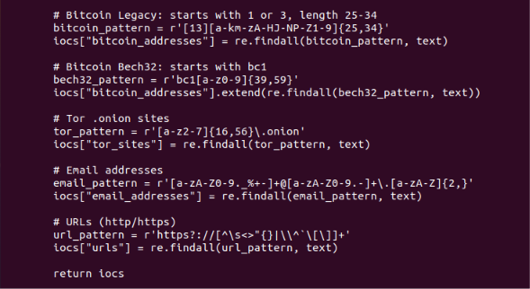

Slide 14
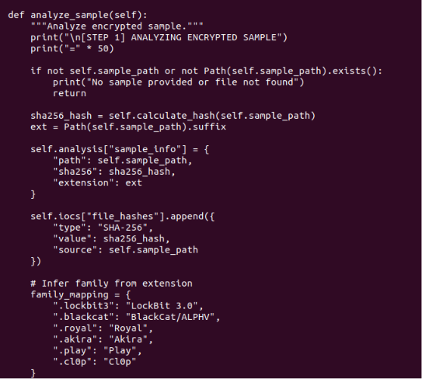
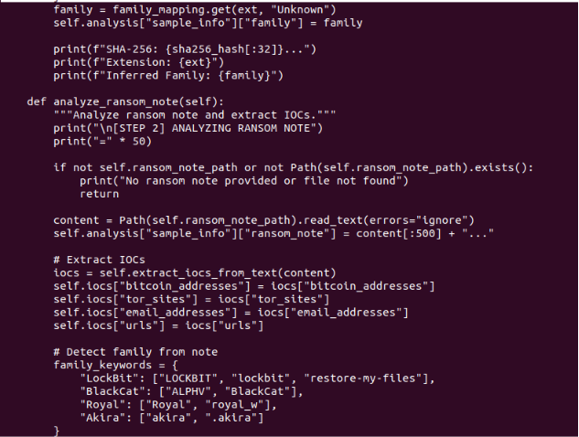

Slide 15
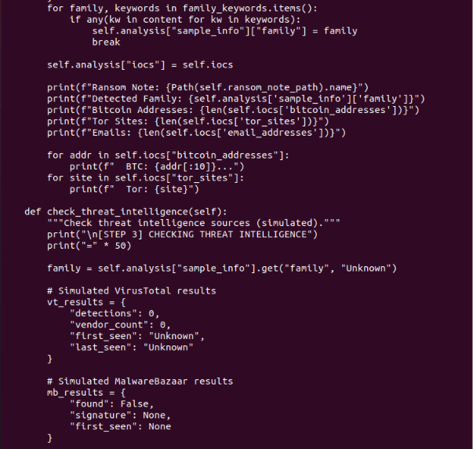
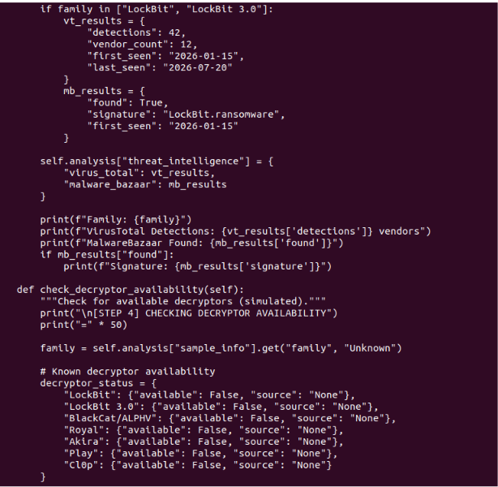

Slide 16
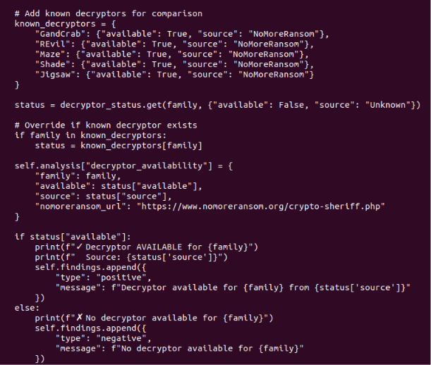

Slide 17
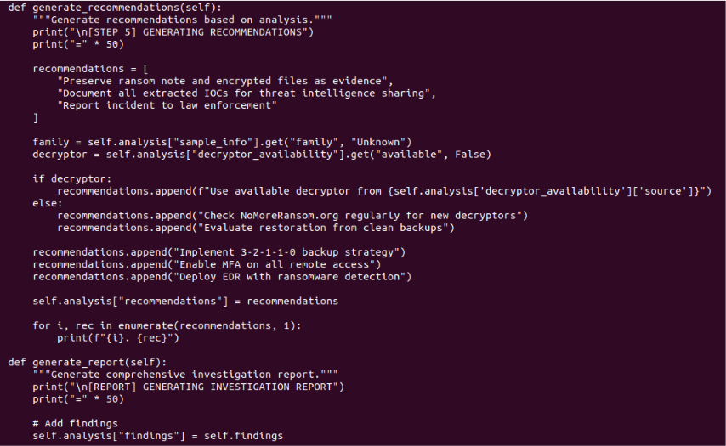

Slide 18
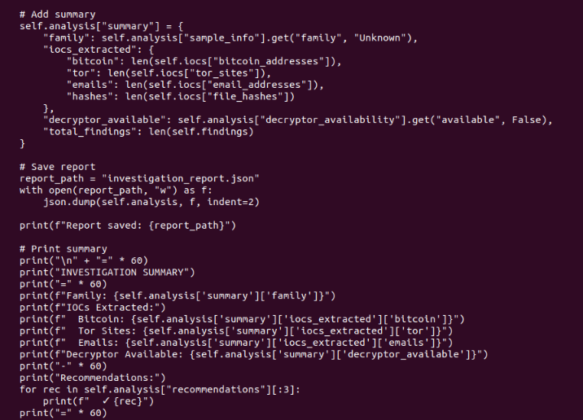

Slide 19
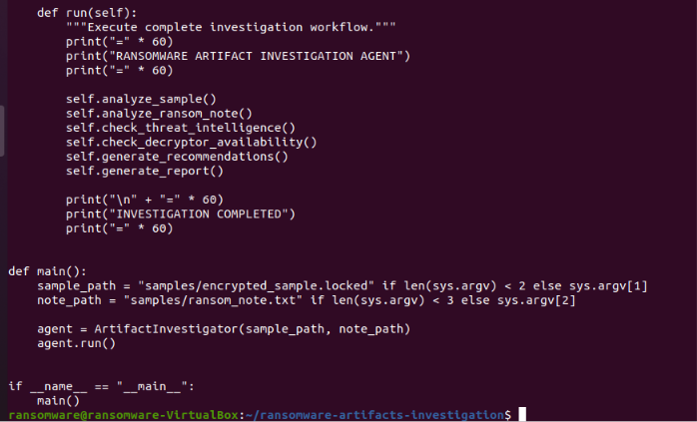

Slide 20
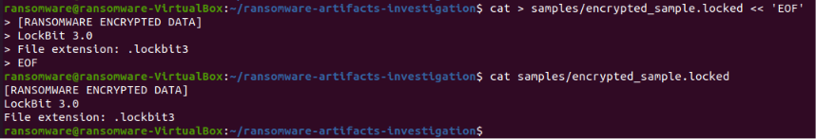
Step 8: Create an encrypted sample file
An encrypted sample file has been created.

Slide 21
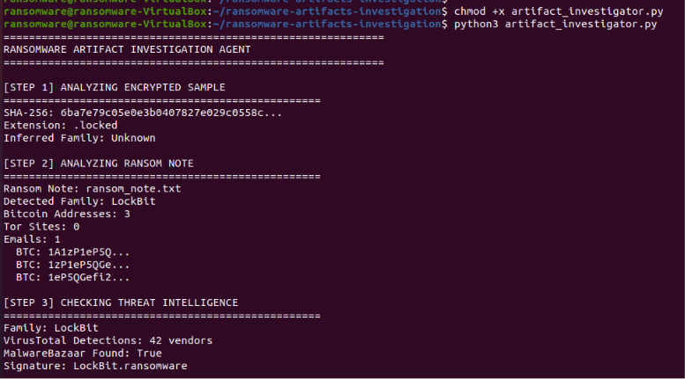
Step 9: Grant execution permissions and run the AI ​​Agent
The AI ​​Agent has been run to investigate indicators of attack.

Slide 22
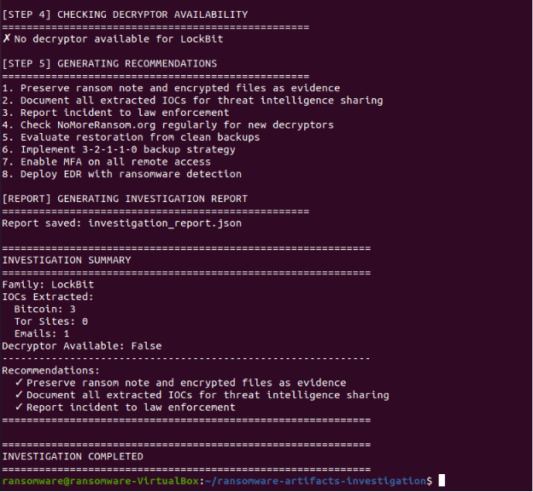

Slide 23
Step 10: View the investigation report
The full investigation report has been viewed.

Slide 24
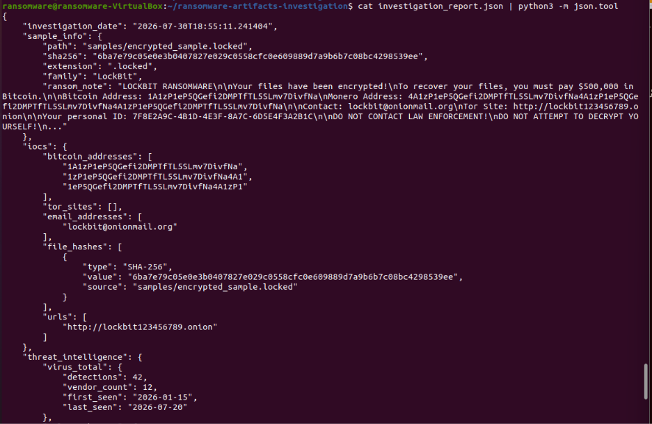

Slide 25
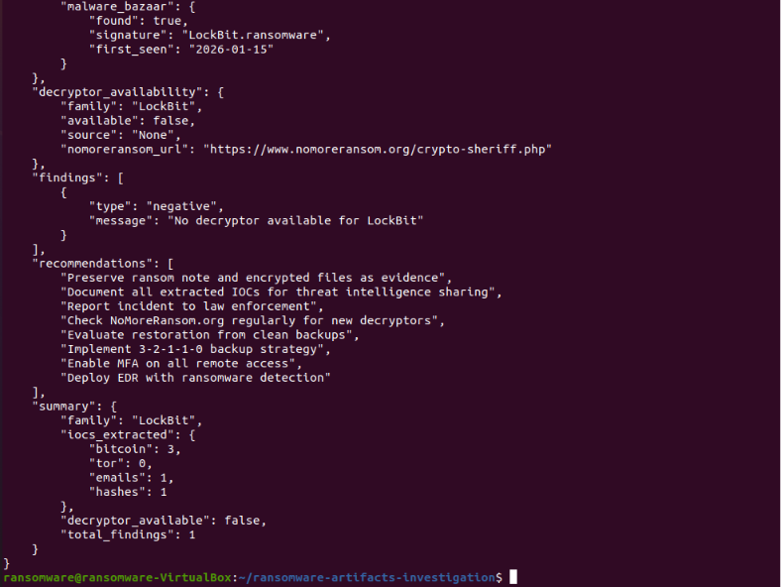

Slide 26
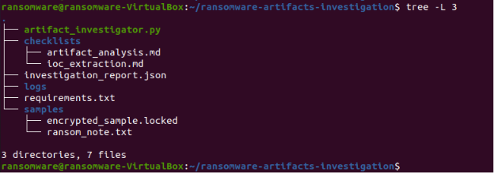
Step 11: Displaying the final project structure
The final project structure has been displayed.

