Slide 1

Software project
TecStore

Slide 2

Problem statement
Over price of technical products in stores.
Waste of time when we buy from stores.

Slide 3
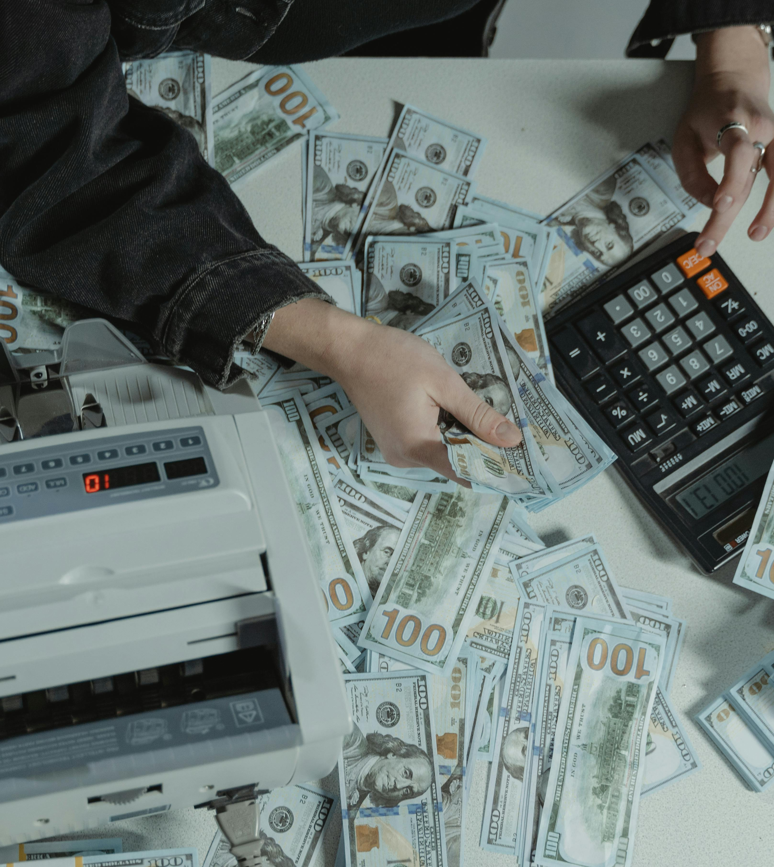
Problem statement
3. Greedy of Merchants.
4. Monopoly of goods.

Slide 4
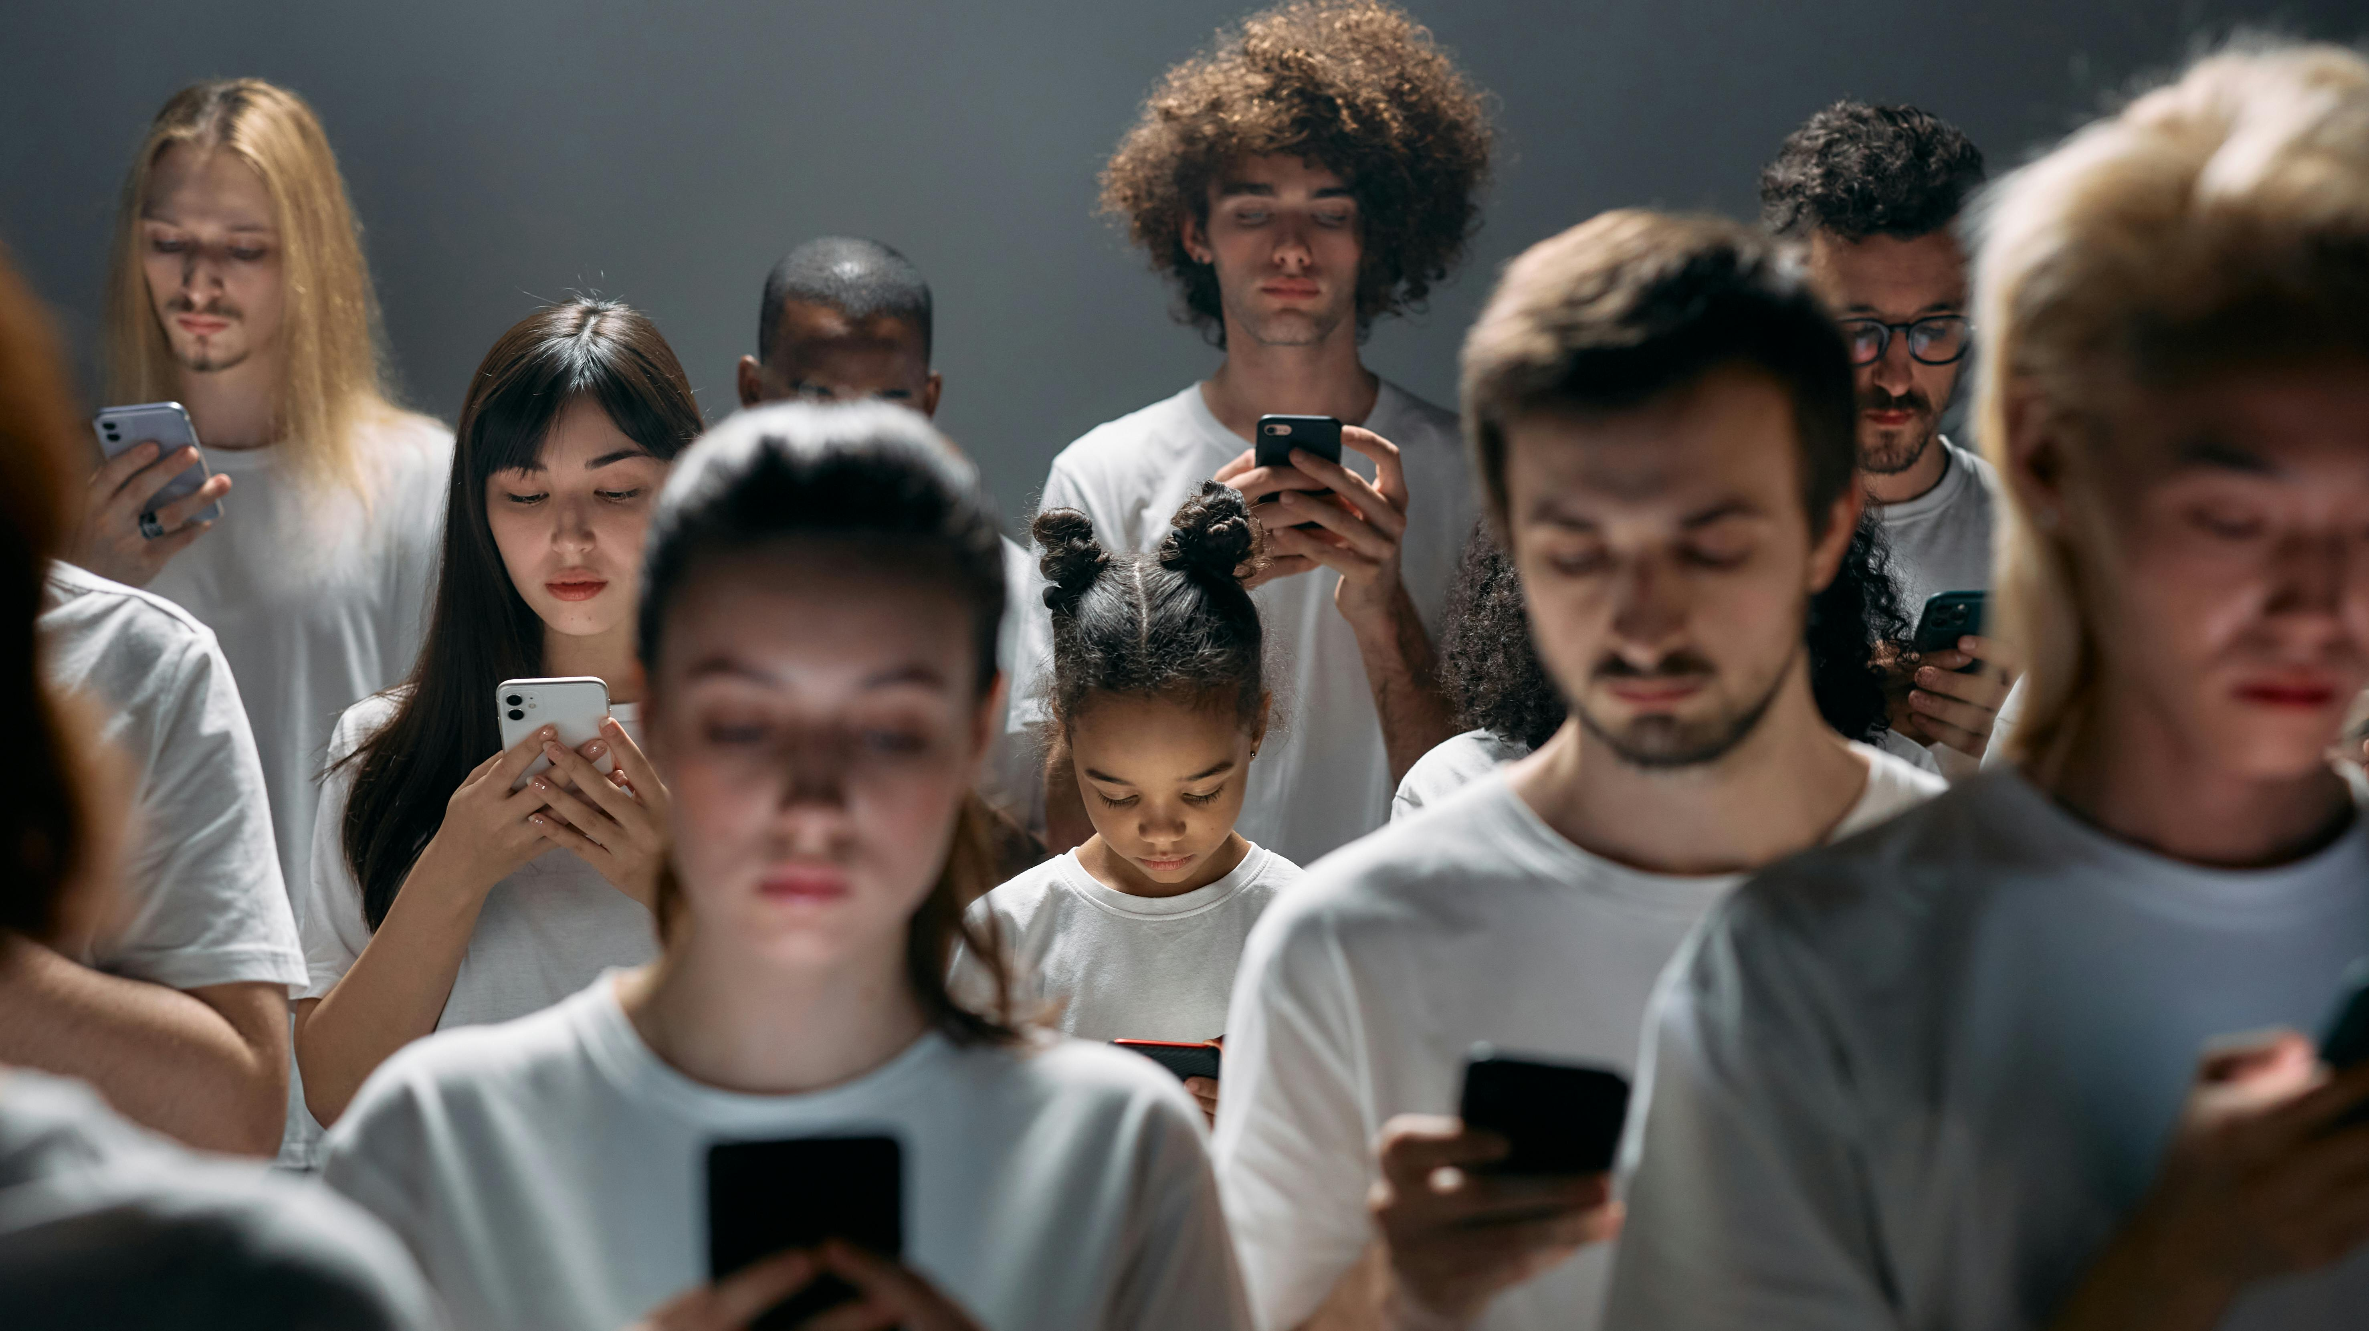
Target users
We target anyone who are interested to modern and technology specifically people who are addicted to fashion and modern tech.

Slide 5

Our goals
we aim to rich all our targets and build a strong customer network. make our customers satisfy using our app.
Avoid Monopoly of Merchants.
Save both time and money for users.
Get rid of tax and over price.
Easy way to get money as a business.

Slide 6
how to solve the problem it’s an easy task for a problem solver
As a software engineer I used to use technology I’ve learned to make life easier so we decided to build a software system as a business to avoid problems we mentioned previously.
We made an application that provides us all things we need in a usual sore and more futures we need.
Easy of use for customers.
Give user all information about the product and illustrate it with pictures.
Our project tecStore simulates the process of shopping in a modern way and easer way.

Slide 7
Usage pattrens
1-browsing behavior for application
2-Mobile domain
3-reviews and ratings

Slide 8

THANK YOU

