Slide 1
PWM Drawer using Graphical LCD and ATmega32A
Eng. Amr Helmy Mohamed Diab
Group: Nasr 58
AMIT Graduation Project

Slide 2
TABLE OF CONTENTS:
1: Overview
2: Program Architecture and Modules
3: Program
4:calculations
5: Test Results
6: Representation for patterns on GLCD

Slide 3
1: Overview

Slide 4
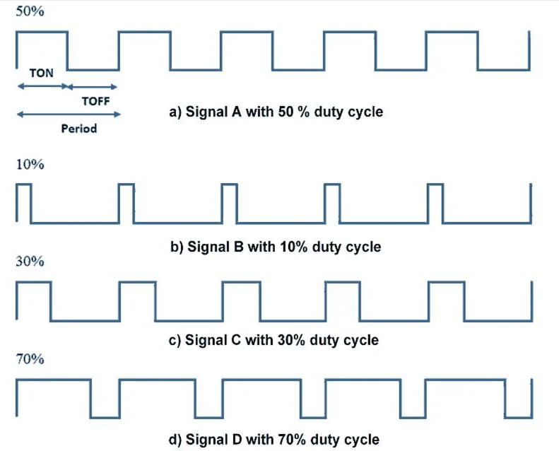
INTRODUCTION:
Pulse Width Modulation (PWM) is a modulation technique used to encode analog signals into digital form. It's widely used in various applications, including controlling the brightness of LEDs, the speed of motors, and the position of servo motors.
The basic principle of PWM involves varying the duty cycle of a digital signal to simulate an analog signal.
The duty cycle is the percentage of one period in which a signal is active. By adjusting this percentage, you can control the average power delivered to a load.

Slide 5
Applications of PWM:
LED Brightness Control: By varying the duty cycle of a PWM signal, you can control the brightness of an LED. This is useful in applications where you need to adjust the light intensity.
Motor Speed Control: PWM is used to control the speed of DC motors. By varying the duty cycle, you can control how fast the motor spins.
Servo Motor Position Control: Servo motors use PWM signals to precisely control their position. By adjusting the duty cycle, you can make the motor move to specific positions.

Slide 6
2:Program Architecture and Modules

Slide 7
Layerd Architecture
Application Layer
PWM_Drawer
PWM Drawer
Hardware Abstraction Layer (HAL)
GLCD
Microcontroller Abstraction Layer (MCAL)
DIO PWM ICU

Slide 8
3:Program

Slide 9
PWM Drawer Program:
Initilization
Initialize PWM PWM_Init
Initialize ICU ICU_Init
Initialize GLCD GLCD_init
Measure Signal
Get Duty Cycle from ICU
ICU_GetDutyCycle
Draw Signal
GLCD_DisplayString
GLCD_DisplayFloatingPoint
GLCD_DisplayInteger
GLCD_DisplaySpecialPattern

Slide 10
PWM Drawer Program:
Measure Signal
Wait for Input Capture
(High Count)
Clear Input capture Flag Set Triggering Edge : Rising Edge
Clear Input capture Flag and Timer Counter Set Triggering Edge : Rising Edge
Wait for Input Capture
(Start)
Clear Input capture Flag and Timer Counter
Set Triggering Edge : Falling Edge
Wait for Input Capture
(Low Count)

Slide 11
PWM Drawer Program:
Draw Signal Shape
Display Falling Edge
Display Pattern until max pixel width (128)
Display Rising Edge
Display Pattern For
Low Time
Display Pattern for
High Time
Display Low Line Pattern
Display High Line Pattern

Slide 12
4:Calculations

Slide 13
Calcualtions Using Fast Pwm:

Slide 14
5:Test Results

Slide 15
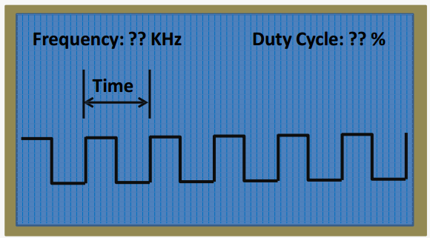
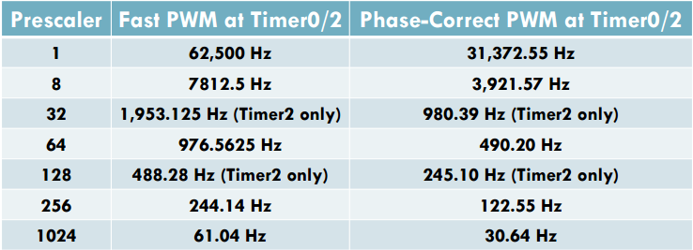

Expected Program Output:
At the code assume the clock frequency = 16 MHz so in the calculations for the fast pwm in the last table is according for this frequency and the following rule:
The calculations in counts assumed 256 in timer 0 and timer 2
The calculations in phase correct PWM like Fast PWM but in the denominator multiply in 2 and the counts will be replaced by top.
Note: the Prescaler (32 , 128 ) value exist in timer 2 only so the Calculations that applied in this cases on timer 2.

Slide 16
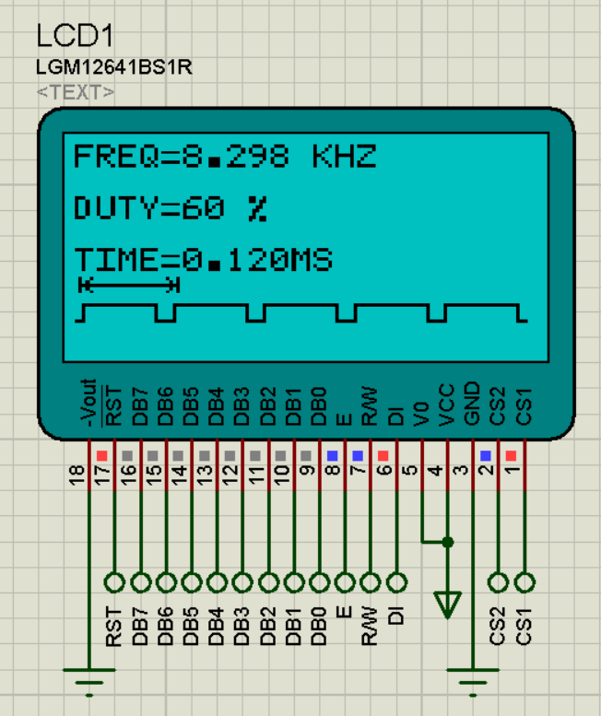
Expected Program Output:
Test Case 1
Prescaler : 8
Duty : 60%
Expected output Frequency : 7.8125 KHz
Output Frequency : 8.298 KHz

Slide 17
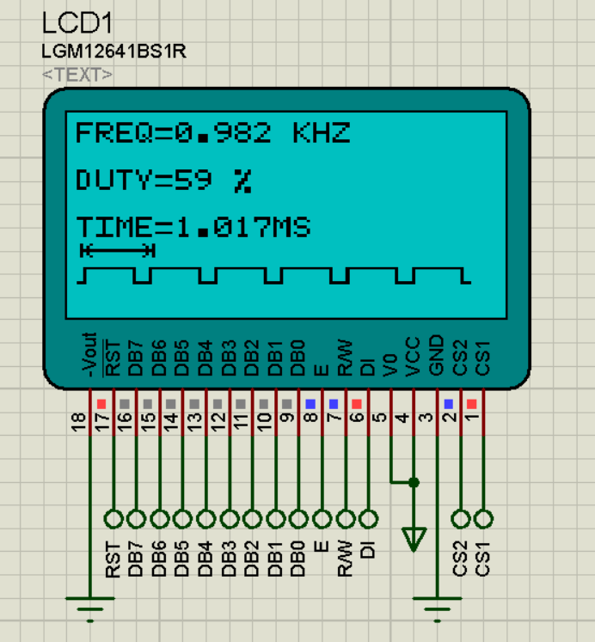
Expected Program Output:
Test Case 2
Prescaler : 64
Duty : 60%
Expected output Frequency : 0.9765 KHz
Output Frequency : 0.982 KHz

Slide 18
6: Representation for patterns on GLCD

Slide 19
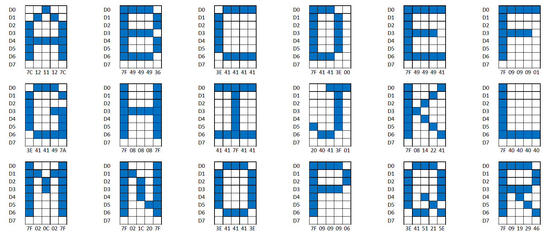
Letters presentation on GLCD:
Representations of the Words in 5x8 pixels ( 8 in row , 5 in column) in hexadecimal and the rest of letters like that.

Slide 20
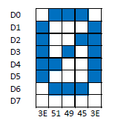
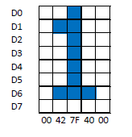
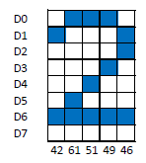
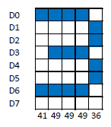
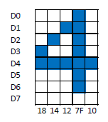
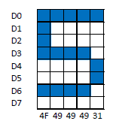
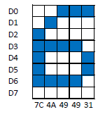
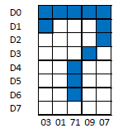
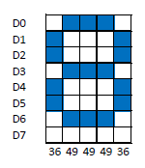
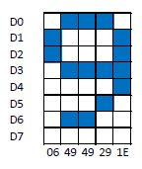
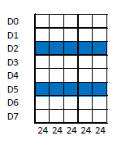
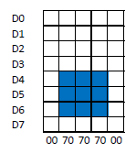
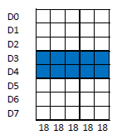
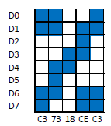
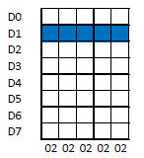
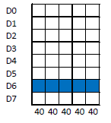
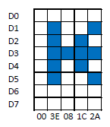
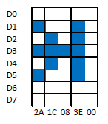
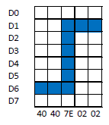
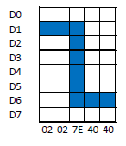
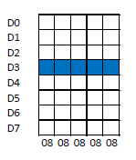
Numbers , signs and special characters presentation on GLCD:

Slide 21
Thanks!
Do you have any questions?
youremail@freepik.com
+91 620 421 838
yourwebsite.com
Please keep this slide for attribution

