Slide 1

UdaPeople product
Why CI/CD ?

Slide 2

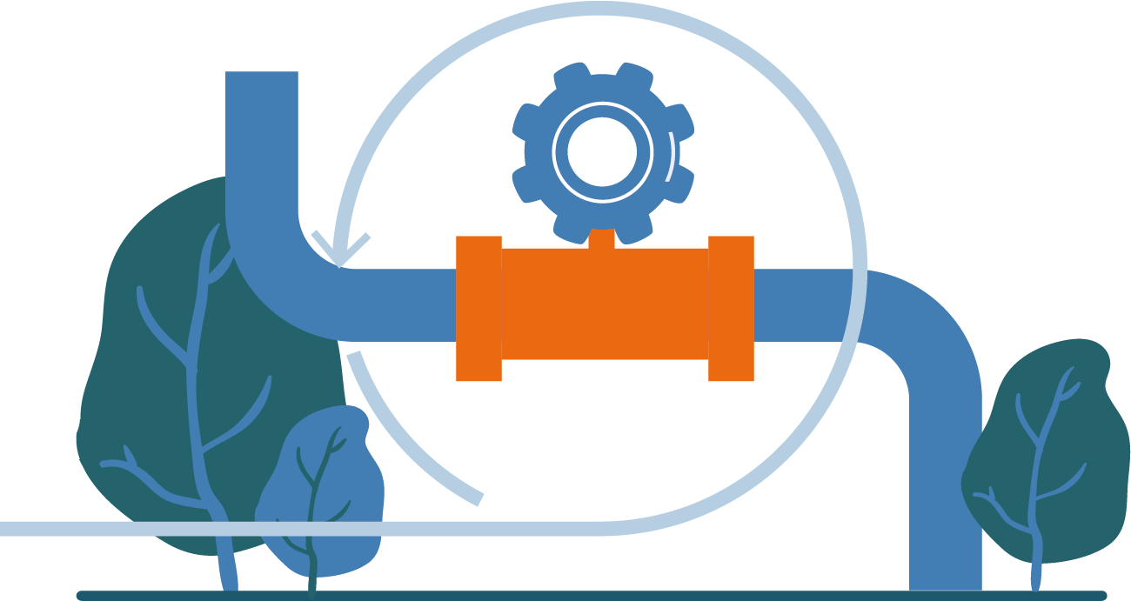


Create revenue
CI/CD
Fast production
Less time to market
Download the application

Slide 3




Protect revenue
Quick undo
Reduced downtime
No to touch profit

Slide 4






Control costs
Less production bugs
Automation
Less testing time
Code Revision
Clean Code

Slide 5



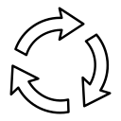
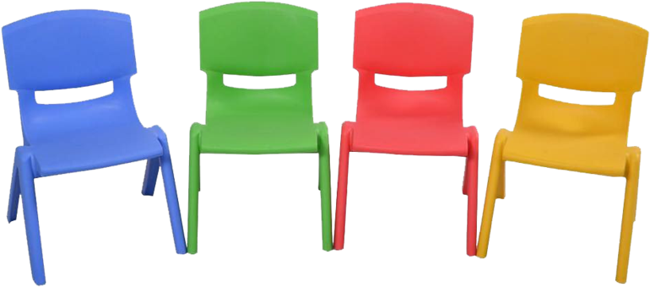

Reduce costs
Less developer time
Fast feedback
Reduce unused resources
Code Revision
Correct deployment

