Slide 1
Advanced Machine Learning
- Regression:
Diamond Price Prediction Using:
SVM Regressor (SVR)
Decision Tree Regressor
- Classification:
Cars Object Detection Using:
RCNN
ResNet50

Slide 2
Regression – Diamond Prediction
Data Set:
  Link: https://www.kaggle.com/datasets/shivam2503/diamonds
  Context: This classic dataset contains the prices and other attributes of almost 54,000 diamonds.
  Content:
    price price in US dollars (\$326--\$18,823)
    carat weight of the diamond (0.2--5.01)
    cut quality of the cut (Fair, Good, Very Good, Premium, Ideal)
    color diamond color, from J (worst) to D (best)
    clarity a measurement of how clear the diamond is (I1 (worst), SI2, SI1, VS2, VS1, VVS2, VVS1, IF (best))
    x length in mm (0–10.74), y width in mm (0–58.9), z depth in mm (0--31.8)
    depth total depth percentage = z / mean(x, y) = 2 * z / (x + y) (43--79)
    table width of top of diamond relative to widest point (43--95)

Slide 3
Regression – Diamond Prediction
Implementation:
  EDA phase to explore the data:
    Checked the data shape
    Data Types
    Brief description for the data (count, mean, std, …)
    Encoding the categorical data columns: 'cut', 'color', & 'clarity'
    Check Correlation between data features
    NULL values
  Data Splitting:
    We split the data into (Train: 85% of all samples and rest 15% as a Test split)

Slide 4
Regression – Diamond Prediction
Implementation:
  Hyper-parameters Selection:
    Applying Grid Search Cross Validation
      decision_tree = {'max_depth': [2, 4, 8], 'min_samples_split': [2, 5, 10], 'min_samples_leaf': [1, 4, 8]}
      svm = {'C': [0.1, 1, 10], 'kernel': ['linear', 'rbf'], 'gamma': [0.1, 1, 10]}
    Fitting The Models
      Decision Tree Regressor
      SVR

Slide 5
Regression – Diamond Prediction
Results:
  Hyper-parameter tuning results:
    Decision Tree Best Parameters: {'max_depth': 8, 'min_samples_leaf': 8, 'min_samples_split': 2}
    SVM Best Parameters: {'C': 10, 'gamma': 0.1, 'kernel': 'linear'}
  Training Results:
    RMSE Score for decision tree 716.415
    RMSE Score for svm 1402.3092

Slide 6
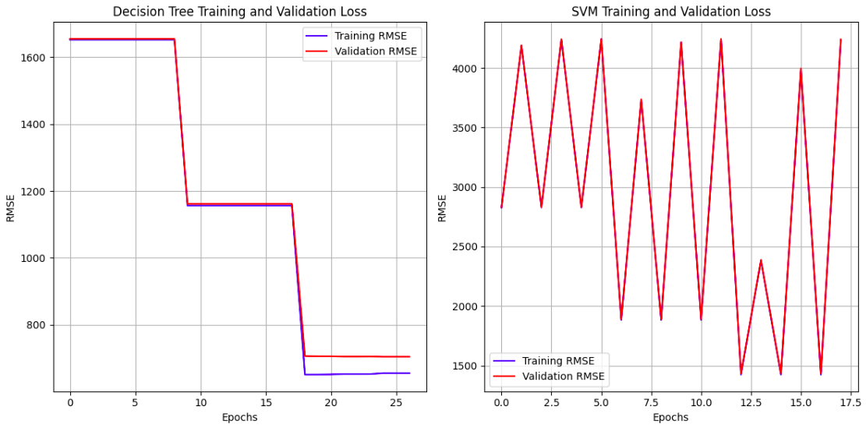
Regression – Diamond Prediction
Results:
  Training Results:

Slide 7
Classification – Cars Object Detection
Data Set:
  Link: https://www.kaggle.com/datasets/sshikamaru/car-object-detection
  Context: The dataset contains media of cars in all views
  Content:
    Training Data Folder: Cars Images
    Test Data Folder: Car Images
    Data bounding csv file
      Image: Image Name
      Xmin
      Ymin
      Xmax
      Ymax

Slide 8
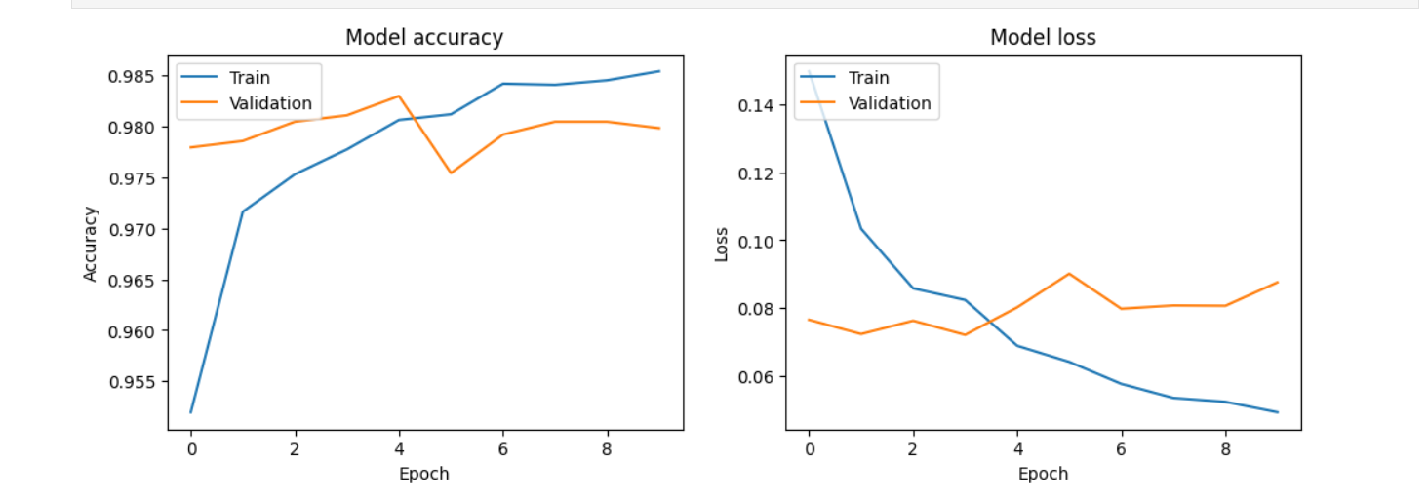
Classification – Cars Object Detection
Results:

Slide 9
Thanks

