Slide 1
Rockbuster Stealth: Data Analysis
Home
Context
Analysis
Conclusions
The End
Start strategy
data analysis

Slide 2

“Without big data, you are blind and deaf and in the middle of a freeway.” — Geoffrey Moore.
Home
Context
Analysis
Conclusions
The End

Slide 3
Context
REVENUE BY GENRES AVERAGE RENTAL BY RATING
TOP COSTOMER LOCATION
Conclusions
TOP MOVIES AND TOP CUSTOMERS
Home
Context
Analysis
Conclusions
The End
01
02
Regions with number and the highest customer amounts.
Will show revenue by genres also average rental duration by rating.
03
04
Contain the main results and recommendations.
Will show the top movies earning and most customers amount paid.

Slide 4
TOP COSTOMER LOCATION
Home
Context
Analysis
Conclusions
The End
01
REGIONS WITH NUMBER AND THE HIGHEST CUSTOMER AMOUNTS

Slide 5
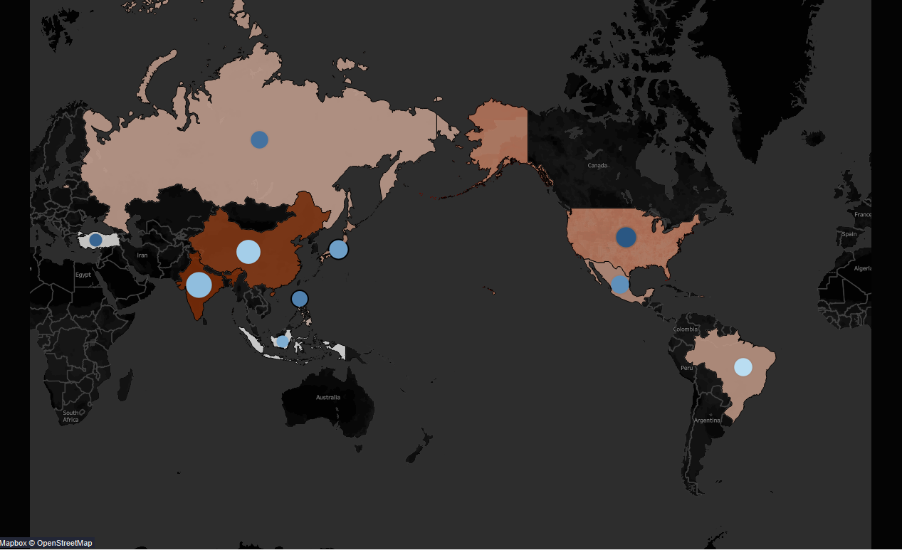
Home
Context
Analysis
Conclusions
The End
Top 5 countries
India, China, United States, Japan, Mexico.
American Samoa
Has the lowest customers
Total countries
Rockbuster is based out of 108 countries.
https://public.tableau.com/app/profile/amr7313/viz/Task3_10_16803494090680/Sheet1?publish=yes

Slide 6
REVENUE BY GENRES AVERAGE RENTAL BY RATING
Home
Context
Analysis
Conclusions
The End
02
WILL SHOW REVENUE BY GENRES ALSO
AVERAGE RENTAL DURATION BY RATING

Slide 7
Home
Context
Analysis
Conclusions
The End
REVENUE BY GENRES
Family movies has less revenue and sport movies have the highest revenue

Slide 8
AVERAGE RENTAL BY RATING
Home
Context
Analysis
Conclusions
The End
Rockbuster’s rental average is between 4.7-5.2 days.
NG-17 (rating) having the highest rental average.

Slide 9
TOP MOVIES TOP CUSTOMERS
Home
Context
Analysis
Conclusions
The End
03
Will show the top movies earning and most customers amount paid.

Slide 10

Home
Context
Analysis
Conclusions
The End
Top earning movies
There are 1000 movies sell by Rockbuster company.
Film “Apache Divine” has the most earning.

Slide 11
TOP CUSTOMERS
Home
Context
Analysis
Conclusions
The End
Customer ID | First name | Last name | Country | City | Total amount paid
225 | Arlene | Harvey | India | Ambattur | 111.76
424 | Kyle | Spurlock | China | Shanwei | 109.71
240 | Marlene | Welch | Japan | Iwaki | 106.77
486 | Glen | Talbert | Mexico | Acua | 100.77
537 | Clinton | Buford | United States | Aurora | 98.76

Slide 12
Conclusions
Home
Context
Analysis
Conclusions
The End
04
Contain the main results and recommendations

Slide 13
Results
NG-17 (rating)
Average rental duration
Home
Context
Analysis
Conclusions
The End
having the highest rental average, and we need more data to know the Genres
of films that is popular and have same rating.
Rockbuster’s rental average is between 4.7-5.2 days.

Slide 14
RECOMMENDATIONS
The genres the total paid
Europe market
Top customers rate total amount paid
Home
Context
Analysis
Conclusions
The End
Focus on the sport, science and animation because they are have the most the total paid, and make search about why other genres have less amount paid.
When we analysis top amount paid region we notice that European country it is not in the list, so we need to start find ways to join the market.
The average for top customers rate total amount paid is 100 dollar so we need to find new ways to make this number higher like pay online or makes discount, and I think if we do survey about reasons that open new reseach and great recommendations

Slide 15

Thanks

