Slide 1
Linear Equation
Solver
{ ax + by = c }
C++ Project
Gaussian Elimination · Cramer's Rule · OOP Design
Sara Abdelsamie
Maiar Emam
Amr Muhammad
Ahmad Elsayed

Slide 2
Project Overview
🎯 Goal
🔧 Method
Parse and solve systems of linear equations using C++ with OOP
Cramer's Rule with matrix determinants for exact solutions
📦 Structure
💻 Input
Term struct, Equation class, and Solver class working together
Command-line based: read equations, execute operations interactively

Slide 3
System Architecture
struct Term
class Equation
class Solver
coeff : float
var : string
terms : vector<Term>
rhs : float
simplify() / toString()
eqs / all_vars
readEquations()
execute() + 9 funcs
Term is used by → Equation → Solver

Slide 4
Key Functions
01
parseTerm() · readEquation()
02
updateVarList()
Parses tokens into Term (coeff+var); reads n equations into Term list + RHS
Scans all equations and rebuilds the master list of distinct variable names
→ Maiar Emam
→ Sara Abdelsamie
03
getCoeffMatrix()
04
determinant()
Builds the n×n coefficient matrix for Cramer's Rule
Recursive cofactor expansion to compute det of any n×n matrix
→ Amr Muhammad
→ Amr Muhammad
05
substituteVar()
06
execute()
Eliminates a variable by substituting one equation into another
Command loop: solve, add, subtract, column, equation, D, D_value
→ Ahmad Elsayed
→ Amr Muhammad

Slide 5
How It Works — Cramer's Rule
1
Read Equations
User inputs n equations. Each is parsed into Term list + RHS.
2
Build Matrix
getCoeffMatrix() creates the coefficient matrix A[n][n].
3
Compute det(A)
determinant() uses recursive cofactor expansion.
4
Cramer's Loop
For each variable, replace column with RHS → compute det(Aᵥ).
5
Output Solution
xᵥ = det(Aᵥ) / det(A). Print result for each variable.

Slide 6
Supported Commands
Command
Description
solve
Solve the system using Cramer's Rule
D
Print the full coefficient matrix
D <var>
Print matrix with a column replaced by RHS
D_value
Print the determinant of the coefficient matrix
equation <n>
Print equation n in simplified form
column <var>
Print all coefficients for a given variable
add <a> <b>
Add equations a and b, print result
subtract <a> <b>
Subtract equation b from a, print result
num_vars
Print the number of distinct variables
quit
Exit the solver

Slide 7
Team Contributions
Sara Abdelsamie
Maiar Emam
Equation formatting & simplification
Input parsing & equation reading
simplify() · toString() · updateVarList()
parseTerm() · readEquation() · readEquations()
Amr Muhammad
Ahmad Elsayed
Matrix ops, Cramer's Rule, command loop
Equation algebra & variable management
getCoeffMatrix() · determinant() · getCoeff() · execute()
addEq() · subEq() · substituteVar() · updateVarList()

Slide 8
Thank You!
Linear Equation Solver · C++ OOP Project
Questions & Discussion
Sara Abdelsamie · Maiar Emam · Amr Muhammad · Ahmad Elsayed

Slide 9
Code of Main Function
main.cpp
#include <iostream>
#include "Solver.h"
using namespace std;
int main() {
Solver s;
s.readEquations(); // parseTerm() + readEquation() called inside
s.execute(); // command loop: solve, add, subtract, D, ...
return 0;
}
Call flow: main → readEquations() → readEquation() → parseTerm() → updateVarList() → execute()

Slide 10
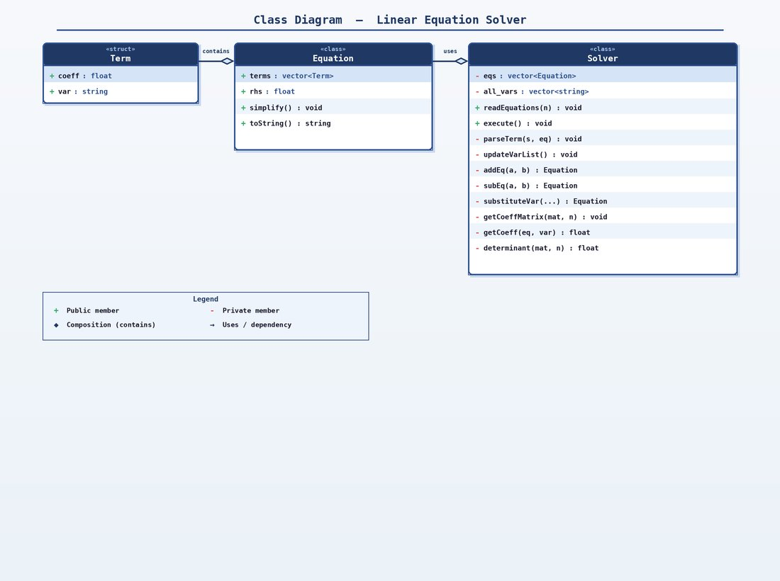
UML Class Diagram — Linear Equation Solver

