Slide 1

COFFEE SALES ANALYTICS
REPORT

Slide 2
About The Project
In the beginning I had a data about Coffee sales with a data about customers including their names, country, IDs, and all their orders details as you will see in the next slides. I tried to figure out the customers needs and that’s by knowing what are their preferences regarding the Coffee type and size etc.

Slide 3

DATA GATHERING

Slide 4
XLOOKUP AND INDEX, MATCH COMBINATION
I got three dataset orders, customers, products by linking the primary key to the foreign key using xlookup and index, match combination to add the relevant data to my analysis which what I said in the beginning, studying customers preferences.

Slide 5

DATA FORMATTING

Slide 6
USING IF FUNCTION FOR DATA FORMATTING
Some columns have abbreviated names, so I used if function to map this names again, ex. Instead of coffee name Rob, Exc, Ara, Lib I changed it to robusta, excelsa, arabica, and Liberica. And I did the same procedure to roast type.
Coffee Type | Roast Type
Rob | M
Exc | M
Ara | L
Exc | M
Rob | L
Lib | D
Exc | D
Lib | L
Rob | M
coffee Type name | Roast Type
Robusta | Medium
Excelsa | Medium
Arabica | Light
Excelsa | Medium
Robusta | Light
Liberica | Dark
Excelsa | Dark
Liberica | Light
Robusta | Medium

Slide 7

Multiplication function for sales column
Did multiplication to calculate total sales for each customer. Did some number formatting

Slide 8

COFFEE SALES DASHBOARD
In The next section I’ll discuss my final dashboard and the processes I made to achieve this result.

Slide 9
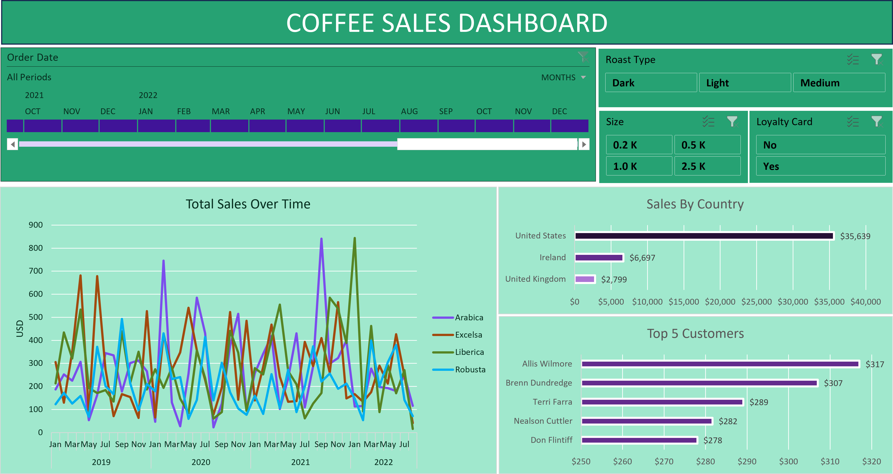
beautiful, isn’t it ? Let down the dashboard and let’s dig deep the process.

Slide 10
I tried to figure out how to get valuable insights from this data, so I said why don’t I know what are people preferences so I Found that the most preferred coffee type is arabica and liberica, so why don’t we make a mix of the two most wanted coffee type and study if it will gain a welcoming? Hopefully, they gather a data about to the result

Slide 11
Which country counts for the highest Sales? I inserted a pivot table to know the answer to the question. I found that united states is the highest country on sales which is logical as united states is the biggest market among the other two countries

Slide 12
I answered a question which is what is the top 5 customers in terms of sales, I found the top 4 is from United states and “Don Flintiff” is from united kingdom which is a little bit weird because it’s the least country in terms of sales

Slide 13
Final thoughts
This data set is pretty clean, so I didn’t have to make data cleaning before the analysis
We need a huge marketing campaign in Ireland and united kingdom
We need put money on CAC “customer Acquisition cost” in Irish and English people to increase sales as well!

Slide 14
AMR SALAH
DATA ANALYST

