Slide 1


MTA Daily Ridership
Final Graduation Project

Slide 2






Team 3 [CLS CAI3_DAT2_G6]
Amr Salah
Noha Mohsen
Tony Mamdouh
Mostafa Ahmed
Mohamed Emad Kasem
Ahmed Mohamed Ibrahim Abdou

Slide 3

Project Overview
Largest transit network in North America
Data from March 2020–2025
Focus: COVID‑19 recovery analysis & YoY trends

Slide 4
Dataset Overview
MTA Daily Ridership dataset (deprecated 2025)
Modes: Subway, Bus, LIRR, MNR, AAR, SIR, Bridges & Tunnels
Metrics: Ridership, Recovery %, Date

Slide 5
Data Preparation & Modeling
Unpivoted dataset into clean fact model
Star schema: Fact_Riders, Calendar, Rider Type
Data cleaning & type enforcement

Slide 6
Key Measures (DAX)
Estimated Ridership
Avg Recovery
Pre‑Pandemic Ridership
Recovery Rate
YoY % Change

Slide 7
Dashboard Insights
2020 drop due to pandemic
Strong recovery in Subway & Bus
Seasonal peaks May–Oct
Consistent YoY improvement (2023–2024)

Slide 8
Tools & Tech
Power BI Desktop
Power Query (M)
DAX
Excel Staging

Slide 9
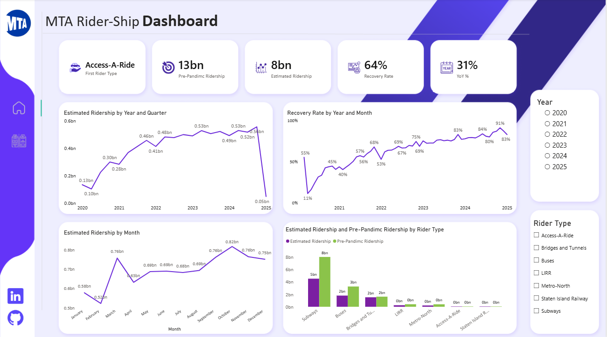

Slide 10
