Slide 1
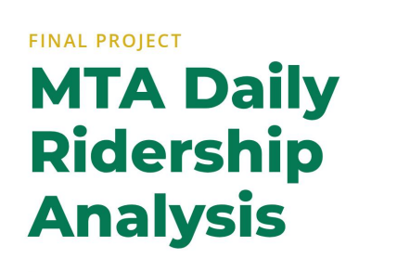


Slide 2


The project aims to answer the critical question: "How is New York City's transit network recovering from the COVID-19 pandemic, and what are the new travel patterns?"

Slide 3

Name | Email | ID
Amr Mohammed Ahmed Mohammed | amrabdelghany000@gmail.com | 21086749
Mohammed Ahmed Hassanein Khalifa | eng.mohammedzaher@gmail.com | 21053928
Mohammed Mamdouh Fathy | mamdouhmohamed220@gmail.com | 21081802
Paula Sameh Sobhy | paulasameh549@gmail.com | 21021295
Abanoub Shawkat Ragheb | Beboshawket30@gmail.com | 21030220
Bishoy Mina Elkomos Bishoy | bishoy.elmalah@gmail.com | 21009483

Slide 4
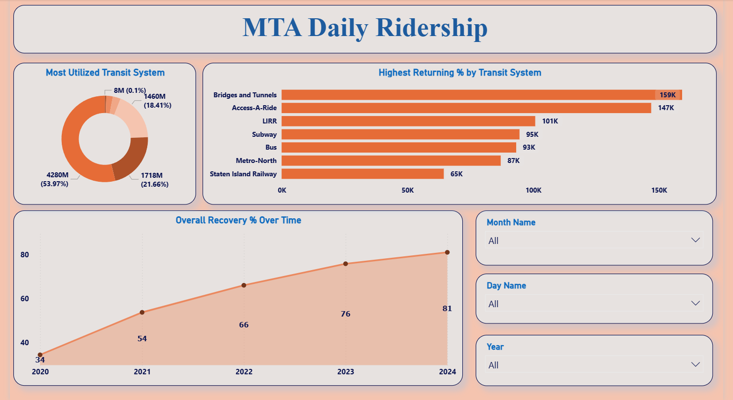

Slide 5
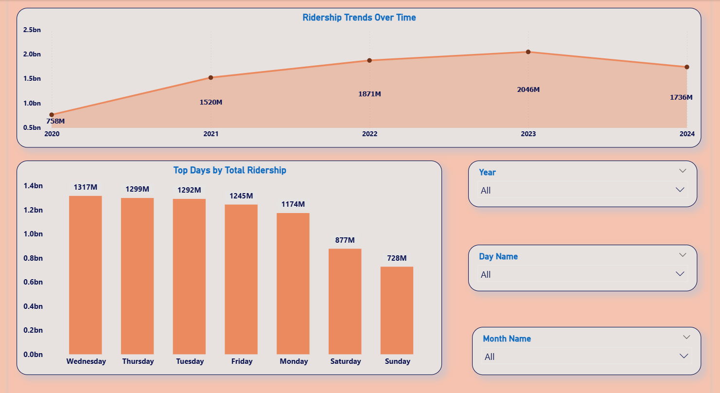

Slide 6
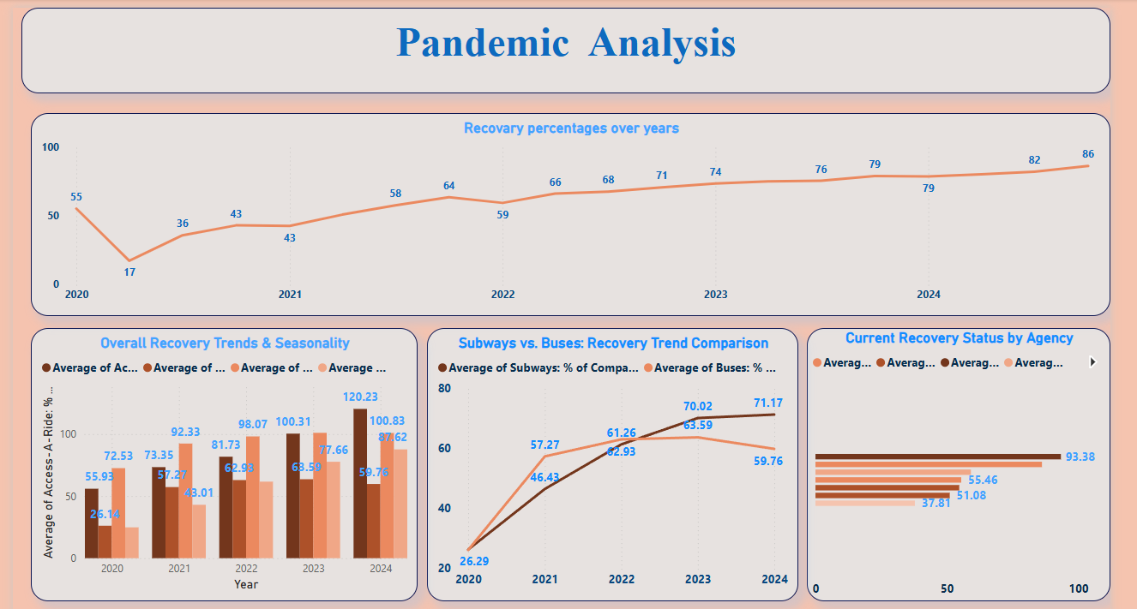

Slide 7
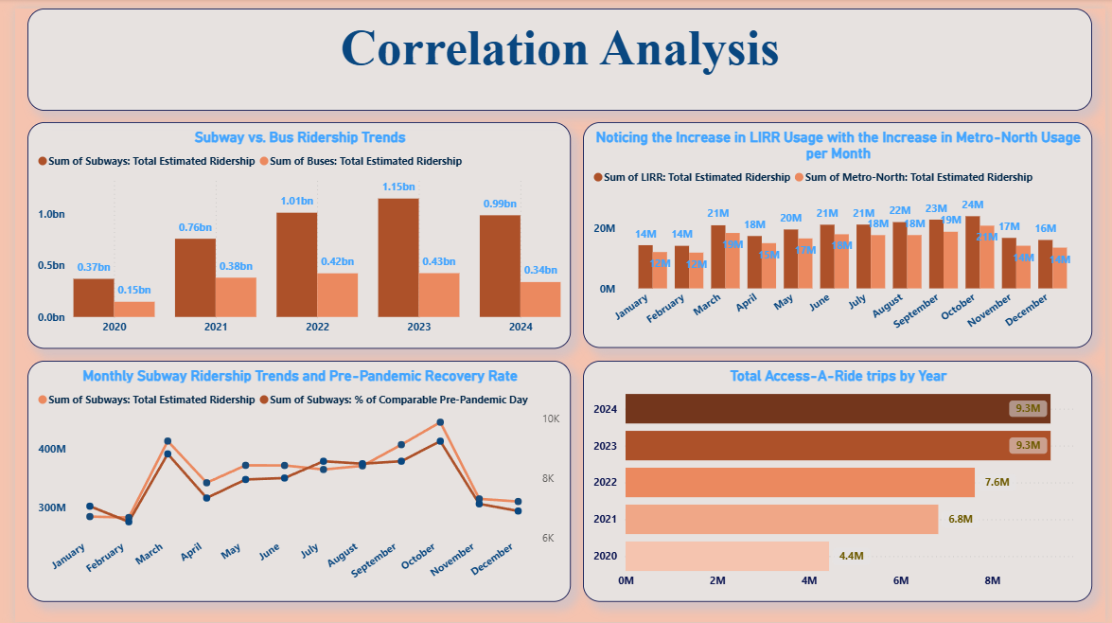

Slide 8
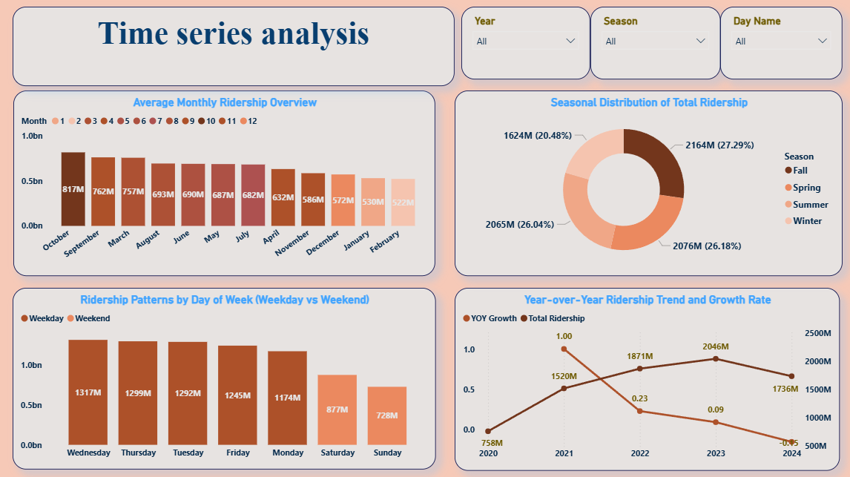

Slide 9


