Slide 1
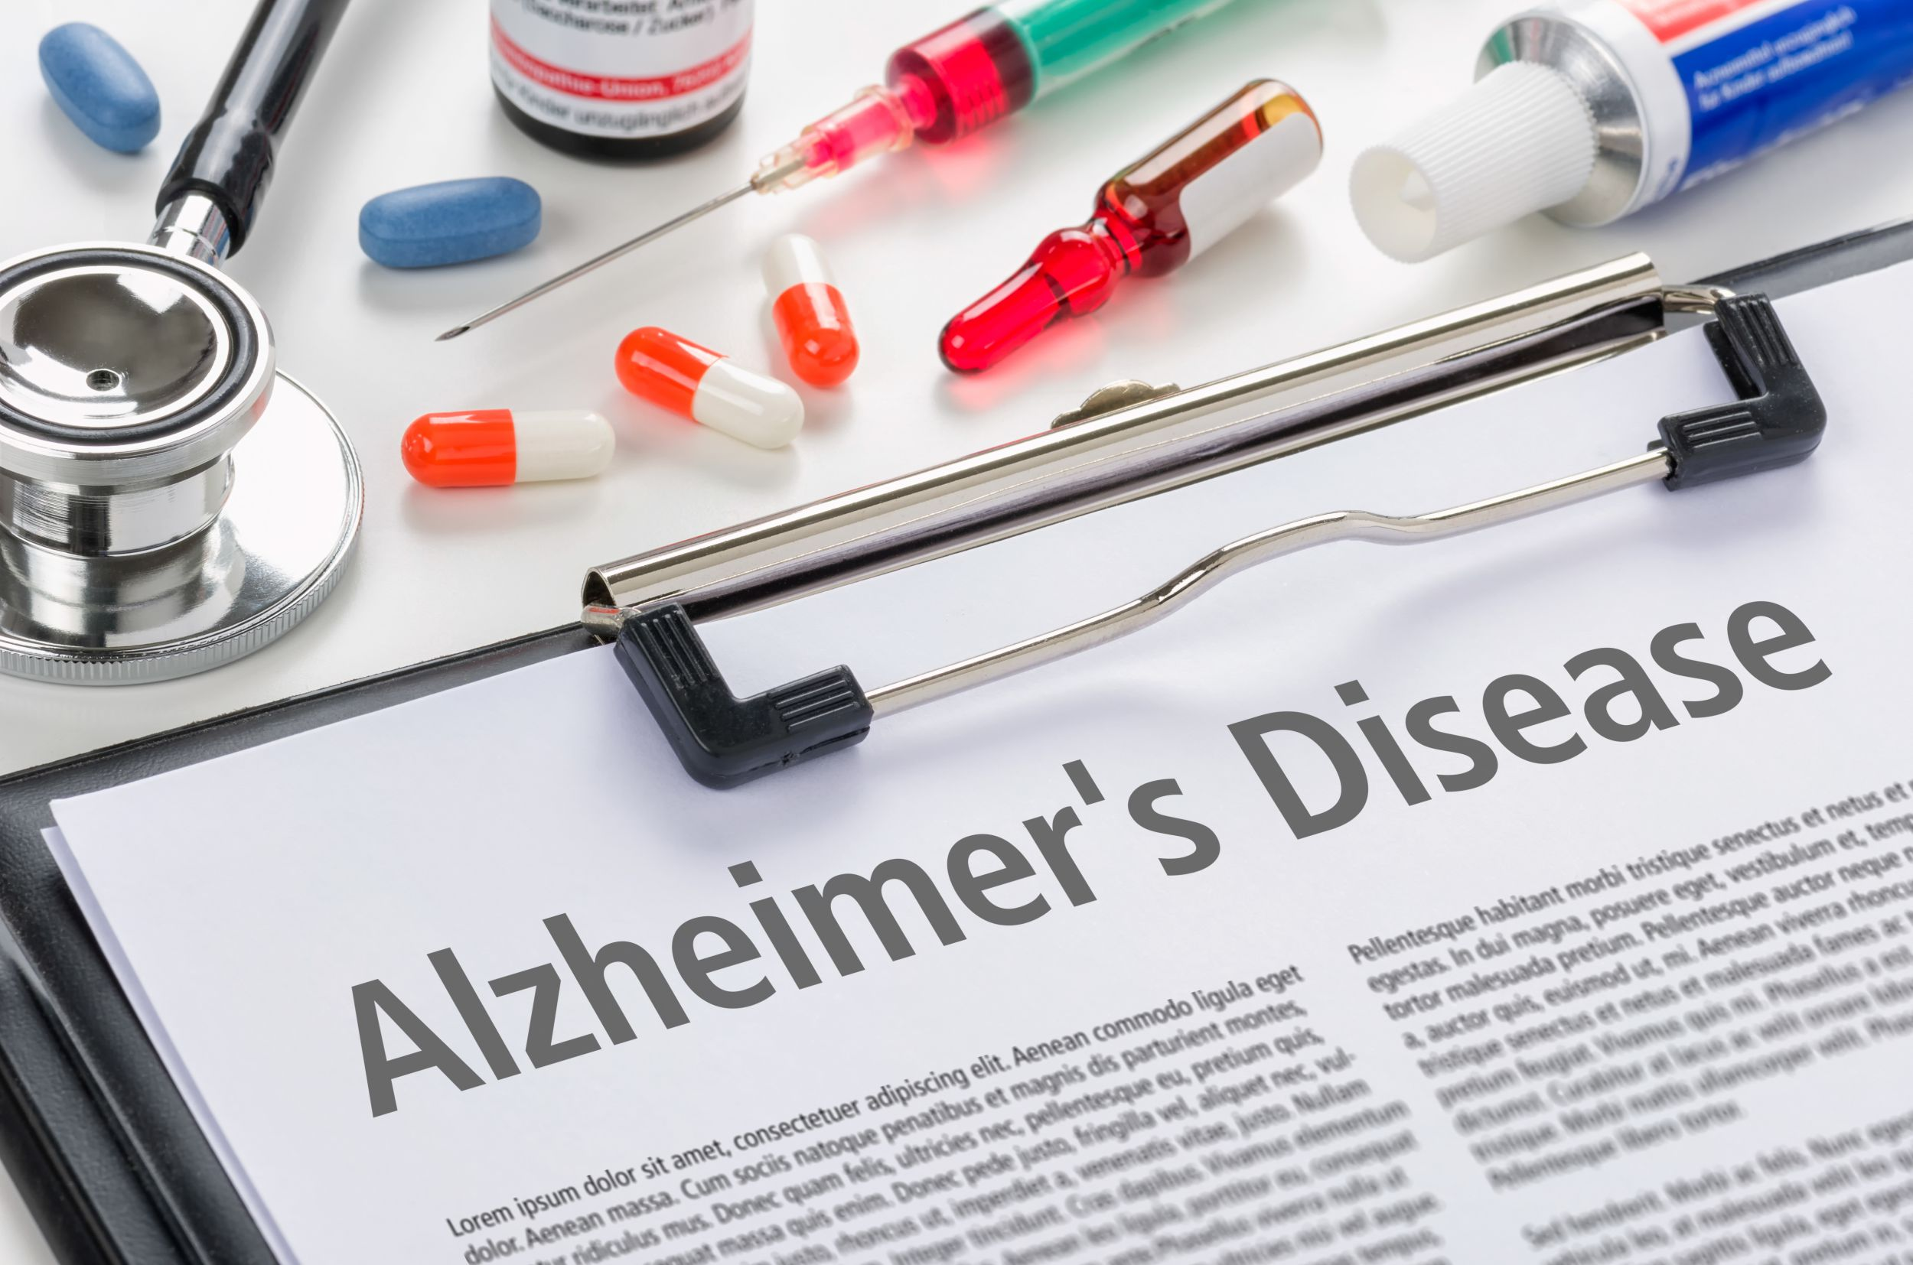
Bio Team
Alzheimer’s disease Prediction

Slide 2

Alzheimer's disease
Alzheimer's disease (AD) is a progressive neurodegenerative disease. Though best known for its role in declining memory function, symptoms also include: difficulty thinking and reasoning, making judgements and decisions, and planning and performing familiar tasks. It may also cause alterations in personality and behavior. The cause of AD is not well understood. There is thought to be a significant hereditary component. For example, a variation of the APOE gene, APOE e4, increases risk of Alzheimer's disease.

Slide 3
Project Motivation
According to global statistics, there are approximately 47 million Alzheimer’s patients in the world, and that Egypt has 400,000 with this disease, and it is expected that in 2030 the percentage will increase to 75 million patients in the world, and by 2050 it will reach 132 million patients, and statistics have proven that 70 % of dementia patients will be from developing countries.

Slide 4
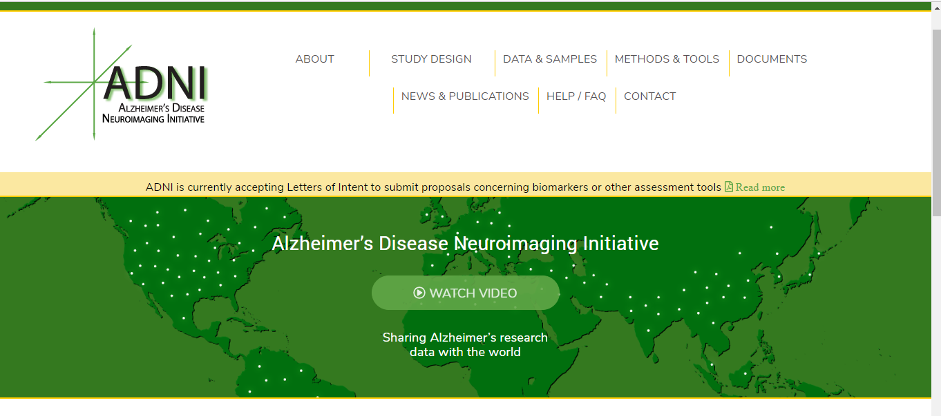
Project Description:
Using data provided by the ADNI Project, it is our goal to develop a computer model that assists in the diagnosis of the disease. We will try multiple models recently popularized in machine learning (Neural Network, SVM, etc.) and more traditional statistical models such as ordinal regression, multinomial regression, and decision trees.

Slide 5
Features/Predictor Variables Used:
APOE4 ( Apolipoprotein E )
Imputed Genotype
PTRACCAT (Race)
APOE ε4 increases risk for Alzheimer's disease and is also associated with an earlier age of disease onset. Having one or two APOE ε4 alleles increases the risk of developing Alzheimer's
To excluse unobservable genetic patterns and if it equal true then it founded if it's not then it couldn't be find.
Alzheimer suffers race most of them are black
MMSE ( mini mental state examination )
AGE (Age at baseline)
PTEDUCAT (Years of Education))
to examine the mental abilities most Normal people are ranged between ( 21 -25 ) and most Alzheimer's suffers are ranged between (26-30)
The number of education years of most Alzheimer's suffers ranged between ( 11 - 20 ) years.
Most ages of Alzheimer's sufferers range between (62-84). It's rarely to be Alzheimer's sufferers in his thirties

Slide 6

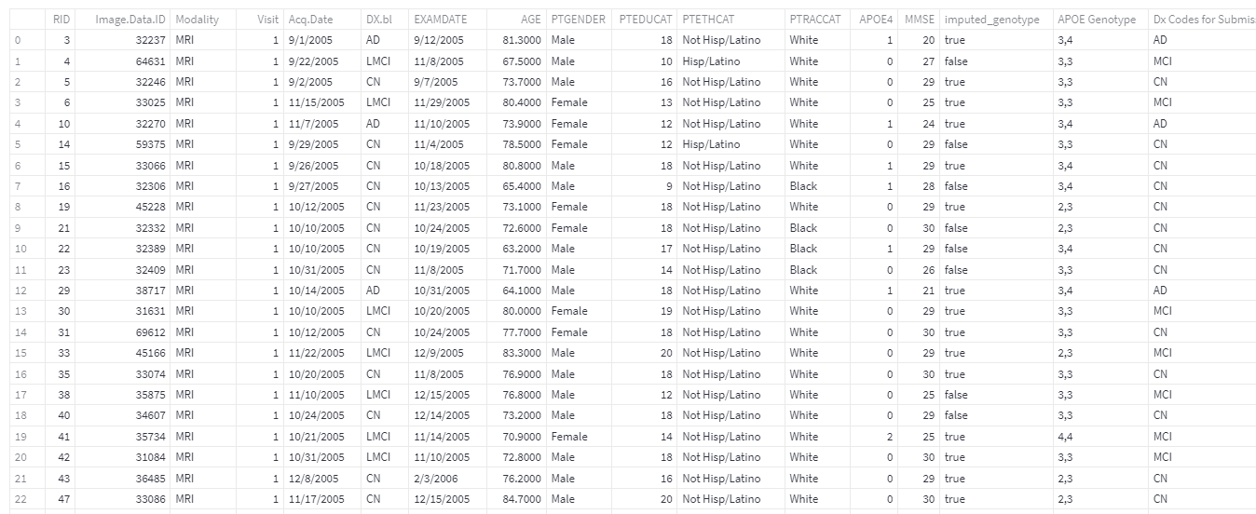
Dataset

Slide 7
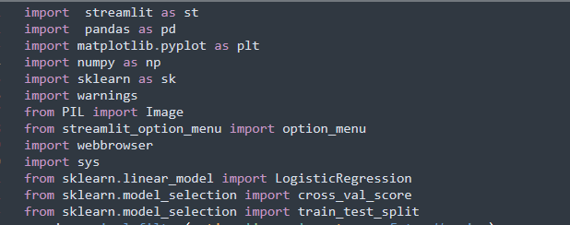
#
Importing required libraries
1.Streamlit :turns data scripts into shareable web apps in minutes. All in pure Python. No front‑end experience required.
2. pandas: is a fast, powerful, flexible and easy to use open source data analysis and manipulation tool
3. Matplotlib :is a comprehensive library for creating static, animated, and interactive visualizations in Python. Matplotlib makes easy things easy and hard things possible
4.Scikit-learn is an indispensable part of the Python machine learning . It is very widely used across all parts of the bank for classification, predictive analytics, and very many other machine learning tasks.

Slide 8


Logistic Regression
Logistic regression is one of the most popular Machine Learning algorithms, which comes under the Supervised Learning technique. It is used for predicting the categorical dependent variable using a given set of independent variables.
Logistic regression predicts the output of a categorical dependent variable. Therefore the outcome must be a categorical or discrete value. It can be either Yes or No, 0 or 1, true or False, etc. but instead of giving the exact value as 0 and 1, it gives the probabilistic values which lie between 0 and 1.
Logistic Regression is much similar to the Linear Regression except that how they are used. Linear Regression is used for solving Regression problems, whereas Logistic regression is used for solving the classification problems.
Notes:
Regression problems: requires the prediction of a quantity

Slide 9
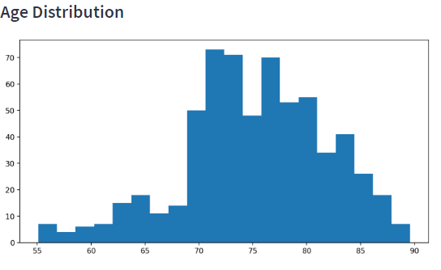
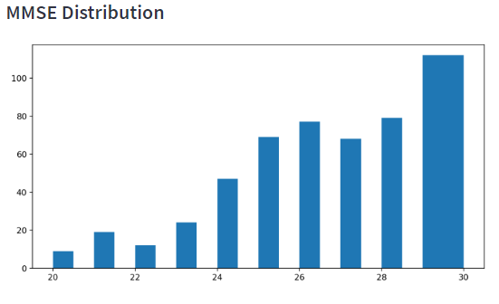
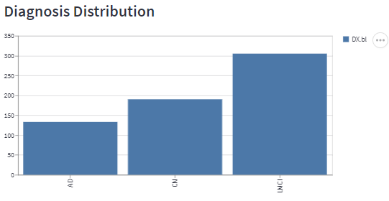
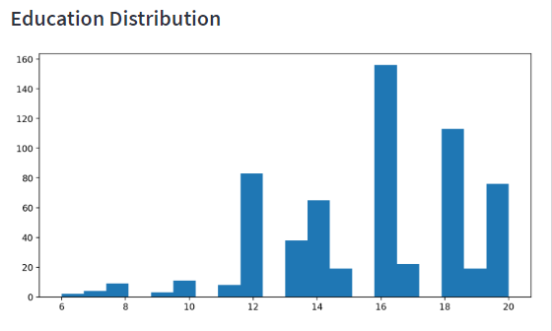
Data Distribution

Slide 10
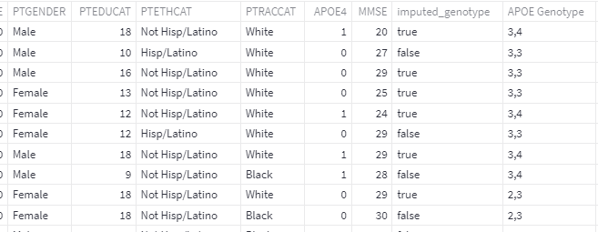
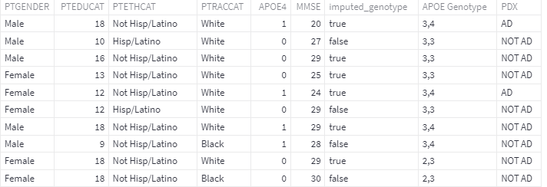
Results
Input data
Output data

Slide 11
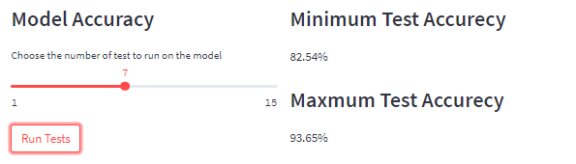
PDX: “AD” if they have Alzheimer's disease and “NOT AD” they have not Alzheimer's disease. This is the column we are trying to predict. It is called the our target.
Accuracy of our model

Slide 12

THANK YOU

