Slide 1
Single cell RNA-seq
Single cell RNA-seq data analysis course
CSC 21.9.2018
Heli Pessa

Slide 2
Different technologies for capturing single-cell transcriptomes
Plate-based: SMART-Seq2, STRT-Seq, CEL-Seq
Droplet-based: 10X Chromium, Drop-Seq, Indrop, Fluidigm C1
Microwell-based: ICell8, Seq-Well
Libraries are usually 3’ tagged: only a short sequence at the 3’ end of the mRNA is sequenced
How does this influence the data?

Slide 3
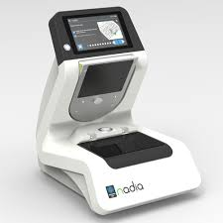
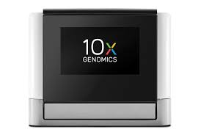
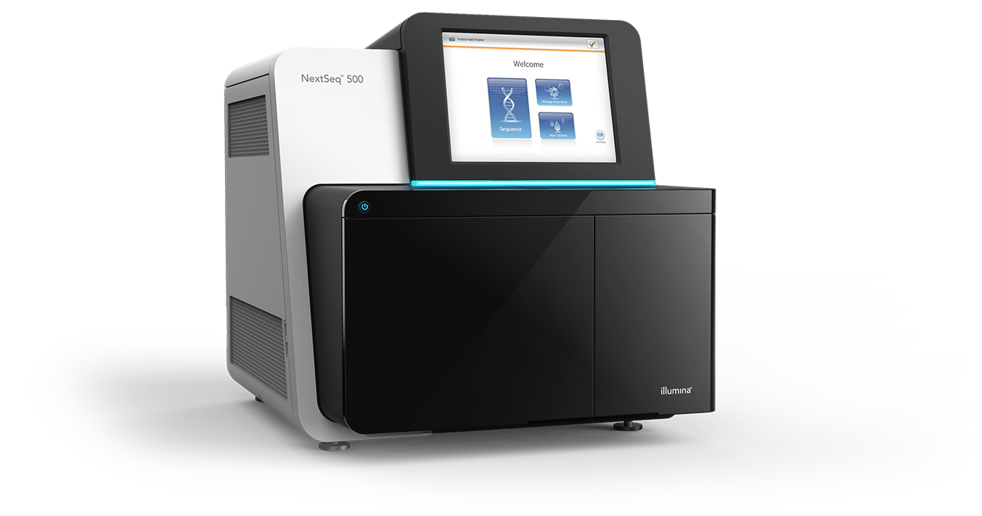
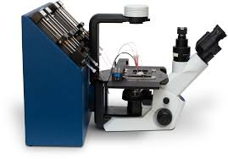
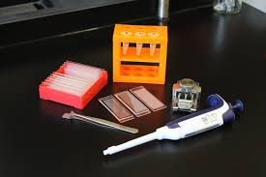
Different technologies for capturing single-cell transcriptomes
Encapsulation of cells
RNA capture
Library prep and sequencing
Drop-Seq
Oil
Barcoded RNA capture beads
Barcoded single-cell transcriptomes
10X
Indrop
Cells
Seq-Well

Slide 4
RNA capture
UMI
PCR primer site
Cell barcode
Linker-5’-TTTTTTTAAGCAGTGGTATCAACGCAGAGTACJJJJJJJJJJJJNNNNNNNNTTTTTTTTTTTTTTTTTTTTTTTTTTTTTT3’
3’AAAAAAAAAAAAAAAAAAAAAAAAAANNNNNNNNNN…5'
mRNA
Barcoded RNA capture beads
Capture oligo preparation
Ligation of short oligonucleotides (10X and Indrop): known set of barcodes
Split-and-pool synthesis (Drop-Seq): random barcodes

Slide 5
cDNA synthesis
RNA capture
Cell
barcode
Primer site
UMI
Linker-5’-TTTTTTTAAGCAGTGGTATCAACGCAGAGTACJJJJJJJJJJJJNNNNNNNNTTTTTTTTTTTTTTTTTTTTTTTTTTTTTT3’
mRNA 3’AAAAAAAAAAAAAAAAAAAAAAAAAANNNNNNNNNNNNN…5'
Reverse transcription
cDNA
Bead oligo 5’TTTTTTTTTTTTTTTTTTTTTNNNNNNNNNNNNNNNNNCCC3’
mRNA 3’AAAAAAAAAAAAAAAAAAAAANNNNNNNNNNNNNNNNN5’
Template switch
cDNA
Bead oligo 5’TTTTTTTTTTTTTTTTTTTTTNNNNNNNNNNNNNNNNN CCCATTCACTCTGCGTTGATACCACTGCTT3’
mRNA 3’AAAAAAAAAAAAAAAAAAAAANNNNNNNNNNNNNNNNN GGGTAAGTGAGACGCAACTATGGTGACGAA5’
Template switch oligo (Drop-Seq)
cDNA
PCR primer site
Linker-TTTTTTTAAGCAGTGGTATCAACGCAGAGTACJJJJJJJJJJJJNNNNNNNNTTTTTTTTTTTNNNNNNNNNNNNNNNNNCCCATTCACTCTGCGTTGATACCACTGCTT
PCR primer site

Slide 6
SC library preparation
Read 1: Cell barcode & UMI
Read 2: gene sequence
JJJJJJJJJJJJNNNNNNNNTTTTTTTTTTTTTTTTNNNNNNNNNNNNNNNNNNNNNNNNNNN
Preamplification of full length cDNA
Sequencing adapter ligation or tagmentation
Library amplification
-> plenty of PCR copies!
Paired-end sequencing
Read1: cell barcode (CB) and molecular barcode (UMI)
Read2: cDNA sequence

Slide 7
Data preprocessing
Sequencing and read quality control
FastQC
Barcode and UMI extraction
Platform-specific software
Poly-A and adapter trimming
E.g. Trimmomatic
Alignment
STAR or pseudoaligner such as Kallisto or Salmon
Genome reference preferred due to pre-mRNA sequences

Slide 8
Aligned BAM file
NS500683:159:HNK27BGX2:1:22302:8023:19890 16 chr1 168156 0 10M883N43M2S * 0 0 TTCCATTTCTTCGGATCCTTGTAAGAGCAGAGCAGGCGATGGAGAGGGTGGGACG EE//E/A///AEEE<EEEE/AEEA/EEAEEEAEEE///E/E<EEEEEE/EAA//A XC:Z:GGTTCAGATAAA MD:Z:36T16 GE:Z:RP11-34P13.13 XF:Z:CODING PG:Z:STAR RG:Z:A NH:i:7 NM:i:1 XM:Z:CAGGCTTT UQ:i:14 AS:i:51 GS:Z:-
NS500683:159:HNK27BGX2:4:12409:13259:15575 16 chr1 184922 0 55M * 0 0 TCTGCTCAGTTCTTTATTGATTGGTGTGCCATTTTCTCTGGAAGCCTCTTTAGAG /AAEEEEEEE6EEEEEEEEEEEEEEEEEAEEEEE6EAEEEEEEEEE6EEEAAAAA XC:Z:TGATTCAGAATT MD:Z:30G19A4 GE:Z:FO538757.2 XF:Z:CODING PG:Z:STAR RG:Z:A NH:i:9 NM:i:2 XM:Z:GAGACCTG UQ:i:68 AS:i:50 GS:Z:-
NS500683:159:HNK27BGX2:4:13608:19540:8853 16 chr1 184922 0 55M * 0 0 TCTGCTCAGTTCTTTATTGATTGGTGTGCCATTTTCTCTGGAAGCCTCTTTAGAG E6/E///EEE/AEAAEAEEEEAEEEEEE</EEEEEEEEEEAEEEEEEEEEAAAAA XC:Z:GGTGTGACTAGA MD:Z:30G19A4 GE:Z:FO538757.2 XF:Z:CODING PG:Z:STAR RG:Z:A NH:i:9 NM:i:2 XM:Z:TCCTCTGC UQ:i:68 AS:i:50 GS:Z:-
Col Field Description
1 QNAME Query template NAME (read id)
2 FLAG bitwise FLAG
3 RNAME Reference sequence NAME
4 POS leftmost mapping POSition
5 MAPQ MAPping Quality
6 CIGAR CIGAR string
7 RNEXT Ref. name of the mate/NEXT read
8 PNEXT Position of the mate/NEXT read
9 TLEN observed Template LENgth
10 SEQ SEQuence
11 QUAL base QUALity
The last column can be followed by an arbitrary number of tags. XC (cell barcode), XM (UMI) and XF (read alignment location) are specific to Drop-Seq.

Slide 9
Data preprocessing cont’d
Cell barcode error correction
DropEst
UMI counting
DropEst or platform-specific software

Slide 10
Properties of single cell transcriptomes
Low gene and transcript counts per cell
High drop-out rate: genes with 0 counts
High variation
AAATGCCGTCCTCTTG-1 AACACGTGTATCTGCA-1 AACACGTTCAGGCCCA-1 AACACGTTCTGCTGTC-1 AACCATGGTATAGGTA-1
ENSG00000239906 0 0 0 0 0
ENSG00000241599 0 0 0 0 0
ENSG00000279928 0 0 0 0 0
ENSG00000279457 1 0 0 0 2
ENSG00000228463 0 0 0 0 1
ENSG00000236743 0 0 0 0 0
ENSG00000236601 0 0 0 0 0
ENSG00000237094 0 0 0 0 0
ENSG00000278566 0 0 0 0 0
ENSG00000230021 0 0 0 0 0

Slide 11
R tools for scRNA-Seq analysis
QC: scater, Seurat, MAST
Dimentionality reduction, differential expression: Seurat, MAST, Monocle, SCDE
Developmental trajectory/pseudotime analysis: Monocle, TSCAN, Slingshot
And many more, see e. g. www.scrna-tools.org

Slide 12
Quality control
Examine numbers of genes and transcripts present
Remove empty barcodes capturing ambient RNA
Remove dead cells
Remove uninformative genes
Cell QC is done first, then gene QC (why?)

