Slide 1


Nanocourse 2019: Bulk RNA-seq 1. De novo transcriptome assembly 2. Expression estimation 3. Differential expression analysis
Adam H. Freedman
FAS Informatics Group

Slide 2
1. De novo transcriptome assembly
Uses
No available genome
The genome of the closest related species divergent from your species to the point where read mapping performance is poor
The draft genome assembly is bad enough that a large % of scaffolds shorter than gene models
There are genes that should be in your species’ genome that are not there

Slide 3
Beware ye who enter here …
Many problems
Paralog collapse
Missing genes
High genotyping error rates
Biased expression estimates
There are some ways to correct these …
See our biorxiv preprint where we summarize the bad news
Error, noise and bias in de novo transcriptome assemblies
https://www.biorxiv.org/content/10.1101/585745v4

Slide 4
Online resources
Our de novo best practices workflow:
http://informatics.fas.harvard.edu/best-practices-for-de-novo-transcritome-assembly-with-trinity.html
Relevant python scripts:
https://github.com/harvardinformatics/TranscriptomeAssemblyTools

Slide 5
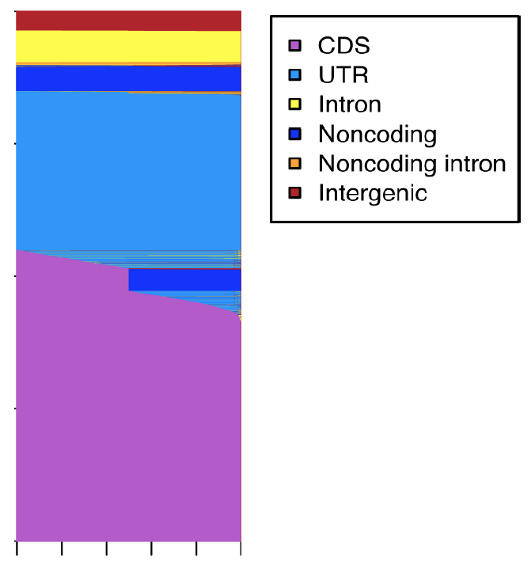
The assembly problem
Short reads, long features
Sequencing errors
Large range in coverage depth
PCR bias, expression variation
Reads outside known annotations
Spurious transcription
pre-mRNA intronic reads
Contigs typically transcript fragments
Result of graph-based approaches
Reads
0
0.2
0.4
0.6
0.8
1
Proportion of read

Slide 6
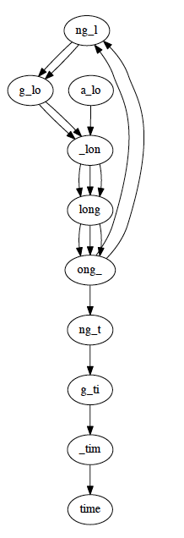
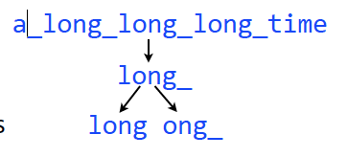
Under the hood in Trinity: De Bruijn graphs
Assembly based on graphs of overlapping sub-strings (k-mers)
A non-biological example: building a graph for “a_long_long_long_time”
Pick substring length (e.g. 5)
Split each k-mer into left and right k-1 mers
Add k-1 mers as nodes to graph (if not already there), adding edge
from left k-1 mer to right k-1 mer
If kmer already there, add additional edges to extant pair of k-1 mers
Want to learn more? See debruijn graph slides by Langmead in: /n/regal/informatics/workshops/trinity/selfstudy_materials/debruijn.graph_langmead.pdf
Explore Debruin graphs with python (http://nbviewer.ipython.org/7237207)

Slide 7
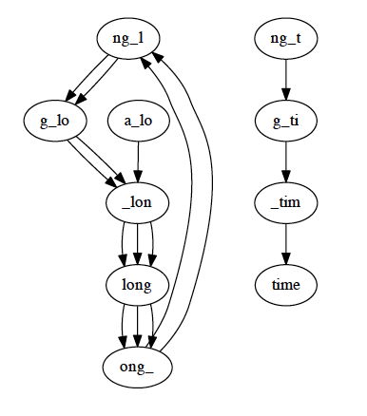
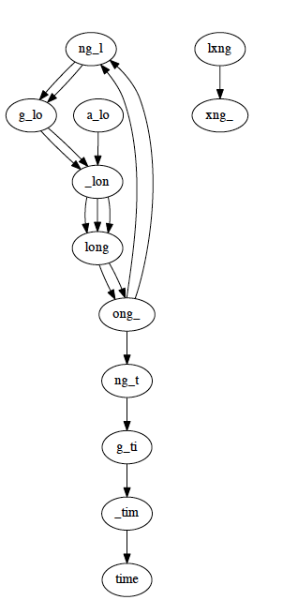
Potential issues: gaps, errors
Our original graph
Coverage gap: ong_t “not sequenced”
Error: 1 copy of long_
into lxng_
Even under ideal conditions (no errors, uniform coverage), you don’t always get back the superstring that goes in

Slide 8
Trinity workflow
1. raw reads*
2. error corrected reads: step1
3. error corrected reads: step2
x
x
x
x
x
x
x
x
x
x
x
error
x
discard
x
x
x
x
x
x
x
x
x
x
x
x
x
correction
x
unfixable
x
x = mutation x = sequencing error
x = unfixable error
4. trimmed reads*
5. “blacklist”
filtering
6. assembly contigs: “genes” and “isoforms”
trim adapters and
Trinity
gene 1
x
x
7. Evaluate assembly quality
x
x
low qual bases
x
x
x
x
gene 2
Align to dbase of undesirable targets (rRNA, contaminants)
* Look at reads with FastQC

Slide 9
Workflow Implementation

Slide 10
Different from what you’ve seen so far
We’ll do job cluster job submissions rather than work in an interactive session
You’d never do most steps in transcriptome assembly (or estimating gene expression for that matter) in a login node
Thus … a whirlwind tour of High Performance Computing on Odyssey

Slide 11
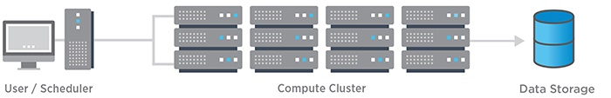
What is a cluster and how does it work?
1. You tell the scheduler what you need
2. It queues you up for resources
3. Runs cmds you specify in a script
4. Writes output to specified location (dir in your lab storage)

Slide 12
What are jobs?
Sets of instructions to the scheduler that
Tell it what resources you need
Memory
Time
# CPUs
What programs (already) on the cluster to which you want access
What programs/script you want to run, including all the various command line arguments and locations of files you need to process

Slide 13
How to access programs on Odyssey?
The module system
”module-query” allows us to search for what’s on Odyssey
“module-list” lets us see what is in our environment
“module load < module name>” loads w/ dependencies into your PATH
”module purge” dumps everything
This can be very useful …

Slide 14
A simple example
SLURM, partitions, modules and other things …
#!/bin/bash
#SBATCH -p shared,serial_requeue # Partition to submit to
#SBATCH -n 1 # Number of cores
#SBATCH -t 01:00:00 # Runtime in days-hours:minutes
#SBATCH --mem 1500 # Memory in MB
#SBATCH -J fastqc # job name
#SBATCH -o fastqc.%A.out # File to which standard out will be written
#SBATCH -e fastqc.%A.err # File to which standard err will be written
module purge
module load fastqc/0.11.8-fasrc01
fastqc --outdir `pwd` illumina_reads_for_my_pet_unicorn.fq

Slide 15

Today’s assembly data
20 million 2 x 100 paired-end un-stranded RNA-seq reads from pool of 8 Mus musculus wild-caught samples from Massif Central, France
SRA headers fixed so no problems with Trinity
For workshop SLURM jobs, we’ll use 1 million PE reads

Slide 16
Working with data: use symlinks
Safer not to directly touch raw data
Better to work with links to it
If you accidentally delete the link, all you lose is the link
syntax
ln -s <file linking from> $(pwd)/<file link name>

Slide 17
Workflow implementation practicals
For each step in workflow:
Make directory for step in questions
Create symlinks from fastq files from previous step (if there is one) to new directory
Execute slurm job

Slide 18
Step 1: quality check raw reads w/ FastQC
fastqc.sh:
#!/bin/bash
#SBATCH -p shared,serial_requeue # Partition to submit to
#SBATCH -n 1 # Number of cores
#SBATCH -t 01:00:00 # Runtime in days-hours:minutes
#SBATCH --mem 1500 # Memory in MB
#SBATCH -J fastqc # job name
#SBATCH -o fastqc.%A.out # File to which standard out will be written
#SBATCH -e fastqc.%A.err # File to which standard err will be written
module purge
module load fastqc/0.11.8-fasrc01
fastqc --outdir `pwd` $1

Slide 19
Exercise 1: fastqc
For each fastq file do:
Sbatch fastqc.sh <name of fastq file>
scp the html reports back to your laptop, and take a look

Slide 20
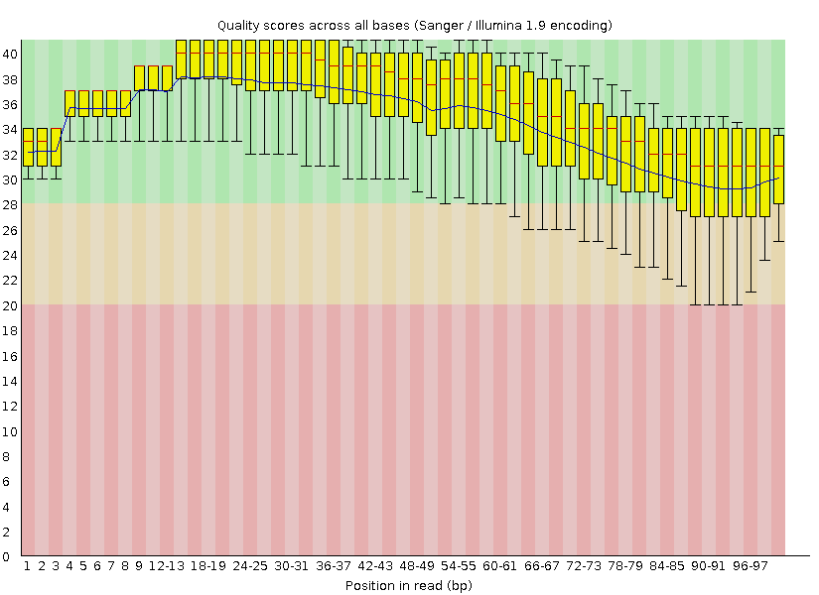
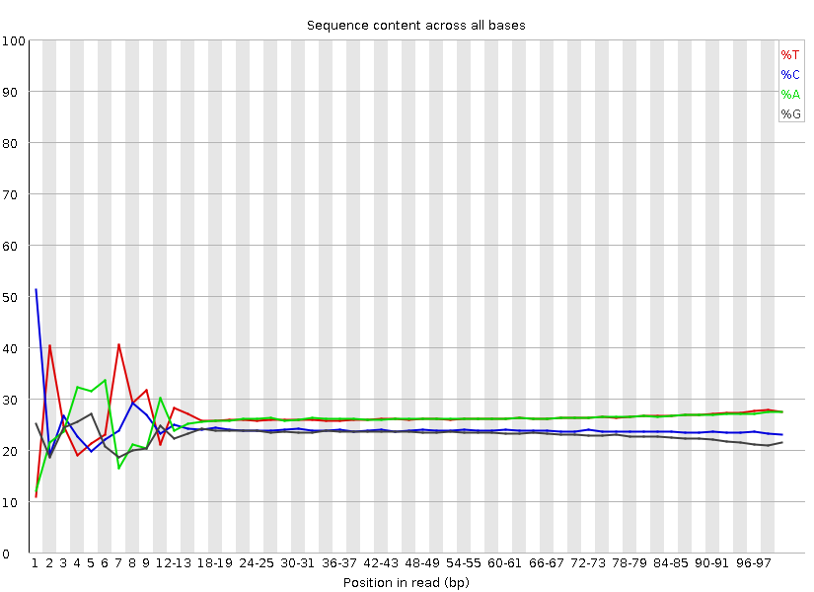
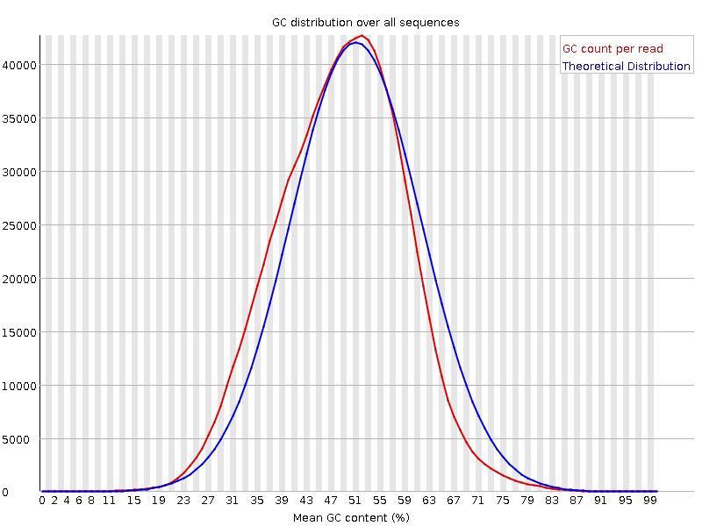
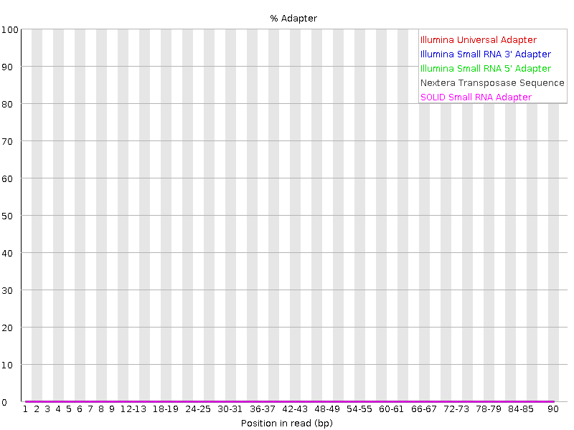
Fastqc: raw R2
base qualities
sequence content
GC content
adapter content
Notes:
No overrepresented sequences found

Slide 21
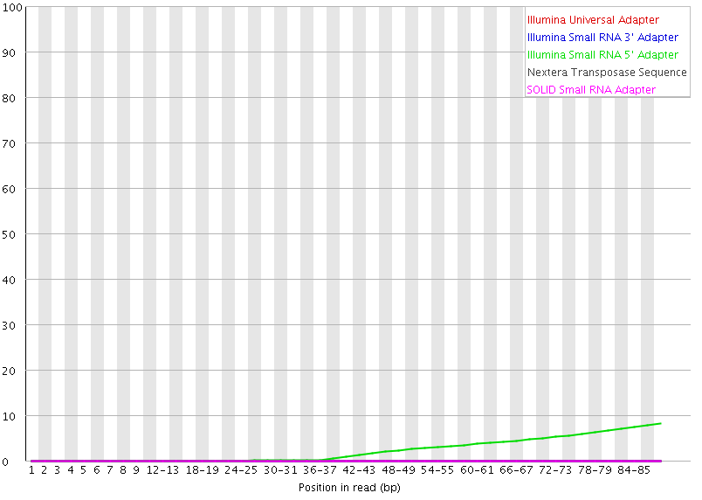
This is what adapter contamination looks like
Notes:
Rom 25 to 75k reads per over-rep sequence

Slide 22
Step 2: correct errors with Rcorrector
https://github.com/mourisl/Rcorrector*
Uses kmer counts to determine the best path through the De Bruijn graph for each read with the minimum number of base changes.
May not perform well for reads coming from low-expression transcripts
But assemblies for lowly expressed transcripts will be pretty crummy regardless…
Trimming and error correction benefits
reduces run-time significantly
should improve assembly by reducing fragmentation of de Brujin graphs
*Song, L., Florea, L., Rcorrector: Efficient and accurate error correction for Illumina RNA-seq reads. GigaScience. 2015, 4:48.

Slide 23
The Rcorrector slurm script
rCorrector.sh
#!/bin/bash
#SBATCH -N 1
#SBATCH -n 12
#SBATCH -p serial_requeue,shared
#SBATCH -e rcorrector_%A.e
#SBATCH -o rcorrector_%A.o
#SBATCH -J rcorrector
#SBATCH --mem=24000
#SBATCH --time=01:00:00
module purge
module load Rcorrector/20180919-fasrc01
# $1 = comma-separated list of R1 files
# $2 = comma-separated list of R2 files
# one could also specify an optional -od $(pwd) cmd to and supply a 3rd cmd line argument to specify explicitly the output directory. NOTE: this wouldn't have to be the current working directory
perl /n/helmod/apps/centos7/Core/Rcorrector/20180919-fasrc01/bin/run_rcorrector.pl \
-t 12 -1 $1 -2 $2

Slide 24
Exercise: run Rcorrector script
cd into your 1-rcorrector/mytest directory and execute a slurm job submission

Slide 25
Rcorrector can’t fix some reads
@SRR203276.27:61DFRAAXX100204:1:100:10002:17360/1 l:26 m:58 h:66
CTGGACTGGAGGAAGGTGTGGGTGCAGACATGGCGAAGGCTCTTTGGATTTCTTCAGGGCTGGCATTCCGCACAAA
+
CCCCCCCCCCCCCCCCDCCCCCDCCCCCCCCCCCCCCCCCCCCCCCCCCCCCCCCCCDCCDDCCCBCCCCCCCCAC
@SRR203276.31407513:61DFRAAXX100204:2:120:8972:13779/1 l:1 m:194 h:275 unfixable_error
CCCCAAGCTAGTGCCCCTGGGAGGCAGCAGCTTCTTTGCCTTTAGGGACGAACTTCAGTGAGCTGCTAAATATTCA
+
CCCCCCCCCCCCCCCCCCCCCCCCCCCCCCCCCCCCCCCCCCCDCCCBCC@CCCCCBDBA@CCBCC@BABBBDDCB+
CCCFFFFFHHHHHJJJJJJJJJJJJJJJJJJJJJJHFDDB
@SRR2040597.64484488:64484488/1 l:172 m:380 h:555 cor
GGAGCCGGAGCGCGCGAGTAGCATCCTTGGTGGCAGAGCACCCAAGGCCAGAGCACTGCTGCACTCCAGCTCAGGAAAGGTGACTCAAGAGCCTGACC
+
CCCFFFFFHHHHHJJJJJGHJJJJJJJJJJHIIHJJHHHHHFFFDDDDDDDDDDDDDDDDDDDDDDDDDDDDDDDDBCDDCCDCDDDDDCDC@CBB?C
Tagged with lowest (l), median (m) and highest (h) kmer counts in read
Unfixable reads include low complexity junk and other seemingly normal sequence
We can remove these with a python script

Slide 26
Slurm script to rm unfixable reads
rmrcorrector_unfixable.sh:
#!/bin/bash
#SBATCH -p shared,serial_requeue # Partition to submit to
#SBATCH -n 1 # Number of cores
#SBATCH -t 01:00:00 # Runtime in days-hours:minutes
#SBATCH --mem 1500 # Memory in MB
#SBATCH -J rmunfix # job name
#SBATCH -o rmunfix.%A.out # File to which standard out will be written
#SBATCH -e rmunfix.%A.err # File to which standard err will be written
module purge
module load python/2.7.14-fasrc01
# $1 == rcorrector corrected R1 fastq
# $2 == rcorrector corrected R2 fastq
# $3 == sample name (to be included in metrics output log filename)
python /n/scratchlfs/informatics/nanocourse/rna-seq/denovo_assembly/python_scripts/FilterUncorrectabledPEfastq.py -1 $1 -2 $2 -s $3

Slide 27
Exercise 3: steps
Using rmrcorrector_unfixable.sh, submit job to Odyssey with sbatch
When job completed, rmunfixable.log will list:
Total # of PE reads
# PE reads with one end unfixable (so pair removed)
# remaining PE reads

Slide 28
Step 4: read trimming
Illumina bcl2fastq may incompletely strip adapters, and won’t remove R1 containing R2 adapter (and vice versa) if insert size is short
Options for trimming
Trimmomatic
Cutadapt (nicely wrapped by TrimGalore!)
We’ll use TrimGalore!
We’ve seen incomplete adapter removal by Trimmomatic
Always check w/ fastqc to make sure adapters are removed post-trimming!!

Slide 29
Some more thoughts on read trimming
High quality threshold may adversely impact assemblies
May need to explicitly specify adapter sequences
Libraries built on Apollo robot in Bauer Core
Protocols that don’t use standard Illumina-type reagents
Our workshop data comes from a ligation stranded protocol that uses Wafergen-like adapters
Fastqc should indicate no remaining adapter contamination
Caveat: expression bias with trimming
For more info on effects of read trimming: McManes MD (2014) On the optimal trimming of high-throughput mRNA sequence data. Front. Genet. 10.3389/fgene.2014.00013

Slide 30
Slurm script to run TrimGalore!
trimgalore.sh:
#!/bin/sh
#SBATCH -n 1
#SBATCH -t 05:00:00 #Runtime in minutes
#SBATCH -p shared,serial_requeue
#SBATCH -e tgalore_ERR1101637_%A.err
#SBATCH -o tgalore_ERR1101637_%A.out
#SBATCH --mem=3000
#SBATCH -J tgalore
module purge
module load cutadapt/1.8.1-fasrc01
/n/scratchlfs/informatics/nanocourse/rna-seq/denovo_assembly/util/TrimGalore/trim_galore --paired --illumina --retain_unpaired --phred33 --output_dir $(pwd) --length 36 -q 5 --stringency 1 -e 0.1 $1 $2

Slide 31
Exercise 4: submit trimgalore job
Using trimgalore.sh, submit job to Odyssey with sbatch
Note, there is some research coming out indicating that quality trimming can bias expression analyses, but this is mitigated if one doesn’t let reads get too short.
Feel free to adjust the –length argument to 75 to set the minimum read length after trimming for adapters and quality to 75

Slide 32
Mapping to a “blacklist”
A way to try and remove undesireable sequences
Complex biological samples
Parasite vs. host
Symbionts vs. host
RNA from environment
We’ve seen assemblies of contigs blast to food:
Butterfly larvae contigs (they eat cow dung) to Bos Taurus
Adult contigs to A. thaliana
rRNA not removed entirely by polyA selection
Map to SILVA database
Better sense of how many reads you’ll have for downstream expression analyses
We use BOWTIE2 in sensitive mode

Slide 33
Slurm script to remove rRNA via SILVA
rrnablacklist.sh:
#!/bin/bash
#SBATCH -N 1
#SBATCH -n 12
#SBATCH -t 06:00:00
#SBATCH -p shared,serial_requeue
#SBATCH --mem=24000
#SBATCH -e blacklist_ERR1101637_%A.e
#SBATCH -o blacklist_ERR1101637_%A.o
module purge
module load bowtie2/2.3.2-fasrc02
bowtie2 --quiet --very-sensitive-local --phred33 -x /n/scratchlfs/informatics/nanocourse/rna-seq/denovo_assembly/databases/silva/DNA_SILVA_132_tax_SSUParc_LSUParcPlusCarolinensisReferenceRNA -1 $1 -2 $2 --threads 12 --met-file ERR1101637_bowtie2_metrics.txt --al-conc-gz paired_aligned_ERR1101637.fq.gz --un-conc-gz paired_unaligned_ERR1101637.fq.gz --al-gz unpaired_aligned_ERR1101637.fq.gz --un-gz unpaired_unaligned_ERR1101637.fq.gz

Slide 34
Exercise 5: run blacklist job
Create a directory to run blacklist analysisis in
Symlink trimmed fastq files from previous analysis into this directory
sbatch rrnablacklist.sh <trimmed R1> <trimmed R2>

Slide 35
What if FASTQC were to still find overrepresented sequences?
What are they?
E.g. rRNA’s that weren’t in SILVA
Adapters from custom/new library configurations
BLAST to see what they are
One option is to remove them
RemoveFastqcOverrepSequenceReads.py at: https://github.com/harvardinformatics/TranscriptomeAssemblyTools
Our data don’t have any, so we don’t have to worry about it today

Slide 36
Transcriptome assembly with TRINITY
Too compute heavy and too time-consuming to do in workshop
We’ll do QC on the assembly based upon 20 million reads
And briefly go over the anatomy of a TRINITY SLURM job submission

Slide 37
Finally …. the script to run TRINITY
trinity.sh:
#!/bin/bash
#SBATCH -N 1
#SBATCH -n 24
#SBATCH -p bigmem
#SBATCH -e trinity_%A.e
#SBATCH -o trinity_%A.o
#SBATCH --mail-type=END
#SBATCH --mail-type=BEGIN
#SBATCH -J trinity
#SBATCH --mem=250000 # for full assembly
#SBATCH -t 48:00:00
module purge
module load trinityrnaseq/2.8.5-fasrc01
Trinity --seqType fq --max_memory 240G --min_kmer_cov 1 --left paired_unaligned_ERR1101637.fq.1.gz --right paired_unaligned_ERR1101637.fq.2.gz --output mouse_Trinity_2019.02.21 --CPU 24
#add to trinity call to run parallel jobs on compute farm #
##########################################################
## --grid_exec "/n/home_rc/afreedman/software/HpcGridRunner-1.0.2/hpc_cmds_GridRunner.pl --grid_conf $(pwd)/grid.conf -c" --grid_node_max_memory 5G
Notes:
NOTE you can run it in steps as well

Slide 38
Grid jobs
Part of Chrysalis, and Butterfly, can be parallelized across a grid of jobs rather than running them using the resources allocated for the master Trinity job
To do this you have to:
Specify the path to a grid job submission manager tool
Create a configuration file for that manager tool to use to get SLURM job settings
HpcGridRunner
http://hpcgridrunner.github.io/
What you’d add to Trinity: --grid_exec ”/YOUR/PATH/TO/HpcGridRunner-1.0.2/hpc_cmds_GridRunner.pl --grid_conf grid.conf

Slide 39
The grid.conf file
# grid type:
grid=SLURM
# template for a grid submission
cmd=sbatch -p general --mem=5500 --time=02:00:00 –account=<your account
# number of grid submissions to be maintained at steady state by the Trinity submission system
max_nodes=500
# number of commands that are batched into a single grid submission job.
cmds_per_node=200
Be sure to change to your account or the parallel jobs will die
Don’t use serial_requeue, as Trinity parallel jobs often fail when re-queued
Be aware of your fair share … if your parallel jobs pend to long it could cause your master Trinity job to timeout

Slide 40
Output: the Trinity fasta
>TRINITY_DN4669_c0_g1_i1 len=237 path=[429:0-236] [-1, 429, -2]
ATTAAGGATATCTGTCTACATATCTGAGTGCTGCCTCAGACCTCCGACTTTATTAAAATTGTGT
GCTGGAGTTCACATCATATTCATCACCGCCCCAACCTGGAGGAGATGGGAGATGGCTCAGGGCG
AGGTGCGGTGTTTTACATAGGGAAAGCTCAGCACCCTCCCCCCCG
>TRINITY_DN4615_c0_g1_i1 len=317 path=[295:0-316] [-1, 295, -2]
GTTACCTCTGTGATTACCAGGGGTCTCAGGCTGTGGGCATGCACAGCTTCCTGGTAGCGGGCTC
AGTAGCTGGGACCAAATAAACACTGGAGGCAGGGAGTCCCTTCTCTCTCACCTCTCCTGCAGAG
GGAGGTGTCTCGGCTCTCCTGCTGCAGCCTCCATAATTTAATCTGAGCATAGAACTGCGGG
TRINITY_DN4669_c0_g1_i1 len=237 path=[429:0-236] [-1, 429, -2]
Contig number
path: list of vertices in the compacted graph that
represent the final transcript sequence and the
range within the given assembled sequence that
those nodes corresond to.
Gene number
Length
Isoform number
Some downstream tools will crash because of this extra text, esp. for big graphs:
SOLUTION: create and submit script that does something like : awk ‘{print $1}’ Trinity.fasta > cleaned_Trinity.fasta

Slide 41
Evaluating assembly quality
How do we know whether our assembly is any good?
Three kinds of metrics
Contiguity
Completeness
Accuracy
Read support of assembly
Correct nucleotides relative to “true” transcripts
Another perspective
Data set “independent”
Completeness metrics mostly fall in this category
Independent in quotes because, of course, some transcriptomes (C. elegans) are simpler than others (human)
Data set dependent
E.g. scoring schemes meant to evaluate different parameter settings/assemblers, such as DETONATE scores

Slide 42
Contiguity and completeness
truth
annotation
transcripts
assemblies
high contiguity, low completeness
low contiguity, high completeness
low contiguity, low completeness + garbage
Reality is likely messy, fragmented and very much incomplete
Spurious element from pre-mRNA intronic reads
Transcript assembled from transcriptional noise reads, un-annotated lncRNA? Who knows??

Slide 43
The problem with contiguity metrics
truth
annotation
transcripts
The frequently reported N50
Arrange contigs from shortest to longest
Add up contigs until their total length = 50% of the overall assembly length
Length of longest contig in this set = N50
Little info as to whether the assembly correct
assembly that concatenates all exons from all genes and transcripts into one contig will have a very high N50!
Small values of contiguity metrics certainly indicate fragmented, but large values don’t necessarily mean the assembly is good
How many contigs are really chimeric mis-assemblies?

Slide 44
Quality assessment: read support for assembly
Trinity transcripts may not always represent properly paired reads
PE reads that don’t support transcripts may have been discarded
Transcripts may have been improperly constructed
Mapping reads as pairs won’t readily reveal this problem
Instead, map R1 and R2 separately and then assess extent of improper pairing
Trinity contig 1
Trinity contig 2
x
x

Slide 45
Getting basic summary statistics
trinitystats.sh:
#!/bin/bash
#SBATCH -p shared,serial_requeue # Partition to submit to
#SBATCH -n 1 # Number of cores
#SBATCH -t 00:20:00 # Runtime in days-hours:minutes
#SBATCH --mem 1500 # Memory in MB
#SBATCH -J trinstats # job name
#SBATCH -o trinstats.%A.out # File to which standard out will be written
#SBATCH -e trinstats.%A.err # File to which standard err will be written
module purge
module load trinityrnaseq/2.8.5-fasrc01
/n/helmod/apps/centos7/Core/trinityrnaseq/2.8.5-fasrc01/util/TrinityStats.pl $1 > ${1}.assemblymetrics.txt

Slide 46
# Genes, transcripts, N50
Metric
Genes | 96963
Transcripts | 126125
N50 | 3028
Median contig length | 476

Slide 47
Evaluating whether reads support assembly
ReadRepresentationStats.sh:
#!/bin/bash
#SBATCH -N 1
#SBATCH -n 16
#SBATCH -p shared,serial_requeue
#SBATCH -e rs_pt1_%A.err # File to which STDERR will be written
#SBATCH -o rs_pt1_%A.out # File to which STDOUT will be written
#SBATCH -J rs_pt1 # Job name
#SBATCH --mem=1000 # Memory requested
#SBATCH --time=00:10:00 # Runtime in HH:MM:SS
module purge
module load gcc/4.9.3-fasrc01
module load samtools/1.5-fasrc02
module load bowtie2/2.3.2-fasrc02
# $1 == path to trinity bowtie2 index; $2 == R1 fastq; $3 ==R2 fastq
bowtie2 -p 10 -q --no-unal -k 20 -x $1 -1 $2 -2 $3 2>align_stats.txt| samtools view -@10 -Sb -o bowtie2.bam
cat 2>&1 align_stats.txt

Slide 48
Trinity Assessment - BUSCO
BUSCO: assessing genome assembly and annotation completeness with single-copy orthologs Felipe A. Simão et al (Bioinformatics 2015) (busco.ezlab.org)
Contains a set of near universal single orthologs from orthodb
Gives quantitative assessment of genome assembly, gene set, and transcriptome completeness.
Contains ortholog profiles for
Arthropods
Vertebrates
Fungi
Bacteria
Metazoans
Eukaryotes
Plants
Databases currently live in /n/regal/informatics_public/BUSCO/ but will soon be migrated to a new location (TBD)

Slide 49
Next steps: reducing assembly
Some Trinity transcripts may have little read support
Low expression
Poorly assembled
Noise
Consider removing most lowly expressed transcripts
Do NOT cluster transcripts with tools like CD-HIT!
Do NOT assembly individuals separately and do such clustering!
Clustering contigs via annotation into “genes” will improve gene-level expression estimates

Slide 50
Estimating RNA abundance, i.e. expression

Slide 51
Data
D. melanogaster parallel evolution study data
Zhao et. Al. 2014 PLoS Genetics
2 factors: temperature, population (geography)
populations: Maine, Panama
temperatures: high, low
3 biological replicates per temperature x population combination
Reads have been pre-processed
Adapters removed
No quality trimming …. Why?
We’ll execute RSEM and KALLISTO on a single down-sampled sample (1 million reads)

Slide 52
Expression estimation:
Traditional “align and count”
RSEM
Wraps alignment step then estimates abundance while accounting for mapping uncertainty, i.e. when reads map to sequences shared across isoforms
Pseudo-alignment based
kmer matches to generate probabilities that reads originate from a particular transcript that are converted to counts
Very fast
KALLISTO
Doesn’t estimate gene-level expression
Generic workflow
Build Index
Estimate expression

Slide 53
The exciting expression metrics interlude …

Slide 54
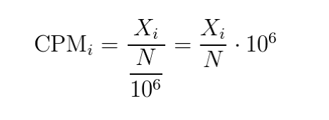
Metrics: count stuff
Most DE tools take as input counts, i.e. the # of reads assigned to a transcript
Normalized internally to account for library size differences
Raw counts assumed to come from a negative binomial distribution
Counts per million (CPM)
# of reads mapped to a transcript per million mapped reads

Slide 55
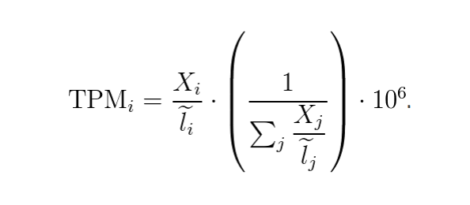
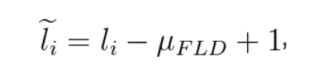
Metrics: within-sample normalized metrics
Transcripts per million (TPM)
The l term represents effective length:
TPMs not directly comparable between experiments
Implications for comparative transcriptomics of >1 species

Slide 56
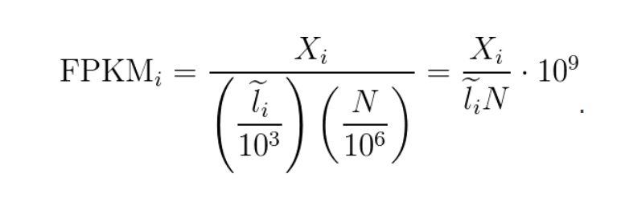
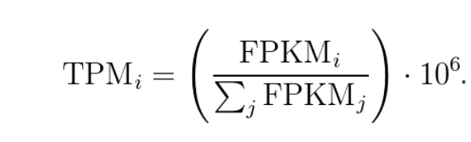
Metrics: within-sample normalized metrics
Fragments per kilobase of exon per million mapped reads
Related to TPM
FPKM and RPKM are problematic
See Wagner et al.
See https://haroldpimentel.wordpress.com/2014/05/08/what-the-fpkm-a-review-rna-seq-expression-units/
Notes:
FPKM takes the same rate we discussed in the TPM section and instead of dividing it by the sum of rates, divides it by the total number of reads sequenced and multiplies by a big number

Slide 57
Build kallisto transcripts index
#!/bin/bash
#SBATCH -n 1
#SBATCH -p serial_requeue
#SBATCH -e kallindex_%A.err
#SBATCH -o kallindex_%A.out
#SBATCH -J kallindex
#SBATCH --mem=8000
#SBATCH -t 0:20:00
module purge
module load kallisto/0.43.1-fasrc02
kallisto index -i Drosophila_melanogaster.BDGP6.dna_sm.toplevel.transcripts.idx Drosophila_melanogaster.BDGP6.dna_sm.toplevel.transcripts.fa

Slide 58
Build RSEM genome index (with gtf)
#!/bin/bash
#SBATCH -n 6
#SBATCH –N 1
#SBATCH -p serial_requeue
#SBATCH -e rsemindex_%A.err
#SBATCH -o rsemindex_%A.out
#SBATCH –J rsemindex
#SBATCH --mem=8000
#SBATCH -t 02:00:00
module purge
module load rsem/1.2.29-fasrc03
# the rsem module also loads R/3.4.2-fasrc01 AND bowtie2/2.3.2-fasrc02
# in principle, you can load a newer version of bowtie2
Workdir=${PATH_TO_COPY_OF_GENOME}
rsem-prepare-reference -p 8 --bowtie2 --gtf ${workdir}/Drosophila_melanogaster.BDGP6.85.gtf ${workdir}/Drosophila_melanogaster.BDGP6.dna_sm.toplevel.fa \ ${workdir}/Drosophila_melanogaster.BDGP6.dna_sm.toplevel

Slide 59
Running RSEM
rsem.sh:
#!/bin/bash
#SBATCH -n 12
#SBATCH -p shared,serial_requeue,general
#SBATCH -e rsem_%A.err
#SBATCH -o rsem_%A.out
#SBATCH -J rsem
#SBATCH --mem=2000
#SBATCH -t 06:00:00
module purge
module load rsem/1.2.29-fasrc03
# $1 = R1
# $2 = R2
# $3 = ref genome without fasta/fa file extension
# $4 = outfile prefix
# single end mode requires you have an independent estimate of sequenced fragment size mean and sd
rsem-calculate-expression --bowtie2 -p 12 --time --paired-end $1 $2 $3 $4
# with a reference genome, we can also supply --output-genome-bam so the alignments will be in a format for easy visualization in IGV\

Slide 60
Understanding RSEM output
Gene-level
gene_id transcript_id(s) length effective_length expected_count TPM FPKM
FBgn0000003 FBtr0081624 299.00 106.60 7.50 72.84 78.58
FBgn0000008 FBtr0071763,FBtr0071764,FBtr0100521,FBtr0342981 4665.00 4472.42 18.00 4.17 4.50
Isoform-level
transcript_id gene_id length effective_length expected_count TPM FPKM IsoPct
FBtr0081624 FBgn0000003 299 106.60 7.50 72.84 78.58 100.00
FBtr0071763 FBgn0000008 4847 4654.42 0.00 0.00 0.00 0.00
FBtr0071764 FBgn0000008 5173 4980.42 0.00 0.00 0.00 0.00
Building an expression (count) matrix:
rsem-generate-data-matrix *genes.results > mycountmatrix.out

Slide 61
Building a matrix from RSEM ouputs
rsem-generate-data-matrix *genes.results > mycountmatrix.out

Slide 62
Running kallisto
kallisto_quant_pe.sh:
#!/bin/bash
#SBATCH -n 6
#SBATCH -p shared,serial_requeue,general
#SBATCH -e quant_%A.err
#SBATCH -o quant_%A.out
#SBATCH -J quant
#SBATCH --mem=16000
#SBATCH -t 06:00:00
# $1 == sample id
module purge
module load kallisto/0.45.1-fasrc01
kallisto quant -i /n/scratchlfs/informatics/nanocourse/rna-seq/expression/ref/Drosophila_melanogaster.BDGP6.dna_sm.toplevel.transcripts.idx -b 100 -t 6 -o ${1}_quant ${1}_1_val_1.fq ${1}_2_val_2.fq

Slide 63
Understanding KALLISTO output
In an output directory:
run_info.json that describes settings, genome index, cmd line
an *h5 binary
a tabular (*tsv) file with abundance estimates

Slide 64
Differential expression

Slide 65
Inference limits on bulk RNA-seq
Condition 1
Condition 2
Underlying process
Bulk inference
Expression of interesting gene
high
No DE
No DE
low
inter-cell type reciprocal DE
No DE
cell type 1
cell type 2
differential cell composition only
DE
cell-type specific DE
DE (if cell type above some minimal fraction)
universal DE
DE

Slide 66
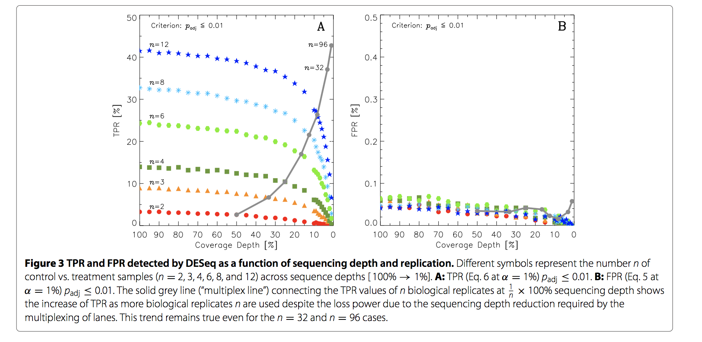
Quick thought on replication: more is better
Robles et al.2012, BMC Genomics

Slide 67
Workflows
raw fastq
Fastqc to make sure nothing wonky
adapter trimmed (fastq)
Read mapping to transcripts (bowtie2/STAR) w/ RSEM
Pseudo-alignment with kallisto
pseudocounts
bam file and effective counts
All in R
sleuth
limma voom
differential expression results
Notes:
One can export kalliosto counts to a ”count” table via tximport for use with tools like limma, but this method does not perform as well

Slide 68
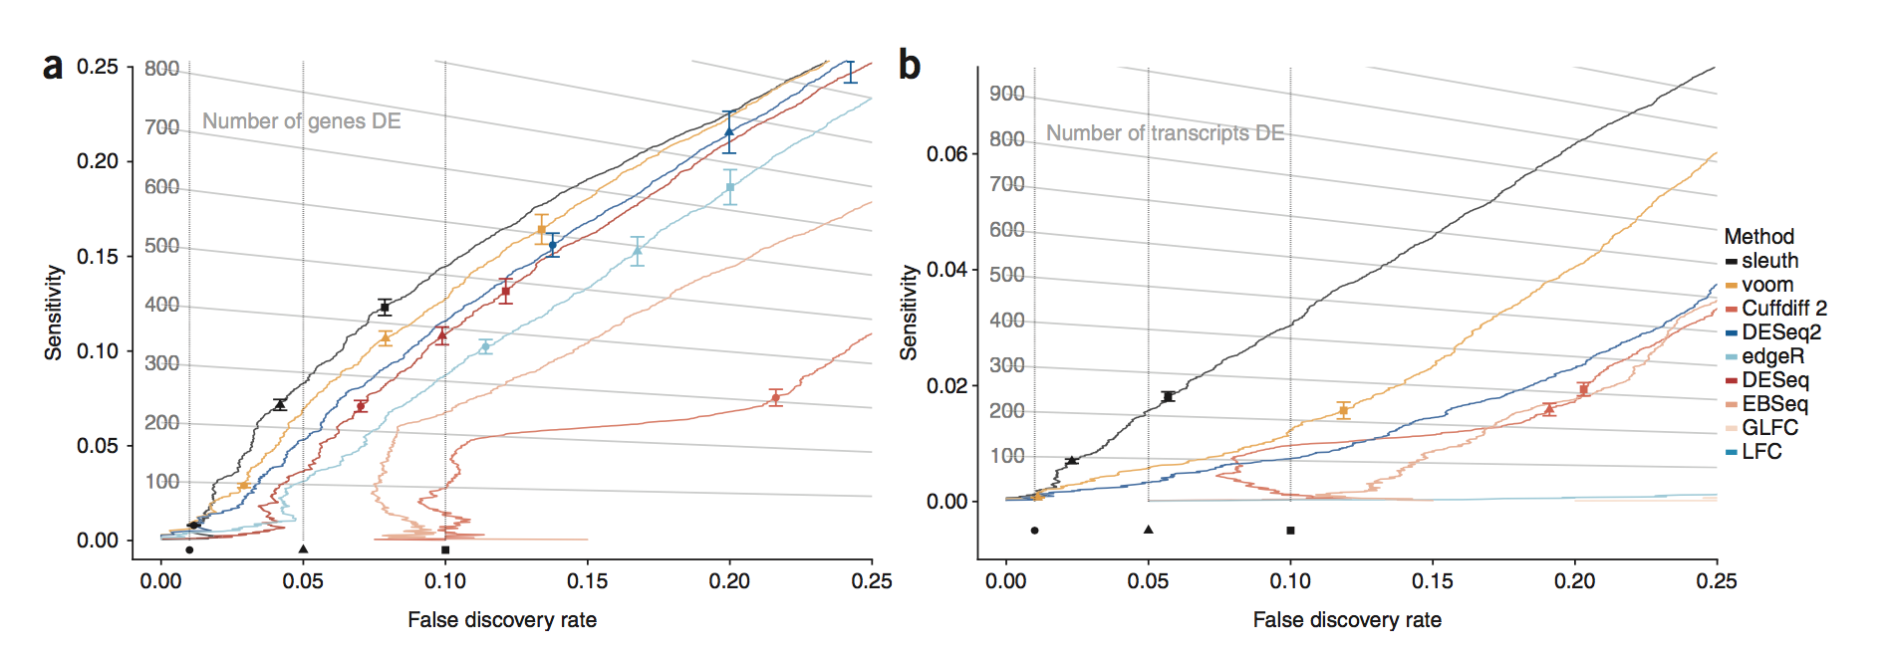
Why kallisto/sleuth and RSEM/limma voom?
Pimentel et al. 2017, Nature Methods

Slide 69
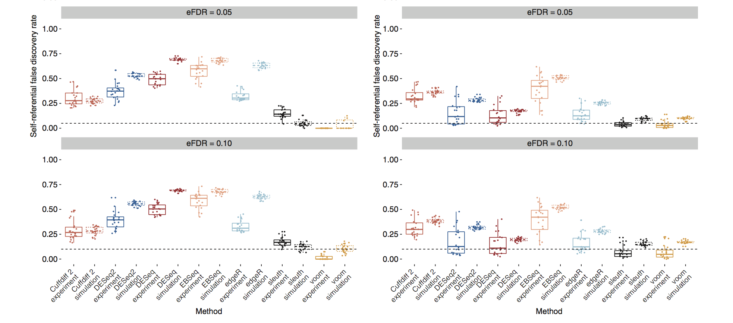
Why kallisto/sleuth and RSEM/limma voom?
Isoform-level
Gene-level
Pimentel et al. 2017, Nature Methods

