Slide 1


Introduction to scRNA-seq
Adam H. Freedman and Yasin Kamaz
FAS Informatics Group

Slide 2
Some quick definitions
Bulk RNA-seq
Any assay using sequence reads from an NGS instrument that cannot generate cell-specific expression estimates
Includes pools of cells of the same type obtained through sorting that aren’t assigned cell barcodes
scRNA-seq
Any protocol using NGS reads that uses read mappings to a set of reference transcripts in order to obtain cell-specific estimates of abundance
Does NOT include things like multiplexed single cell qPCR

Slide 3
Motivations
Analyze rare populations hard to detect in bulk experiments
Understand cell subpopulation distributions
Pre-scRNAseq assays (e.g. FISH) detected orders of magnitude expression variation in putatively ”identical cells”
Developmental, tissue-specific, and intra-tissue treatment diferences
Remove potential biases of bulk perspective
Mean expression for cell population can be biased by a few cells
Distinguish patterns and processes that are unidentifiable in bulk experiments

Slide 4
Why scRNA-seq? Inference limits on bulk RNA-seq
Condition 1
Condition 2
Underlying process
Bulk inference
Expression of interesting gene
high
No DE
No DE
low
inter-cell type reciprocal DE
No DE
cell type 1
cell type 2
differential cell composition only
DE
cell-type specific DE
DE (if cell type above some minimal fraction)
universal DE
DE

Slide 5
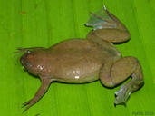
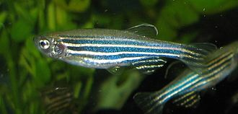
“But whenever there is a change in anatomy, cell type, and physiology there must be an underlying alteration in the developmental program.”
-Briggs et al. 2018, Science
Daniel Portik

Slide 6
Why scRNA-seq?: new (developmental) questions
Which cell state transitions are conserved and which are labile?
Can different endpoints originate from different precursors
Plasticity?
Drift?
Conserved co-expression modules?
What regulatory changes occur during transitions between cell states?
Conserved among tissues and species?
How does gene expression differ between different cell types/states at particular developmental time points?
How do cell-level developmental changes contribute to (adaptive) phenotypes?

Slide 7
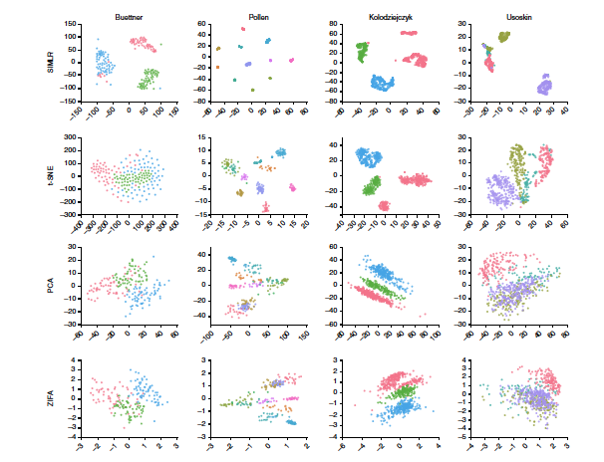
Foundation of SC analysis intra-sample variation
Defining cell sub-populations a fundamental objective
Biologically interesting
Required for downstream analyses
Subpopulation identification via clustering
Clustering algorithms and effects on inference an active area of research
Wang et al. 2017, Nature Methods

Slide 8
Clustering interpretation can be tricky
For the same sample(s)
Pick the method that produces the most distinct clusters?
Is this the most biologically sensible?
How to interpret differences in sub-population distinctness between samples/conditions?
And … what if different methods yield different results?
Risk of only finding what you seek
Wang et al. 2017, Nature Methods

Slide 9
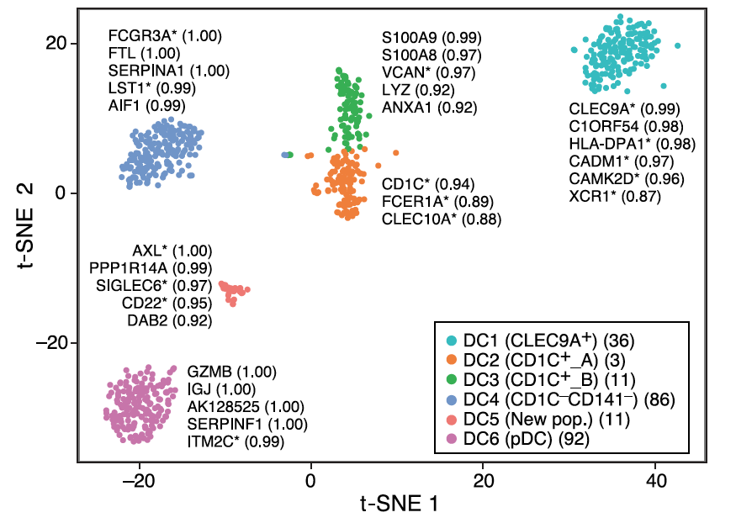
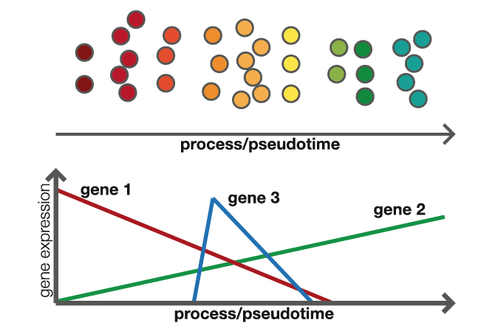
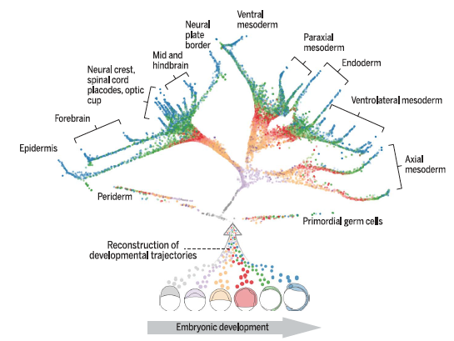
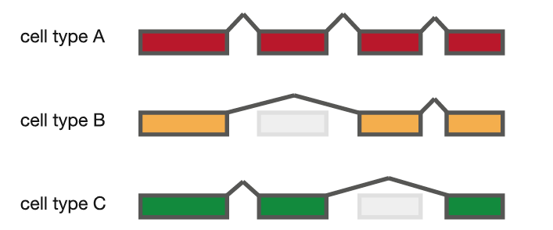
Diverse analyses options post-clustering
cell type markers
state transitions
developmental trajectories
Villani et al. 2017 Science
Kolodziejczyk et al. 2016 Mol. Cell
Farrell et al. 2018 Science
Alternative splicing
Some analyses may look at cell populations and processes that don’t have clearly demarcated cell subpopulations
Kolodziejczyk et al. 2016 Mol. Cell

Slide 10

Two broad classes of experimental approaches
Read-based
paired end sequencing of fragment
whole transcript coverage
typically small # of cells
@ Bauer Core: SMART-seq
Tag-based
Paired end library, but only 1 read is fragment sequence
Other contains well/cell barcode and Unique Molecular Identifier (UMI)
UMI tags a single RNA molecule
RNA counts are obtained by collapsing on UMIs
thousands of cells
@ Bauer core: 10x

Slide 11
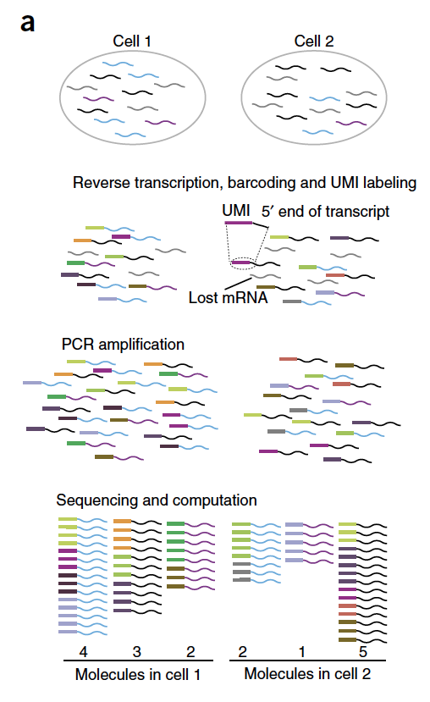
What are UMIs and why should we care?
Mix of random UMIs of set length added to each well/droplet
UMIs ligated onto individual RNA fragments
Concentration targeted so that 1 unique UMI per molecule
Counting is done at UMI level
Post PCR instances of > 1 UMI collapsed
Removes PCR bias
Combined with cell/well barcodes so can trace molecules across multiplexed cell libraries
Islam et al. 2014 Nature Methods

Slide 12
Typical applications of approaches
Read-based
Isoform and gene-level expression analyses
Former much more noisy unless sequence to very high depth
Alternative splicing
Tag-based (UMI)
Gene-level expression analyses
Since only capture one end (typically 3’), you can’t detect isoform variations
Expression estimates typically more robust than non-UMI approaches that have an enrichment/PCR step

Slide 13
scRNA-seq technical challenges

Slide 14
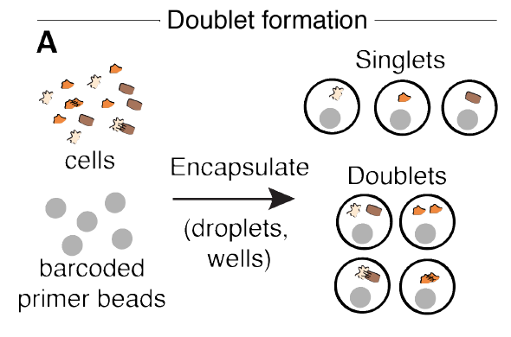
Doublets: what are they?
>1 cell can wind up in a droplet/well during library construction
majority being w/ 2 cells
Unless one visually inspects wells (e.g. C1), on cannot confirm doublets
Some data suggesting that even visual detection not 100% efficient
Not practical for high throughput assays (e.g. 10x)
Wolock et al., 2018, bioRxiv

Slide 15
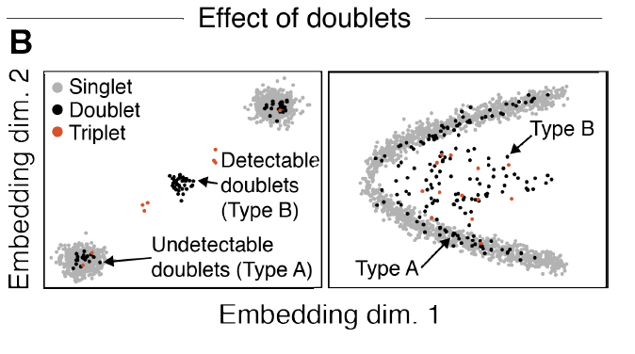
Doublets: why do we care?
Doublet of same cell type may not cause big problems but,
Doublets of different types may have unique expression profiles
Occupy unique positions in reduced dimension space
Incorrectly identified as unique cell populations
Some bench protocols require contaminant hetero-specific cells to be present
Wolock et al., 2018, bioRxiv

Slide 16
Doublets: how to detect them?
6 months ago, 10x said they weren’t looking at the doublet problem
Ad hoc solutions may be chainsaw when need a scalpel
Filtering out cells with high UMI counts might exclude real cell populations with high RNA content
Just a few weeks ago, 3 tools published on bioRxiv
Scrublet, DoubleDecon, DoubletFinder
Different flavors of same approach involving simluations and nearest-neighbor statistics

Slide 17
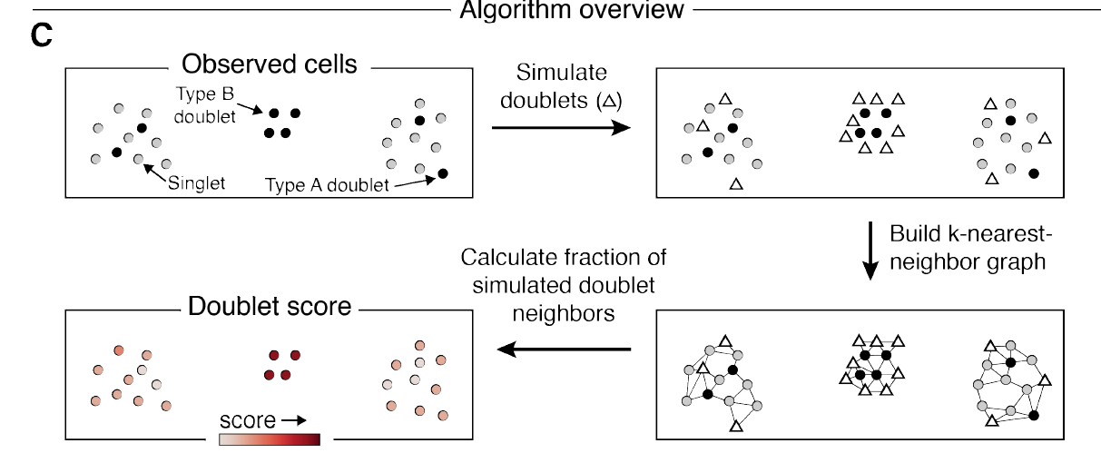
Scrublet!!
Wolock et al., 2018, bioRxiv
Implemented in python
We have yet to establish best practices/tools … stay tuned!!

Slide 18
scRNA-seq noisier than bulk RNA-seq
Bulk RNA-seq
average across many millions of cells
Unless cells pre-sorted, averaged across cell types
Even if sorted, averaged across subpopulations sharing cell markers/morphology
millions of reads per sample
scRNA-seq
far fewer cells
Far fewer reads per cell than reads per bulk RNA-seq sample
”zero inflation”
Technical: dropouts (expressed but not detected)
Biological: intra-cellular temporal variation in expression (some genes ”off” when a cell is sampled)

Slide 19
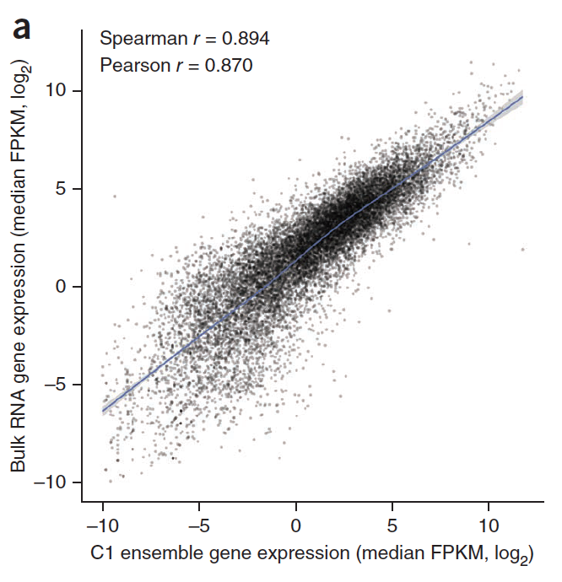
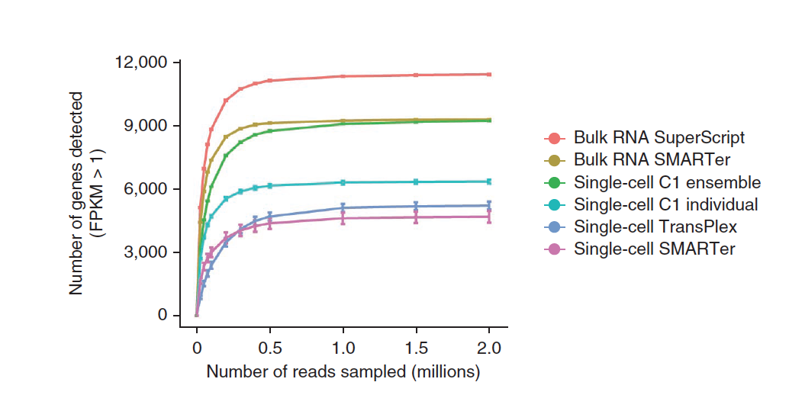
Aggregating scRNA-seq recapitulates bulk signal
log₂(gene FPKM)
bulk
bulk
aggregated sc
bulk RNA-seq
# genes detected (FPKM >1)
aggregated scRNA-seq
# reads (millions)
Wu et al. 2014, Nature Methods

Slide 20
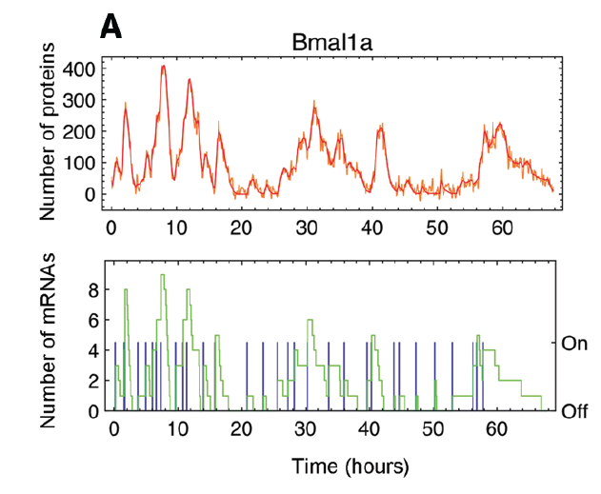
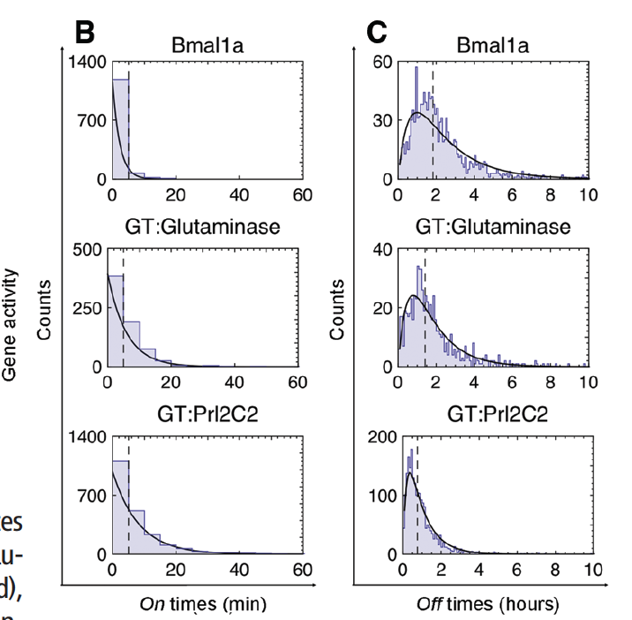
Biological noise: temporal variation
Cell-level patterns of expression variation
Gene activity happens in “bursts”
Apparent at both protein and mRNA levels
Bursting varies among genes
Suter et al. 2011 Science

Slide 21
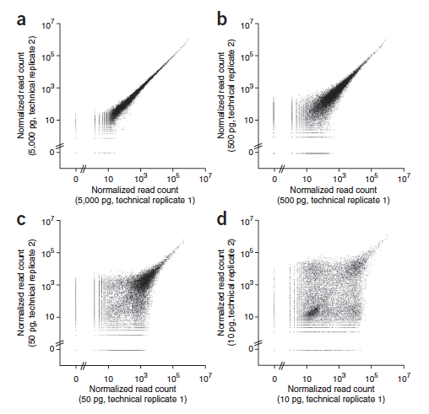
Technical noise: input RNA and expression level
Lower input material == greater difference between technical replicates
Inter-replicate differences higher at lower expression levels
5000 pg
500 pg
50 pg
10 pg
Brennecke et al. 2013 Nat. Methods

Slide 22
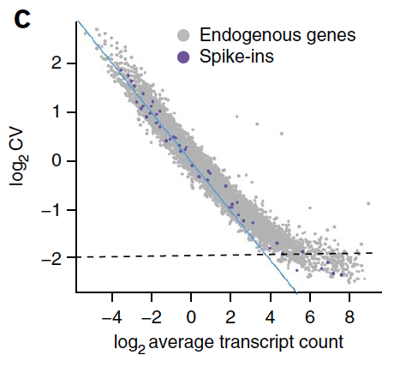
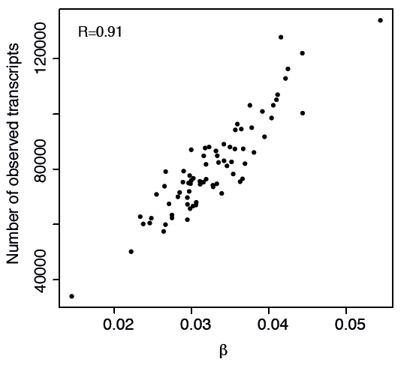
The noise by expression level pattern explained
Grun et al. fit statistical models to variation in endogenous genes and spike-ins
Noise at lower expression levels consistent with Poisson sampling
Variation plateaus at higher expression levels
Estimates of sequencing efficiency (β) capture this pattern
Caused by global tube-to-tube sampling efficiency
Poisson prediction
Grun et al. 2014 Nat. Methods

Slide 23
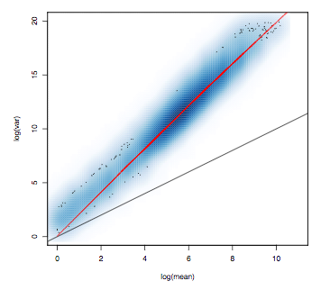
General over-dispersion consistent with bulk
scRNA-seq
Bulk
log(variance)
Poisson prediction
Poisson
log(mean)
Risso et al. 2011
Grun et al. 2014 Nat. Methods

Slide 24
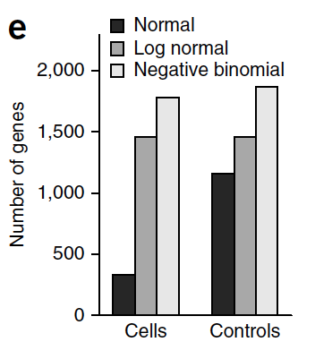
Small (?) problem: distributional heterogeneity
Negative binomial (NB) captures over-dispersion for bulk
Most scRNA-seq DE tools assume NB as well
Some evidence that there is distributional heterogeneity among genes!!
If true, no easy way to handle this
Grun et al. 2014 Nat. Methods

Slide 25
Study design and batch effects
Rare or impossible that all cell pools derived from conditions of interest are prepared for sequencing simultaneously
Cell pool libraries may vary due to technical factors
Batch effects occur when
Some % of expression variation across libraries due to technical factors
E.g. Pipetting differences, amplification bias, sequencing depth
In the worst case scenario, batch and biological condition are completely confounded

Slide 26
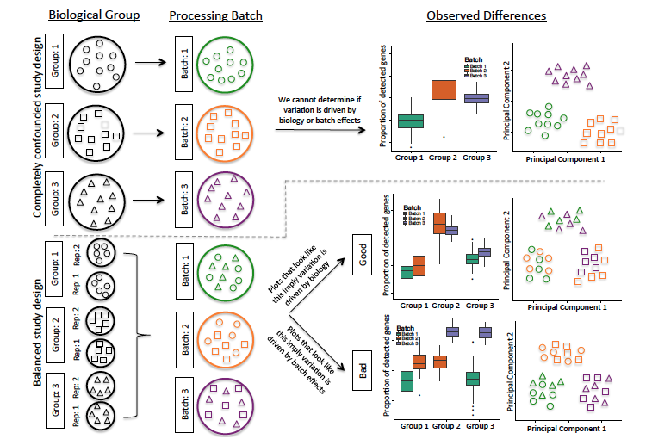
Batch effects: good vs. bad design
Hicks et al. 2015 BioRxiv

Slide 27
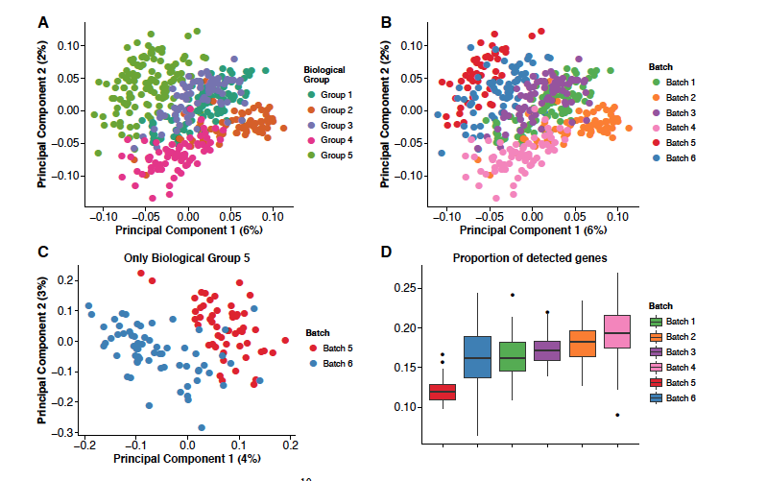
Batch effects can screw up cell groupings
Hicks et al. (2015) looked at four high profile scRNA-seq data sets
all showed evidence of batch effect confounding
Close correspondence between groups and batches in PC space
Even within a group, batch effects observed
Imagine you are interested in variation among groups in gene expression noise …..
Hicks et al. 2015 BioRxiv

Slide 28
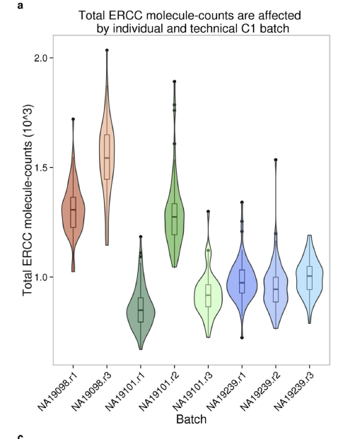
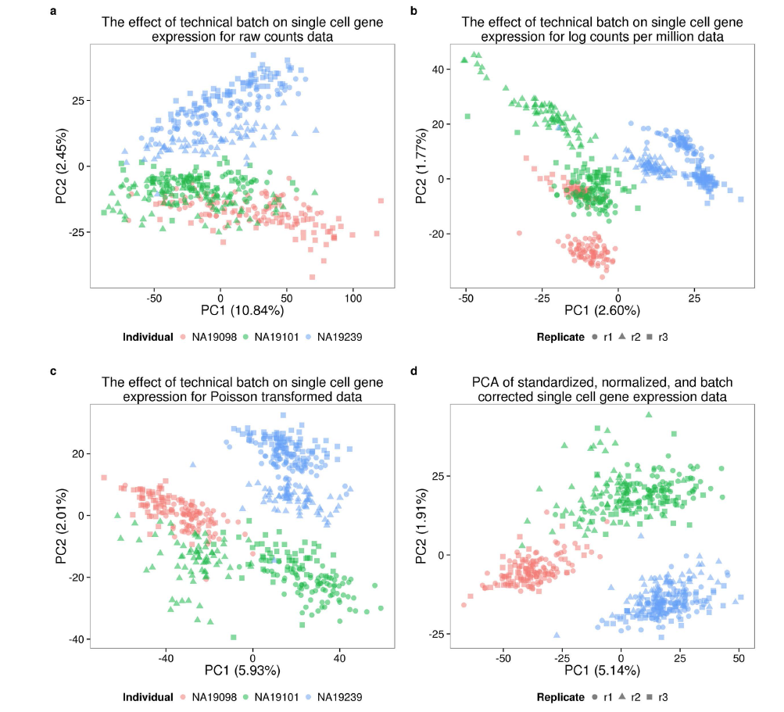
Batch effects: spike-ins don’t necessarily fix ‘em
Uncorrected
ERCC spike-ins frequently used to try and correct for technical effects and adjust expression estimates
Previous intuitive caveats had to do with compositional bias
Shorter transcripts and polyA tails*
ERCC counts vary across technical replicates within individuals AND across individuals
Biological variation influences ERCC standards so shouldn’t be used for batch effect correction
Batch effect correction methods an active area of research
Corrected
Tung et al. 2017 Scientific Reports
* Relative to mammalian transcripts

Slide 29
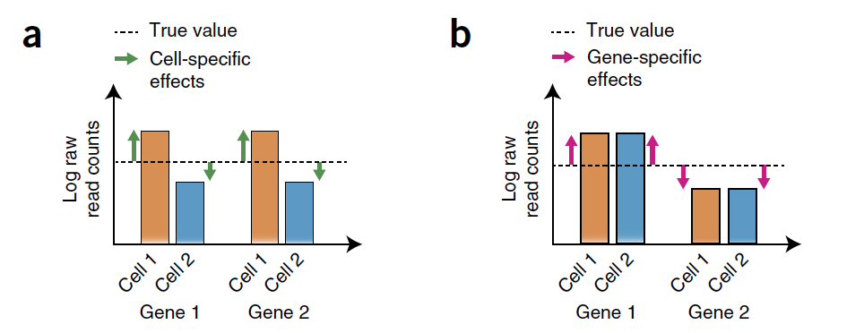
Normalizing expression estimates
Normalization methods important to remove systematic biases across cells
Vallejos et al. 2017, Nature Methods
Notes:
Normalizing between cell /sample effects perhaps most important, as within cell corrections for GC content, etc more straightforward???

Slide 30
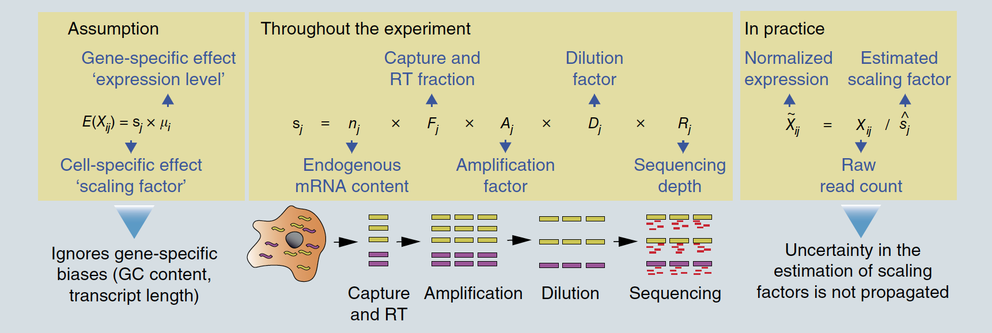
Co-opting bulk RNA-seq methods
Most tools/pipelines apply ”global scaling” methods developed for bulk RNA-seq to account for sequencing depth variation among samples
Vallejos et al. 2017, Nature Methods
Notes:
DESeq doesn’t deal with zero inflation well as constructs a pseudoreference sample based upon geometric mean of genes across cells ---problem because geometric mean is based on many zeroes

Slide 31
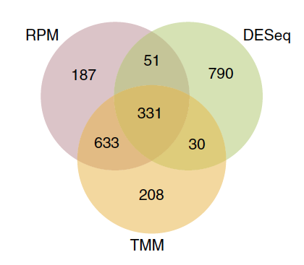
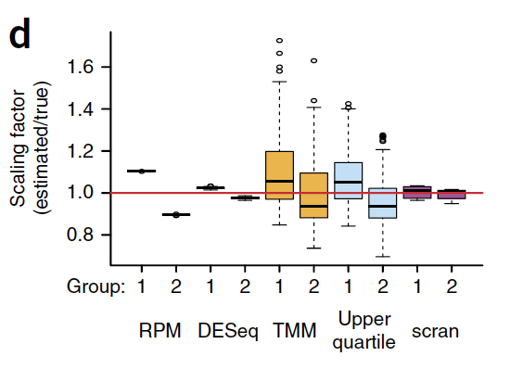
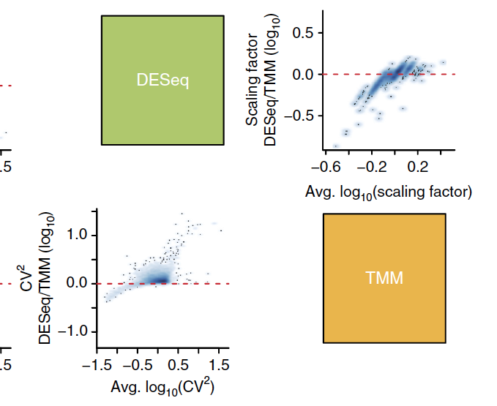
Bulk methods inconsistent and perform so-so
1. Scaling factors inconsistent between methods
2. Low concordance among top variable genes
3. Not as good as scRNA-seq tailored methods
Bulk
scRNA-seq
Vallejos et al. 2017, Nature Methods
Notes:
DESeq doesn’t deal with zero inflation well as constructs a pseudoreference sample based upon geometric mean of genes across cells ---problem because geometric mean is based on many zeroes

Slide 32
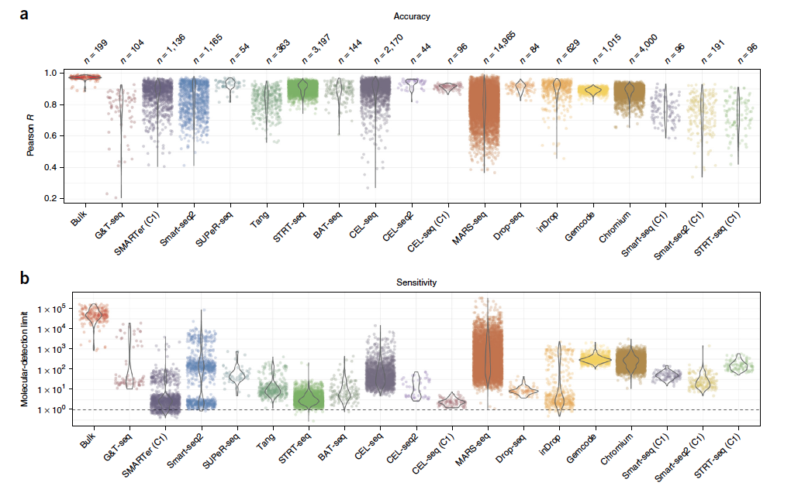
Evaluating available methods
Accuracy: Pearson correlation with known spike-in concentration
Sensitivity: # input molecules at which detection probability reaches 50%
Svensson et al. 2017, Nature Methods
Notes:
DESeq doesn’t deal with zero inflation well as constructs a pseudoreference sample based upon geometric mean of genes across cells ---problem because geometric mean is based on many zeroes

Slide 33
Identifying cell populations: a closer look
Projecting cell expression profiles to lower dimensional space (dimension reduction)
PCA
tSNE
SIMLR
Learns cell-to-cell similarity matrix with multiple kernels, and feeds matrix to tSNE
Define cell subpopulations by clustering on reduced dimensional space variables
K-means (SIMLR uses this)
Hierarchical clustering
Graph-based
Seurat** uses shared nearest neighbor (SNN) counts, in a manner similar to SNN-Cliq (Xu and Su, 2015, Bioinformatics)
** Our workflow today will mostly use Seurat

Slide 34
Next steps: workflow examples
Importing data into Seurat
Data pre-processing
Identifying cell subpopulations (w/ tSNE)
10x PBMC data set
Multi-sample integrative analysis
Brand new approach (Butler et al. 2018, Nat. Biotech.)
Can compare tissues, treatments, species
”Aligns” samples using shared correlation structure
Alternative ways to do clustering
A quick run of SIMLR to
Identify # of clusters
Visualize clusters in tSNE space

Slide 35
Final thoughts before getting our hands dirty
Single-cell analysis methods are rapidly evolving
Establishing best practices for core analyses (clustering, doublet detection) is a work in progress
Even more so for more advanced applications such as developmental transition time course experiments
Expect analysis workflows on the Informatics Group website in the (probably not too) near future

