Slide 1


Travel Blog
Website
Welcome to the presentation of our new travel blog! We're excited to share with you our vision for this website, a platform that connects travelers with amazing destinations and enriching experiences.

Slide 2
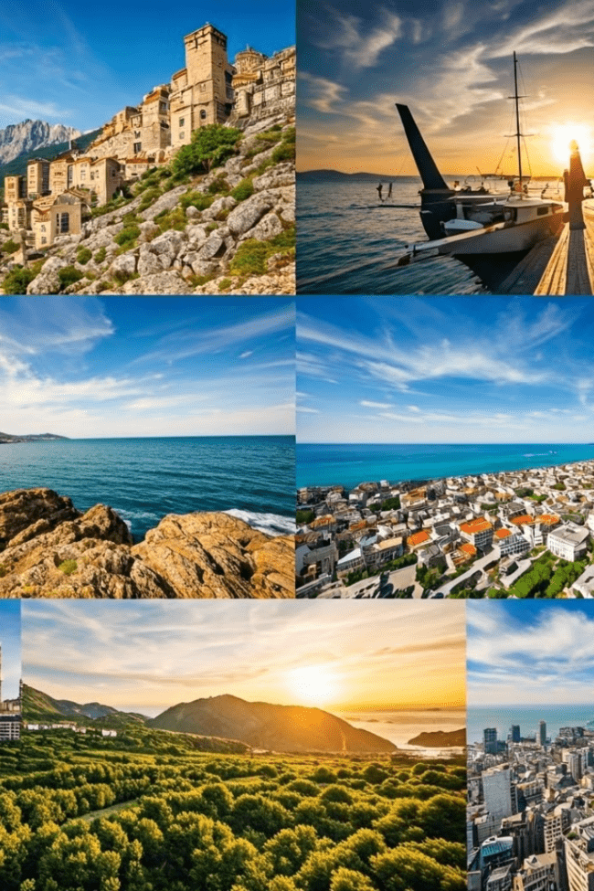
Benefits of the Travel Blog
1
Inspiration
2
Information
The blog provides inspiration for travel enthusiasts.
Provides valuable information and insights into various destinations.
3
Community
Fosters a community of travelers and travel enthusiasts.

Slide 3
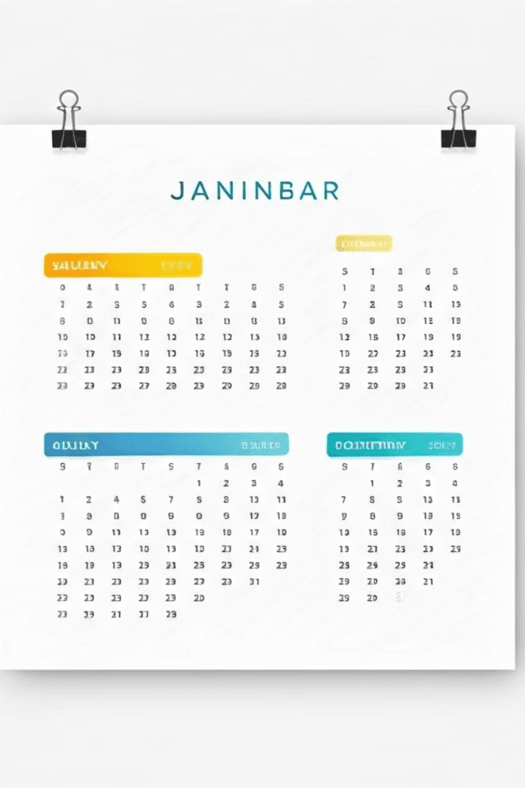
Triweekly Meeting Schedule
1
Saturday Meetings
2
Monday Meetings
3
Wednesday Meetings

Slide 4
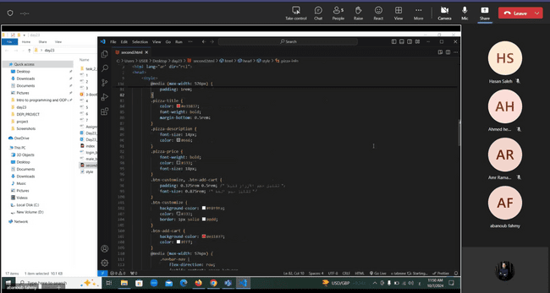
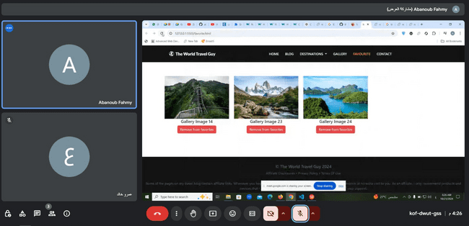

On-site Photos from Meetings
Brainstorming Session
Project Review
Milestone Celebration
Generating creative ideas for project features and functionalities.
Analyzing progress, identifying areas for improvement, and planning future steps.
Recognizing team achievements and fostering a positive work environment.

Slide 5
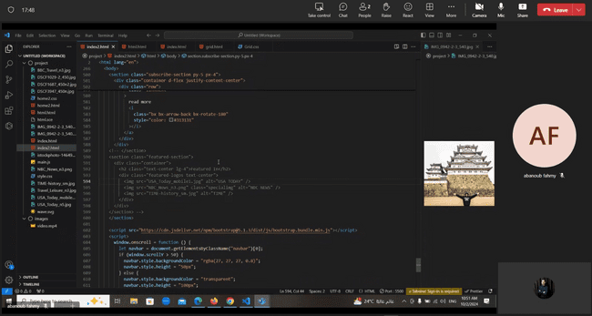
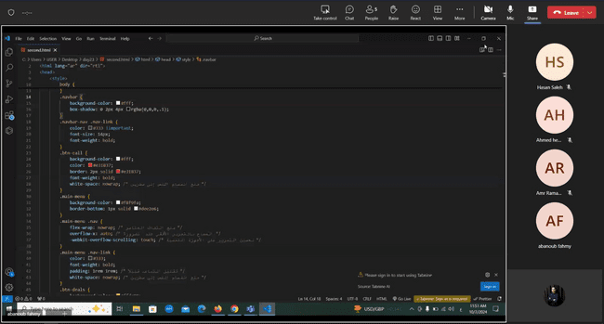
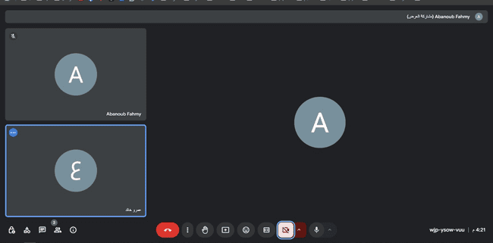

Slide 6
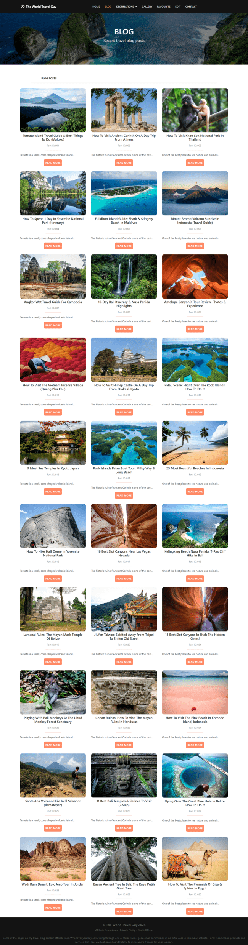
Amr Khaled's Role
1
Login & Admin
2
Blog page
Implemented the login page functionality, redirecting users based on their role (admin or guest).
Design the blog page and make it responsive.
3
Contact Form
4
Edit page
connected the contact form with EmailJS
Developed the admin edit page and its functionality.

Slide 7
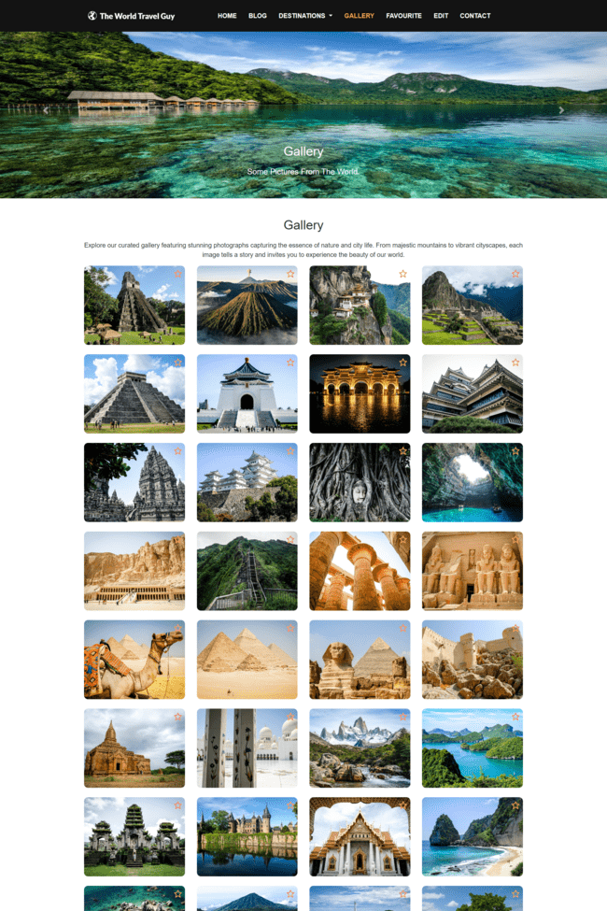


Amr Ramadan's Role
Gallery
Designed the gallery page and implemented the slider functionality, and Ensured the gallery and slider were responsive using Bootstrap.
‘Read more’
Created the 30 'read more' pages for blog posts.

Slide 8
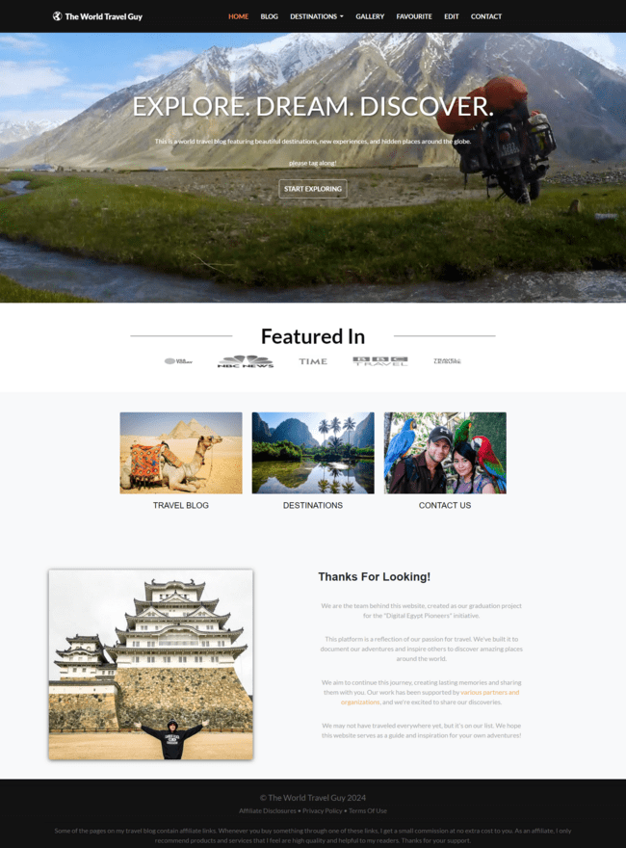
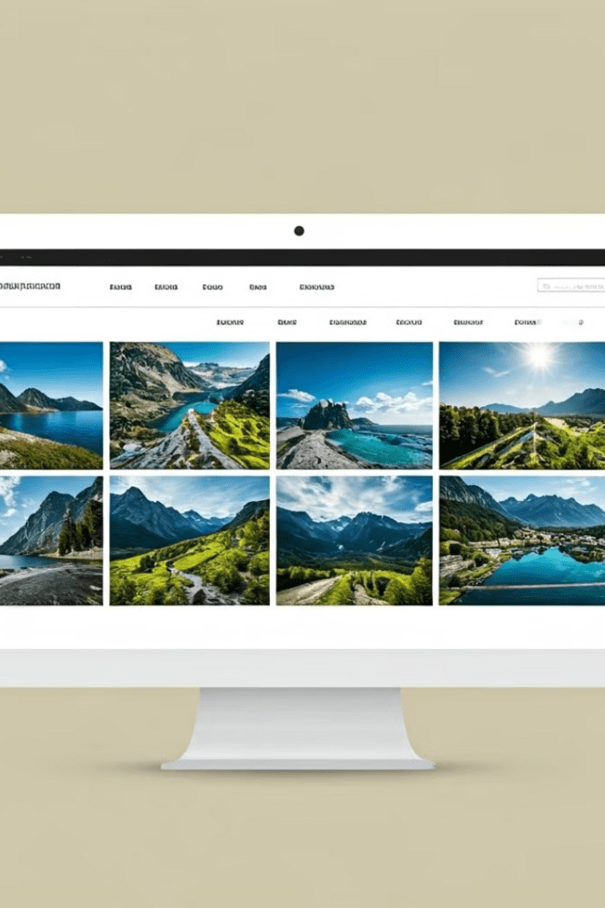
Abanoub Fahmy's Role
Navigation Bar
Homepage
Created the navigation bar for all pages with Bootstrap.
Designed the homepage and made it responsive.
Favorites
Developed the functionality for adding and displaying favorites.

Slide 9

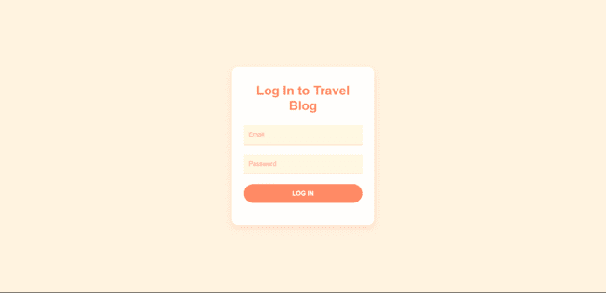
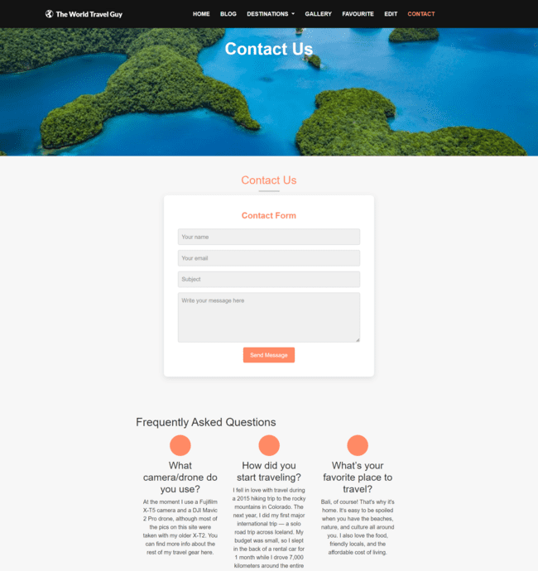


Sarah Swissry's Role
Contact page
Log in Design
The contact page was made responsive and designed to align with the website's visual identity.
The login page was made responsive and designed to align with the website's visual identity.

Slide 10
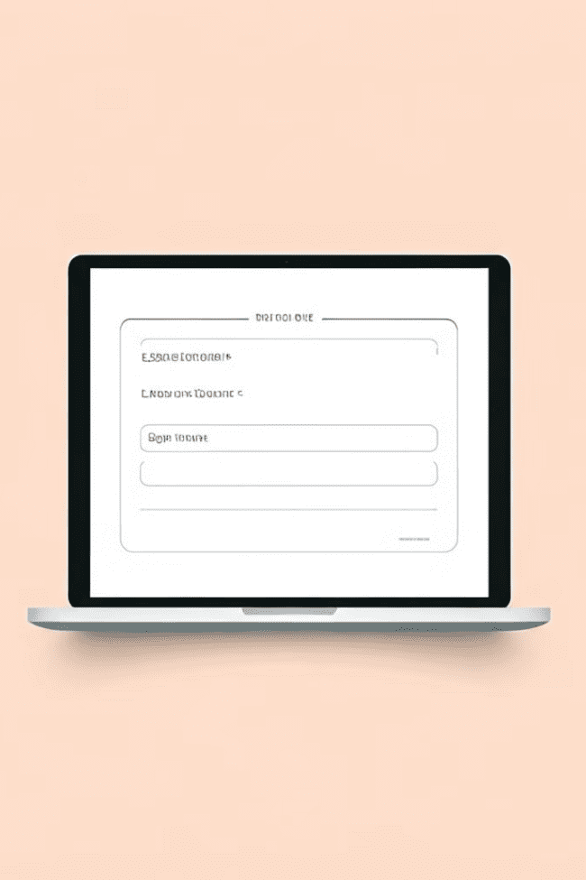
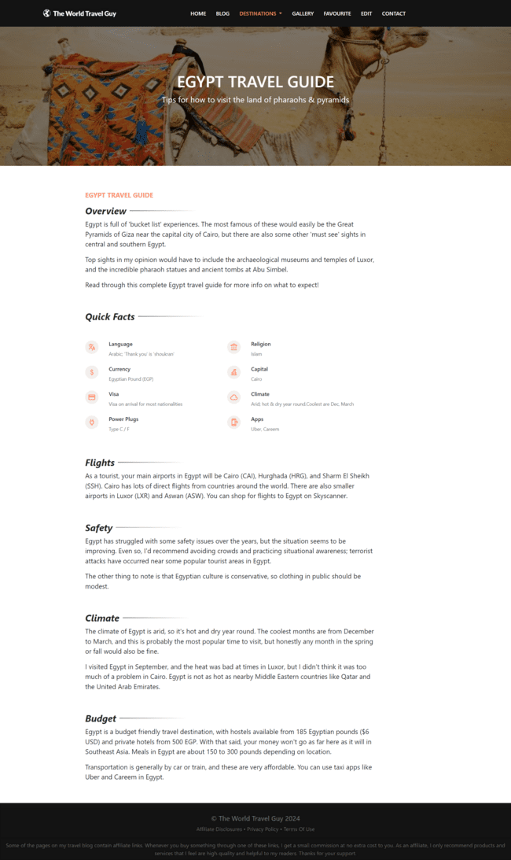
Ahmed Hegazy's Role
Destinations page
The destinations page was created, where countries were categorized and organized for easy navigation.
Destinations in nav. bar
The destinations section was added to the navigation bar, and its functionality was implemented for seamless user interaction.

Slide 11
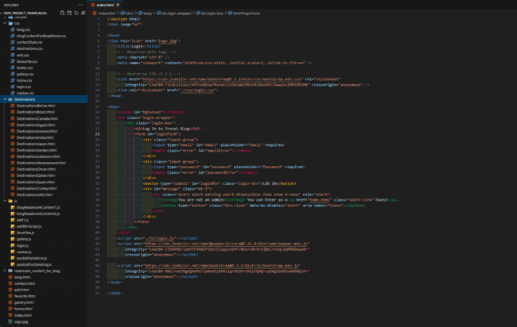
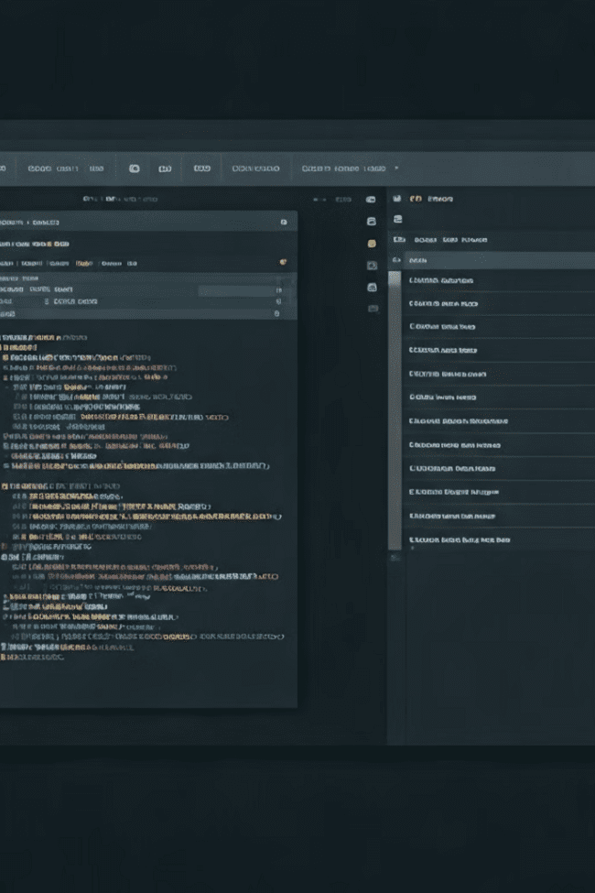
Ahmed El-Gazzar's Role
1
CSS Organization
The CSS code was initially inline in the HTML file. It was reorganized into a separate CSS folder and linked to the original HTML file for consistency across the website.
2
JavaScript Optimization
The JavaScript code was initially inline in the HTML file. It was reorganized into a separate JavaScript folder and linked to the original HTML file for consistency across the website.

Slide 12

Conclusion
This blog is dedicated to inspiring and empowering travelers to explore the world. We hope you join our community, discover new places, and create unforgettable memories.

