Slide 2
Group Members

Slide 3
Project Goal
Classifying social media text as objective/ subjective
Subjective:
Text contains sentiment, feeling, or opinion
Questions accepts more than one answer
Objective:
Text contains only facts
Questions with only on answer

Slide 4
Dataset
Source: Twitter
Collecting method:
Tool: twint
Manually
Indomain: [james bond, restaurants, fifa]
Objective: 433, subjective: 411 (844 total)
Outdomain: [movies, squid game]
Objective: 204, subjective: 466 (670 total)

Slide 5
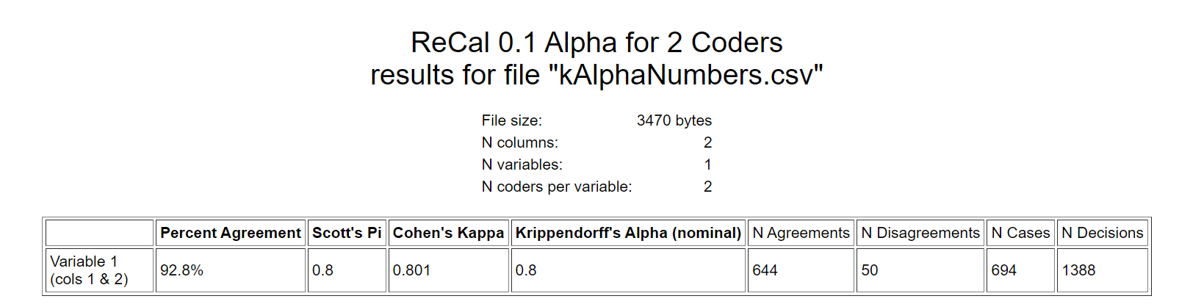
Labeling
Manually labeled
Krippendorff’s alpha score [83.1% ~ 92.8%]

Slide 6
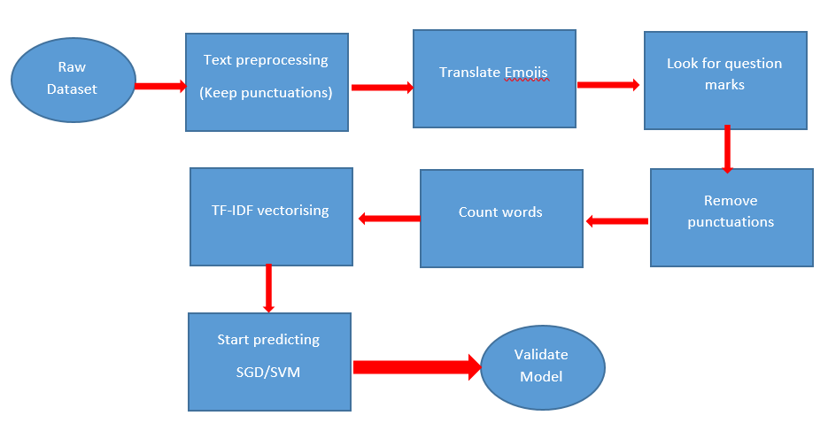
Machine Learning

Slide 7
ML Result
In-domain
Target | Precision | Recall | F1-score
Objective | 42% | 72% | 53%
Subjective | 93% | 78% | 85%
Out-domain
Target | Precision | Recall | F1-score
Objective | 47% | 47% | 47%
Subjective | 77% | 77% | 77%

Slide 8


Slide 9
Deep Learning
Applied models
Convolutional neural network “CNN”
Long short-term memory “LSTM”
Weights types
Word to vectors “word2vec”
Global vectors “GLOVE”
Test time & accuracy
Same epochs & batch size

Slide 10
In-domain
 | CNN |  | LSTM
 | Word2vec | GLOVE | Word2vec | GLOVE
Time | 1m28.6s | 1m42.7s | 46m4.2s | 7m18.4s
Objective
Precision | 81% | 98% | 92% | 98%
Recall | 94% | 84% | 95% | 99%
F1-score | 87% | 90% | 94% | 98%
Subjective
Precision | 95% | 80% | 95% | 99%
Recall | 83% | 97% | 92% | 98%
F1-score | 88% | 88% | 94% | 98%

Slide 11
Out-domain
 | CNN |  | LSTM
 | Word2vec | GLOVE | Word2vec | GLOVE
Time | 1m28.6s | 1m42.7s | 46m4.2s | 7m18.4s
Objective
Precision | 25% | 71% | 54% | 51%
Recall | 34% | 45% | 37% | 51%
F1-score | 29% | 55% | 44% | 51%
Subjective
Precision | 79% | 63% | 60% | 79%
Recall | 71% | 83% | 75% | 79%
F1-score | 75% | 72% | 67% | 79%

Slide 12
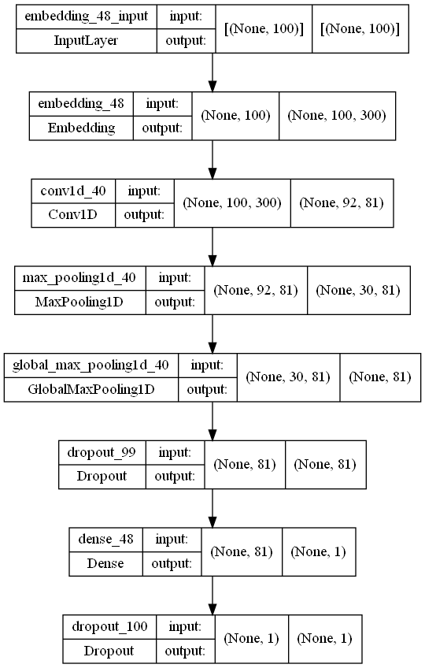
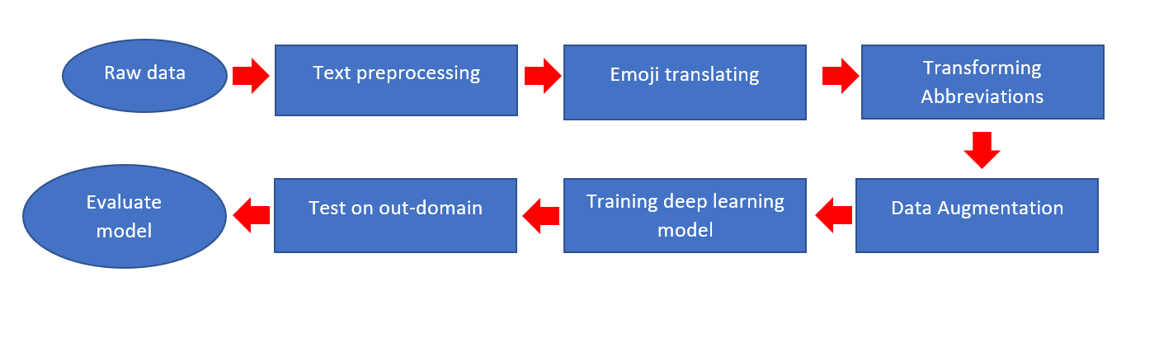
Model Architecture
Tackle overfitting
Add more entries ✓
Shuffle text ×
Back-translation ✓
Dropout layers✓

Slide 13
Best model
CNN + GLOVE
In-domain
Target | Precision | Recall | F1-score
Objective | 97% | 90% | 93%
Subjective | 89% | 97% | 93%
Out-domain
Target | Precision | Recall | F1-score
Objective | 63% | 57% | 60%
Subjective | 79% | 83% | 81%

Slide 14
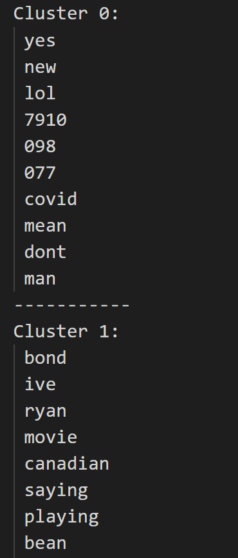
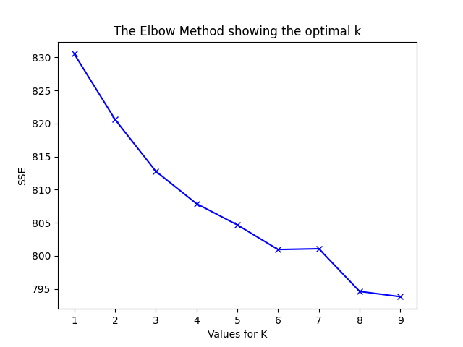
Clustering
K-means
8 clusters
Evaluation score: 0.016
DBSCAN
5 clusters
Evaluation score: 0.014

Slide 15
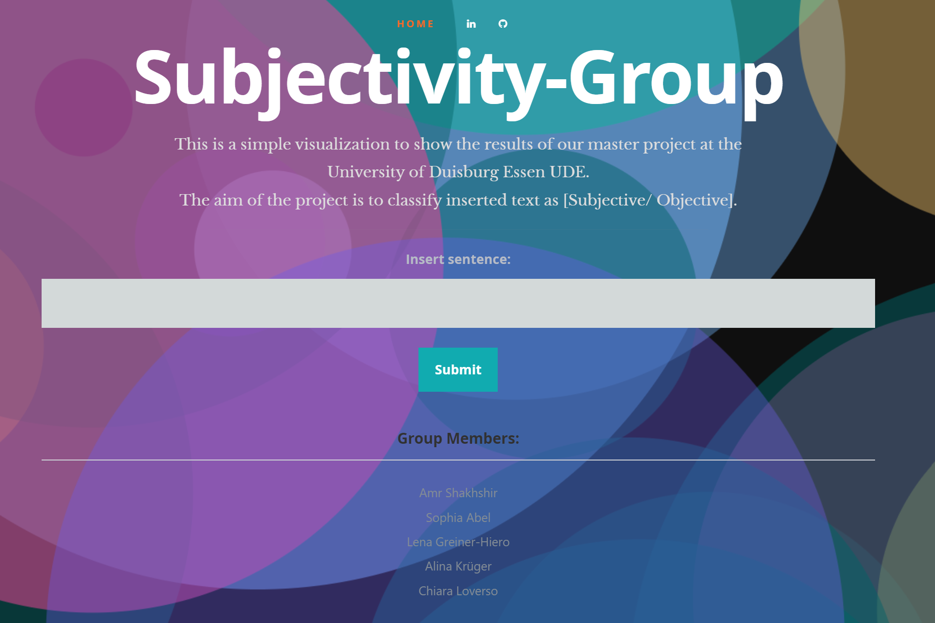
Live Demo

Slide 16
Obtained skills
Skills | Alina |  | Amr |  | Chiara |  | Lena |  | Sophia
 | Proficiency | Relevancy | Proficiency | Relevancy | Proficiency | Relevancy | Proficiency | Relevancy | Proficiency | Relevancy
ML basic concepts | 1 | 0 | 3 | 1 | 1 | 0 | 1 | 0 | 1 | 0
Text preprocessing | 2 | 0 | 3 | 1 | 2 | 0 | 2 | 0 | 2 | 0
Deep learning concepts | 0 | 0 | 2 | 1 | 0 | 0 | 0 | 0 | 0 | 0
Categorizing entries | 3 | 1 | 1 | 1 | 3 | 1 | 3 | 1 | 3 | 1
Working in a group | 3 | 1 |  | 1 | 3 | 1 | 3 | 1 | 3 | 1
Managing the group | 3 | 1 |  | 1 | 3 | 1 | 3 | 1 | 3 | 1
Looking for new ideas | 2 | 1 |  | 1 | 2 | 1 | 2 | 1 | 2 | 1
Explaining own part of task clearly | 3 | 1 |  | 1 | 3 | 1 | 3 | 1 | 3 | 1
Specifying current & future goal | 2 | 1 |  | 1 | 2 | 1 | 2 | 1 | 2 | 1
Ability to communicate | 3 | 1 | 3 | 1 | 3 | 1 | 3 | 1 | 3 | 1
Proficiency Relevancy
0: No capabilities 0: The capability is not relevant to the field of study/ task
1: Basic level 1: The capability is relevant to the field of study/ task
2: Intermediate level
3: Advanced level

Slide 17
Further Improvements
Connect application to a database
Add text that is inserted by users to the database
Allow users to rate classification result to monitor and improve accuracy
Add aspect detection model

Slide 18
References
[1] Understanding opinion mining: http://efus-network.eu/efus/files/2019/03/D6.2-Opinion-mining-from-open-sources-PRACTICIES.pdf
[2] Twint: https://github.com/twintproject/twint
[3] Emot: https://github.com/NeelShah18/emot
[4] Text preprocessing steps: https://medium.com/@datamonsters/text-preprocessing-in-python-steps-tools-and-examples-bf025f872908
[5] Krippendorf’s alpha calculator: http://dfreelon.org/utils/recalfront/recal-oir/
[6] LSTM tutorial: https://towardsdatascience.com/choosing-the-right-hyperparameters-for-a-simple-lstm-using-keras-f8e9ed76f046
[7] NLP processing: https://www.youtube.com/watch?v=xvqsFTUsOmc&list=PLpSK06odCvYc9XniVgZwHmFSBd7fUupR5&index=3
[8] NLP GLOVE model: https://www.youtube.com/watch?v=xvqsFTUsOmc&list=PLpSK06odCvYc9XniVgZwHmFSBd7fUupR5&index=3
[9] Word embedding word2vec: https://www.youtube.com/watch?v=kKDYtZfriI8&list=PLpSK06odCvYc9XniVgZwHmFSBd7fUupR5&index=5
[10] CNN + GLOVE tutorial: https://www.youtube.com/watch?v=oMd7sMlxYFk&list=PLpSK06odCvYc9XniVgZwHmFSBd7fUupR5&index=11&t=2s
[11] GLOVE download: https://nlp.stanford.edu/projects/glove/
[12] Text clustering: https://www.youtube.com/watch?v=ORpDAUQUnkU&t=729s
[13] Project’s repository: https://github.com/AmrShakhshirUDE/opinionMining#dataset-source
[14] Deployed project: https://opinion-mining-ude.herokuapp.com/

