Slide 1

OPINION MINING IN SOCIAL MEDIA
Amr Shakhshir | Sophia Abel | Lena Greiner-Hiero | Chiara Loverso | Alina Krüger

Slide 2
WHAT WAS THE PROJECT GOAL?
Classifying social media posts as objective and subjective
SUBJECTIVTY
OBJECTIVITY
Text contains sentiment, feeling, opinion
Questions accepts more than one answer
Text contains only facts
Questions with only one answer

Slide 3
DATASET
DOMAINS
SOURCE
COLLECTING METHOD
In-Domain
[james bond, restaurants, fifa]
Objective: 433 | Subjective: 411
Out-Domain
[movies, squid game]
Objective: 204 | subjective: 466
Tweets from Twitter
Tool : Twint
Manual labeling

Slide 4
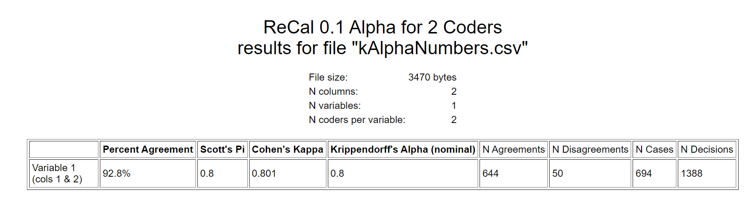
LABELING
Krippendorff´s Alpha Score: 83.1 – 92.8 %

Slide 5
RAW DATASET
01
TEXT PREPROCESSING
02
06
COUNT WORDS
MACHINE LEARNING
TRANSLATE EMOJIS
03
07
TF-IDF VECTORISING
08
START PREDICTING SDG/SVM
Keep punctuations
LOOK FOR QUESTION MARKS
04
REMOVE PUNCTUATIONS
VALIDATE MODEL
05
09

Slide 6
ML RESULTS
 | Target | Precision | Recall | F1-Score
In-Domain | Objective Subjective | 42% 93% | 72% 78% | 53% 85%
Out-Domain | Objective Subjective | 47% 77% | 47% 77% | 47% 77%

Slide 7
APPLIED MODELS
WEIGHT TYPES
Convolutional neutral network (CNN)
Long short-term memory (LSTM)
Word to vectors (word2vec)
Global vectors (GLOVE)
DEEP LEARNING
TEST
TIME & ACCURACY
SAME
EPOCHS & BATCH SIZE

Slide 8
In-Domain
 | CNN |  | LSTM
 | Word2Vec | GLOVE | Word2Vec | GLOVE
Time | 1 min 28 sec | 1 min 42 sec | 46 min 4 sec | 7 min 18 sec
Objectivity
Precision | 81% | 98% | 92% | 98%
Recall | 94% | 84% | 95% | 99%
F1-Score | 87% | 90% | 94% | 98%
Subjectivity
Precision | 95% | 80% | 95% | 99%
Recall | 83% | 97% | 92% | 98%
F1-Score | 88% | 88% | 94% | 98%

Slide 9
Out-Domain
 | CNN |  | LSTM
 | Word2Vec | GLOVE | Word2Vec | GLOVE
Time | 1 min 28 sec | 1 min 42 sec | 46 min 4 sec | 7 min 18 sec
Objectivity
Precision | 25% | 71% | 54% | 51%
Recall | 34% | 45% | 37% | 51%
F1-Score | 29% | 55% | 44% | 51%
Subjectivity
Precision | 79% | 63% | 60% | 79%
Recall | 71% | 83% | 75% | 79%
F1-Score | 75% | 72% | 67% | 79%

Slide 10


MODEL ARCHITECTURE
Raw Data
Text Preprocessing
Emoji Translating
Transforming Abbrevations
Evaluate Model
Test on Out-Domain
Training DL Model
Data Augmentation
Tackle Overfitting:
add more entries
back-translation
dropout layers
shuffle text

Slide 11
IN-DOMAIN
THE BEST MODEL
CNN + GLOVE
Target | Precision | Recall | F1-Score
Objective | 97% | 90% | 93%
Subjective | 89% | 97% | 93%
OUT-DOMAIN
Target | Precision | Recall | F1-Score
Objective | 63% | 57% | 60%
Subjective | 79% | 83% | 81%

Slide 12
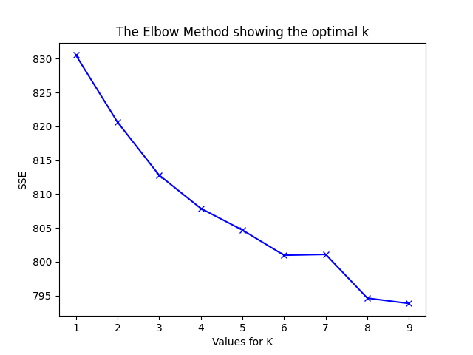
CLUSTERING
K-means:
8 clusters
Evaluation-Score: 0.016
DBSCAN:
5 clusters
Evaluation-Score: 0.014
Cluster 0:
yes
new
lol
7910
098
077
covid
mean
dont
man
Cluster 1:
bond
ive
ryan
movie
canadian
saying
playing
bean

Slide 13
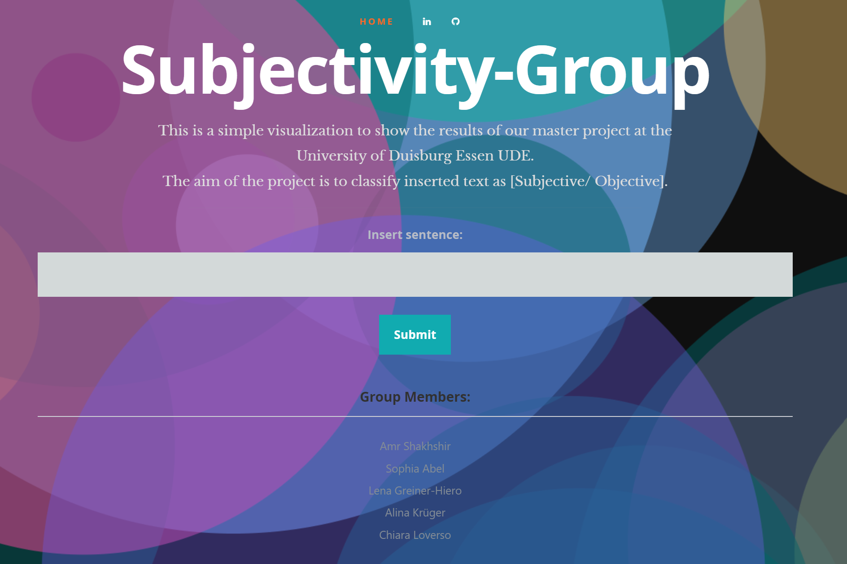
SECTOR NEWS
VENUS
MARS
SATURN
Despite being red, Mars is a cold place, not hot. It’s full of iron oxide dust, which gives the planet its reddish cast
LIVE
DEMO
Venus has a beautiful name and is the second planet from the Sun. It’s terribly hot, even hotter than the other planets
Yes, this is the ringed one. It’s a gas giant, composed mostly of hydrogen and helium. It’s named after the Roman god

Slide 14
SECTOR NEWS
VENUS
MARS
SATURN
Proficiency Relevancy
0: No capabilities 0: The capability is not relevant to the field of study/ task
1: Basic level 1: The capability is relevant to the field of study/ task
2: Intermediate level
3: Advanced level
OBTAINED SKILLS
Skills | Alina |  | Amr |  | Chiara |  | Lena |  | Sophia
 | Proficiency | Relevancy | Proficiency | Relevancy | Proficiency | Relevancy | Proficiency | Relevancy | Proficiency | Relevancy
ML basic concepts | 1 | 0 | 3 | 1 | 1 | 0 | 1 | 0 | 1 | 0
Text preprocessing | 2 | 0 | 3 | 1 | 2 | 0 | 2 | 0 | 2 | 0
Deep learning concepts | 0 | 0 | 2 | 1 | 0 | 0 | 0 | 0 | 0 | 0
Categorizing entries | 3 | 1 | 1 | 1 | 3 | 1 | 3 | 1 | 3 | 1
Working in a group | 3 | 1 | 3 | 1 | 3 | 1 | 3 | 1 | 3 | 1
Managing the group | 3 | 1 | 3 | 1 | 3 | 1 | 3 | 1 | 3 | 1
Looking for new ideas | 2 | 1 | 3 | 1 | 2 | 1 | 2 | 1 | 2 | 1
Explaining own part of task clearly | 3 | 1 | 3 | 1 | 3 | 1 | 3 | 1 | 3 | 1
Specifying current & future goal | 2 | 1 | 3 | 1 | 2 | 1 | 2 | 1 | 2 | 1
Ability to communicate | 3 | 1 | 3 | 1 | 3 | 1 | 3 | 1 | 3 | 1
Despite being red, Mars is a cold place, not hot. It’s full of iron oxide dust, which gives the planet its reddish cast
Venus has a beautiful name and is the second planet from the Sun. It’s terribly hot, even hotter than the other planets
Yes, this is the ringed one. It’s a gas giant, composed mostly of hydrogen and helium. It’s named after the Roman god
*Proficiency *Relevancy
0: No capabilities 0: The capability is not relevant to the field of study/ task
1: Basic level 1: The capability is relevant to the field of study/ task
2: Intermediate level
3: Advanced level

Slide 15
Connect application to a datebase
Assign text that is inserted by users to the database
FURTHER IMPROVEMENTS
Add aspect detection model
Allow users to rate classification result in order to monitor and improve accuracy

Slide 16
SECTOR NEWS
VENUS
MARS
SATURN
Sources
[1] Understanding opinion mining: http://efus-network.eu/efus/files/2019/03/D6.2-Opinion-mining-from-open-sources-PRACTICIES.pdf
[2] Twint: https://github.com/twintproject/twint
[3] Emot: https://github.com/NeelShah18/emot
[4] Text preprocessing steps: https://medium.com/@datamonsters/text-preprocessing-in-python-steps-tools-and-examples-bf025f872908
[5] Krippendorf’s alpha calculator: http://dfreelon.org/utils/recalfront/recal-oir/
[6] LSTM tutorial: https://towardsdatascience.com/choosing-the-right-hyperparameters-for-a-simple-lstm-using-keras-f8e9ed76f046
[7] NLP processing: https://www.youtube.com/watch?v=xvqsFTUsOmc&list=PLpSK06odCvYc9XniVgZwHmFSBd7fUupR5&index=3
[8] NLP GLOVE model: https://www.youtube.com/watch?v=xvqsFTUsOmc&list=PLpSK06odCvYc9XniVgZwHmFSBd7fUupR5&index=3
[9] Word embedding word2vec: https://www.youtube.com/watch?v=kKDYtZfriI8&list=PLpSK06odCvYc9XniVgZwHmFSBd7fUupR5&index=5
[10] CNN + GLOVE tutorial: https://www.youtube.com/watch?v=oMd7sMlxYFk&list=PLpSK06odCvYc9XniVgZwHmFSBd7fUupR5&index=11&t=2s
[11] GLOVE download: https://nlp.stanford.edu/projects/glove/
[12] Text clustering: https://www.youtube.com/watch?v=ORpDAUQUnkU&t=729s
[13] Project’s repository: https://github.com/AmrShakhshirUDE/opinionMining#dataset-source
[14] Deployed project: https://opinion-mining-ude.herokuapp.com/
Despite being red, Mars is a cold place, not hot. It’s full of iron oxide dust, which gives the planet its reddish cast
Venus has a beautiful name and is the second planet from the Sun. It’s terribly hot, even hotter than the other planets
Yes, this is the ringed one. It’s a gas giant, composed mostly of hydrogen and helium. It’s named after the Roman god

