Slide 1
PONG: THE GAME

Slide 2
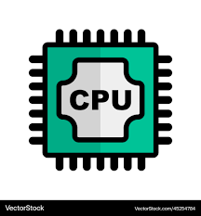





Features
CPU Mode
GitHub
Meetings
Paddle Resizing
UI
Improvements
Structure

