Slide 1

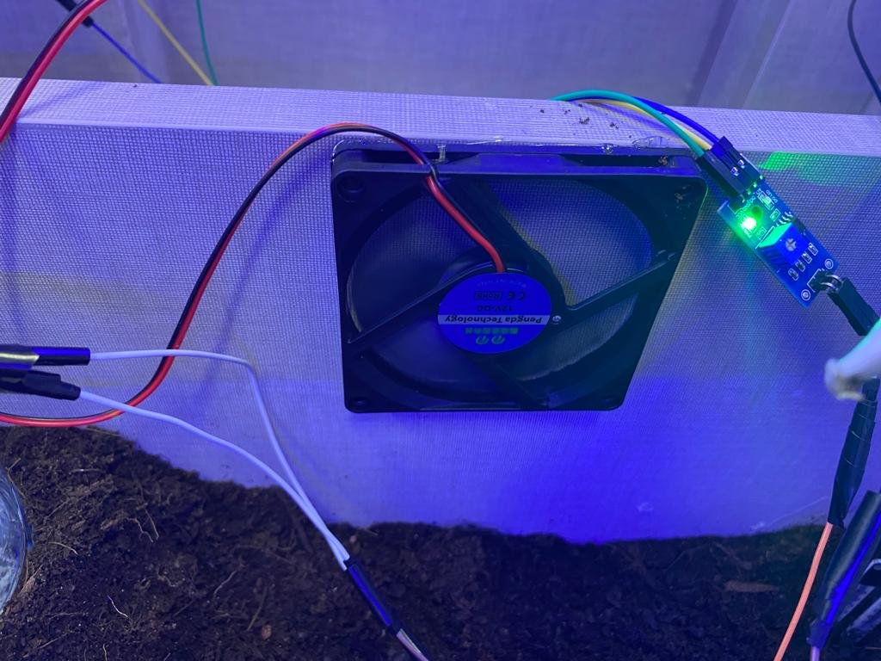
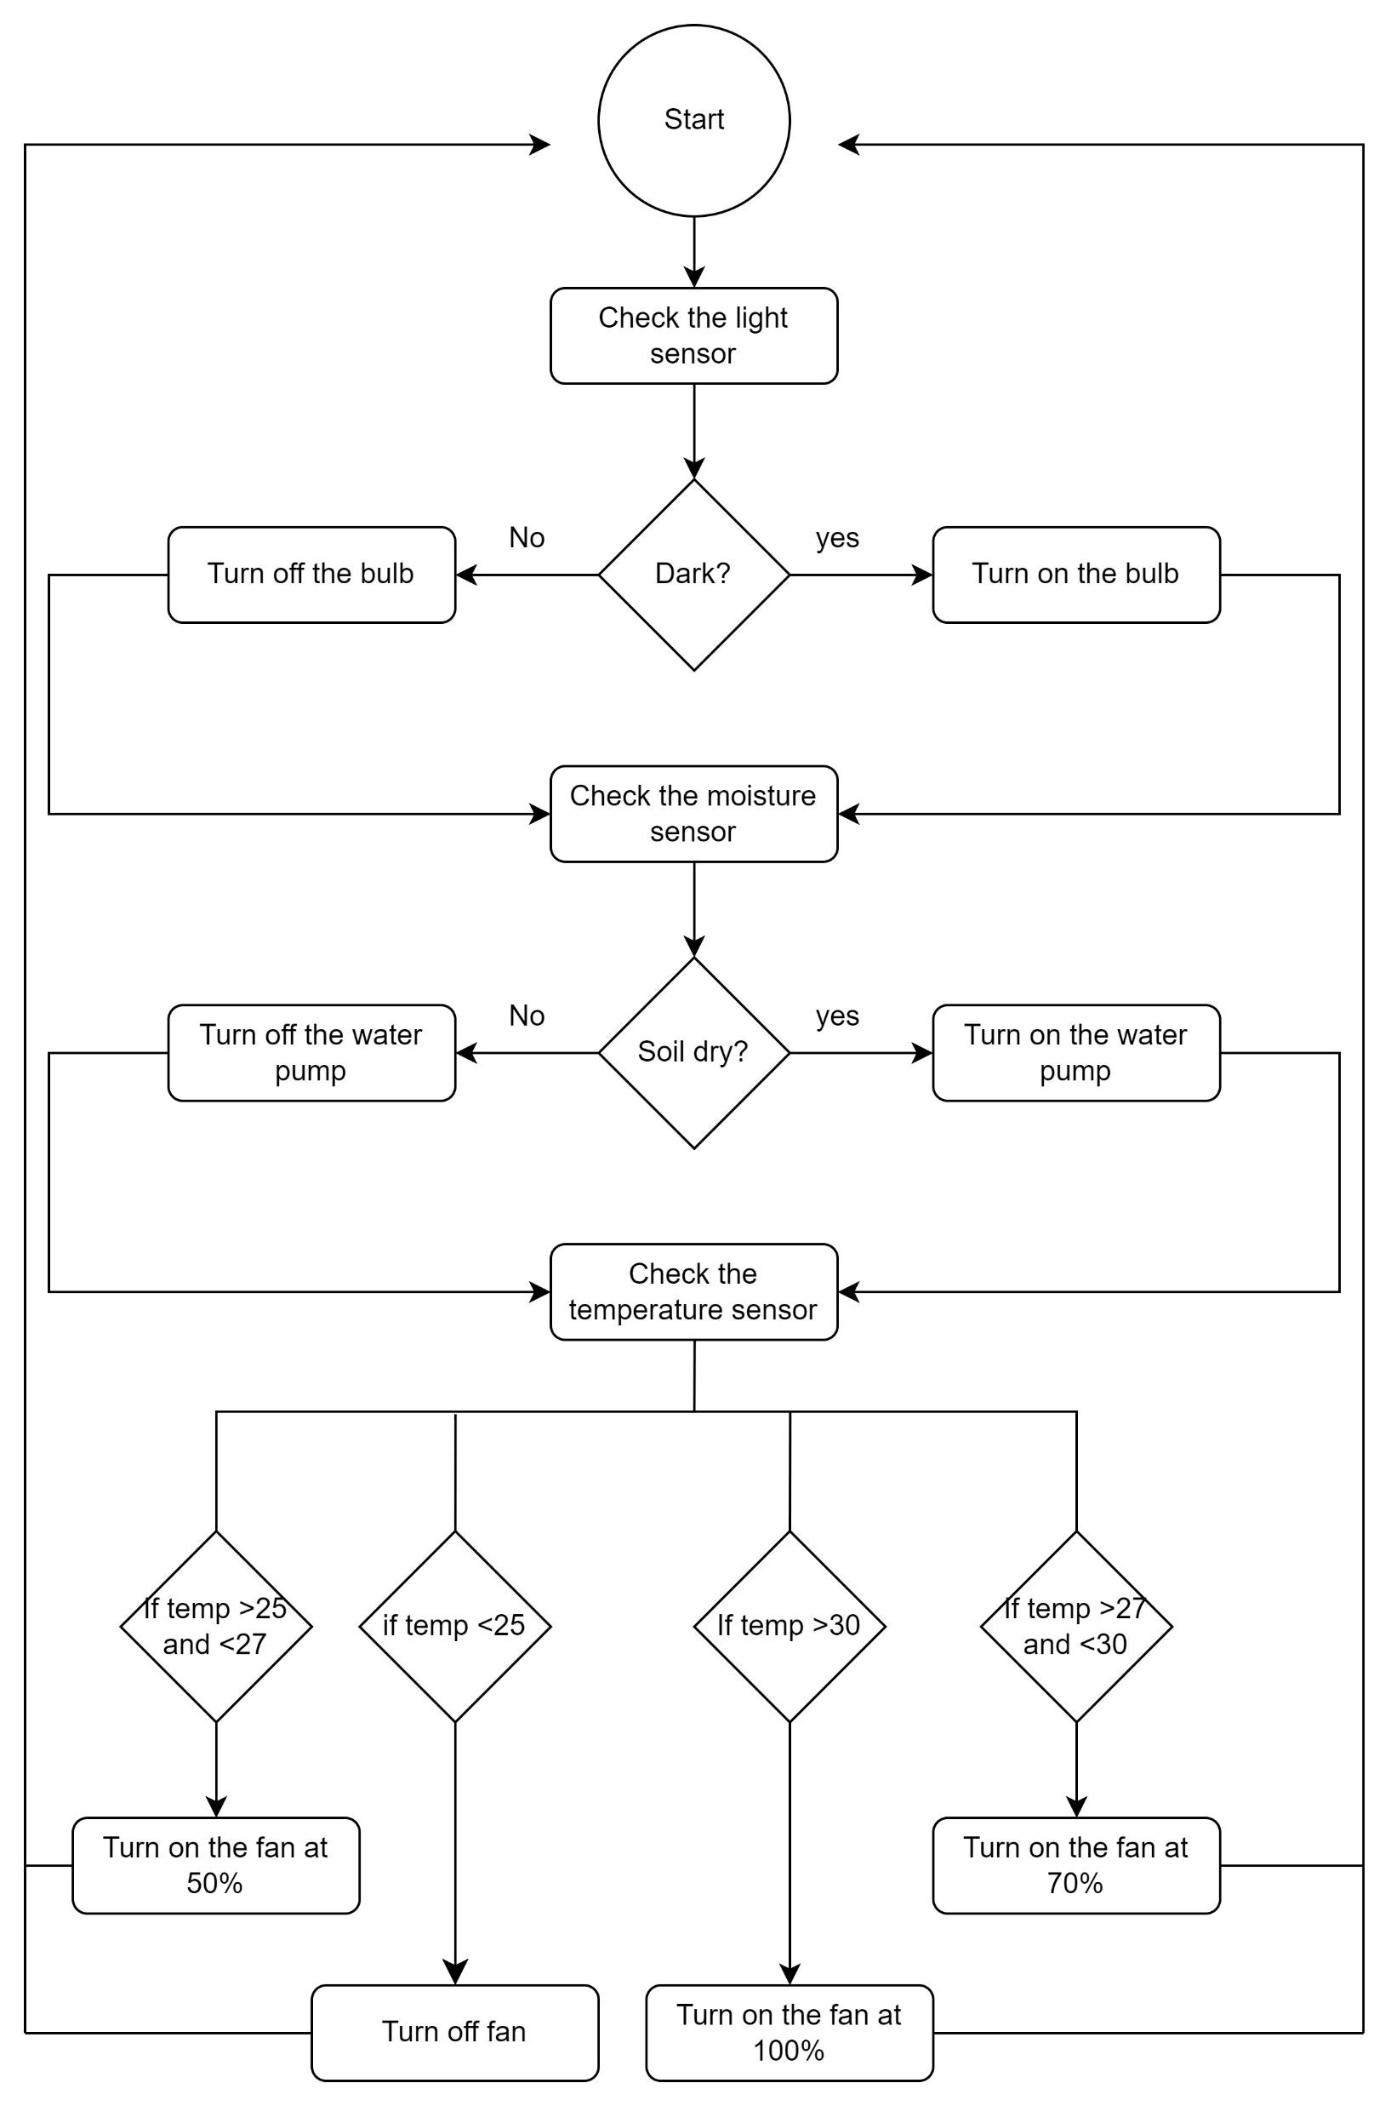
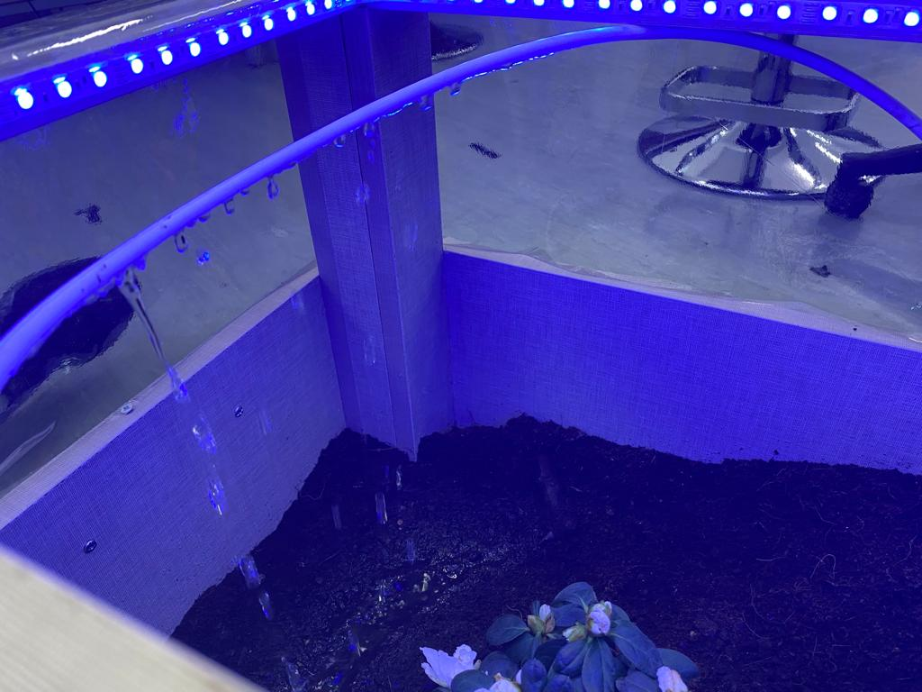
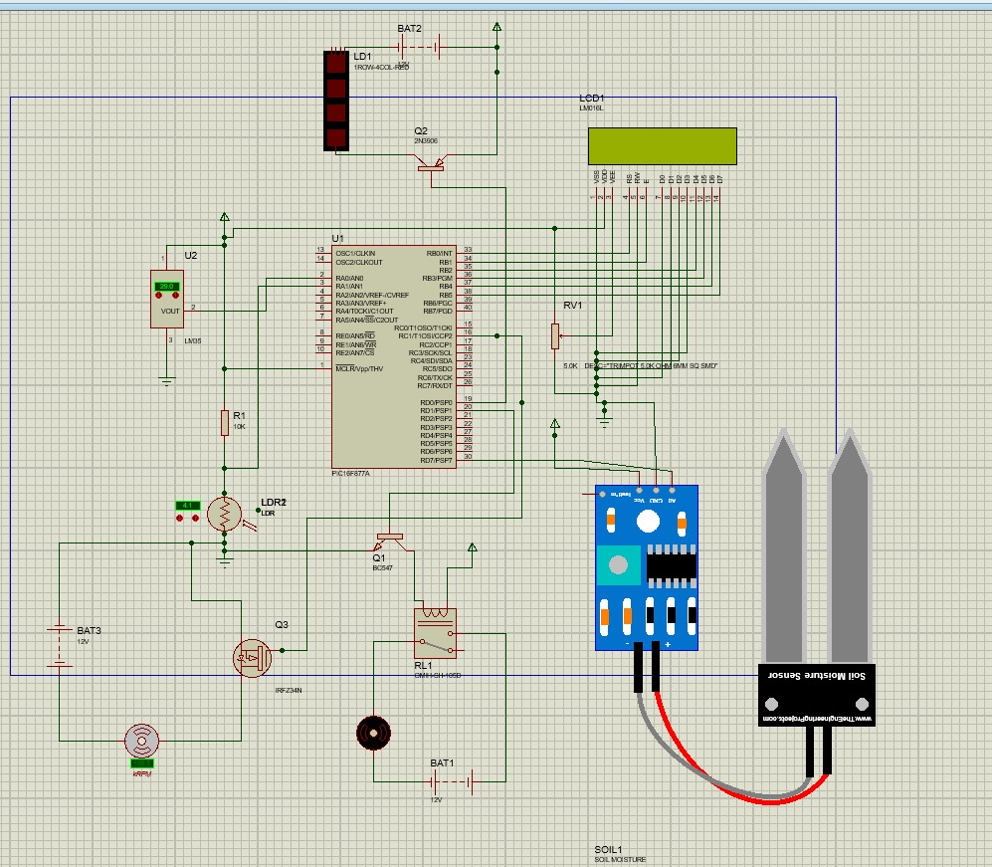
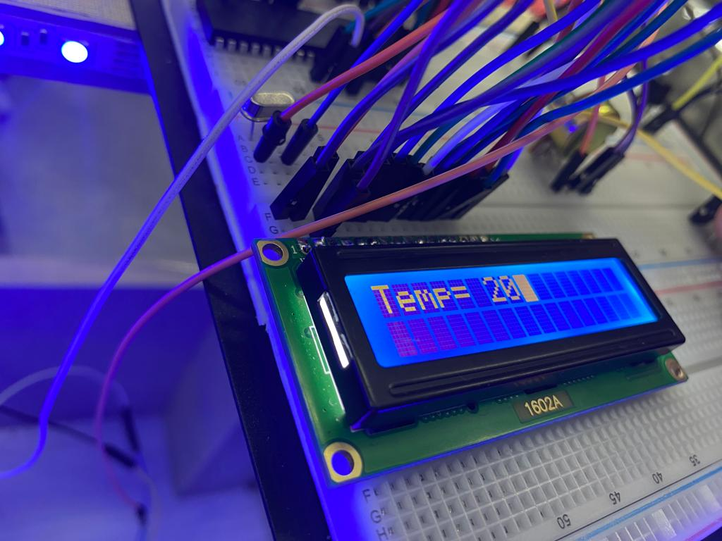
Smart Greenhouse
A.Abidy, R. AlShrouf, A. Zaben
Supervisor: Dr. Belal Sababha
Embedded Systems Final Design Project, Fall 2022
King Abdullah II School of Engineering
Princess Sumaya University for Technology
Introduction
The demand for crop production and quality has increased drastically, thus the need for greenhouses. Greenhouse is a building designed for creating the best environmental conditions by artificially maintaining its environment. Nowadays, using embedded systems to monitor greenhouse is quite significant, especially for control and monitoring to provide optimal conditions. Since the crop growth is independent of the natural environment, a 24/7 monitoring is mandatory. In this project we will be able to control the temperature, light, and moisture of the soil to have the optimal conditions for the best quality and production for plants.
Results
Figure 3: Cooling System.
Figure 4: Watering and Lighting Systems.
Figure 5:Reading the temperature
Design
Figure 1: Flow chart
Figure 2: Electrical Circuit Simulation.
Conclusion
In conclusion, a smart greenhouse is a technologically advanced solution for growing plants in controlled environments. It combines traditional greenhouse methods with modern technology to optimize the growing conditions for plants. The use of sensors, automation, and data analysis allows for precise control of factors such as temperature, moisture, and light, resulting in increased yields and improved plant health. Overall, smart greenhouses represent a significant advancement in the field of agriculture and have the potential to revolutionize the way we grow plants. Embedded systems are a technology that allows for the integration of computer systems into a wide range of everyday devices and appliances. These systems are designed to perform specific tasks and are characterized by their small size, low power consumption, and real-time capabilities. With their aid, we were able to produce this Smart Greenhouse.

